Slide 1
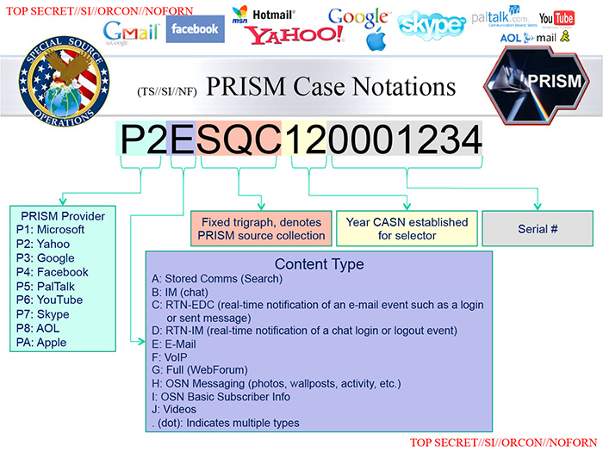

Slide 2
Life logs,
Data Doppelgangers &
Drone attacks
Raghavendra S
FSMK, BMSIT, The Hindu

Slide 3
Life logs
Data trail
Call logs
FB activity
Google's on you
Comprehensive profiling

Slide 4
Autobiographies, impeccable as ever!

Slide 5
Curious case of ex-CIA director
Genre: Romance, Drama, Thriller
Cast: David Petreaus as the protagonist
Paula Broadwell, as his renewed love interest
Gmail as the invincible antagonist
Tags: Love, Treason

Slide 6
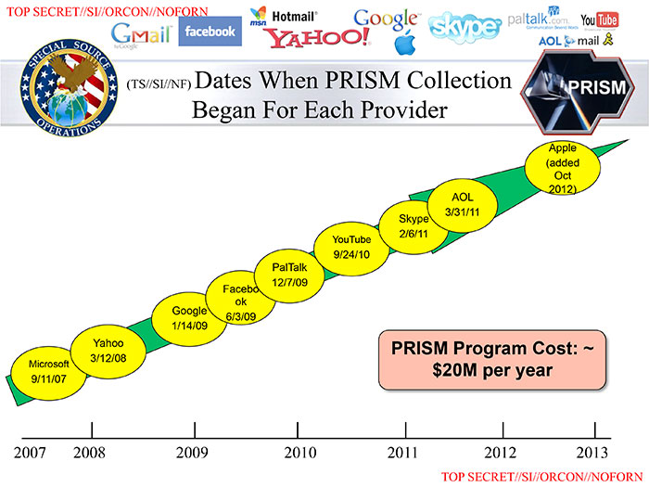
Know your enemies

Slide 7

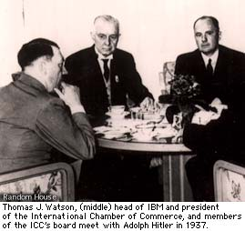
Nothing new!

Slide 8

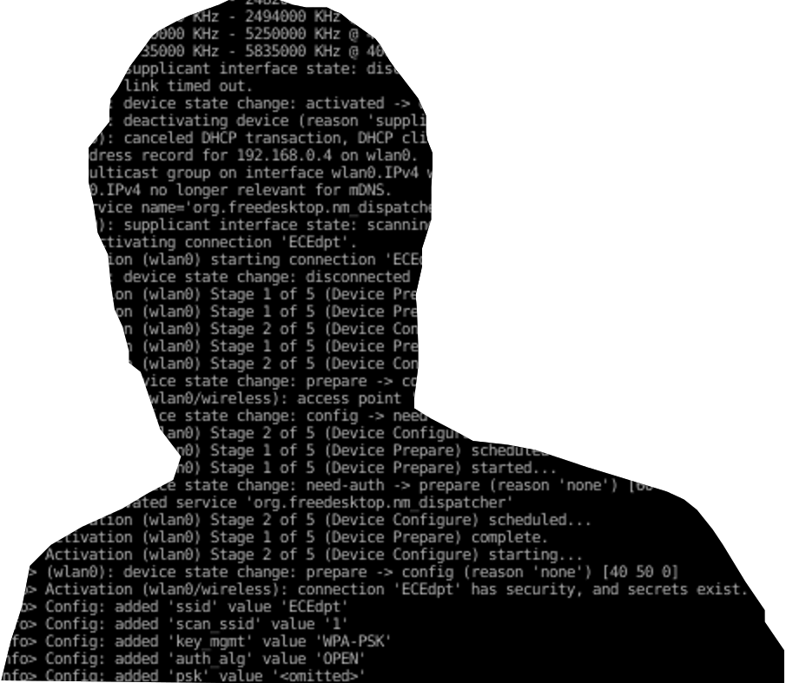
Data Doppelgangers

Slide 9
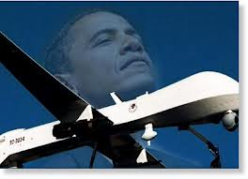
Digital signatures and.....

Slide 10
Aaron Swartz JSTOR
Bradley Manning War logs
Julian Assange WikiLeaks
Laura Poitras My Country, My Country
Jeremy Hammond Stratfor
Jacob Appelbaum TOR/WikiLeaks
Edward Snowden PRISM-break

Slide 11
Aaron Swartz Forced to suicide
Bradley Manning At least 50 yrs in prison
Julian Assange House arrest, asylum
Laura Poitras Censored, detained
Jeremy Hammond Decade in prison
Jacob Appelbaum Under surveillance, detained
Edward Snowden In exile, uncertain

Slide 12
Ethical question
Safe Nuclear Energy, not atom bombs!
Free Software, not Open Source!

Slide 13
