Slide 1

The times they are a changin

Slide 2
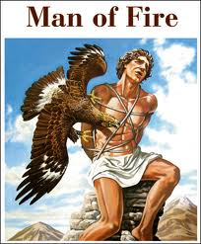
Prometheus is a Titan, who, in Greek mythology, is credited with the theft of fire for human use, an act that enabled progress and civilization. He is known for his intelligence, and as a champion of humanity.
The punishment of Prometheus as a consequence of the theft : Zeus, king of the Olympian gods, sentenced the Titan to eternal torment for his transgression. The immortal Prometheus was bound to a rock, where each day an eagle, the emblem of Zeus, was sent to feed on his liver, only to have it grow back to be eaten again the next day.

Slide 3
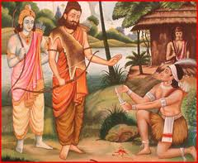
Ekalvya

Slide 4

Whats internet freedom

Slide 5
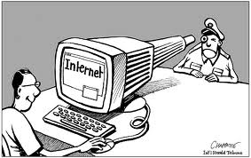

Slide 6


Slide 7


Slide 8
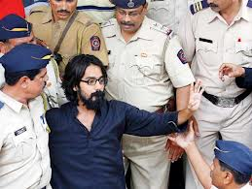

Slide 9
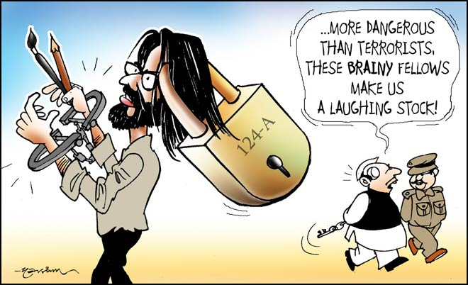

Slide 10
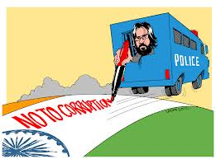

Slide 11
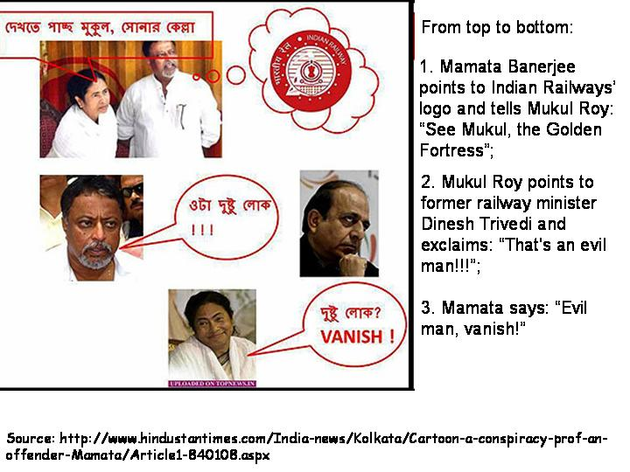

Slide 12
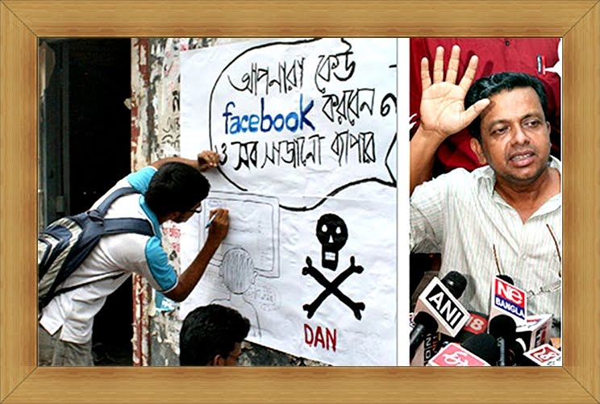

Slide 13
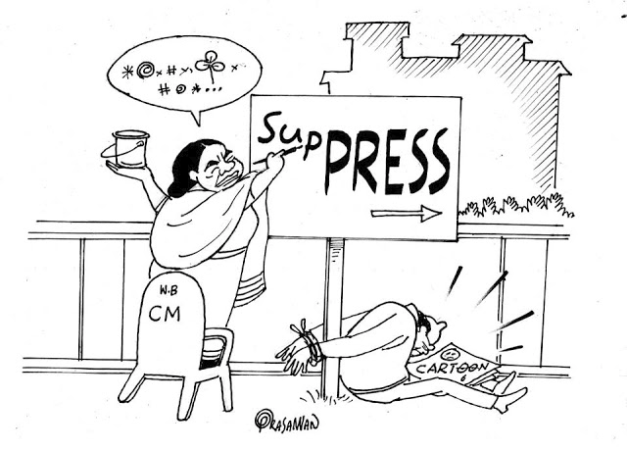

Slide 14


Slide 15

SOPA and PIPA

Slide 16
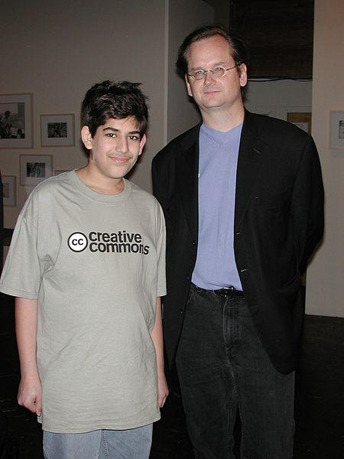
Programmer at 7 years
RSS 1.0 at 14
he understood social and econmic structures

Slide 17
Aaron
He could have been the next Steve Jobs
but instead he struggled – he followed RMS
he hacked into jstor – broke pay walls – for us
was working with thoughtworks to build our networks
sucesfully stopped sopa and pipa
was victimised

Slide 18
Aaron
For the US government, this was therefore a test case of how far the Computer Fraud and Abuse Act could be stretched and the government’s ability to prosecute hackers.
Freedom of the Internet is a welcome goal everywhere, but not in the US.
Remember how vigorously the US “fought” for Internet freedom in the recent ITU conference in Dubai?

Slide 19
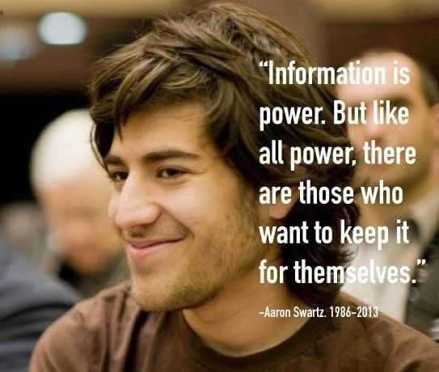

Slide 20

Fsmk – meet the brats !
What does technology mean to you
Is it just a means to become a 'software clerk'
What does it mean to the ordinary people in this country
If you are youg, If you have a skill – techie, artist, campaigner
If you have hacking spirit
You can join the fun guys at fsmk
Be a little but naughty
YOU CAN INTERVENE

Slide 21
Aaron and Questioning
If you are in the tech sector – why are you there?
Do you really think technology is making the world a
better place. Why do you believe that.
Do you really understand what makes the world a bad
place to begin with.
Have you ever listened to the people technology helps or
Hurts
What you do – does it change the world
He has a deep shame in lying.
He had a deep shame in believing the world is changing. Than actually changing it.

