Slide 2
PM5
PM4
PM3
PM2
PM1
VSC
Z5
Z4
Z3
Z2
Z1

Slide 3
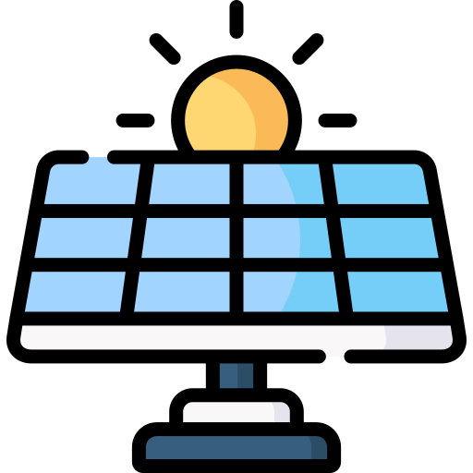

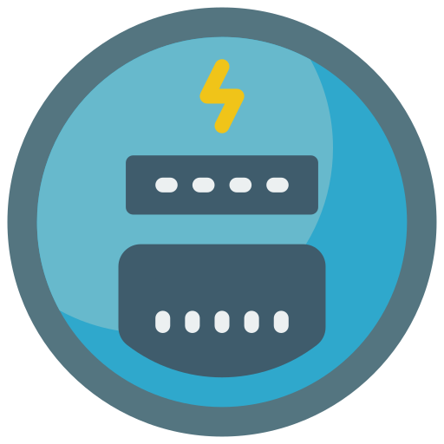


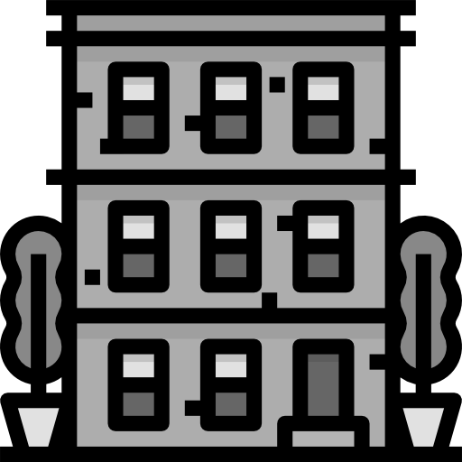

Utility meter
Grid connection point
Traditional consumers/generators
Private meter
Self-consumption cluster

Slide 5

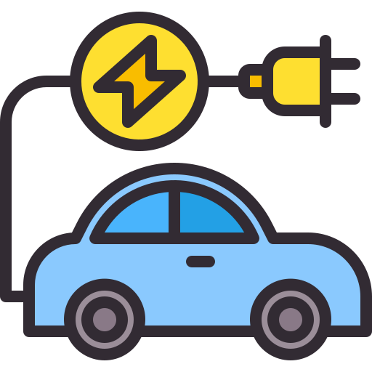
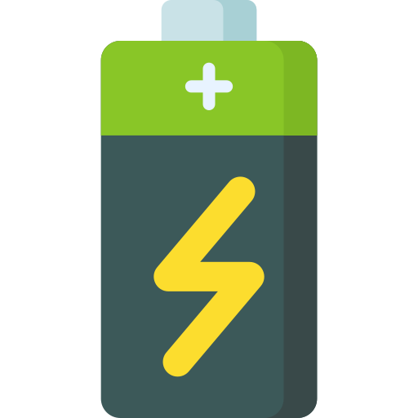
Utility smart meter
Traditional consumers/generators
Local energy community

