Slide 1
ACM & MUG Tech Talk
Software Development Tools on Unix
October 15, 2002
http://acm.cs.virginia.edu/presentations.php3

Slide 2
Overview
Intro to Unix, getting around
Text editors
Gcc
Debugging
Profiling
Revision management
Searching files
Useful programming and misc tools

Slide 3
Intro to Unix: Files
Filesystem a single tree
Filenames case senstitive
Physical devices can be mounted anywhere
/
tmp
dev
etc
home
usr
chris
mary
lib
include
bin
local
lib
include
bin

Slide 4
Intro to Unix: Essential Cmds
cd - change directory - cd
mkdir - make a directory - md
cp - copy a file - copy
ls - list files - dir
rm - remove a file - del
mv - move a file - move & ren
grep - expression searching
top - cpu and memory usage
who/w - who else is logged in
man - read documentation

Slide 5
Intro to Unix: More
A central idea in Unix:
  Make small tools that do one job well and that can be connected
ACM Intro to Unix presentation: http://acm.cs.virginia.edu/archives/events/workshop/unix/
Online resources
  Lots, just search
Books
  Again, lots
CHUUG: http://www.chuug.org/

Slide 6
Text Editors
Crucial tools for using Unix
Two main editors (easy flamewar topic):
  emacs
  vi
Great features in both:
  Syntax highlighting
  Brace matching
  Sophisticated text manipulation/movement
  Scriptable
  …

Slide 7
Text Editors: vi
If it’s unix, vi is installed
  vim, http://www.vim.org
Simple and small
Modal
  Command: move, perform commands
  Insert
  Others (replace, selection, more)
Built in help, “: help”

Slide 8
Text Editors: emacs
Kitchen-sink powerful
Configurable, extensible, complicated
emacs and xemacs
emacsclient
Tutorial: C-h t

Slide 9
Text Editors: Pure IDEs
KDevelop: KDE
Anjuta: GTK/GNOME

Slide 10
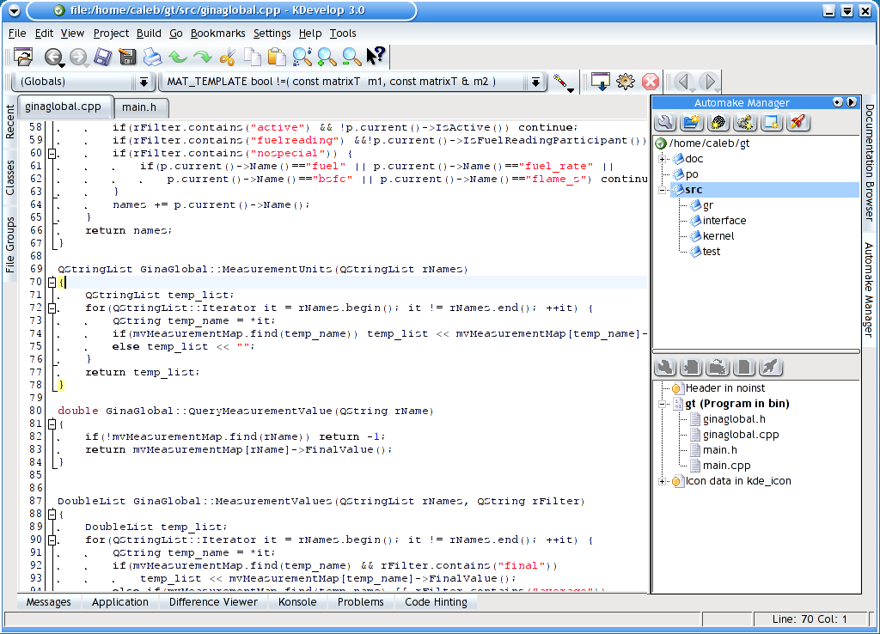
Text Editors: IDEs
KDevelop

Slide 11
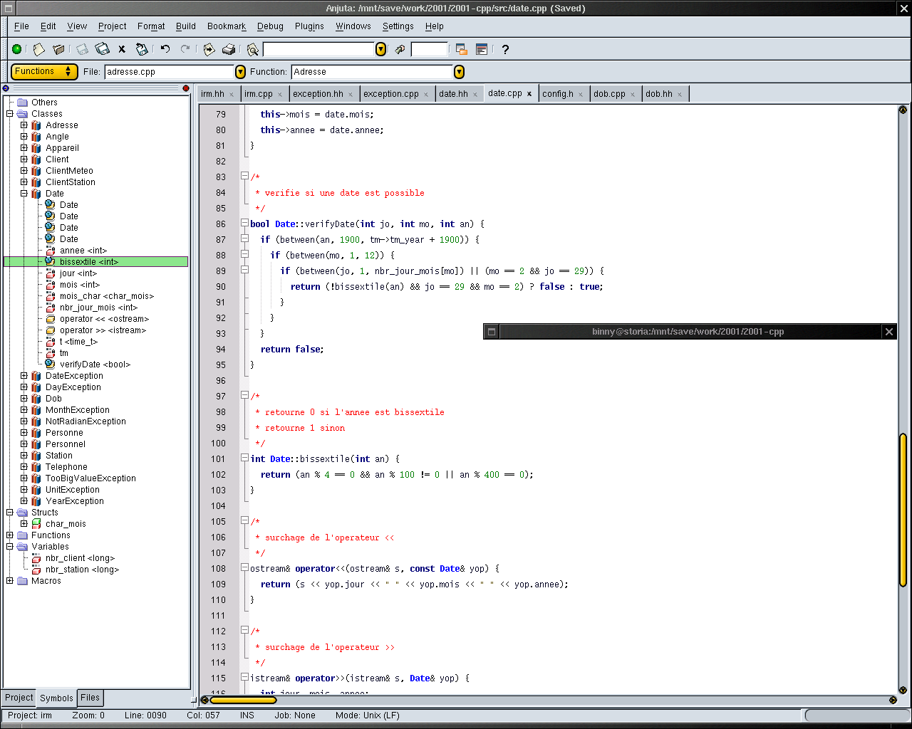
Text Editors: IDEs
Anjuta

Slide 12
gcc the Gnu Compiler Collection
Frontends for:
  C: gcc
  C++: g++
  More (ada, java, objective-c, fortran, …)
Backends for:
  x86, ia-64, ppc, m68k, alpha, hppa, mips, sparc, mmix, pdp-11, vax, …

Slide 13
gcc/g++: Usage
g++ foo.cpp
  Outputs ./a.out binary
g++ -g -Wall –pedantic foo.cpp bar.cpp baz.o –o foo
  -g: produce debugging information
  -Wall –pedantic: many types of warnings
  -o foo: output to file “foo”
Linking libraries:
  eg math library: –lm
    The library foo is named libfoo.a under unix

Slide 14
gcc/g++: Usage
Optimizations
None/-O0: Compile afap, debugging as expected
-O1: some reduction of code size & exec time
-O2: most opts w/o space-speed tradeoffs
-O3: more
cpu-specific optimization flags as well
  eg scheduling, assembly style, native types (get 128bit doubles on x86!), aligning, …

Slide 15
gcc/g++: Usage
Misc
Run only preprocessor: -E
  -C: don’t discard comments
  -MM: dependency info (useful for makefiles)
Macros:
  Define: -Dmacro and –Dmacro=defn
  See defined after preprocessing: -E –dM
-fall-virtual: treat all member fns as virtual
  Except constructor and new/delete
Cross-compile

Slide 16
Debugging
gdb and dbx
Frontends:
  insight (part of gdb)
  ddd
  gvd
  kdbg
  emacs

Slide 17
Debugging gdb: the Gnu DeBugger
Debugs C, C++, and Modula-2
Text and graphical interfaces
Program crashes
  Leaves a “core” file
    Memory dump of the program
  Run gdb on binary and core, explore state of program at crash
Common usage:
  gdb binary
  gdb binary core

Slide 18
Debugging gdb: Essential Commands
break [file:]function - set breakpoint
break class::member_fn
run [arglist] - run program
bt - print function stack
print expr - print the result of expr
c - continue execution
next, step - next instruction/line
watch - watch an expr
info locals - local variables
help - builtin help

Slide 19
Profiling
“90% exec time spent in 10% of the code”
Popular tools for profiling:
  gprof
    Flat profile: time spent in fns and how often called
    Call graph: Which functions called which and how often
    Annotated source: source w/ #times each line executed
  gcov
    Test coverage
  SimpleScalar
    Program performance analysis
    Mirco-arch modeling
    Hardware-software co-verification

Slide 20
Profiling gprof Usage
Use cc/cpp options: -pg –a
Run the binary as normal, outputs gmon.out and bb.out
Run gprof to analyze

Slide 21
Revision Management
diffutils:
  Find differences among files (diff and diff3)
  Update a set of files from generated differences (patch)
cvs
  Maintains a history of changes for groups of files
    Including: who, when, what, and optionally why
  Analogue of Visual SourceSafe
  New alternatives: subversion and bitkeeper

Slide 22
Revision Management
What CVS lets you do
Modify source code locally until it’s ready to be merged with what everyone sees
  Multiple people can modify the same file and be ok
Develop multiple versions of software simultaneously
  And merge these branches later on
Recall past versions of code base
  Based on time ago or version
See committer's comments on their changes

Slide 23
Searching files: grep
Searches lines of text for given pattern
“grep”?
  From ed subcommand “g/re/p”
  “Globally search for the Regular Expression and Print the lines containing matches to it”
Also great for parsing program output
  program_foo | grep regex

Slide 24
Searching files: grep
Regex Examples
Regex | Will match | Won’t match
ab | baby | borris
^ab | abby | baby
ad$ | monad | monads
[cC]hris | Chris, chris | cHris
[0-9a-zA-Z] | Any alphanumeric | ?, $
[^aeiou]s | Zrvwls | is
a.b | arbitrary | arkabane
a*b | arkabane | bardvark

Slide 25
Other Useful Programming Tools
indent: format source code
static checking
  C: splint
  Java: escjava
lex and yacc (gnu: flex and bison)
  Code generators for lexical analyzers and parsers
nm: lists symbols from object files

Slide 26
Other Useful Programming Tools, cont
gengetopt: generates code to parse options
Dynamic code generation
  lightning and vcode
GUI layout
  gtk: glade (C and C++ code generation)
  qt: Kdevelop
  Glade and KDevelop: layout by hand or from XML
  fltk: fluid
make
  Automates generation of files from sources files

Slide 27
Other Useful Programs
screen: multiple terminals within a terminal
wc: Word Count
ssh and scp: remote login and file copy
find: find files
  find . –name “foo*bar” –type f –exec wc –l {$1} \;
Printing: a2ps and enscript
  Syntax highlighting, multipage, toc

Slide 28
Other Useful Programs, cont
tar and gzip/bzip2: collect and compress files
  Analogue of winzip
less/more: look through files
wget: retrieve files via http and ftp
xmms: winamp-like mp3 player

Slide 29
ACM & MUG Tech Talk
Software Development Tools on Unix
October 15, 2002
http://acm.cs.virginia.edu/presentations.php3

