Slide 1

Introduction to the Windows XP Architecture
WIN133

Slide 2


Today…
Examining the structure of the Windows 2000/XP OS
Processes and Threads
The programmer’s perspective on how XP works
How programs work in XP

Slide 3
Questions:
What does “Architecture” mean?
What does it mean in computers?

Slide 4

Windows 2000/XP’s Architecture
XP’s Key Design Items:
  Layered design
  Abstraction
  Object-oriented
  Client/Server
Notes:
Windows XP is built like a house: you begin with a foundation, add one floor, add another floor, etc.
Abstraction means that it is possible to use something without understanding how it is actually implemented. For example, consider the task of saving a file to your floppy disk. You don’t have to know anything about how your computer really works to get the job done. It’s the same for programming in XP. Toward the end of the lecture we will be discussing APIs and DLLs which provide abstract functionality to the programs we run/write in Windows.
Everything in XP is an “object” (not necessarily in the classical CS sense) that can be programmed. It is this “object” design that allows us to use Abstraction (e.g., the “Desktop”, or a “Folder”)
All of Windows XP is based on this networking concept. In fact, the whole bridge between the kernel and user modes is CRSS.exe (Client/Server Runtime Subsystem). For example, the way that XP designates a hard drive on a local computer is the same as if it were a drive on a remote computer over a network. Another example would be the concept of “consuming” services provided by the system (e.g., Data Access via OLE DB or ODBC). The OS provides all kinds of services that programs use as “clients”.

Slide 5


Architecture – Layers
Windows XP is built in Layers…
  User mode – layer closest to the person
    Applications that you run (Word, Netscape)
    Support programs for applications - the Windows XP Subsystems
  Kernel mode – layer closest to hardware
    Programs that help software running on our system use the computer’s hardware
    Device drivers (software interfaces to hardware)

Slide 6
Layers (con’t)
It all begins with your hardware
Windows XP was designed to work on almost any type of hardware.
Instead of writing a different version of XP for every hardware platform, MS created HAL
  The Hardware Abstraction Layer is a piece of software that sits between XP and your hardware.
  XP doesn’t actually know anything about your hardware. It leaves that up to HAL.
  Whenever XP needs to do something with your hardware it asks HAL how to do it.

Slide 7
Layers (con’t)
On top of HAL sits the XP Kernel
Kernel mode programs are “Trusted” programs that get to do privileged activities with the computer’s hardware (CPU, RAM, etc.)
  Components provided (mostly) by MS
  Manufacturers of hardware devices also provide device driver software
    This software must pass a rigorous test

Slide 8
Microkernel
At the heart of the kernel is the Microkernel
The Microkernel is very small
On its own it can’t do much
But it is important because it provides building-blocks for all the Executive Services running in the Kernel

Slide 9
Windows XP Executive Services
Provides services for applications (e.g., draws the GUI on the screen, checks security rights, performs disk I/O)
Relies on the Microkernel to do everything
Together, the Microkernel and Executive Services make-up the Windows XP Kernel
Executive
Services
Microkernel

Slide 10

Layers (con’t)
User mode
  Environment subsystem components are provided by Microsoft. These subsystems…
    Allow users to run their applications
    Provide important services to all applications, including client, server, and security services
  Applications
    Browser, e-mail client, word processor, etc.

Slide 11
Architecture diagram
Win 32-bit
App
Win 32-bit
App
Win 32-bit
App
Win 32-bit
App
Win32
Subsytem
(Win32 API)
User Mode
Kernel Mode
Executive Services
I/O
Security
IPC
Virtual
Process
Plug and
Power
Window
Manager
Reference
Manager
Memory
Manager
Play
Manager
Manager
Monitor
Manager
Manager
and GDI
File
Object Manager
Graphics
Systems
Device
Device Drivers
Microkernel
Drivers
Hardware Abstraction Layer (HAL)
Computer Hardware

Slide 12
Architecture – implications
Windows XP’s architecture is the key to its:
  Reliability
  Scalability (Professional, Server, Advanced Server, Datacenter Server)
  Security
  Portable (runs on Intel AND other platforms)
Windows Me, 9x, and 3.x do not have this type of architecture

Slide 13
So how does it all work?
Let’s start by defining some terms…
  Program
  Process
  Thread

Slide 14
Definitions (program)
Program
  Also known as an application
  It is…
  The software stored on disk or other media
  Here we mean the program “Microsoft Word” (i.e., the one you could buy)

Slide 15
Definitions (process)
Process
  A program that has been loaded from long-term storage (e.g., hard drive) into memory by the OS and is being run
  It includes…
    System resources it needs to run (e.g., RAM, etc.)
    One or more threads

Slide 16
Definitions (thread)
Thread
  A component (or part) of a process
  Or, a single unit of executable code
  The C programs you are writing in IPC are an example of a single threaded program
    Larger programs tend to use multiple threads.

Slide 17
Examples – more on threads
Each thread is an single unit of executable code
The programmer decides to create threads when he/she needs to do multiple tasks at the same time or can’t wait for one task to finish before starting another.
When multiple threads are used, it appears that the software runs faster
  Still only 1 thread executes at a time

Slide 18
Examples – more on threads
Thread examples (again…)
  Text editing, spell check, printing
Each thread can be executed independently of each other

Slide 19
Examples
Program
  Microsoft Office 2000
    Stored in C:\Program Files\Microsoft Office
Process
  WINWORD.EXE (loaded in memory)
Thread(s)
  Text editing, spell check, printing, etc.

Slide 20
Ok, ok, so it’s built in layers and there are lots of threads, but how does the OS actually make my programs work?
Answer: APIs and Libraries

Slide 21
Definitions
Let’s define some more terms:
  API (Application Programming Interface)
  Library
  DLL (Dynamic Link Library)

Slide 22
API
Application Programming Interface
A set of pre-made programming functionality and tools for building software applications.
APIs make it easier to develop programs by providing all the building blocks a programmer needs to create complex programs.

Slide 23
Example API:
English vs. XP
Novel
subject
verb
object
News-
paper
Capitalization
apple
apple
A
B
C
D
E
apple
F
G
H
I
J
All words
must have
one vowel
Cat
Cat
Cat
K
L
M
N
O
woman
woman
P
Q
R
S
T
woman
punctuation
rules
Web
Page
U
V
W
X
Y
is
is
Rules for
Making Words
is
Z
Words
Alphabet
Grammar
Writing
Microkernel
Native API
(Low-level API)
Executive
Services
Win32 API
(High-level API)
32-bit Windows
Applications
Notes:
The Native API in Windows XP is stored in ntdll.dll, and is

Slide 24
API (con’t)
Windows XP comes with 2 main APIs:
  Win32 API which allows programmers to build 32-bit Windows programs in User Mode.
  Native API which helps programs and services in User Mode do things in the kernel. Programmer’s don’t use this much, but the Win32 API does.
Because all programmers use these APIs, users get programs that look and feel like each other.
The Windows APIs are stored in libraries

Slide 25
Libraries
We’ve all been to a library, but what is a library in programming?
  A collection of precompiled routines or functions that a program can use.
We put commonly used routines in a library so we don’t have to re-write them
  Example: sorting a list of numbers
Windows uses a special kind of library called Dynamic Link Libraries

Slide 26
Dynamic Link Libraries (DLL)
A DLL is: A library of executable functions or data that can be used by a Windows application. Example: user32.dll, kernel32.dll
DLLs provide one or more functions that a Windows program accesses by creating a link to the DLL.
  The word “Dynamic” means that the link is created whenever the function or data is needed (i.e., while the program is running) instead of being linked at compile time
DLLs can also contain just data--icons (e.g., shell32.dll), fonts, text, etc.
A DLL’s extension is usually .dll, but may be .sys, .fon, .drv, etc.

Slide 27
DLL (con’t)
DLLs can be used by several applications at once. Instead of writing the same functionality multiple times, common code is put into DLLs
  Example: CreateWindow( ) function in user32.dll
Some DLLs are provided with Windows XP and are available for any Windows application.
  There are about 2,000 DLLs under the \windows directory alone.
  Most OS system DLLs are placed in \windows\system32
Other DLLs are written for a particular application and are installed with the application (this is why we need to install!)
  Spellchecker in MS Office is the same for Word, Excel, Power Point, etc. The DLL that contains this functionality is msp232.dll.

Slide 28

APIs and DLLs
We said the Windows APIs were stored in libraries. There are 4 main library files:
  The Native API (kernel level functions) is stored in a file called ntdll.dll. The Win32 API libraries make use of this file to do things with hardware
  The Win32 API is split between 3 files:
    kernel32.dll - File I/O (CreateFile( )), thread management, etc.
    user32.dll - Window (e.g., CreateWindow( )) and Event Messaging (e.g., mouse-clicks) functions
    gdi32.dll - Drawing functions to actually draw the windows we see on the screen (e.g., LineTo( ))

Slide 29
The BIG Picture…
Which makes more sense now
Win 32-bit
App
Win 32-bit
App
Win 32-bit
App
Win 32-bit
App
Win32
Subsytem
(Win32 API)
User Mode
Kernel Mode
Executive Services
I/O
Security
IPC
Virtual
Process
Plug and
Power
Window
Manager
Reference
Manager
Memory
Manager
Play
Manager
Manager
Monitor
Manager
Manager
and GDI
File
Object Manager
Graphics
Systems
Device
Device Drivers
Microkernel
Drivers
Hardware Abstraction Layer (HAL)
Computer Hardware

Slide 30
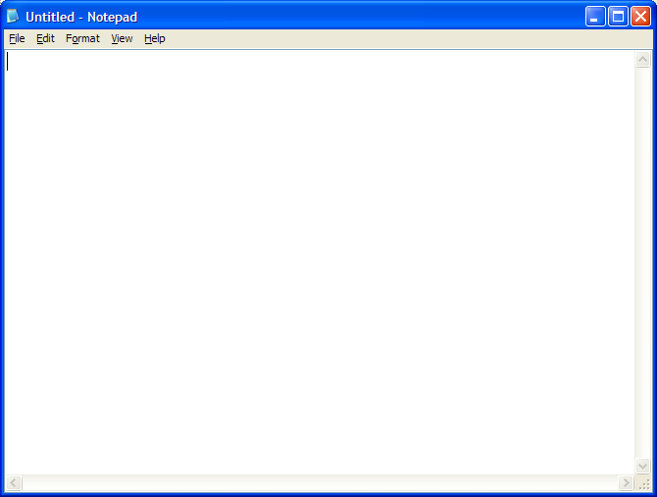
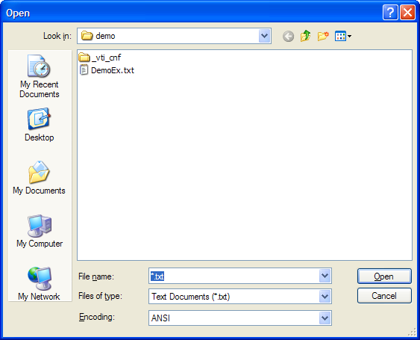
Example - Opening a file in Notepad.exe

Slide 31
Notepad.exe - Opening a file
1 Process - 4 separate Threads
kernel32.dll
shlwapi.dll
comctl32.dll
Notepad.exe
shell32.dll
kernel32.dll
ntdll.dll
comdlg32.dll
user32.dll
177 other
libraries
gdi32.dll
Notes:
c:\winnt\system32\notepad.exe links to 180 dynamic link libraries in total
some of these are the same libraries linked to repeatedly either directly or indirectly via another library (e.g., kernel.dll is linked directly, and also via comdlg32.dll which calls it as part of the service it provides to notepad)
Role of libraries shown:
comdlg32.dll - Common Dialogs for Windows (e.g., Open, Save, Save As, Print, etc.). When the user opens a file, he/she is presented with the standard File Open dialog box.
connects to shell32.dll to locate My Documents, History, Desktop, and other shortcuts available in the open dialog box
connects to kernel32.dll to create its threads for dialog box
connects to comctl32.dll to use its toolbars and other pre-made GUI controls
connects to user32.dll to create the dialog GUI
connects to gdi32.dll to draw the GUI controls on the screen using rectangles, fonts, and other basic shapes
shell32.dll - Performs high-level file operations, and allows the file to be read from disk via ntdll.dll (i.e., the Natvie NT API)
shlwapi.dll - gets the default system directory to be displayed when the user clicks File/Open (i.e., c:\winnt\system32 or the like)
kernel32.dll - creates threads needed to complete file/open operation, and helps load other libraries
ntdll.dll - This is dll that supplies User Mode programs/dlls access to kernel mode services. Ntdll.dll is also known as the NT Native API. The Win32 API relies on it heavily.

Slide 32
Summary
XP’s architecture is the key to its stability, security, and scalability
The OS is built in layers, with each layer providing services to the one above it
  The 2 most important layers are Kernel Mode and User Mode
Few programs are allowed to access hardware directly--which provides stability
Programmers/Programs access low-level functionality via APIs stored in DLL files

Slide 33
What now?
As a user:
  Pay attention to DLL files on your computer. Don’t delete them unless you know what they are.
    Many are shared for reasons we discussed earlier
  Watch which DLLs get installed to your system and where they go.
As a developer:
  As you go on as a programmer you’ll hear a lot more about APIs and maybe even write some of your own.
  If you go on to become a Windows developer, you’ll want to consider learning the Win32 API

