Slide 1
Distributed File Systems
(Chapter 14, M. Satyanarayanan)
CS 249
Kamal Singh

Slide 2
Topics
Introduction to Distributed File Systems
Coda File System overview
Communication, Processes, Naming, Synchronization, Caching & Replication, Fault Tolerance and Security
Summary
Brief overview of Distributed Google File System (GFS)

Slide 3
Introduction
Distributed File Systems is a File System that aims to support file sharing, resources in the form of secure and persistent storage over a network.

Slide 4
Distributed File Systems (DFS)
DFS stores files on one or more computers and make these files accessible to clients, where they appear as normal files
Files are widely available
Sharing the files is easier than distributing individual copies
Backups and security easier to manage

Slide 5
Distributed File Systems (DFS)
Issues in designing a good DFS
File transfer can create
  Sluggish performance
  Latency
Network bottlenecks and server overload can occur
Security of data is important
Failures have to be dealt without affecting clients

Slide 6
Coda File System (CFS)
Coda has been developed in the group of M. Satyanarayanan at Carnegie Mellon University in 1990’s
Integrated with popular UNIX operating systems
CFS main goal is to achieve high availability
Advanced caching schemes
Provide transparency

Slide 7
Architecture
Clients cache entire files locally
Cache coherence is maintained by the use of callbacks (inherit from AFS)
Clients dynamically find files on server and cache location information
Token-based authentication and end-to-end encryption is used

Slide 8
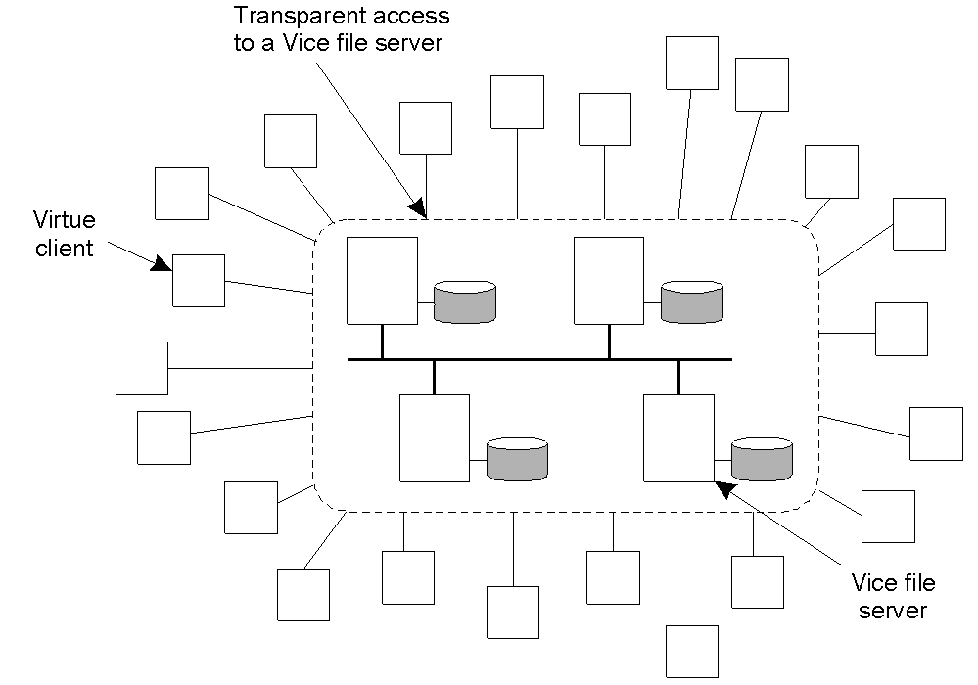
Overall organization of Coda

Slide 9
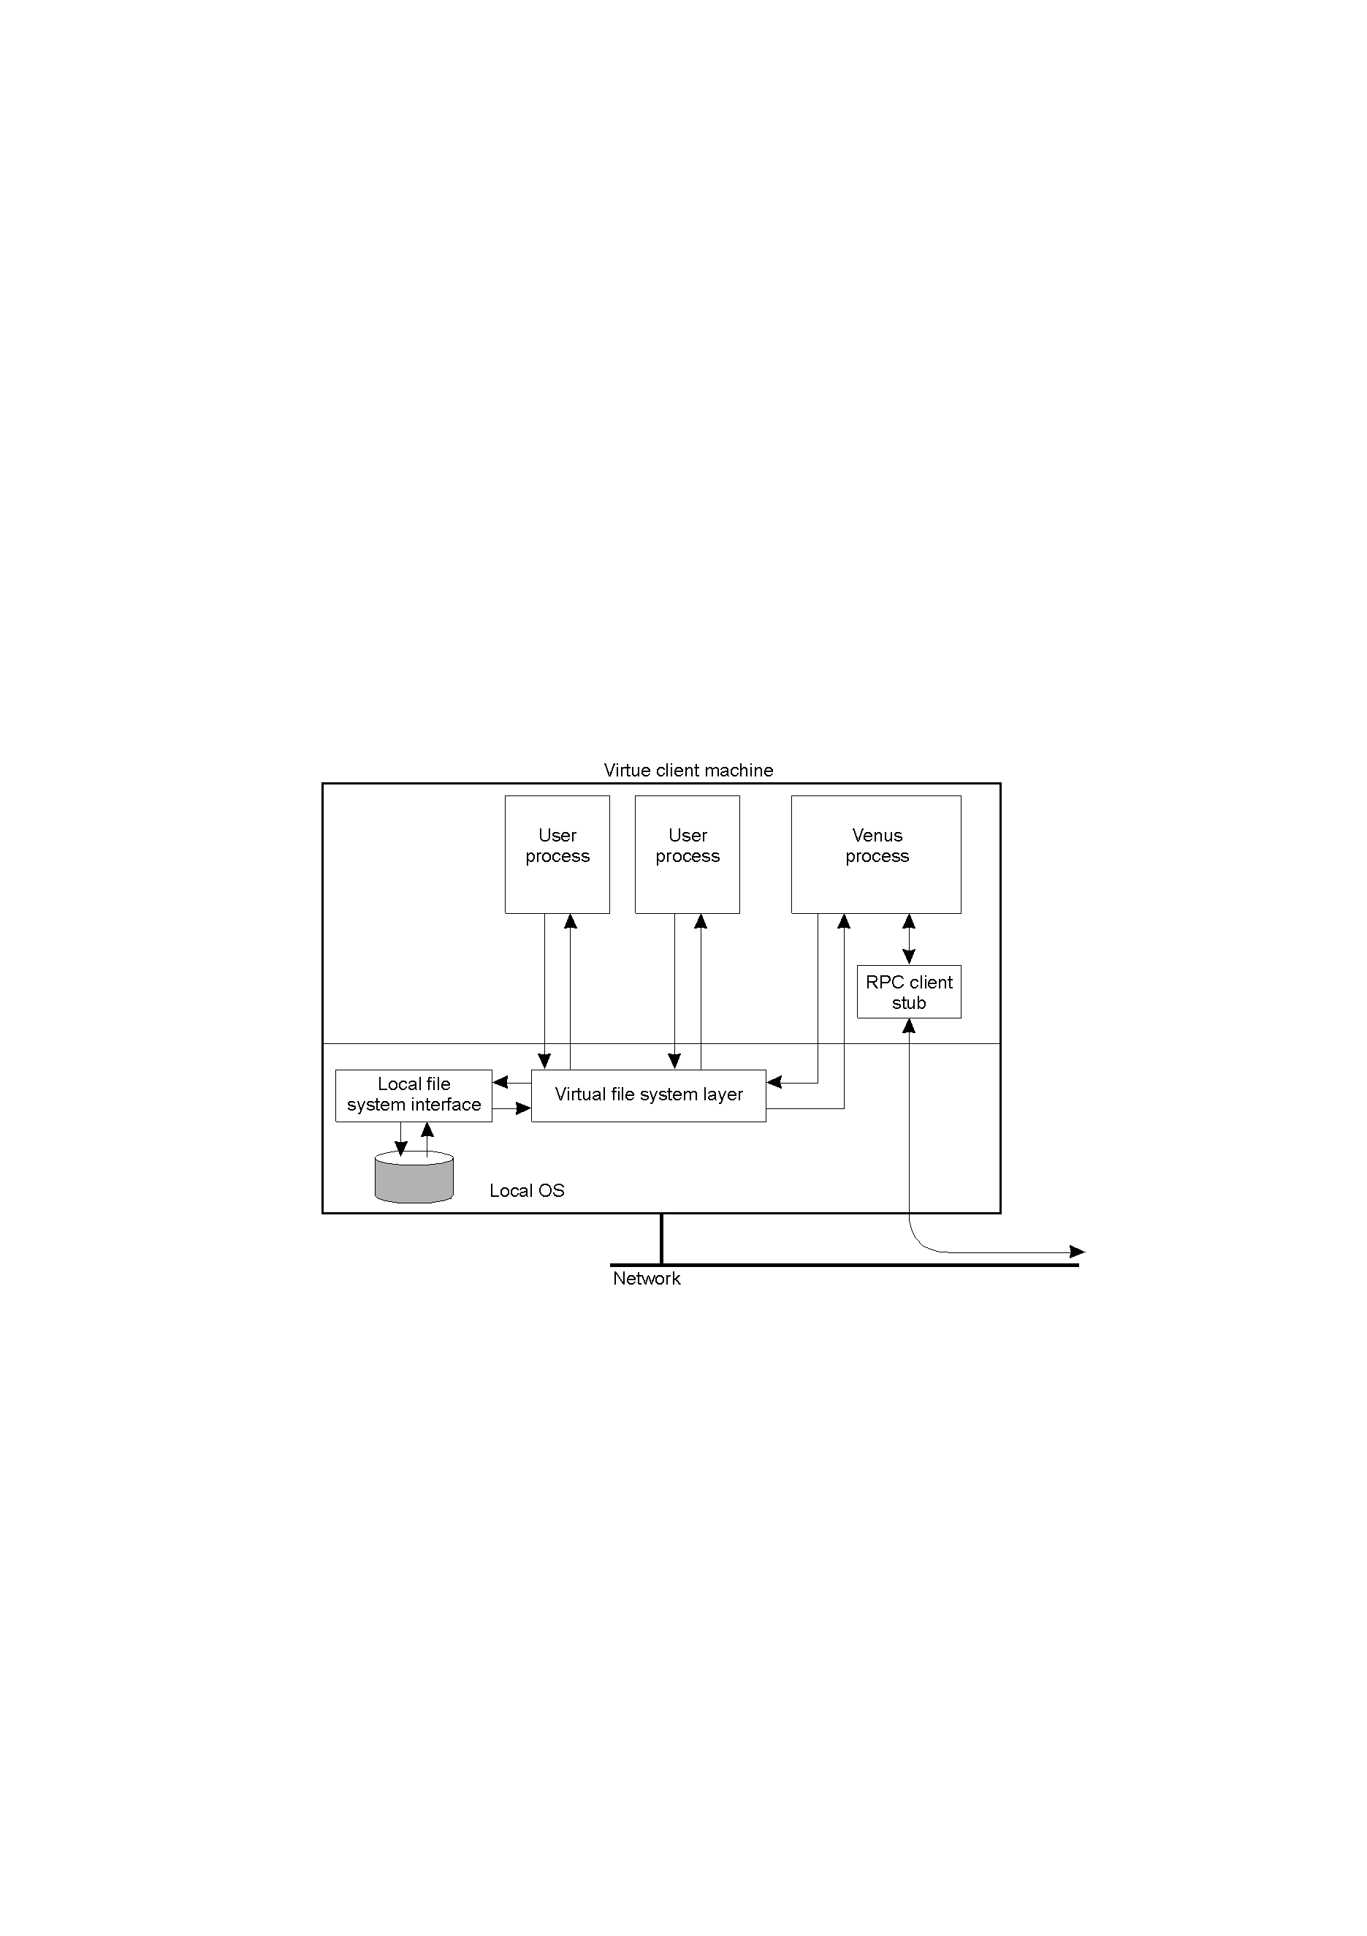
Virtue client machine
The internal organization of a Virtue workstation
  Designed to allow access to files even if server is unavailable
  Uses VFS to intercepts calls from client application

Slide 10
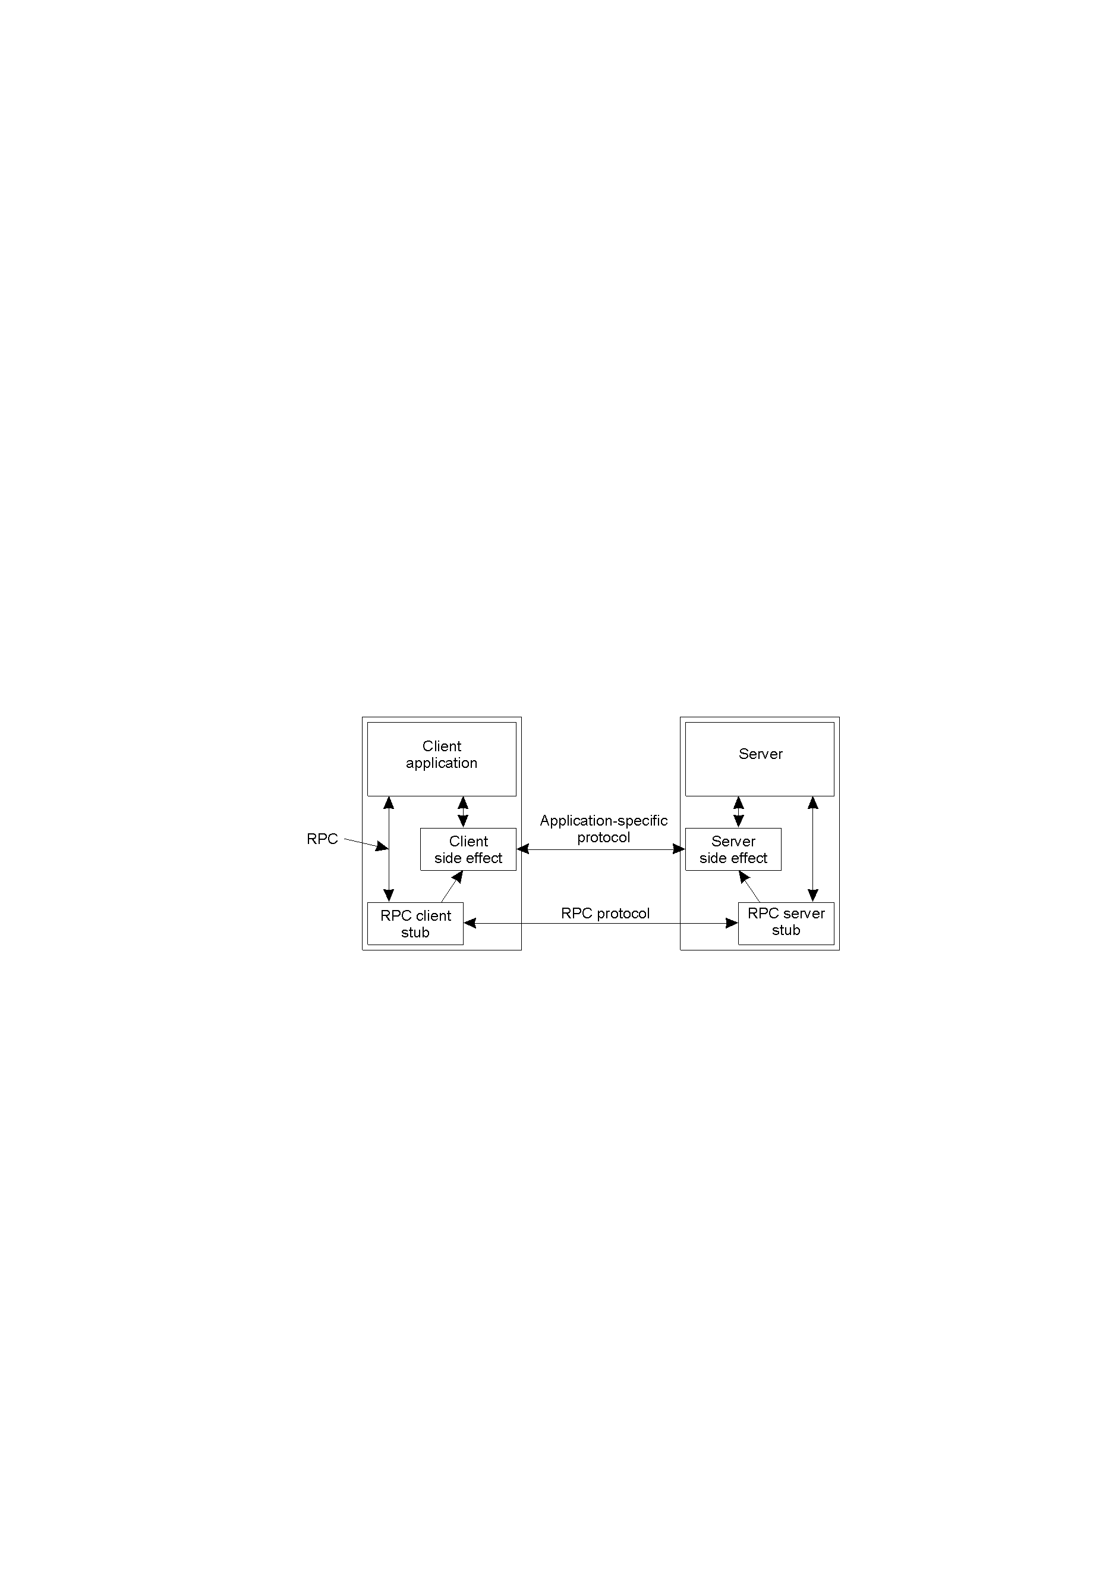
Communication in Coda
Coda uses RPC2: a sophisticated reliable RPC system
  Start a new thread for each request, server periodically informs client it is still working on the request
RPC2 supports side-effects: application-specific protocols
  Useful for video streaming
RPC2 also has multicast support

Slide 11
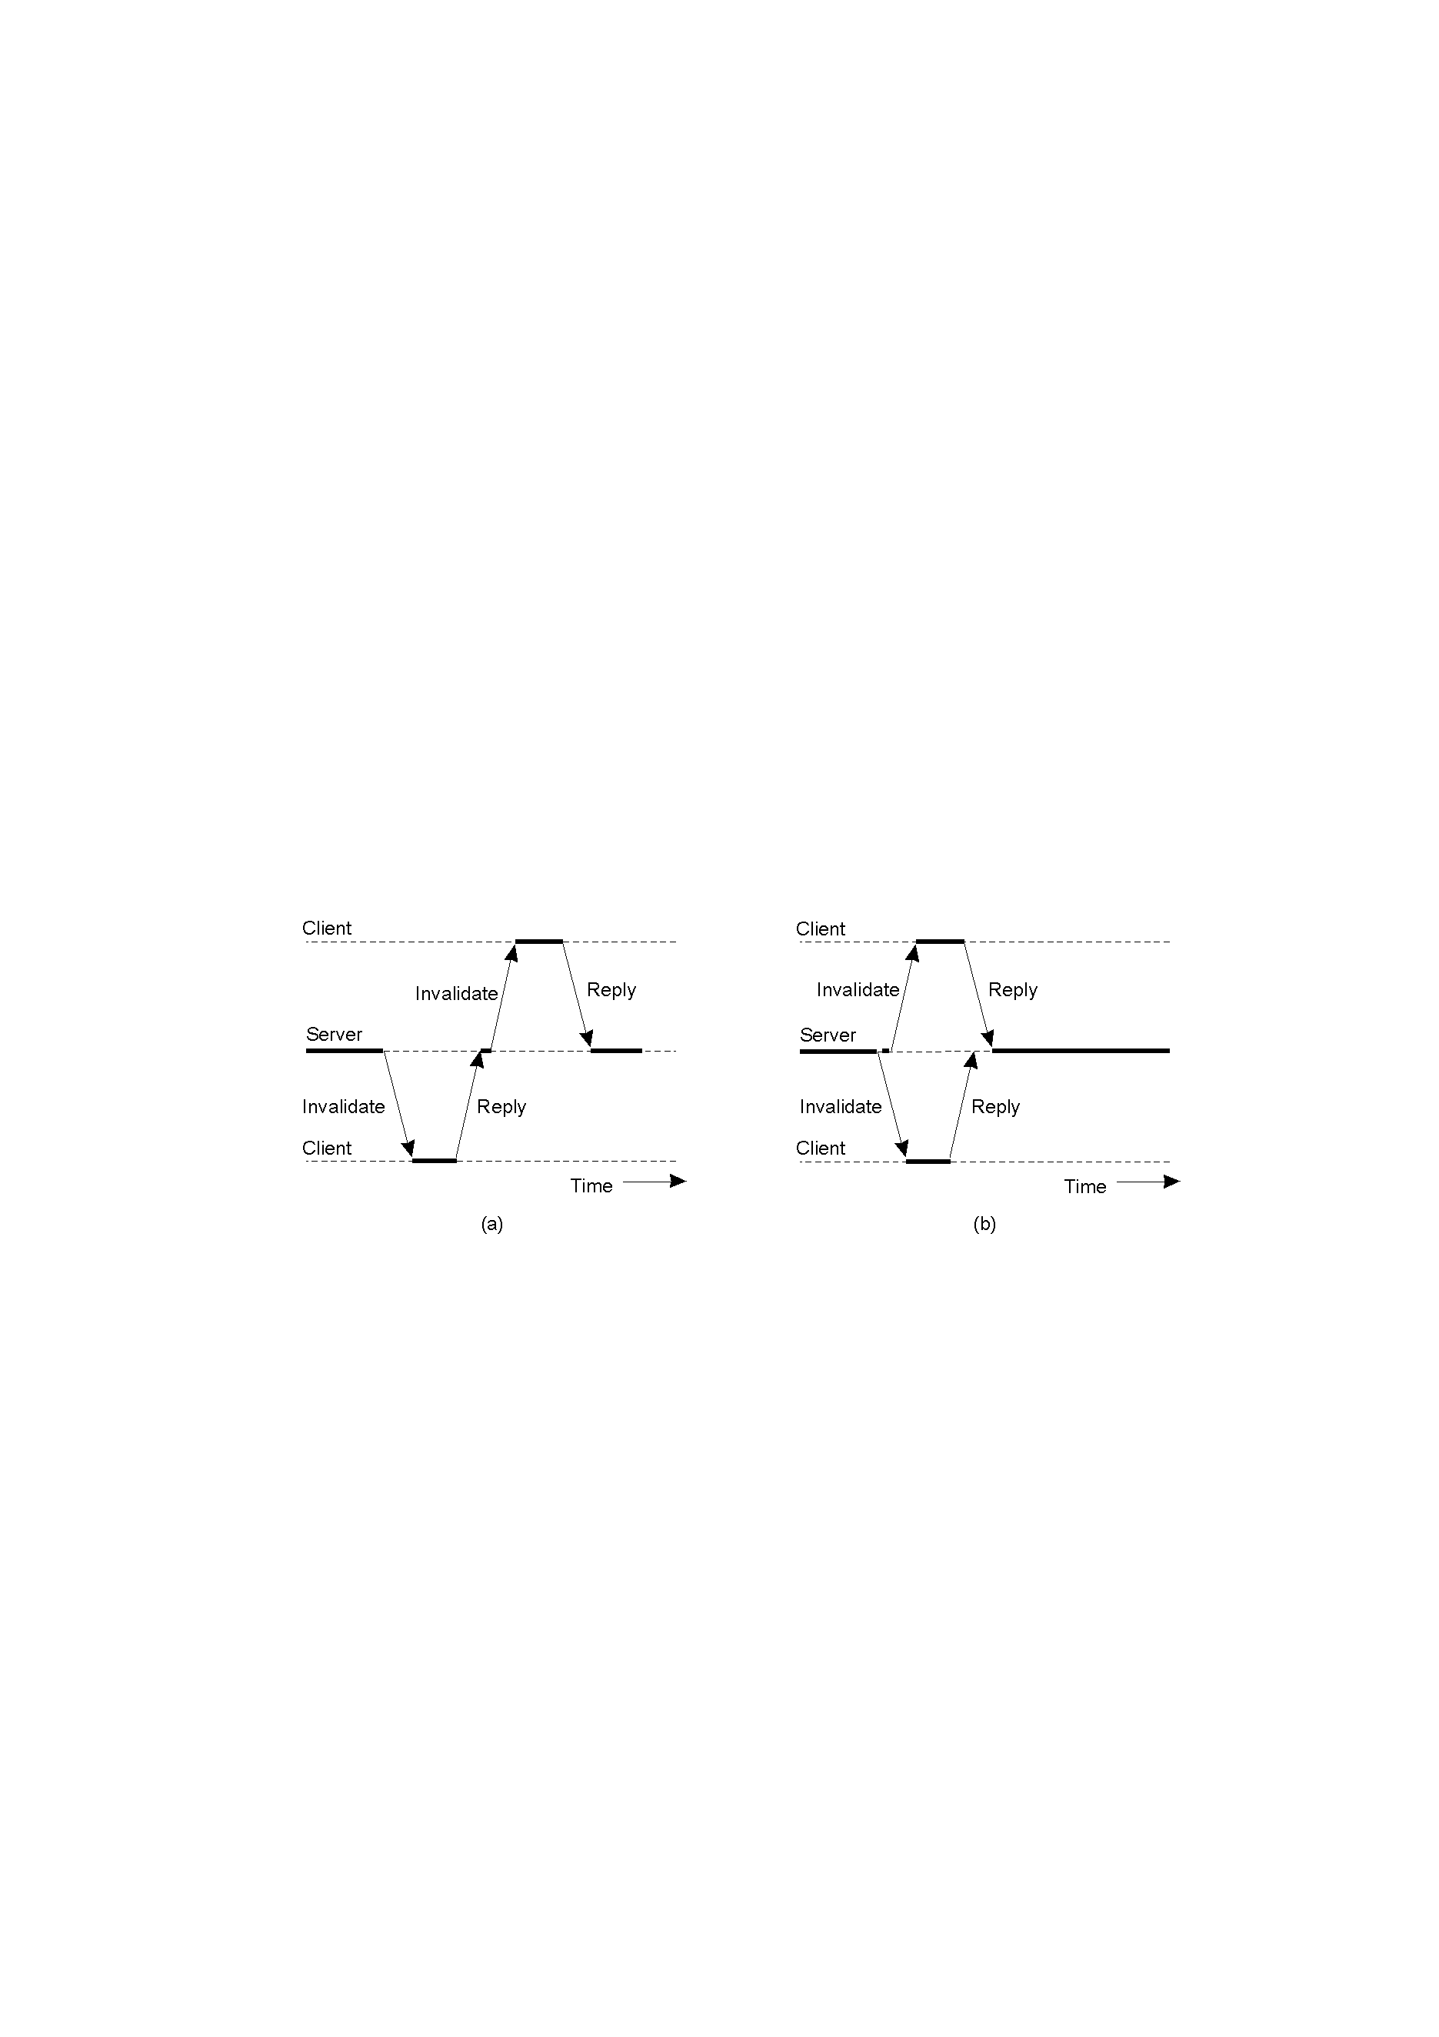
Communication in Coda
Coda servers allow clients to cache whole files
Modifications by other clients are notified through invalidation messages require multicast RPC
  Sending an invalidation message one at a time
  Sending invalidation messages in parallel

Slide 12
Processes in Coda
Coda maintains distinction between client and server processes
Client – Venus processes
Server – Vice processes
Threads are nonpreemptive and operate entirely in user space
Low-level thread handles I/O operations

Slide 13
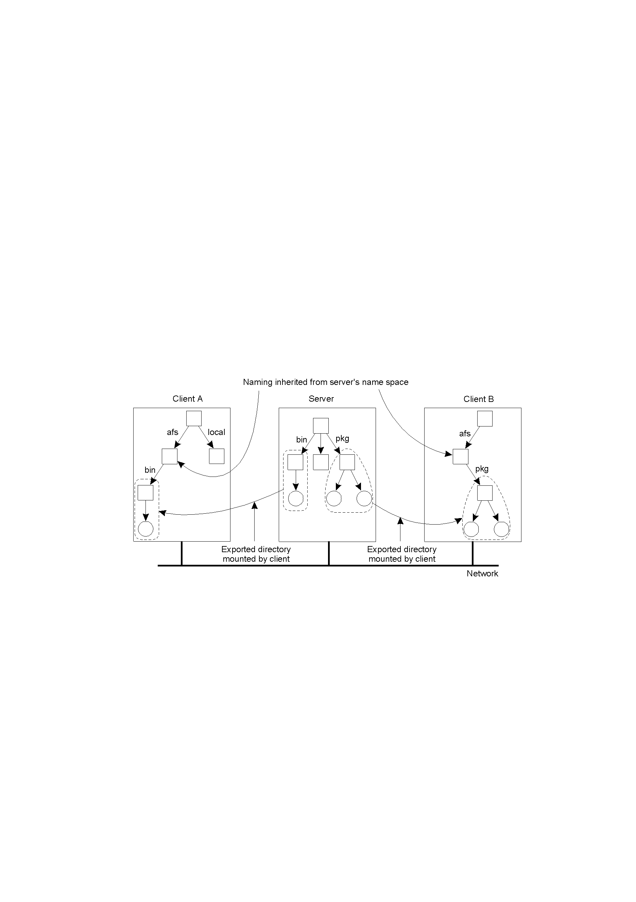
Naming in Coda
Clients have access to a single shared name space.
Notice Client A and Client B!

Slide 14
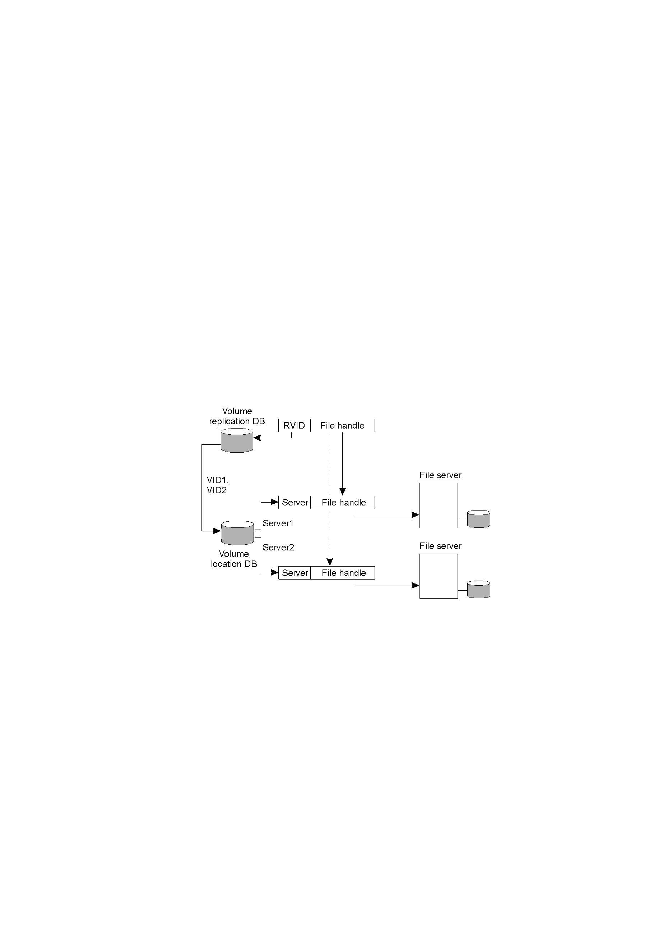
File Identifiers
Each file in Coda belongs to exactly one volume
  Volume may be replicated across several servers
  Multiple logical (replicated) volumes map to the same physical volume
  96 bit file identifier = 32 bit RVID + 64 bit file handle

Slide 15
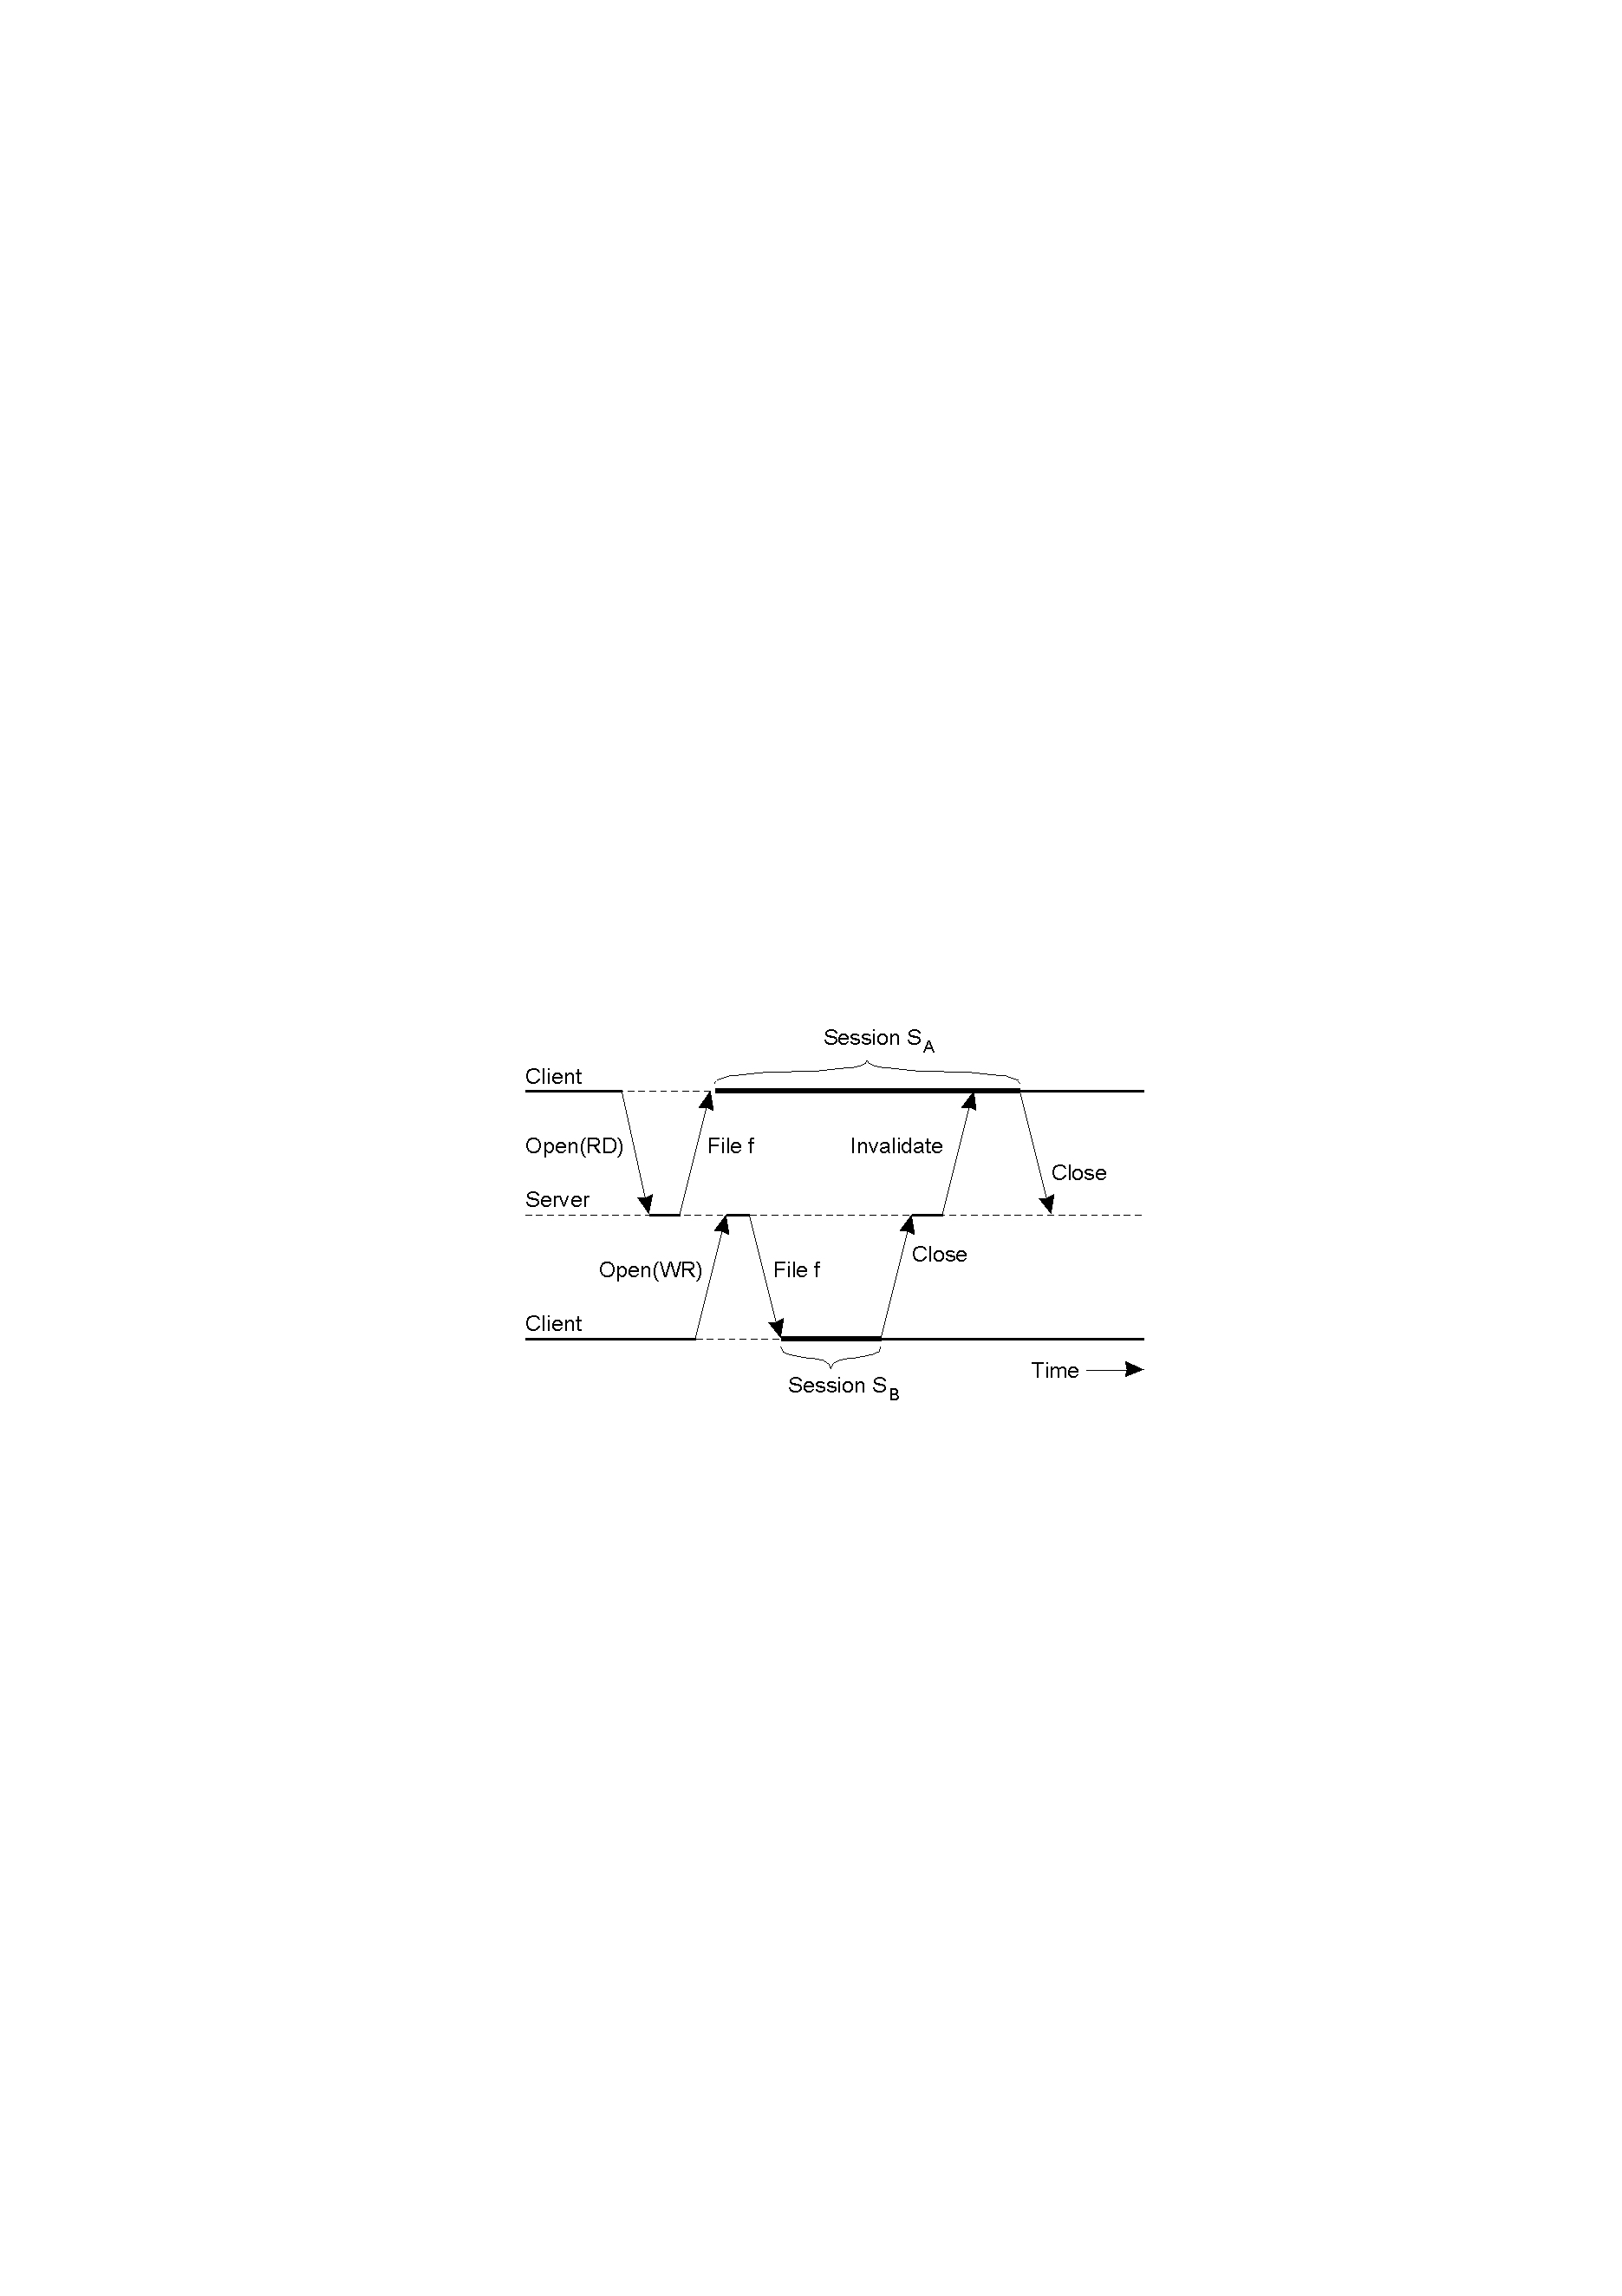
Synchronization in Coda
  File open: transfer entire file to client machine
  Uses session semantics: each session is like a transaction
    Updates are sent back to the server only when the file is closed

Slide 16
Transactional Semantics
File-associated data | Read? | Modified?
File identifier | Yes | No
Access rights | Yes | No
Last modification time | Yes | Yes
File length | Yes | Yes
File contents | Yes | Yes
Partition is a part of network that is isolated from rest (consist of both clients and servers)
  Allow conflicting operations on replicas across file partitions
  Resolve modification upon reconnection
  Transactional semantics: operations must be serializable
    Ensure that operations were serializable after they have executed
  Conflict force manual reconciliation

Slide 17
Caching in Coda
Caching:
  Achieve scalability
  Increases fault tolerance
How to maintain data consistency in a distributed system?
Use callbacks to notify clients when a file changes
If a client modifies a copy, server sends a callback break to all clients maintaining copies of same file

Slide 18
Caching in Coda
Cache consistency maintained using callbacks
Vice server tracks all clients that have a copy of the file and provide callback promise
  Token from Vice server
  Guarantee that Venus will be notified if file is modified
Upon modification Vice server send invalidate to clients

Slide 19
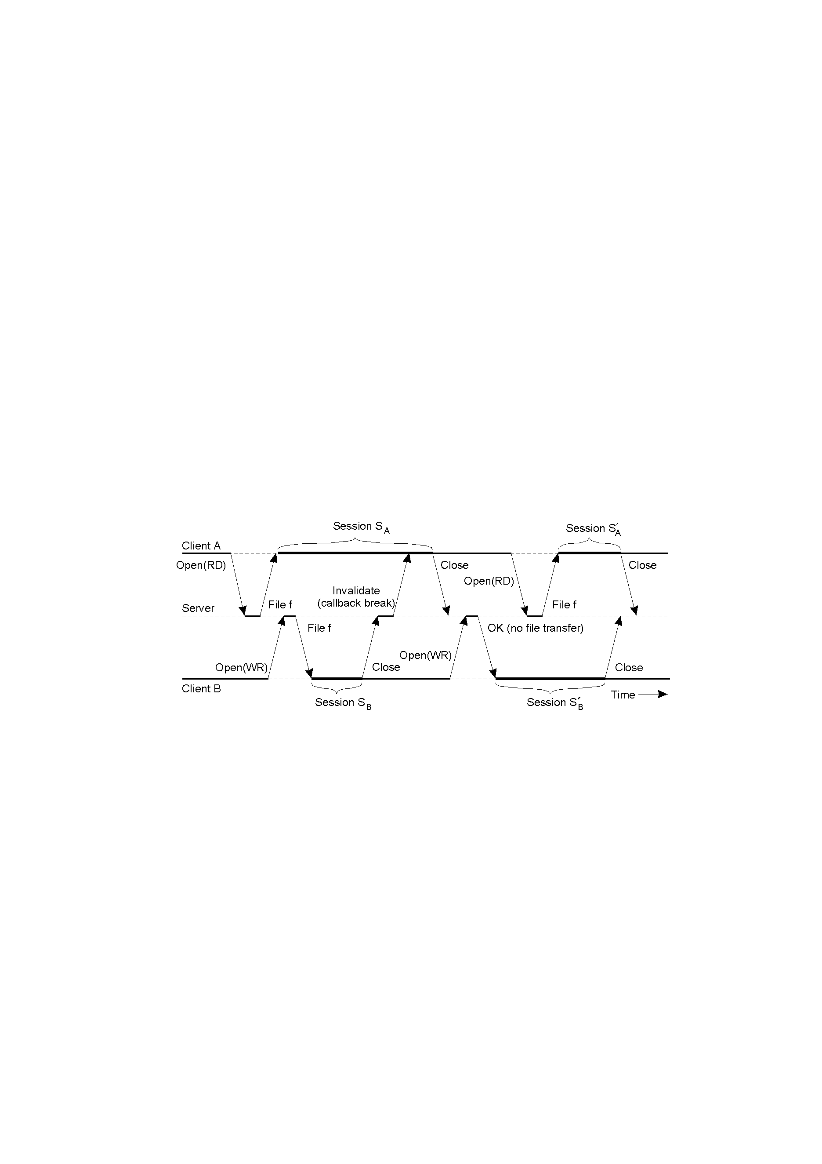
Example: Caching in Coda

Slide 20
Server Replication in Coda
Unit of replication: volume
Volume Storage Group (VSG): set of servers that have a copy of a volume
Accessible Volume Storage Group (AVSG): set of servers in VSG that the client can contact
Use vector versioning
  One entry for each server in VSG
  When file updated, corresponding version in AVSG is updated

Slide 21
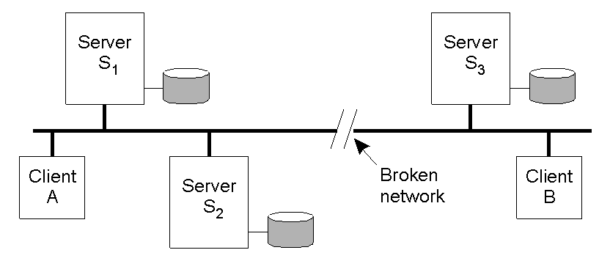
Server Replication in Coda
Versioning vector when partition happens: [1,1,1]
Client A updates file → versioning vector in its partition: [2,2,1]
Client B updates file → versioning vector in its partition: [1,1,2]
Partition repaired → compare versioning vectors: conflict!

Slide 22
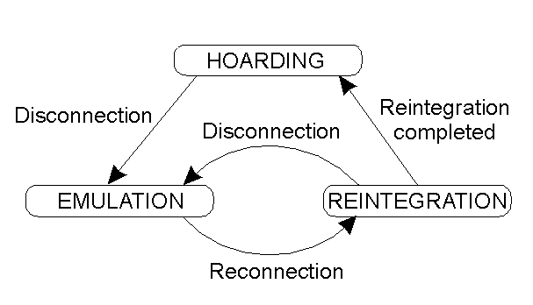
Fault Tolerance in Coda
HOARDING: File cache in advance with all files that will be accessed when disconnected
EMULATION: when disconnected, behavior of server emulated at client
REINTEGRATION: transfer updates to server; resolves conflicts

Slide 23
Security in Coda
Set-up a secure channel between client and server
  Use secure RPC
System-level authentication

Slide 24
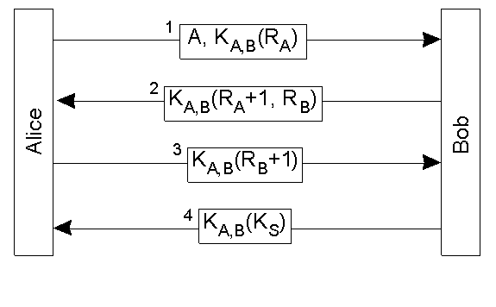
Security in Coda
Mutual Authentication in RPC2
Based on Needham-Schroeder protocol

Slide 25
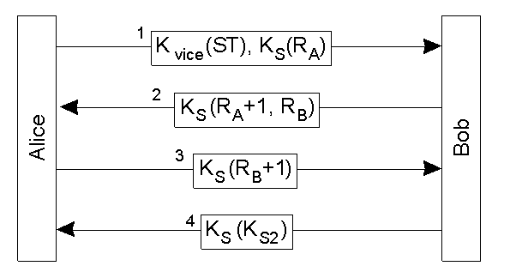
Establishing a Secure Channel
Upon authentication AS (authentication server) returns:
  Clear token: CT = [Alice, TID, K_{S}, T_{start}, T_{end}]
  Secret token: ST = K_{vice}([CT]*_{Kvice})
  K_{S}: secret key obtained by client during login procedure
  K_{vice}: secret key shared by vice servers
Token is similar to the ticket in Kerberos
Vice Server
Client (Venus)

Slide 26
Summary of Coda File System
High availability
RPC communication
Write back cache consistency
Replication and caching
Needham-Schroeder secure channels

Slide 27
Google File System
The Google File System
http://labs.google.com/papers/gfs.html
By: Sanjay Ghemawat, Howard Gobioff and Shun-Tak Leung
Appeared in: 19th ACM Symposium on Operating Systems Principles,
Lake George, NY, October, 2003.

Slide 28
Key Topics
Search Engine Basics
Motivation
Assumptions
Architecture
Implementation
Conclusion

Slide 29
Google Search Engine
Search engine performs many tasks including
  Crawling
  Indexing
  Ranking
    Maintain Web Graph, Page Rank
  Deployment
    Adding new data, update
    Processing queries

Slide 30
Google Search Engine
Size of the web > 1 billion textual pages (2000)
Google index has over 8 billion pages (2003)
Google is indexing 40-80TB (2003)
Index update frequently (~every 10 days) (2000)
Google handles 250 million searches/day (2003)
How to manage this huge task, without going down????

Slide 31
Motivation
Need for a scalable DFS
Large distributed data-intensive applications
High data processing needs
Performance, Reliability, Scalability, Consistency and Availability
More than traditional DFS

Slide 32
Assumptions – Environment
System is build from inexpensive hardware
Hardware failure is a norm rather than the exception
Terabytes of storage space
15000+ commodity machines (2001)
~100 machines die each day (2001)

Slide 33
Assumptions – Applications
Multi-GB files rather than billion of KB-sized files
Workloads
  Large streaming reads
  Small random reads
  Large, sequential writes that append data to file
  Multiple clients concurrently append to one file
High sustained bandwidth preferred over latency

Slide 34
Architecture
Files are divided into fixed-size chunks
Globally unique 64-bit chunk handles
Fixed-size chunks (64MB)
Chunks stored on local disks as Linux files
For reliability each chuck replicated over chunkservers, called replicas

Slide 35
Why 64 MB chunk size?
  Reduces need to interact with master server
  Target apps read/write large chunks of data at once, can maintain persistent TCP connection
  Larger chunk size implies less metadata
  Disadvantages:
    Possible internal fragmentation
    Small file may be one chunk, could cause chunkserver hotspots

Slide 36
Architecture
Master server (simplifies design):
  Maintains all file system metadata
    Namespace
    access control info
    file→chunk mappings
    current location of chunks (which chunkserver)
  Controls system-wide activities
    Chunk lease management
    Garbage collection of orphaned chunks
    Chunk migration between servers
  Communicates with chunkservers via “Heartbeat” messages
    Give slaves instructions & collect state info

Slide 37
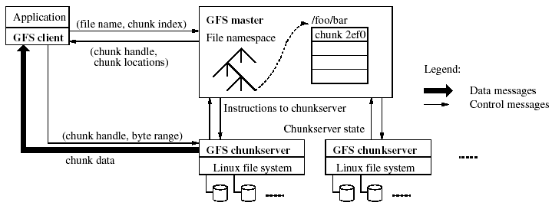
Architecture
Contact single master
Obtain chunk locations
Contact one of chunkservers
Obtain data

Slide 38
Metadata
Master stores 3 types of metadata:
  File and chunk namespaces
  Mapping from files to chunks
  Location of chunk replicas
  Metadata kept in memory
    It’s all about speed
    64 bytes of metadata per 64MB chunk
    Namespaces compacted with prefix compression
  First two types logged to disk: operation log
    In case of failure & also keeps chunk versions (timestamps)
  Last type probed at startup, from each chunkserver

Slide 39
Consistency Model
Relaxed consistency model
Two types of mutations
  Writes
    Cause data to be written at an application-specified file offset
  Record appends
    Operations that append data to a file
    Cause data to be appended atomically at least once
    Offset chosen by GFS, not by the client
States of a file region after a mutation
  Consistent
    If all clients see the same data, regardless which replicas they read from
  Defined
    Consistent & all clients see what the mutation writes in its entirety
  Undefined
    Consistent but it may not reflect what any one mutation has written
  Inconsistent
    Clients see different data at different times

Slide 40
Leases and Mutation Order
Master uses leases to maintain a consistent mutation order among replicas
Primary is the chunkserver who is granted a chunk lease
All others containing replicas are secondaries
Primary defines a mutation order between mutations
All secondaries follows this order

Slide 41
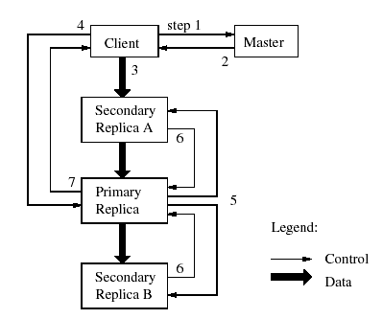
Implementation – Writes
Mutation Order
identical replicas
File region may end up containing mingled fragments from different clients (consistent but undefined)

Slide 42
Atomic Record Appends
The client specifies only the data
Similar to writes
  Mutation order is determined by the primary
  All secondaries use the same mutation order
GFS appends data to the file at least once atomically
  The chunk is padded if appending the record exceeds the maximum size → padding
  If a record append fails at any replica, the client retries the operation → record duplicates
  File region may be defined but interspersed with inconsistent

Slide 43
Snapshot
Goals
  To quickly create branch copies of huge data sets
  To easily checkpoint the current state
Copy-on-write technique
  Metadata for the source file or directory tree is duplicated
  Reference count for chunks are incremented
  Chunks are copied later at the first write

Slide 44
Namespace Management and Locking
Namespaces are represented as a lookup table mapping full pathnames to metadata
Use locks over regions of the namespace to ensure proper serialization
Each master operation acquires a set of locks before it runs

Slide 45
Example of Locking Mechanism
Preventing /home/user/foo from being created while /home/user is being snapshotted to /save/user
  Snapshot operation
    Read locks on /home and /save
    Write locks on /home/user and /save/user
  File creation
    Read locks on /home and /home/user
    Write locks on /home/user/foo
  Conflict locks on /home/user
  Note: Read lock is sufficient to protect the parent directory from deletion

Slide 46
Replica Operations
Chunk Creation
  New replicas on chunkservers with low disk space utilization
  Limit number of recent creations on each chunkserver
  Spread across many racks
Re-replication
  Prioritized: How far it is from its replication goal
  The highest priority chunk is cloned first by copying the chunk data directly from an existing replica
Rebalancing
  Master rebalances replicas periodically

Slide 47
Garbage Collection
Deleted files
  Deletion operation is logged
  File is renamed to a hidden name, then may be removed later or get recovered
Orphaned chunks (unreachable chunks)
  Identified and removed during a regular scan of the chunk namespace
Stale replicas
    Chunk version numbering

Slide 48
Fault Tolerance and Diagnosis
High availability
  Fast recovery
    Master, chunk servers designed to restore state quickly
    No distinction between normal/abnormal termination
  Chunk replication
  Master replication
    State of master server is replicated (i.e. operation log)
    External watchdog can change DNS over to replica if master fails
    Additional “shadow” masters provide RO access during outage
      Shadows may lag the primary master by fractions of 1s
      Only thing that could lag is metadata, not a big deal
      Depends on primary master for replica location updates

Slide 49
Fault Tolerance and Diagnosis
Data Integrity
  Chunkservers checksum to detect corruption
    Corruption caused by disk failures, interruptions in r/w paths
    Each server must checksum because chunks not byte-wise equal
      Chunks are broken into 64 KB blocks
      Each block has a 32 bit checksum
      Checksums kept in memory and logged with metadata
      Can overlap with IO since checksums all in memory
  Client code attempts to align reads to checksum block boundaries
  During idle periods, chunkservers can checksum inactive chunks to detect corrupted chunks that are rarely read
    Prevents master from counting corrupted chunks towards threshold

Slide 50
Real World Clusters
Cluster A:
  Used regularly for R&D by 100+ engineers
  Typical task reads through few MBs - few TBs, analyzes, then writes back
  342 chunkservers
  72 TB aggregate disk space
  ~735,000 files in ~992,000 chunks
  13 GB metadata per chunkserver
  48 MB metadata on master
Cluster B:
  Used for production data processing
  Longer tasks, process multi-TB datasets with little to no human intervention
  227 chunkservers
  180 TB aggregate disk space
  ~737,000 files in ~1,550,000 chunks
  21 GB metadata per chunkserver
  60 MB metadata on master

Slide 51
Measurements
Read rates much higher than write rates
Both clusters in heavy read activity
Cluster A supports up to 750MB/read, B: 1300 MB/s
Master was not a bottle neck
Recovery time (of one chunkserver)
  15,000 chunks containing 600GB are restored in 23.2 minutes (replication rate ≅ 400MB/s)

Slide 52
Review
High availability and component failure
  Fault tolerance, Master/chunk replication, HeartBeat, Operation Log, Checkpointing, Fast recovery
TBs of Space (100s of chunkservers, 1000s of disks)
Networking (Clusters and racks)
Scalability (single master, minimum interaction between master and chunkservers)
Multi-GB files (64MB chunks)
Sequential reads (Large chunks, cached metadata, load balancing)
Appending writes (Atomic record appends)

Slide 53
References
Andrew S. Tanenbaum, Maarten van Steen, Distributed System: Principles and Paradigms, Prentice Hall, 2002.
Mullender, M. Satyanarayanan, Distributed Systems, Distributed File Systems, 1993.
Peter J. Braam, The Coda File System, www.coda.cs.cmu.edu.
S. Ghemawat, H. Gobioff, and S.-T. Leung. The Google File System. In Proceedings of the 19th ACM Symposium on Operating Systems Principles (SOSP ’03), Bolton Landing (Lake George), NY, Oct 2003.
Note: Images used in this presentation are from the textbook and are also available online.

