Slide 1
Distributed File Systems
Chapter 10

Slide 2
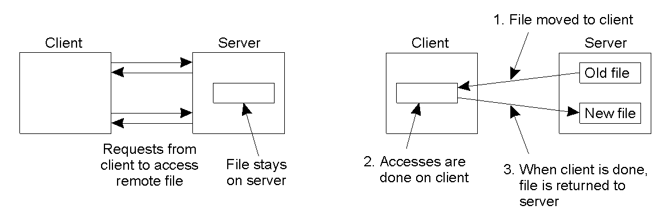
NFS Architecture (1)
The remote access model.
The upload/download model

Slide 3
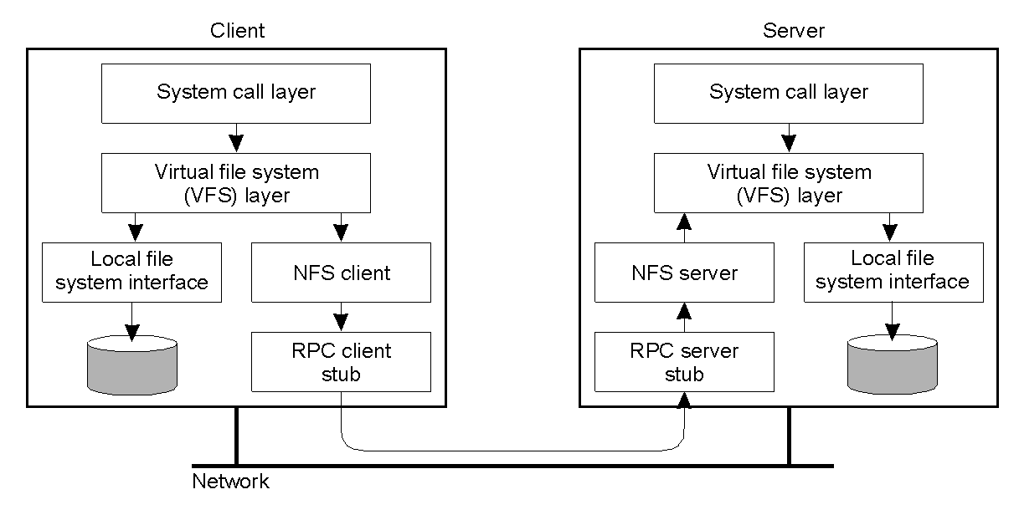
NFS Architecture (2)
The basic NFS architecture for UNIX systems.

Slide 4
File System Model
Operation | v3 | v4 | Description
Create | Yes | No | Create a regular file
Create | No | Yes | Create a nonregular file
Link | Yes | Yes | Create a hard link to a file
Symlink | Yes | No | Create a symbolic link to a file
Mkdir | Yes | No | Create a subdirectory in a given directory
Mknod | Yes | No | Create a special file
Rename | Yes | Yes | Change the name of a file
Rmdir | Yes | No | Remove an empty subdirectory from a directory
Open | No | Yes | Open a file
Close | No | Yes | Close a file
Lookup | Yes | Yes | Look up a file by means of a file name
Readdir | Yes | Yes | Read the entries in a directory
Readlink | Yes | Yes | Read the path name stored in a symbolic link
Getattr | Yes | Yes | Read the attribute values for a file
Setattr | Yes | Yes | Set one or more attribute values for a file
Read | Yes | Yes | Read the data contained in a file
Write | Yes | Yes | Write data to a file
An incomplete list of file system operations supported by NFS.

Slide 5
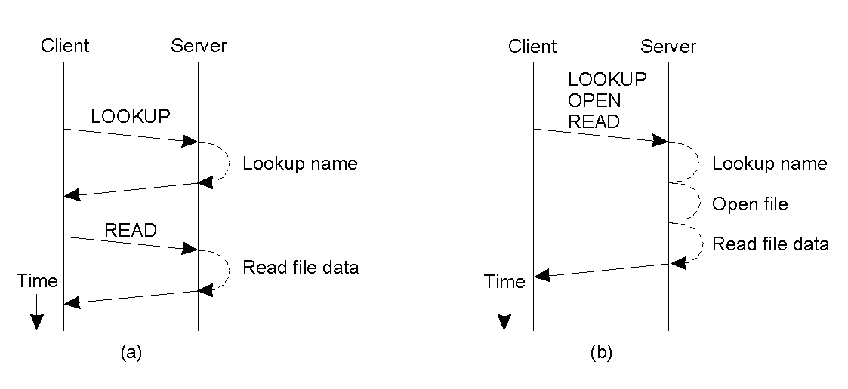
Communication
Reading data from a file in NFS version 3.
Reading data using a compound procedure in version 4.

Slide 6
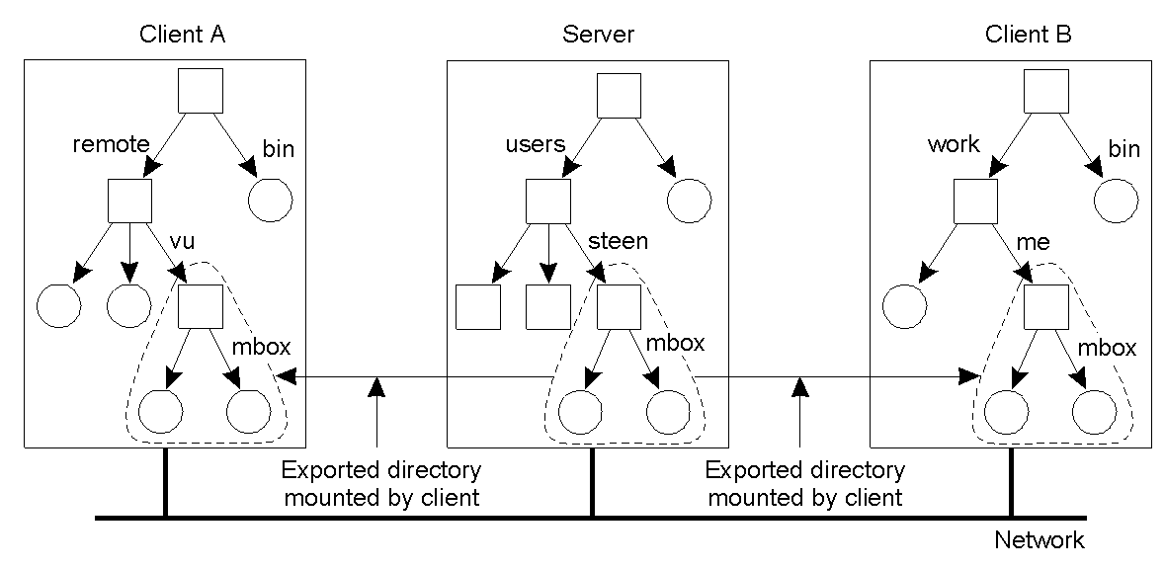
Naming (1)
Mounting (part of) a remote file system in NFS.

Slide 7
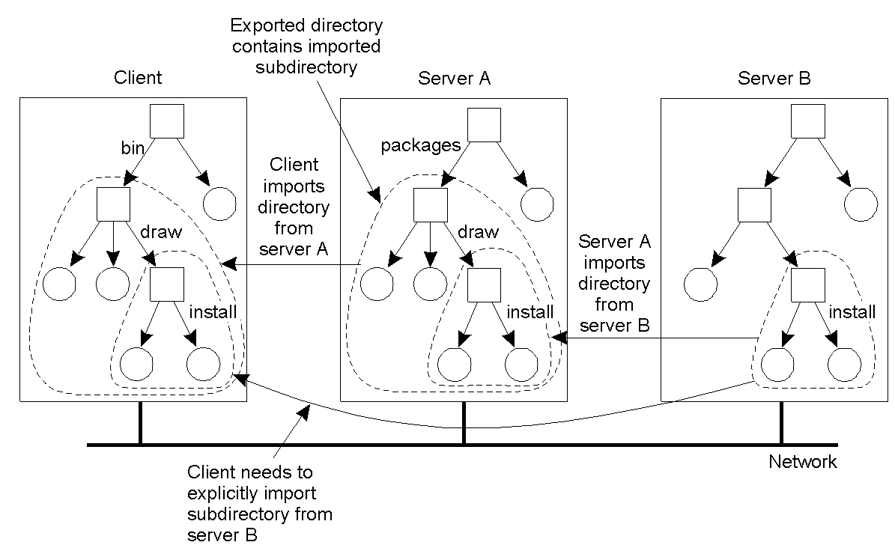
Naming (2)
Mounting nested directories from multiple servers in NFS.

Slide 8
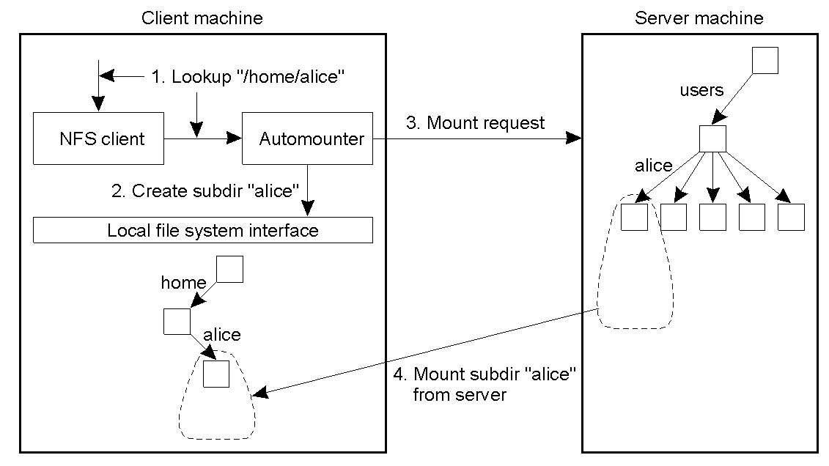
Automounting (1)
A simple automounter for NFS.

Slide 9
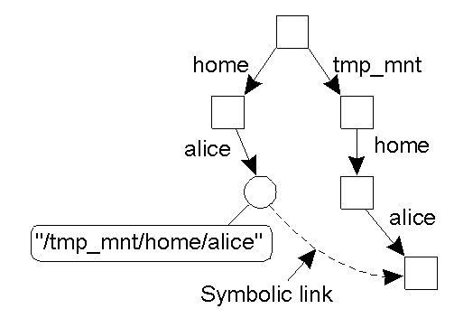
Automounting (2)
Using symbolic links with automounting.

Slide 10
File Attributes (1)
Attribute | Description
TYPE | The type of the file (regular, directory, symbolic link)
SIZE | The length of the file in bytes
CHANGE | Indicator for a client to see if and/or when the file has changed
FSID | Server-unique identifier of the file's file system
Some general mandatory file attributes in NFS.

Slide 11
File Attributes (2)
Attribute | Description
ACL | an access control list associated with the file
FILEHANDLE | The server-provided file handle of this file
FILEID | A file-system unique identifier for this file
FS_LOCATIONS | Locations in the network where this file system may be found
OWNER | The character-string name of the file's owner
TIME_ACCESS | Time when the file data were last accessed
TIME_MODIFY | Time when the file data were last modified
TIME_CREATE | Time when the file was created
Some general recommended file attributes.

Slide 12
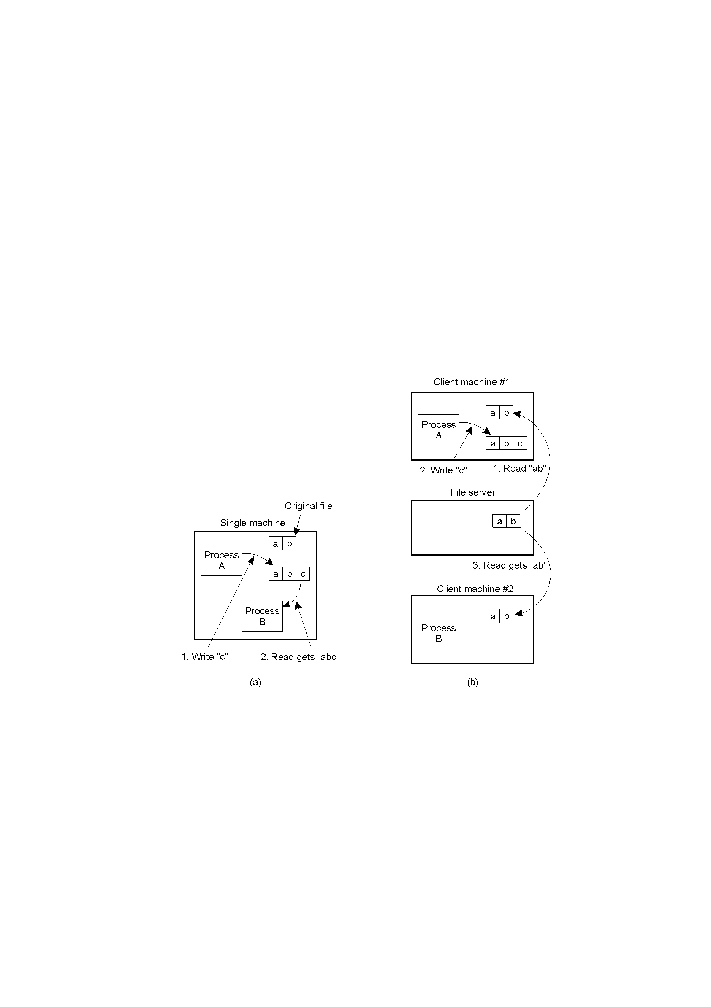
Semantics of File Sharing (1)
On a single processor, when a read follows a write, the value returned by the read is the value just written.
In a distributed system with caching, obsolete values may be returned.

Slide 13
Semantics of File Sharing (2)
Method | Comment
UNIX semantics | Every operation on a file is instantly visible to all processes
Session semantics | No changes are visible to other processes until the file is closed
Immutable files | No updates are possible; simplifies sharing and replication
Transaction | All changes occur atomically
Four ways of dealing with the shared files in a distributed system.

Slide 14
File Locking in NFS (1)
Operation | Description
Lock | Creates a lock for a range of bytes
Lockt | Test whether a conflicting lock has been granted
Locku | Remove a lock from a range of bytes
Renew | Renew the leas on a specified lock
NFS version 4 operations related to file locking.

Slide 15
File Locking in NFS (2)
Current file denial state
 | NONE | READ | WRITE | BOTH
READ | Succeed | Fail | Succeed | Succeed
WRITE | Succeed | Succeed | Fail | Succeed
BOTH | Succeed | Succeed | Succeed | Fail
(a) Requested file denial state
 | NONE | READ | WRITE | BOTH
READ | Succeed | Fail | Succeed | Succeed
WRITE | Succeed | Succeed | Fail | Succeed
BOTH | Succeed | Succeed | Succeed | Fail
(b)
Request
access
Current
access
state
The result of an open operation with share reservations in NFS.
When the client requests shared access given the current denial state.
When the client requests a denial state given the current file access state.

Slide 16
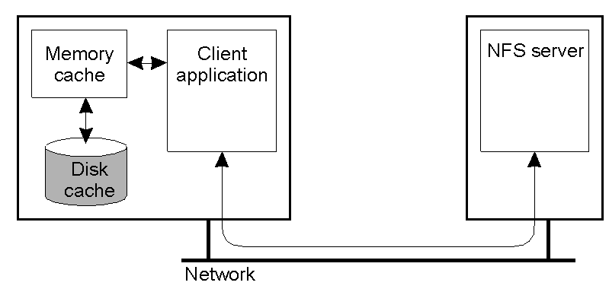
Client Caching (1)
Client-side caching in NFS.

Slide 17
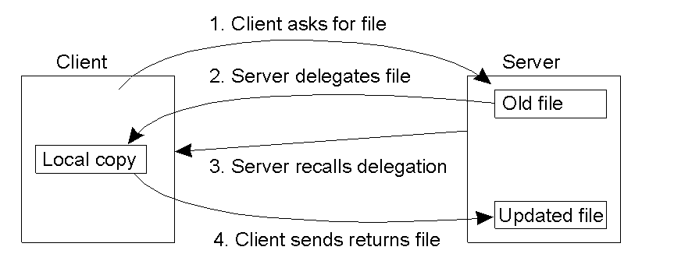
Client Caching (2)
Using the NFS version 4 callback mechanism to recall file delegation.

Slide 18
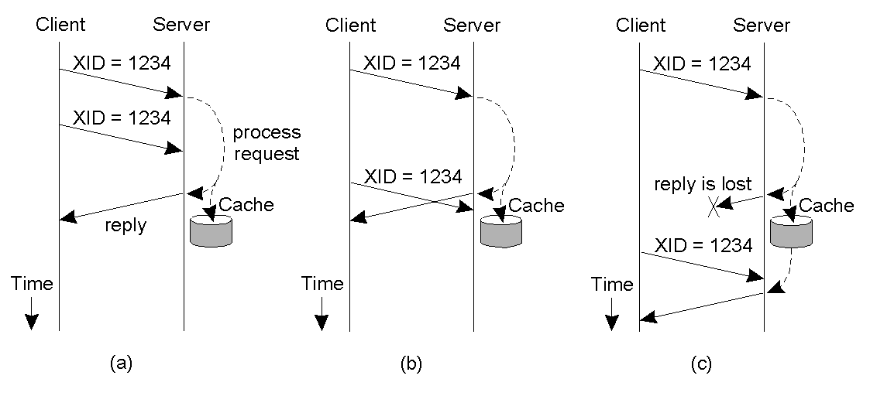
RPC Failures
Three situations for handling retransmissions.
The request is still in progress
The reply has just been returned
The reply has been some time ago, but was lost.

Slide 19
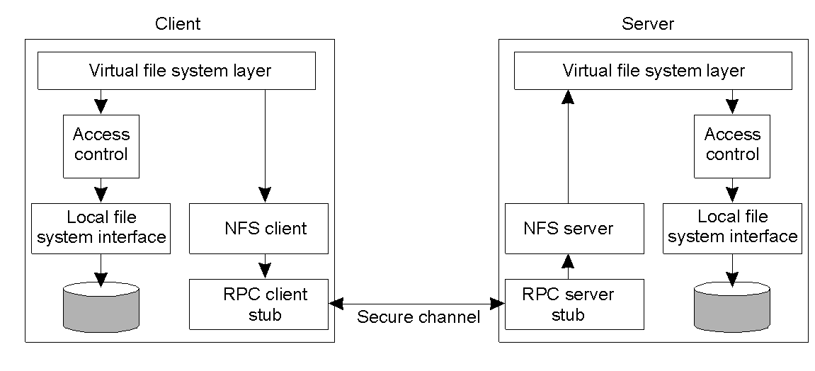
Security
The NFS security architecture.

Slide 20
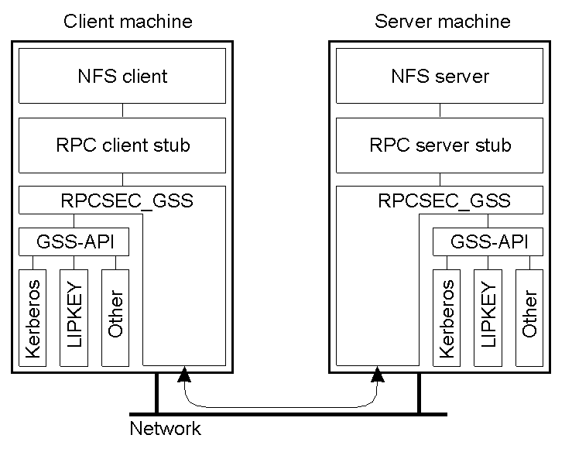
Secure RPCs
Secure RPC in NFS version 4.

Slide 21
Access Control
Operation | Description
Read_data | Permission to read the data contained in a file
Write_data | Permission to to modify a file's data
Append_data | Permission to to append data to a file
Execute | Permission to to execute a file
List_directory | Permission to to list the contents of a directory
Add_file | Permission to to add a new file t5o a directory
Add_subdirectory | Permission to to create a subdirectory to a directory
Delete | Permission to to delete a file
Delete_child | Permission to to delete a file or directory within a directory
Read_acl | Permission to to read the ACL
Write_acl | Permission to to write the ACL
Read_attributes | The ability to read the other basic attributes of a file
Write_attributes | Permission to to change the other basic attributes of a file
Read_named_attrs | Permission to to read the named attributes of a file
Write_named_attrs | Permission to to write the named attributes of a file
Write_owner | Permission to to change the owner
Synchronize | Permission to to access a file locally at the server with synchronous reads and writes
The classification of operations recognized by NFS with respect to access control.

Slide 22
The Coda File System
Type of user | Description
Owner | The owner of a file
Group | The group of users associated with a file
Everyone | Any user of a process
Interactive | Any process accessing the file from an interactive terminal
Network | Any process accessing the file via the network
Dialup | Any process accessing the file through a dialup connection to the server
Batch | Any process accessing the file as part of a batch job
Anonymous | Anyone accessing the file without authentication
Authenticated | Any authenticated user of a process
Service | Any system-defined service process
The various kinds of users and processes distinguished by NFS with respect to access control.

Slide 23
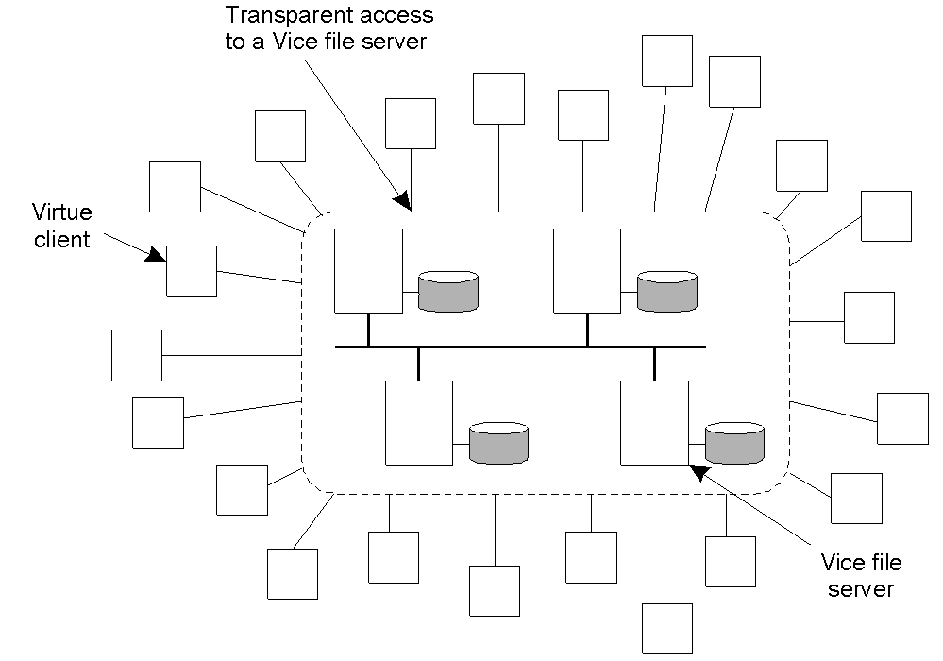
Overview of Coda (1)
The overall organization of AFS.

Slide 24
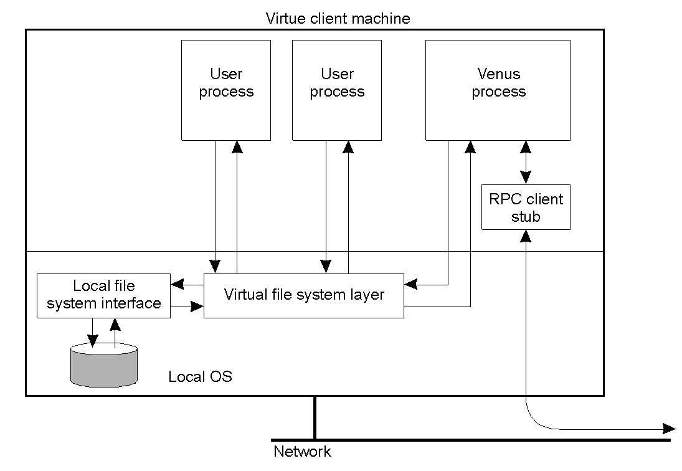
Overview of Coda (2)
The internal organization of a Virtue workstation.

Slide 25
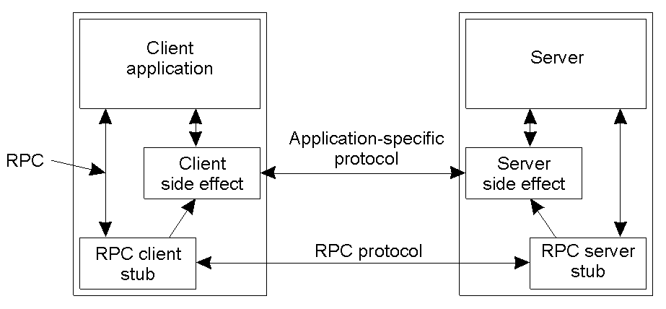
Communication (1)
Side effects in Coda's RPC2 system.

Slide 26
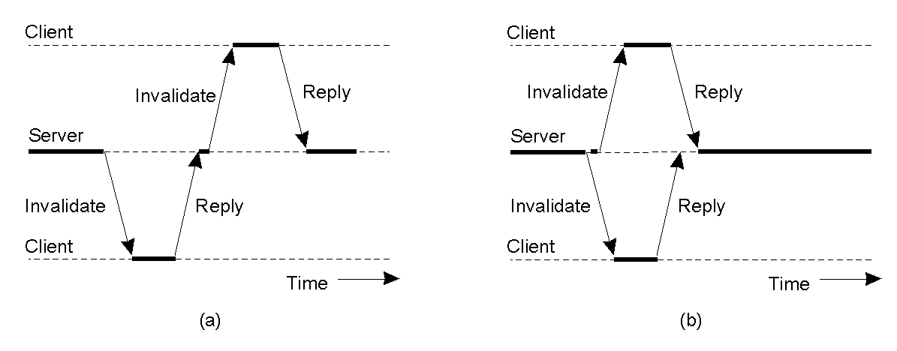
Communication (2)
Sending an invalidation message one at a time.
Sending invalidation messages in parallel.

Slide 27
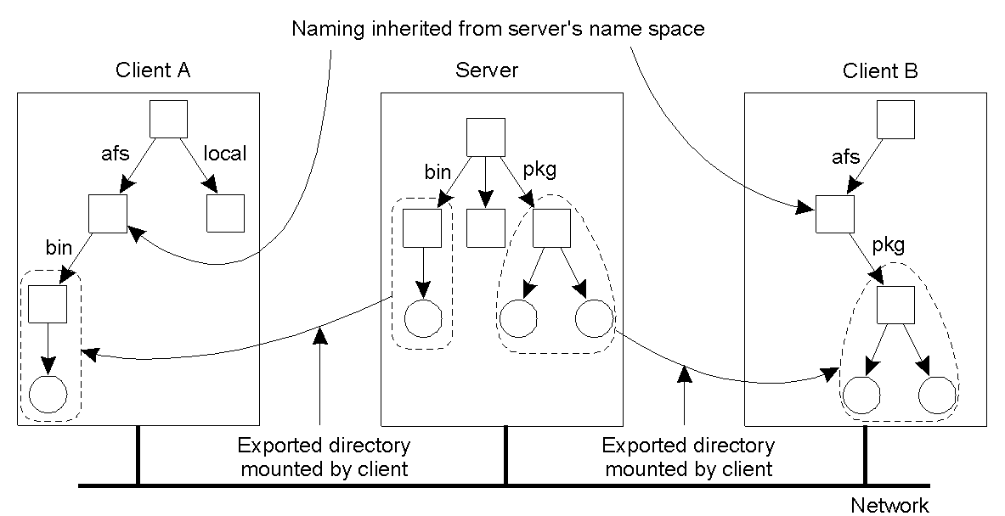
Naming
Clients in Coda have access to a single shared name space.

Slide 28
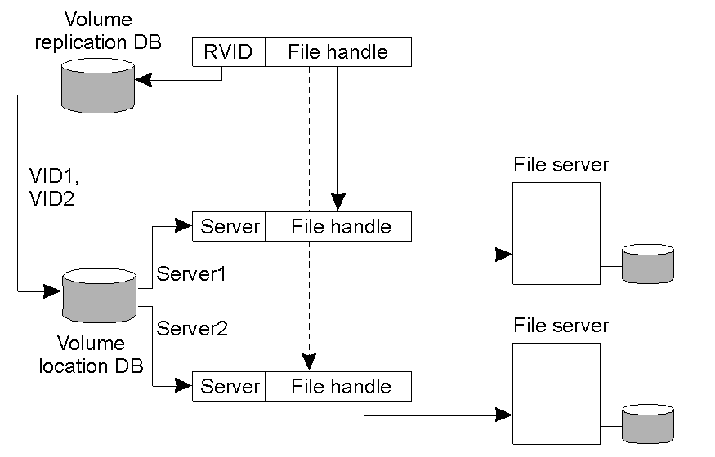
File Identifiers
The implementation and resolution of a Coda file identifier.

Slide 29
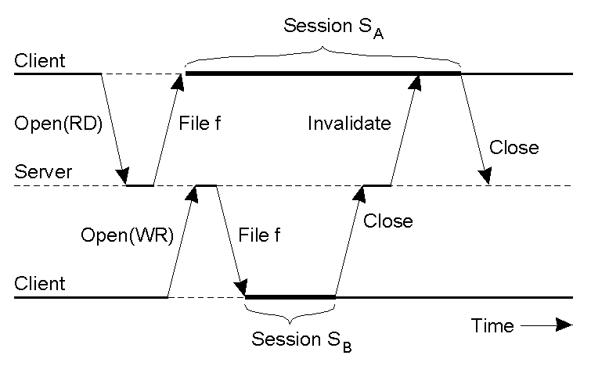
Sharing Files in Coda
The transactional behavior in sharing files in Coda.

Slide 30
Transactional Semantics
File-associated data | Read? | Modified?
File identifier | Yes | No
Access rights | Yes | No
Last modification time | Yes | Yes
File length | Yes | Yes
File contents | Yes | Yes
The metadata read and modified for a store session type in Coda.

Slide 31
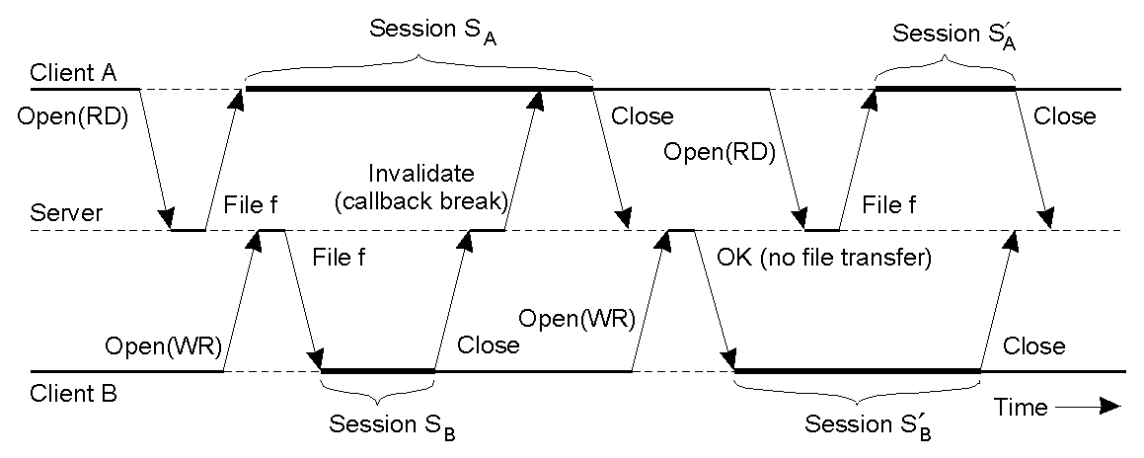
Client Caching
The use of local copies when opening a session in Coda.

Slide 32
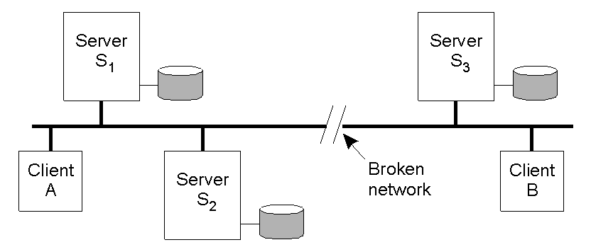
Server Replication
Two clients with different AVSG for the same replicated file.

Slide 33

Disconnected Operation
The state-transition diagram of a Coda client with respect to a volume.

Slide 34
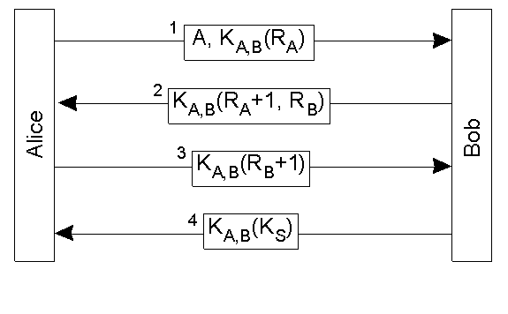
Secure Channels (1)
Mutual authentication in RPC2.

Slide 35
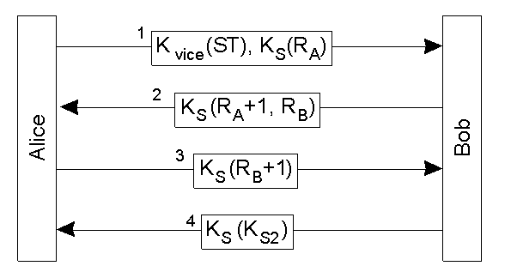
Secure Channels (2)
Setting up a secure channel between a (Venus) client and a Vice server in Coda.

Slide 36
Access Control
Operation | Description
Read | Read any file in the directory
Write | Modify any file in the directory
Lookup | Look up the status of any file
Insert | Add a new file to the directory
Delete | Delete an existing file
Administer | Modify the ACL of the directory
Classification of file and directory operations recognized by Coda with respect to access control.

Slide 37
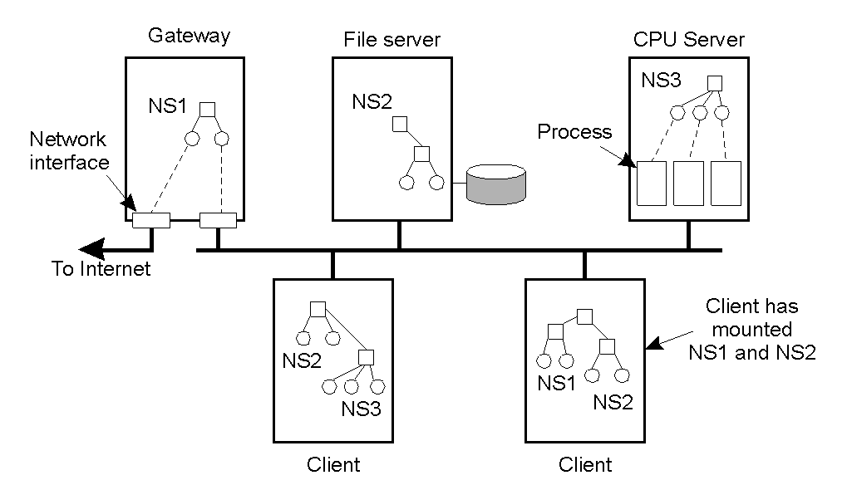
Plan 9: Resources Unified to Files
General organization of Plan 9

Slide 38
Communication
File | Description
ctl | Used to write protocol-specific control commands
data | Used to read and write data
listen | Used to accept incoming connection setup requests
local | Provides information on the caller's side of the connection
remote | Provides information on the other side of the connection
status | Provides diagnostic information on the current status of the connection
Files associated with a single TCP connection in Plan 9.

Slide 39
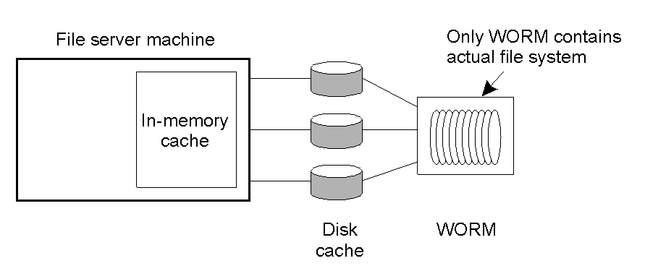
Processes
The Plan 9 file server.

Slide 40
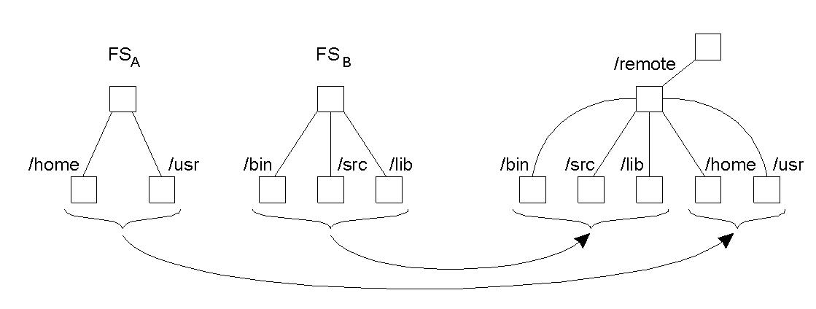
Naming
A union directory in Plan 9.

Slide 41
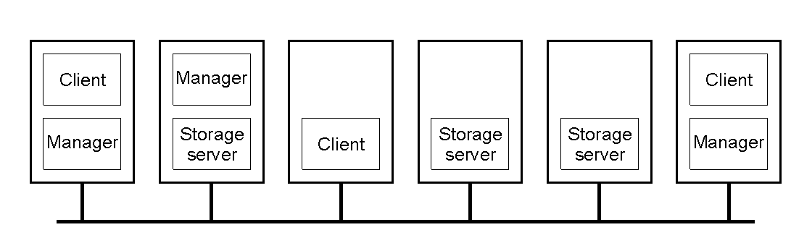
Overview of xFS.
A typical distribution of xFS processes across multiple machines.

Slide 42
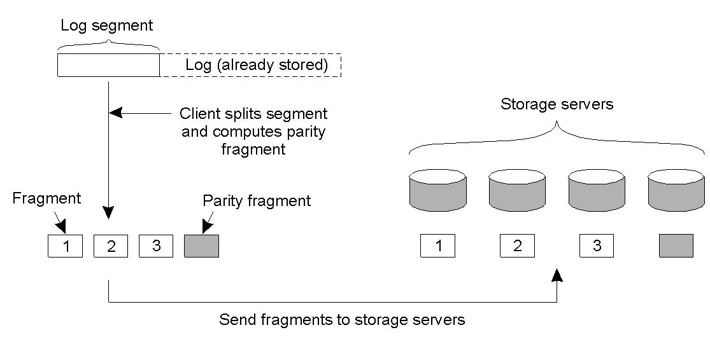
Processes (1)
The principle of log-based striping in xFS.

Slide 43
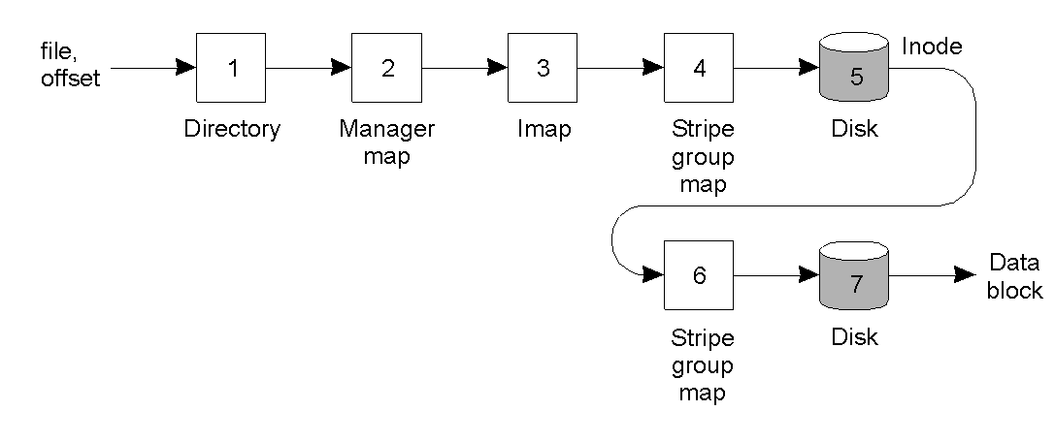
Processes (2)
Reading a block of data in xFS.

Slide 44
Naming
Data structure | Description
Manager map | Maps file ID to manager
Imap | Maps file ID to log address of file's inode
Inode | Maps block number (i.e., offset) to log address of block
File identifier | Reference used to index into manager map
File directory | Maps a file name to a file identifier
Log addresses | Triplet of stripe group, ID, segment ID, and segment offset
Stripe group map | Maps stripe group ID to list of storage servers
Main data structures used in xFS.

Slide 45
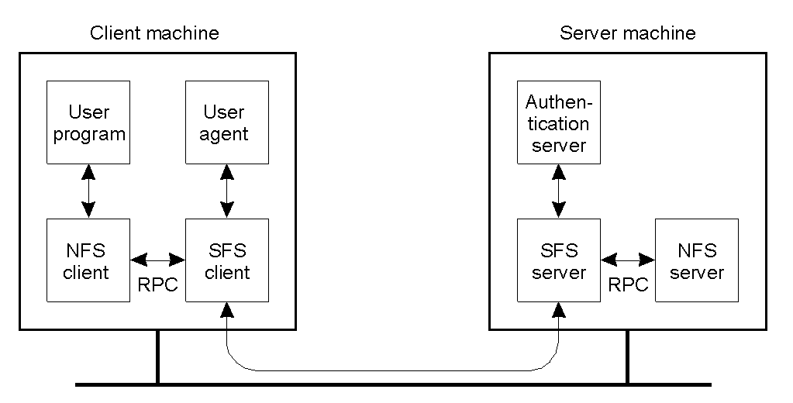
Overview of SFS
The organization of SFS.

Slide 46
Naming
/sfs | LOC | HID | Pathname
/sfs/sfs.vu.sc.nl:ag62hty4wior450hdh63u623i4f0kqere/home/steen/mbox
A self-certifying pathname in SFS.

Slide 47
Summary
Issue | NFS | Coda | Plan 9 | xFS | SFS
Design goals | Access transparency | High availability | Uniformity | Serverless system | Scalable security
Access model | Remote | Up/Download | Remote | Log-based | Remote
Communication | RPC | RPC | Special | Active msgs | RPC
Client process | Thin/Fat | Fat | Thin | Fat | Medium
Server groups | No | Yes | No | Yes | No
Mount granularity | Directory | File system | File system | File system | Directory
Name space | Per client | Global | Per process | Global | Global
File ID scope | File server | Global | Server | Global | File system
Sharing sem. | Session | Transactional | UNIX | UNIX | N/S
Cache consist. | write-back | write-back | write-through | write-back | write-back
Replication | Minimal | ROWA | None | Striping | None
Fault tolerance | Reliable comm. | Replication and caching | Reliable comm. | Striping | Reliable comm.
Recovery | Client-based | Reintegration | N/S | Checkpoint & write logs | N/S
Secure channels | Existing mechanisms | Needham-Schroeder | Needham-Schroeder | No pathnames | Self-cert.
Access control | Many operations | Directory operations | UNIX based | UNIX based | NFS BASED
A comparison between NFS, Coda, Plan 9, xFS. N/S indicates that nothing has been specified.

