Slide 1

Techniques for Real-System Characterization of Java Virtual Machine Energy and Power Behavior
Gilberto Contreras
Margaret Martonosi
Department of Electrical Engineering
Princeton University

Slide 2
Why Study Power in Java Systems?
The Java platform has been adopted in a wide variety of devices
Java servers demand performance, embedded devices require low-power
Performance is important, power/energy/thermal issues are equally important
How do we study and characterize these requirements in a multi-layer platform?

Slide 3
Power/Performance Design Issues
Java Application
Java Virtual Machine
Operating System
Hardware

Slide 4
Power/Performance Design Issues
Java Application
Garbage
Collection
Class
Loader
Runtime
Compiler
Execution
Engine
Java Virtual Machine
Operating System
Hardware
How do the various software layers affect power/performance characteristics of hardware?
Where should time be invested when designing power and/or thermally aware Java virtual Machines?

Slide 5
Outline
Approaches for Energy/Performance Characterization of Java virtual machines
Methodology
  Breaking the JVM into sub-components
  Hardware-based power/performance characterization of JVM sub-components
Results
  Jikes & Kaffe on Pentium M
  Kaffe on Intel XScale
Conclusions

Slide 6
Power & Performance Analysis of Java
Simulation Approach
  Flexible: easy to model non-existent hardware
  Simulators may lack comprehensiveness and accuracy
  Thermal studies require tens of seconds granularity
    Accurate simulators are too slow
√
x
x
Hardware Approach
  Able to capture full-system characteristics and effects
  Data gathering is comparable to hardware speeds
  Only applicable to existent hardware
√
√
x

Slide 7
Hardware-based Characterization
Hardware
Virtual Machine
DAQ
CH0
Track
code
region
0010
CH1
Class Loader
ID: 0001
CH2
CH3
CPU
Garbage Collector
ID: 0010
CH-
Power
measurements
Memory
CH+
Compiler
ID: 0100
scheduler
Execution Engine
ID: 1000

Slide 8
Two Virtual Machines
Jikes RVM
Kaffe JVM
High performance | Flexibility and portability
High-end processors | High-end to embedded
Multiple collectors | Mark-and-sweep
Runtime compiler with different optimization levels | Just-in-time compiler
Design goal
Architecture
support
Garbage
collection
Runtime optimizations

Slide 9
Two Platforms
Pentium M (P6)
Intel XScale
High-performance mobile computers | High-end handheld devices
1.6Ghz, 512MB RAM | 400Mhz, 32MB RAM
31W | 1.4W
Jikes RVM Kaffe | Kaffe
Platform Type
Configuration
Theoretical
Max Power
JVM
Used

Slide 10
Outline
Approaches for Energy/Performance Characterization of Java virtual machines
Methodology
  Breaking the JVM into sub-components
  Power/performance hardware-based characterization of JVM sub-components
Results
  Jikes & Kaffe on Pentium M
  Kaffe on Intel XScale
Conclusions

Slide 11
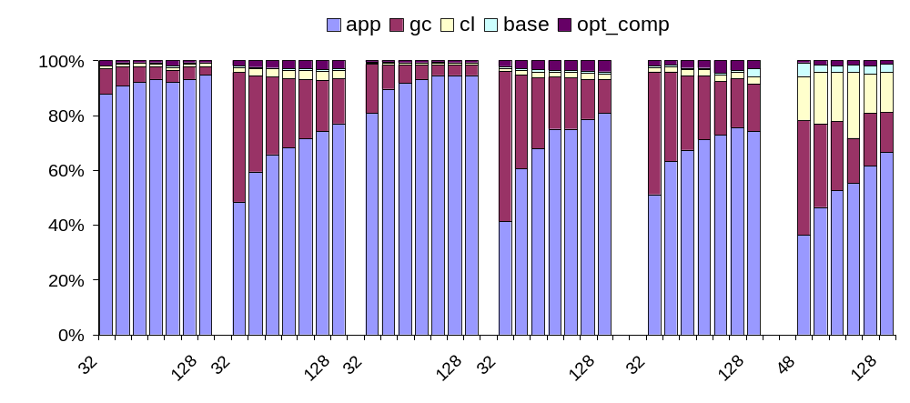
Jikes Energy Distribution on P6
SemiSpace Garbage Collector
Energy Usage
Heap size (MB)
jess
db
javac
jack
fop
compress

Slide 12
Jikes Energy Distribution on P6
SemiSpace Garbage Collector
Energy Usage
Heap size (MB)
jess
db
javac
jack
fop
compress
JVM: Up to 60% of the total energy
GC: Average 37% of the total energy of SpecJVM98

Slide 13
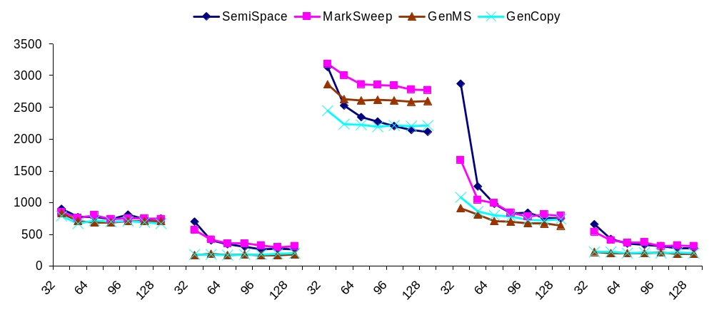
Jikes Energy-Delay Product on P6
EDP (J*sec)
Heap size (MB)
jess
db
javac
jack
compress
Jikes: heap size has a significant impact on energy efficiency
EDP decrease across heap sizes due to a decrease in application execution time

Slide 14
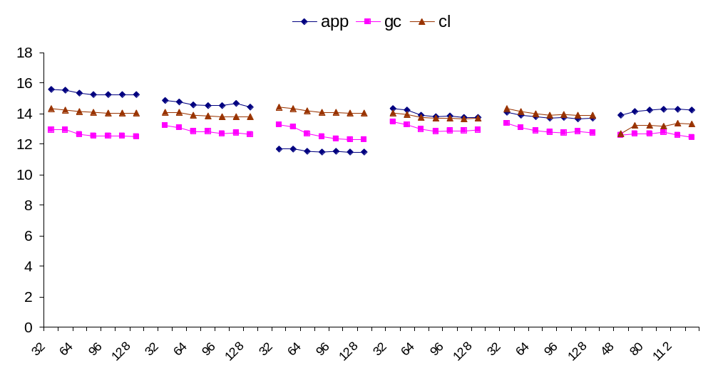
Jikes Power Consumption on P6
GenCopy Garbage Collector
Watts
Heap size (MB)
compress
jess
db
javac
jack
fop
Average power for JVM varies little across heap-sizes
Garbage collector is high energy consumer, but low power

Slide 15
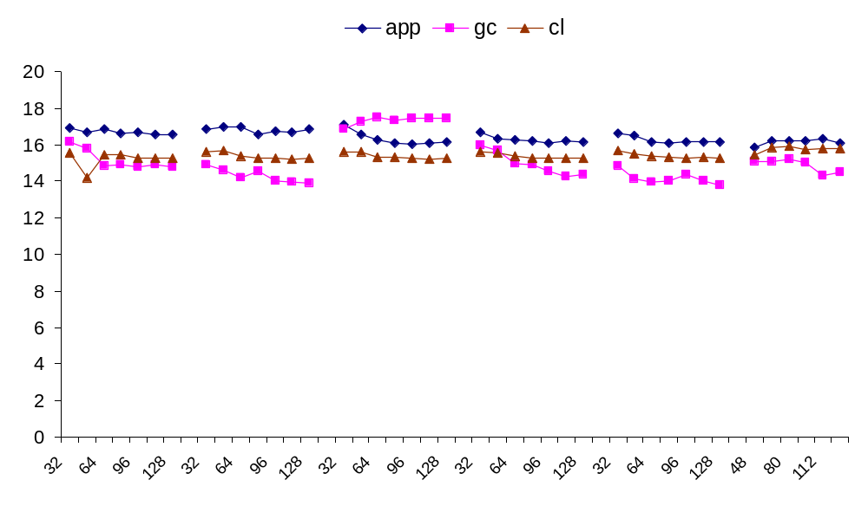
Jikes Peak Power on P6
Watts
Heap size (MB)
jess
db
javac
jack
fop
compress
Execution engine has the highest peak-power

Slide 16
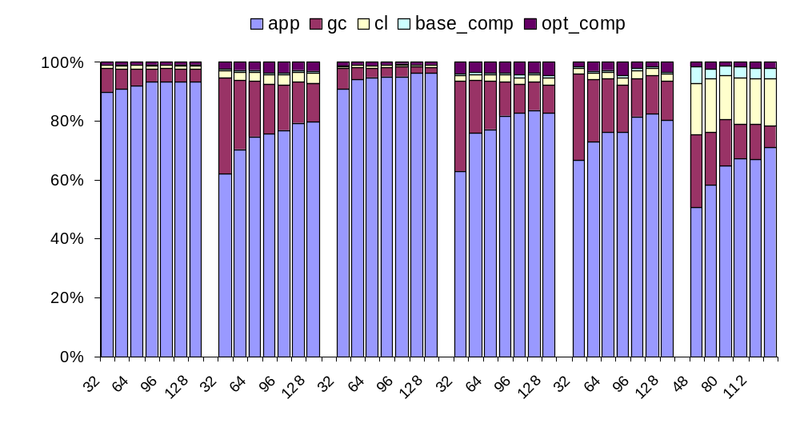
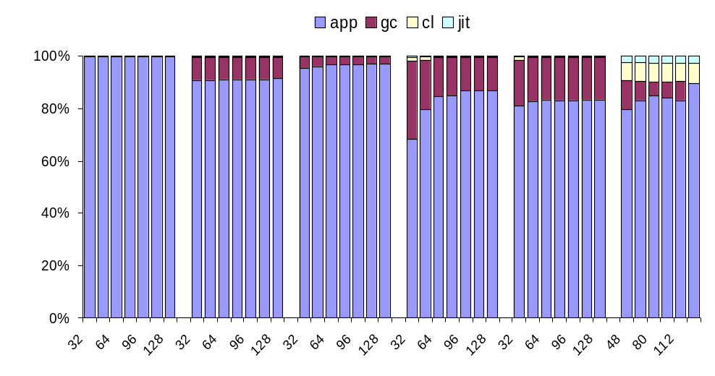
Jikes versus Kaffe: Energy Distribution on P6
Jikes
Kaffe
jess
db
javac
jack
fop
jess
db
javac
jack
fop
compress
compress
Kaffe: high application energy caused by long execution times
Kaffe: 8% of total average energy goes to virtual machine

Slide 17
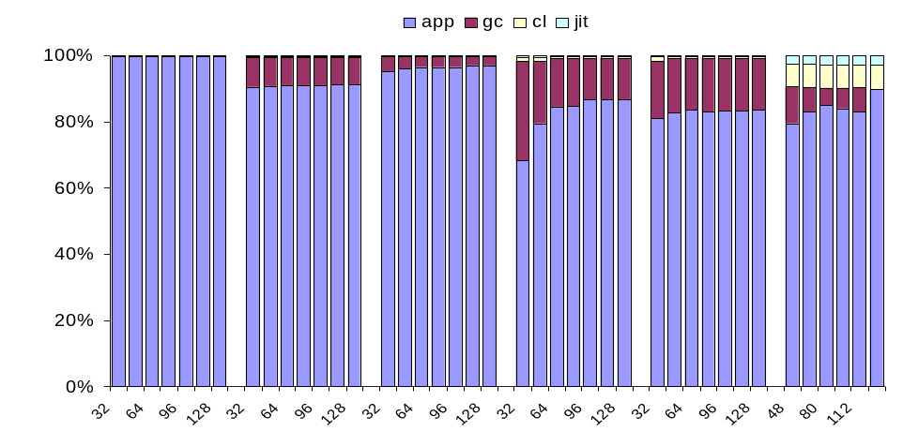
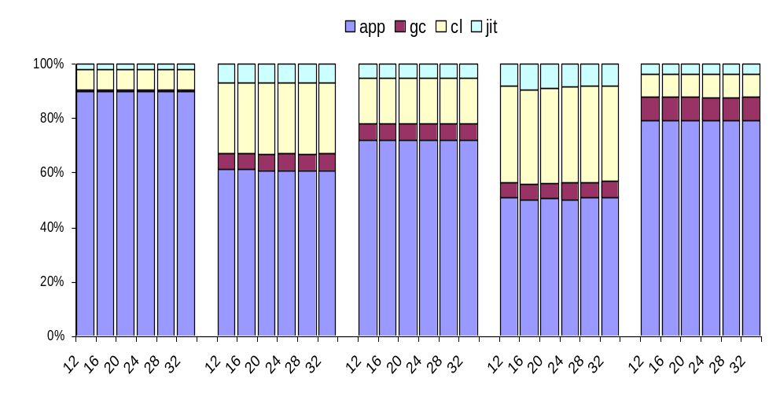
Kaffe Across Platforms
Pentium M
Intel XScale
jess
db
javac
jack
jess
db
javac
jack
compress
compress
XScale: no classes are included in the binary
XScale: GC only represents 6% of the total energy consumed

Slide 18
Conclusions
Methodology
  The complexity of the Java virtual machine calls for a more in-depth power/energy analysis
  Hardware-based characterization of the virtual machine’s sub-components allow long execution times and trustworthy measurements
Lessons learned
  In both platforms, JVM energy overhead is considerable
  Jikes: the GC is low power but high energy consumer (up to 37% on average)
  For Kaffe on XScale, the class loaded becomes high-energy consumer (18% for measured benchmarks)

Slide 19
Thank you!

