Slide 1
The Java Virtual Machine
Martin Schöberl

Slide 2
Overview
Review Java/JVM
JVM Bytecodes
Short bytecode examples
Class information
Parameter passing

Slide 3
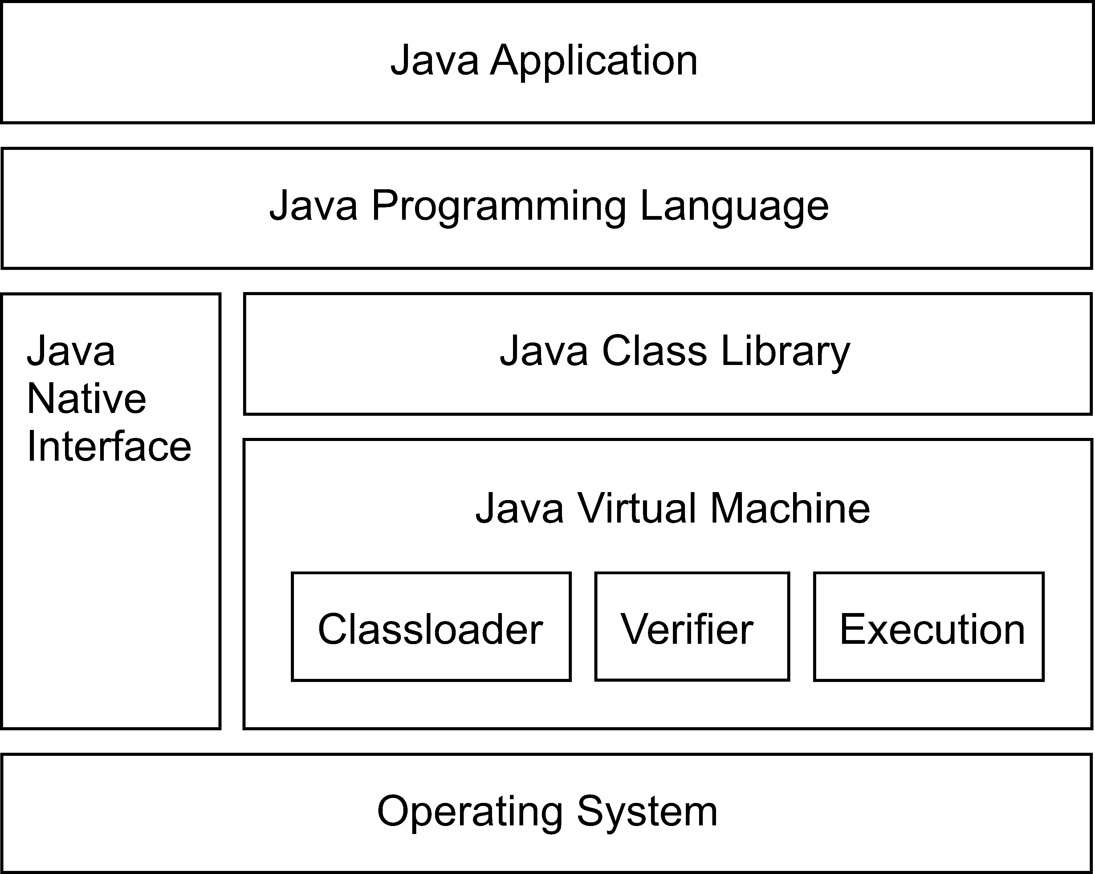
Java system overview

Slide 4
Java Technology
The Java programming language
The library (JDK)
The Java virtual machine (JVM)
  An instruction set and the meaning of those instructions – the bytecodes
  A binary format – the class file format
  An algorithm to verify the class file

Slide 5
JVM Data Types
reference | Pointer to an object or array
int | 32-bit integer (signed)
long | 64-bit integer (signed)
float | 32-bit floating-point (IEEE 754-1985)
double | 64-bit floating-point (IEEE 754-1985)
No boolean, char, byte, and short types
  Stack contains only 32-bit and 64-bit data
  Conversion instructions

Slide 6
JVM Instruction Set
The Bytecodes
Operations on the operand stack
Variable length
Simple, e.g. iadd
Complex, e.g. new
Symbolic references
201 different instructions

Slide 7
Instruction Types
Arithmetic
Load and store
Type conversion
Object creation and manipulation
Operand stack manipulation
Control transfer
Method invocation and return

Slide 8
Arithmetic Instructions
Operate on the values from the stack
Push the result back onto the stack
Instructions for int, long, float and double
No direct support for byte, short or char types
  Handled by int operations and type conversion

Slide 9
iadd
Operation Add int
Format iadd
Forms iadd = 96 (0x60)
Operand Stack ..., value1, value2 => ..., result
Both value1 and value2 must be of type int. The values are popped from the operand stack. The int result is value1 + value2. The result is pushed onto the operand stack.
The result is the 32 low-order bits of the true mathematical result in a sufficiently wide two's-complement format, represented as a value of type int. If overflow occurs, then the sign of the result may not be the same as the sign of the mathematical sum of the two values.
Despite the fact that overflow may occur, execution of an iadd instruction never throws a runtime exception.

Slide 10
fadd
Operation Add float
Format fadd
Forms fadd = 98 (0x62)
Operand Stack ..., value1, value2 => ..., result
Both value1 and value2 must be of type float. The values are popped from the operand stack and undergo value set conversion, resulting in value1' and value2'. The float result is value1' + value2'. The result is pushed onto the operand stack.
The result of an fadd instruction is governed by the rules of IEEE arithmetic.
The Java virtual machine requires support of gradual underflow as defined by IEEE 754. Despite the fact that overflow, underflow, or loss of precision may occur, execution of an fadd instruction never throws a runtime exception.

Slide 11
ladd
Operation Add long
Format ladd
Forms ladd = 97 (0x61)
Operand Stack ..., value1, value2 ..., result
Both value1 and value2 must be of type long. The values are popped from the operand stack. The long result is value1 + value2. The result is pushed onto the operand stack.
The result is the 64 low-order bits of the true mathematical result in a sufficiently wide two's-complement format, represented as a value of type long. If overflow occurs, the sign of the result may not be the same as the sign of the mathematical sum of the two values.
Despite the fact that overflow may occur, execution of an ladd instruction never throws a runtime exception.

Slide 12
Arithmetic Instructions
Add: iadd, ladd, fadd, dadd
Subtract: isub, lsub, fsub, dsub
Multiply: imul, lmul, fmul, dmul
Divide: idiv, ldiv, fdiv, ddiv
Remainder: irem, lrem, frem, drem
Negate: ineg, lneg, fneg, dneg
Shift: ishl, ishr, iushr, lshl, lshr, lushr
Bitwise OR: ior, lor
Bitwise AND: iand, land
Bitwise exclusive OR: ixor, lxor
Local variable increment: iinc
Comparison: dcmpg, dcmpl, fcmpg, fcmpl, lcmp

Slide 13
Load and Store Instructions
Load
  Push value from local variable onto stack
  Push a constant onto the stack
Store
  Transfer value from the stack to a local variable
Typed instructions
Short versions

Slide 14
iload
Operation Load int from local variable
Format iload
index
Forms iload = 21 (0x15)
Operand Stack ... => ..., value
The index is an unsigned byte that must be an index into the local variable array of the current frame. The local variable at index must contain an int. The value of the local variable at index is pushed onto the operand stack.
The iload opcode can be used in conjunction with the wide instruction to access a local variable using a two-byte unsigned index.

Slide 15
iload_<n>
Operation Load int from local variable
Format iload_<n>
Forms iload_0 = 26 (0x1a)
iload_1 = 27 (0x1b)
iload_2 = 28 (0x1c)
iload_3 = 29 (0x1d)
Operand Stack ... => ..., value
The <n> must be an index into the local variable array of the current frame. The local variable at <n> must contain an int. The value of the local variable at <n> is pushed onto the operand stack.
Each of the iload_<n> instructions is the same as iload with an index of <n>, except that the operand <n> is implicit.

Slide 16
istore
Operation Store int into local variable
Format istore
index
Forms istore = 54 (0x36)
Operand Stack ..., value => ...
The index is an unsigned byte that must be an index into the local variable array of the current frame. The value on the top of the operand stack must be of type int. It is popped from the operand stack, and the value of the local variable at index is set to value.
The istore opcode can be used in conjunction with the wide instruction to access a local variable using a two-byte unsigned index.

Slide 17
bipush
Operation Push byte
Format bipush
byte
Forms bipush = 16 (0x10)
Operand Stack ... => ..., value
The immediate byte is sign-extended to an int value. That value is pushed onto the operand stack.

Slide 18
sipush
Operation Push short
Format sipush
byte1
byte2
Forms sipush = 17 (0x11)
Operand Stack ... => ..., value
The immediate unsigned byte1 and byte2 values are assembled into an intermediate short where the value of the short is (byte1 << 8) | byte2. The intermediate value is then sign-extended to an int value. That value is pushed onto the operand stack.

Slide 19
iconst_<i>
Operation Push int constant
Format iconst_<i>
Forms iconst_m1 = 2 (0x2)
iconst_0 = 3 (0x3)
iconst_1 = 4 (0x4)
…
iconst_5 = 8 (0x8)
Operand Stack ... => ..., <i>
Push the int constant <i> (-1, 0, 1, 2, 3, 4 or 5) onto the operand stack.
Each of this family of instructions is equivalent to bipush <i> for the respective value of <i>, except that the operand <i> is implicit.

Slide 20
ldc
Operation Push item from runtime constant pool
Format ldc
index
Forms ldc = 18 (0x12)
Operand Stack ... => ..., value
The index is an unsigned byte that must be a valid index into the runtime constant pool of the current class. The runtime constant pool entry at index either must be a runtime constant of type int or float, or must be a symbolic reference to a string literal.
If the runtime constant pool entry is a runtime constant of type int or float, the numeric value of that runtime constant is pushed onto the operand stack as an int or float, respectively.
Otherwise, the runtime constant pool entry must be a reference to an instance of class String representing a string literal. A reference to that instance, value, is pushed onto the operand stack.

Slide 21
Load and Store Instructions
Load a local variable
  iload, iload_<n>, lload, lload_<n>, fload, fload_<n>, dload, dload_<n>, aload, aload_<n>
Store a local variable
  istore, istore_<n>, lstore, lstore_<n>, fstore, fstore_<n>, dstore, dstore_<n>, astore, astore_<n>
Load a constant
  bipush, sipush, ldc, ldc_w, ldc2_w, aconst_null, iconst_m1, iconst_<i>, lconst_<l>, fconst_<f>, dconst_<d>
Wider index, or larger immediate operand
  wide

Slide 22
Load/Add/Store Example
int a, b, c;
a = 1;
b = 123;
c = a+b;
0: iconst_1
1: istore_0 // a
2: bipush 123
4: istore_1 // b
5: iload_0 // a
6: iload_1 // b
7: iadd
8: istore_2 // c

Slide 23
Type Conversion
Widening numeric conversions
  int to long, float, or double
  long to float or double
  float to double
  i2l, i2f, i2d, l2f, l2d, and f2d
Narrowing numeric conversions
  int to byte, short, or char
  long to int
  float to int or long
  double to int, long, or float
  i2b, i2c, i2s, l2i, f2i, f2l, d2i, d2l, and d2f

Slide 24
Conversion Example
short s;
s = 1;
++s;
0: iconst_1
1: istore_0
2: iload_0
3: iconst_1
4: iadd
5: i2s // truncate
6: istore_0

Slide 25
Object Instructions
Create a new class instance or array
  new, newarray, anewarray, multianewarray
Field access
  getfield, putfield, getstatic, putstatic
Array load, store
  baload, caload, saload, iaload, laload, faload, daload, aaload
  bastore, castore, sastore, iastore, lastore, fastore, dastore, aastore
Length of an array
  arraylength
Check properties
  instanceof, checkcast

Slide 26
Object Creation
Object create() {
return new Object();
}
0: new #2; //class Object
3: dup
4: invokespecial #1; //Method java/lang/Object."<init>":()V
7: areturn

Slide 27
getfield
Operation Fetch field from object
Format getfield
indexbyte1
indexbyte2
Forms getfield = 180 (0xb4)
Operand Stack ..., objectref => ..., value
The objectref, which must be of type reference, is popped from the operand stack. The unsigned indexbyte1 and indexbyte2 are used to construct an index into the runtime constant pool of the current class, where the value of the index is (indexbyte1 << 8) | indexbyte2. The runtime constant pool item at that index must be a symbolic reference to a field, which gives the name and descriptor of the field as well as a symbolic reference to the class in which the field is to be found. The referenced field is resolved. The value of the referenced field in objectref is fetched and pushed onto the operand stack.

Slide 28
putfield
Operation Set field in object
Format putfield
indexbyte1
indexbyte2
Forms putfield = 181 (0xb5)
Operand Stack ..., objectref, value => ...
The unsigned indexbyte1 and indexbyte2 are used to construct an index into the runtime constant pool of the current class…
The value and objectref are popped from the operand stack. The objectref must be of type reference. The referenced field in objectref is set to value.

Slide 29
Field Access
static int statVal;
private int privVal;
void foo() {
int i = statVal + privVal;
statVal = i;
privVal = i;
}
0: getstatic #3; //Field statVal:I
3: aload_0
4: getfield #4; //Field privVal:I
7: iadd
8: istore_1
9: iload_1
10: putstatic #3; //Field statVal:I
13: aload_0
14: iload_1
15: putfield #4; //Field privVal:I
18: return

Slide 30
Operand Stack Manipulation
Direct manipulation of the operand stack
  pop, pop2
  dup, dup2, dup_x1, dup2_x1, dup_x2, dup2_x2
  swap

Slide 31
swap
Operation Swap the top two operand stack values
Format swap
Forms swap = 95 (0x5f)
Operand Stack ..., value2, value1 => ..., value1, value2
Swap the top two values on the operand stack.

Slide 32
Control Transfer
Conditional branch
  ifeq, iflt, ifle, ifne, ifgt, ifge, ifnull, ifnonnull, if_icmpeq, if_icmpne, if_icmplt, if_icmpgt, if_icmple, if_icmpge, if_acmpeq, if_acmpne.
Switch
  tableswitch, lookupswitch.
Unconditional branch
  goto, goto_w, jsr, jsr_w, ret.

Slide 33
if<cond>
Operation Branch if int comparison with zero succeeds
Format if<cond>
branchbyte1
branchbyte2
Forms ifeq = 153 (0x99)
…
ifle = 158 (0x9e)
Operand Stack ..., value => ...
The value is popped from the operand stack and compared against zero. All comparisons are signed:
eq succeeds if and only if value = 0
…
le succeeds if and only if value ≤ 0
If the comparison succeeds, branchbyte1 and branchbyte2 are used to construct a signed 16-bit offset. Execution then proceeds at that offset from the address of the opcode of this if<cond> instruction. Otherwise, execution proceeds at the address of the instruction following this if<cond> instruction.

Slide 34
Method Invocation, Return
invokevirtual
  Invokes an instance method of an object, dispatching on the (virtual) type of the object.
  This is the normal method dispatch in the Java programming language
invokeinterface
  Invokes a method that is implemented by an interface
invokespecial
  Invokes an instance method requiring special handling
  Instance initialization method, a private method, or a superclass method
invokestatic
  Invokes a class (static) method

Slide 35
invokevirtual
Operation Invoke instance method; dispatch based on class
Format invokevirtual
indexbyte1
indexbyte2
Forms invokevirtual = 182 (0xb6)
Operand Stack ..., objectref, [arg1, [arg2 ...]] => ...
The unsigned indexbyte1 and indexbyte2 are used to construct an index into the runtime constant pool…
The objectref must be followed on the operand stack by nargs argument values, where the number, type, and order of the values must be consistent with the descriptor of the selected instance method.
If the method is synchronized, the monitor associated with objectref is acquired or reentered.

Slide 36
Class Information
Instance size
Static (class) variables
Virtual method table
Interface table
Constant pool
Reference to super class

Slide 37
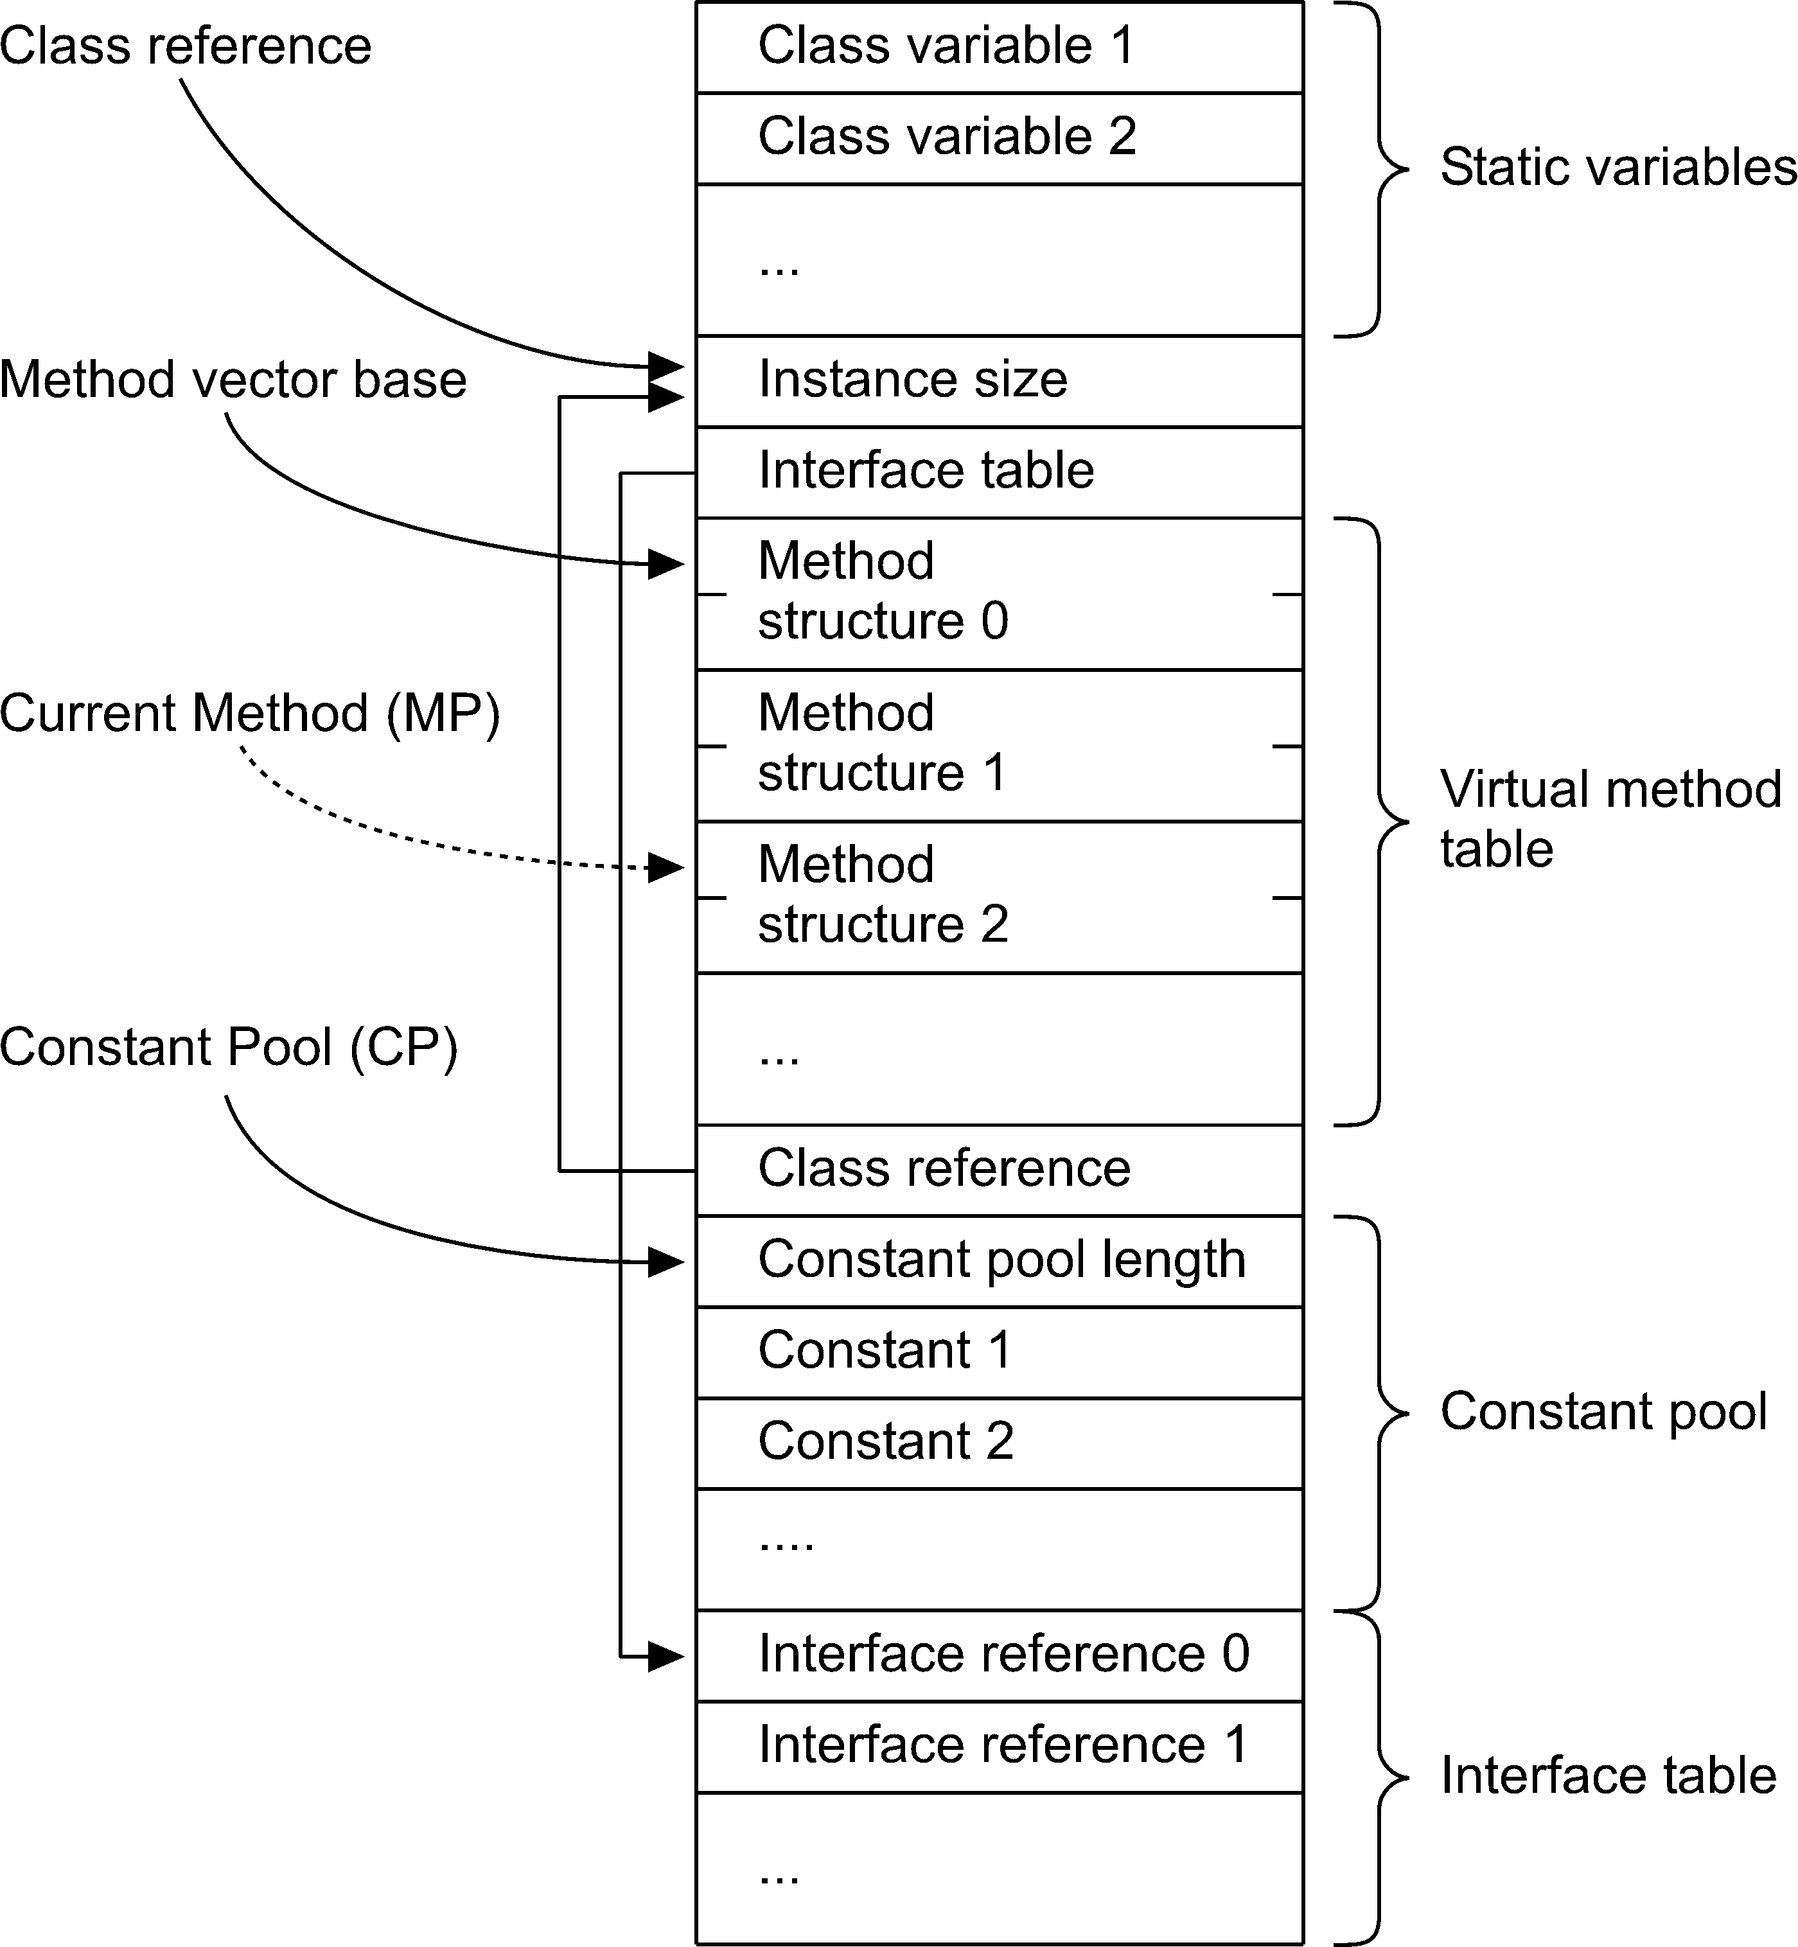

Slide 38
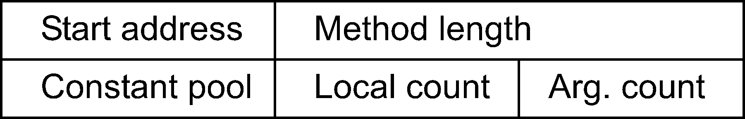
Method Structure
Information about a method
  Address
  Length (for the cache)
  Pointer to the constant pool of the class
  Number of arguments and local variables

Slide 39
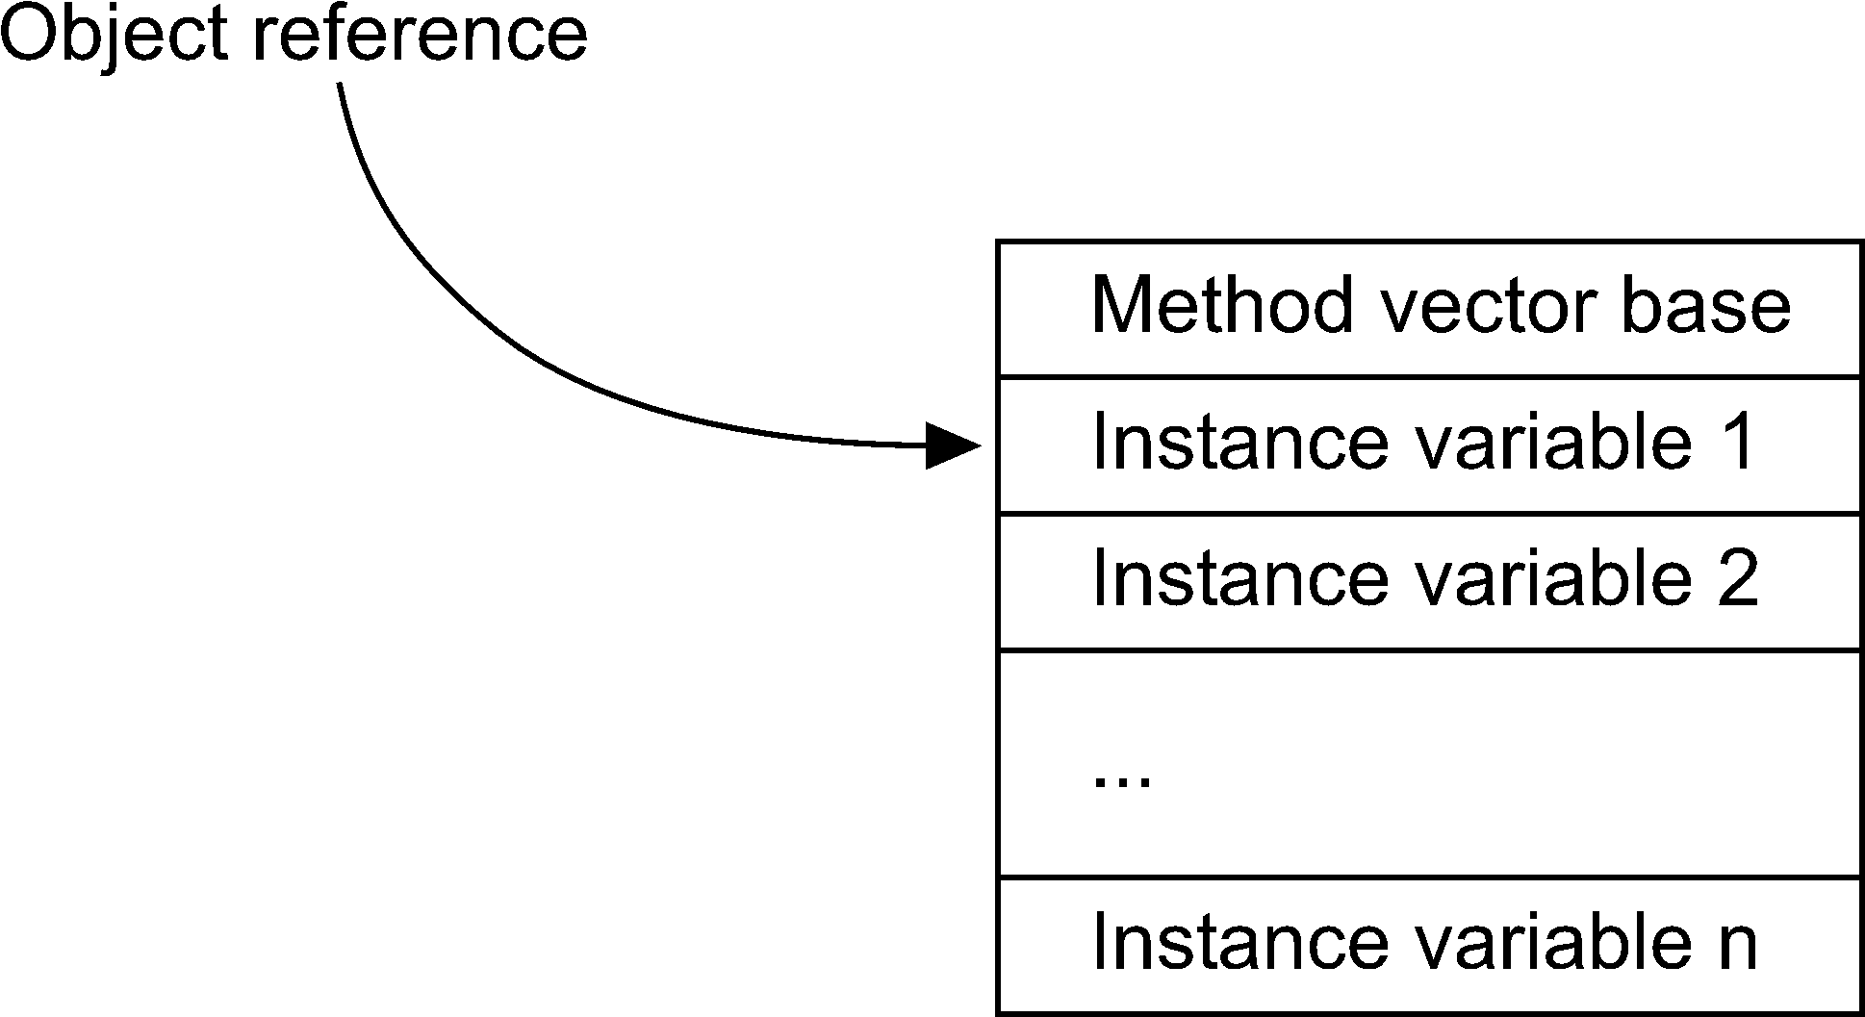
Object Format
Direct pointer
Handle possible
Return pointer to the class information

Slide 40
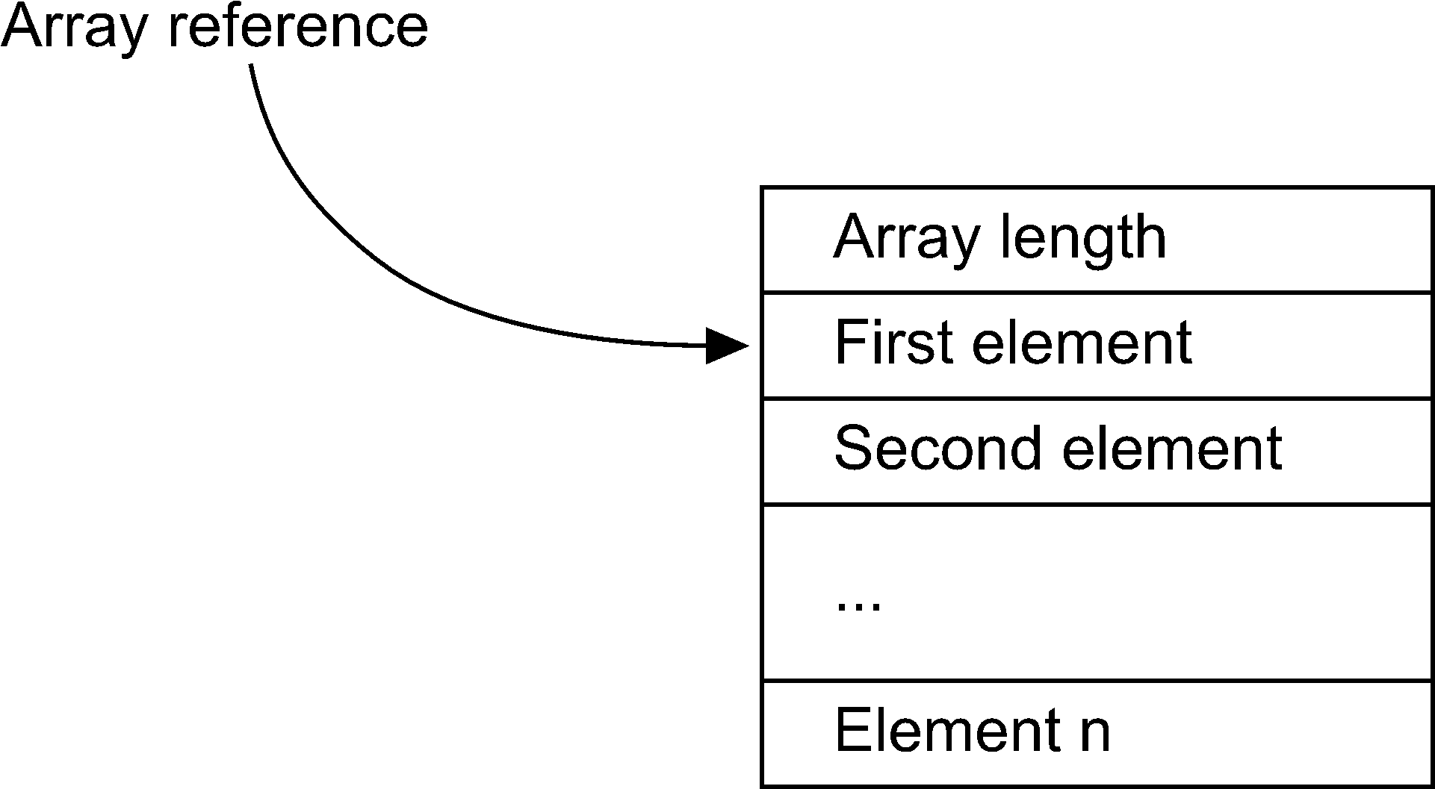
Array Format
Direct pointer
Handle possible
Length is needed

Slide 41
Constant Pool
Contains:
  Simple constants (e.g. 123, 0.345)
  String constants
  Class references
  Field references
  Method references
All references are symbolic in the class file
References can and should be converted to direct pointers

Slide 42
Runtime Data Structures
PC – program counter
Operand stack
  SP – stack pointer
  VP – variable pointer
MP – method pointer
  Reference to the method structure
CP – constant pool
  Current constant pool

Slide 43
Parameter passing
int val = foo(1, 2);
...
public int foo(int a, int b) {
int c = 1;
return a+b+c;
}
The invocation sequence:
aload_0 // Push the object reference
iconst_1 // and the parameter onto the
iconst_2 // operand stack.
invokevirtual #2 // Invoke method foo:(II)I.
istore_1 // Store the result in val.
public int foo(int,int):
iconst_1 // The constant is stored in a method
istore_3 // local variable (at position 3).
iload_1 // Arguments are accessed as locals
iload_2 // and pushed onto the operand stack.
iadd // Operation on the operand stack.
iload_3 // Push c onto the operand stack.
iadd
ireturn // Return value is on top of stack.

Slide 44
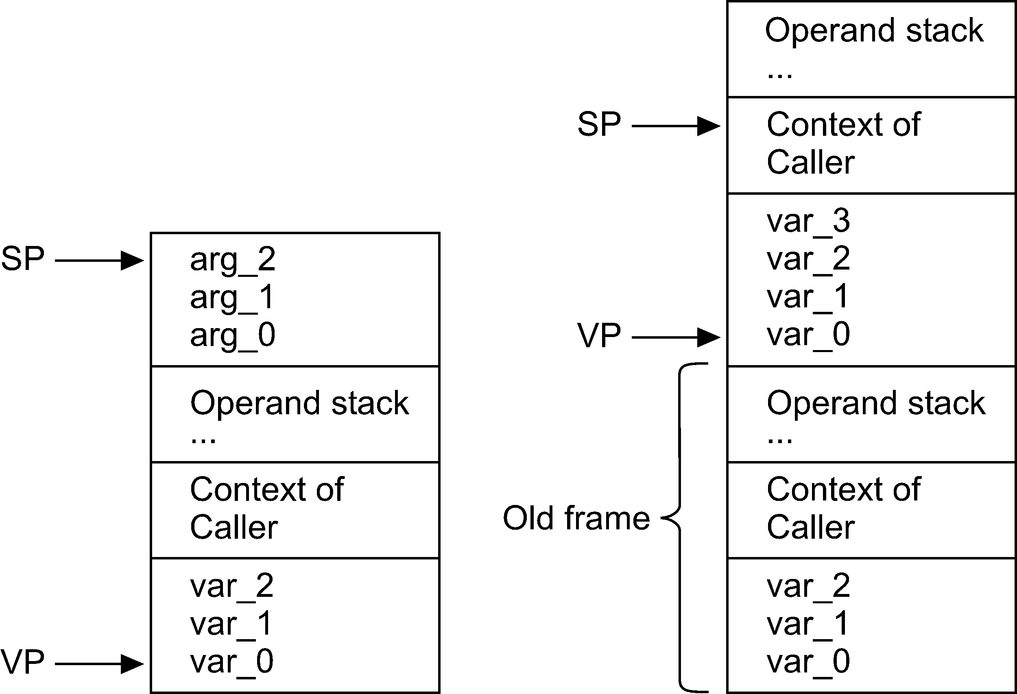
Stack on Method Invocation

Slide 45
Summary
The JVM defines an instruction set – Bytecodes
Simple, typed stack instructions
Complex, such as object creation
Implementation details are not defined
Method invocation suggests a common stack

Slide 46
More Information
JOP Thesis: p 7-16, p 55-64, p 78-82
Virtual Machine Design, Antero Taivalsaari, seminar notes
Tim Lindholm and Frank Yellin. The Java Virtual Machine Specification. Addison-Wesley, 1999, JVMSpec.

