Slide 1
Anyone on this list see me after class!
???
Please send me your e-mail address!
More paper assignments will be posted soon!

Slide 2
CS533 Concepts of Operating Systems
Class 2
Threads and Concurrency

Slide 3
What is a thread?
A thread executes a stream of instructions
  an abstraction for control-flow
Practically, it is a processor context and stack
  Allocated a CPU by a scheduler
  Executes in the context of a memory address space

Slide 4
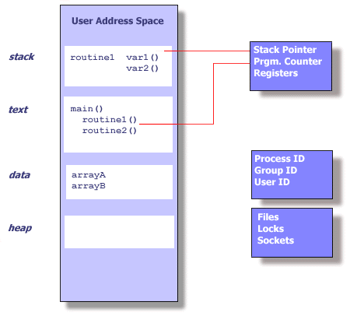
Single thread state within a process

Slide 5
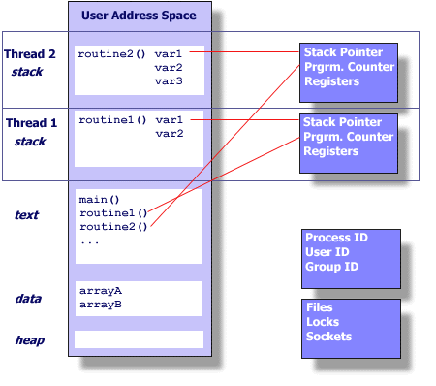
Multiple threads in an address space

Slide 6
Summary of private per-thread state
Stack (local variables)
Stack pointer
Registers
Scheduling properties (i.e., priority)
Set of pending and blocked signals
Other thread specific data

Slide 7
Shared state among threads
Open files, sockets, locks
User ID, group ID, process/task ID
Address space
  Text
  Data (off-stack global variables)
  Heap (dynamic data)
Changes made to shared state by one thread will be visible to the others
  Reading and writing memory locations requires synchronization!

Slide 8
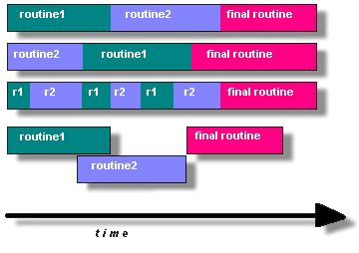
How do you program using threads?
Split program into routines to execute in parallel
  True or pseudo (interleaved) parallelism

Slide 9
Why program using threads?
Utilize multiple CPU’s concurrently
Low cost communication via shared memory
Overlap computation and blocking on a single CPU
  Blocking due to I/O
  Computation and communication
Handle asynchronous events

Slide 10
Common thread programming models
Manager/worker
  Manager thread handles I/O and assigns work to worker threads
  Worker threads may be created dynamically, or allocated from a thread-pool
Peer
  Like manager worker, but manager participates in the work
Pipeline
  Each thread handles a different stage of an assembly line
  Threads hand work off to each other in a producer-consumer relationship

Slide 11
What does a typical thread API look like?
POSIX standard threads (Pthreads)
First thread exists in main(), typically creates the others
pthread_create (thread,attr,start_routine,arg)
  Returns new thread ID in “thread”
  Executes routine specified by “start_routine” with argument specified by “arg”
  Exits on return from routine or when told explicitly

Slide 12
Thread API (continued)
pthread_exit (status)
  Terminates the thread and returns “status” to any joining thread
pthread_join (threadid,status)
  Blocks the calling thread until thread specified by “threadid” terminates
  Return status from pthread_exit is passed in “status”
  One way of synchronizing between threads
pthread_yield ()
  Thread gives up the CPU and enters the run queue

Slide 13
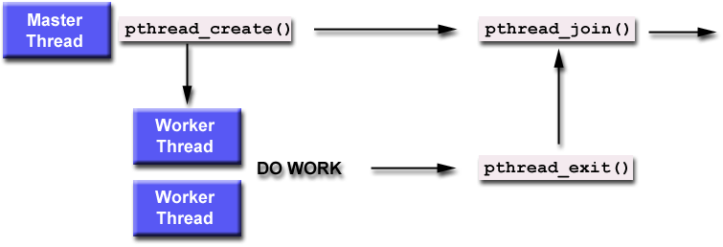
Using create, join and exit primitives

Slide 14
An example Pthreads program
#include <pthread.h>
#include <stdio.h>
#define NUM_THREADS 5
void *PrintHello(void *threadid)
{
printf("\n%d: Hello World!\n", threadid);
pthread_exit(NULL);
}
int main (int argc, char *argv[])
{
pthread_t threads[NUM_THREADS];
int rc, t;
for(t=0; t<NUM_THREADS; t++
{
printf("Creating thread %d\n", t);
rc = pthread_create(&threads[t], NULL, PrintHello, (void *)t);
if (rc)
{
printf("ERROR; return code from pthread_create() is %d\n", rc);
exit(-1);
}
}
pthread_exit(NULL);
}
Program Output
Creating thread 0
Creating thread 1
0: Hello World!
1: Hello World!
Creating thread 2
Creating thread 3
2: Hello World!
3: Hello World!
Creating thread 4
4: Hello World!
For more examples see: http://www.llnl.gov/computing/tutorials/pthreads

Slide 15
Race conditions
What is a race condition?
  Two or more threads have an inconsistent view of a memory location (i.e., a global variable)
Why do race conditions occur?
  Values of memory locations are replicated in registers during execution
  Each thread has its own private register state
  Threads can see stale memory values in registers
How can we avoid race conditions?
  By synchronizing access to shared memory locations

Slide 16
Synchronization by mutual exclusion
Divide thread code into critical sections
  Sections where shared data is accessed (read/written)
Only allow one thread at a time in a critical section by manipulating a lock or “mutex”
Only works if you follow the programming convention!
Thread 1 Thread 2 Thread 3
Lock Lock
A = 2 A = A+1 A = A*B
Unlock Unlock

Slide 17
What does “thread-safe” mean?
A piece of code (library) is “thread-safe” if it defines critical sections and uses synchronization to control access to them
All entry points must be re-entrant
Results not returned in shared global variables nor global statically allocated storage
All calls should be synchronous

Slide 18
Using Pthread mutex variables
Pthread_mutex_lock (mutex)
  Acquire the lock or block until it is acquired
Pthread_mutex_trylock (mutex)
  Acquire the lock or return with “busy” error code
Pthread_mutex_unlock (mutex)
  Free the lock

Slide 19
Condition variables
Mutex locks allow threads to synchronize before accessing the data
Condition variables allow synchronization based on the value of the data
  Used in conjunction with a mutex lock
  Allows a thread in a critical section to wait for a condition to become true or signal that a condition is true
  Acquire mutex lock (enter critical section)
  …
  Block until condition becomes true (frees mutex lock)
  …
  Free mutex lock (leave critical section)

Slide 20
Pthread condition variables
pthread_cond_wait (condition,mutex)
  Releases “mutex” and blocks until “condition” is signaled
pthread_cond_signal (condition)
  Signals “condition” which wakes up a thread blocked on “condition”
pthread_cond_broadcast (condition)
  Signals “condition” and wakes up all threads blocked on “condition”

Slide 21
Invariant of a mutex
The mutex “invariant” is the condition that must be restored before:
  mutex is released
  Wait is called
Example
  Invariant A=B
  Critical section updates A and B

Slide 22
Semantics of condition variables
How many blocked threads should be woken on a signal?
Which blocked thread should be woken on a signal?
In what order should newly awoken threads acquire the mutex?
Should the signaler immediately free the mutex?
  If so, what if it has more work to do?
  If not, how can the signaled process continue?
What if signal is called before wait?

Slide 23
Subtle race conditions
Why does wait on a condition variable need to “atomically” unlock the mutex and block the thread?
Why does the thread need to re-lock the mutex when it wakes up from wait?

Slide 24
Deadlock
  Thread A locks mutex 1
  Thread B locks mutex 2
  Thread A blocks trying to lock mutex 2
  Thread B blocks trying to lock mutex 1
Can also occur with condition variables
  Nested monitor problem (p. 20)

Slide 25
Deadlock (nested monitor problem)
  Procedure Get();
  BEGIN
  LOCK a DO
  LOCK b DO
  WHILE NOT ready DO wait(b,c) END;
  END;
  END;
  END Get;
  Procedure Give();
  BEGIN
  LOCK a DO
  LOCK b DO
  ready := TRUE; signal(c);
  END;
  END;
  END Give;

Slide 26
Deadlock in layered systems
  High layer: Lock M; Call lower layer; Release M;
  Low layer: Lock M; Do work; Release M; return;
Result – thread deadlocks with itself!
Layer boundaries are supposed to be opaque

Slide 27
Deadlock
Why is it better to have a deadlock than a race?
Deadlock can be prevented by imposing a global order on resources managed by mutexes and condition variables
  i.e., all threads acquire mutexes in the same order
  Mutex ordering can be based on layering
  Upcalls break this defense

Slide 28
Priority inversion
Occurs in priority scheduling
Starvation of high priority threads
  Low priority thread C locks M
  Medium priority thread B pre-empts C
  High priority thread A preempts B then blocks on M
  B resumes and enters long computation
Result:
  C never runs so can’t unlock M, therefore A never runs
Solution? – priority inheritance

Slide 29
Dangers of blocking in a critical section
Blocking while holding M prevents progress of other threads that need M
Blocking on another mutex may lead to deadlock
Why not release the mutex before blocking?
  Must restore the mutex invariant
  Must reacquire the mutex on return!
  Things may have changed while you were gone …
Blocking on a condition variable may lead to deadlock
  WHILE NOT expression DO wait(mutex,cv) END;

Slide 30
Dangers of blocking in a critical section
Blocking on a condition variable may lead to deadlock!
Useful pattern:
  WHILE NOT expression DO wait(mutex,cv) END;
Why is this safe for broadcast?

Slide 31
Reader/Writer Locking
Writers exclude readers and writers
Readers exclude writers but not readers
Example, page 15
  Good use of broadcast in ReleaseExclusive()
  Results in “spurious wake-ups”
  … and “spurious lock conflicts”
  How could you use signal instead?
Move signal/broadcast call after release of mutex?
  Advantages? Disadvantages?
Can we avoid writer starvation?

Slide 32
Useful programming conventions
All access to shared data must be potected by a mutex
  All shared variables have a lock
  The lock is held by the thread that accesses the variable
How can this be checked?
  Statically?
  Dynamically?

Slide 33
Automated checking of conventions
Eraser
  A dynamic checker that uses binary re-writing techniques
  Gathers an “execution history” of reads, writes and lock acquisitions
  Evaluates consistency with rules
Eraser infers which locks protect which variables using a lock-set algorithm
  Assume all locks are candidates for a variable ( C(v) is full)
  For each access take intersection of C(v) and locks held by thread and make these the candidate set C(v)
  If C(v) becomes empty, issue warning

Slide 34
Improving the locking discipline
Initialization
  No need to lock if no thread has a reference yet
Read sharing
  No need to lock if all threads are readers
Reader/writer locking
  Distinguish concurrent readers from concurrent readers and writers

Slide 35
Improved algorithm
virgin
rd, wr
First
thread
wr, new thread
exclusive
shared
Modified
(race?)
rd
wr
rd,
new
thread
wr
shared

Slide 36
Questions
Why are threads “lightweight”?
Why associate thread lifetime with a procedure?
Why block instead of spin waiting for a mutex?
If a mutex is a resource scheduling mechanism
  What is the resource being scheduled?
  What is the scheduling policy and where is it defined?
Why do “alerts” result in complicated programs?
What is coarse-grain locking?
  What effect does it have on program complexity?
  What effect does it have on performance?

Slide 37
Questions
What is “lock contention”?
  Why is it worse on multiprocessors than uniprocessors?
  What is the solution? … and its cost?
What else might cause performance to degrade when you use multiple threads?

Slide 38
Why is multi-threaded programming hard?
Many possible interleavings at the instruction level that make it hard to reason about correctness

