Slide 1
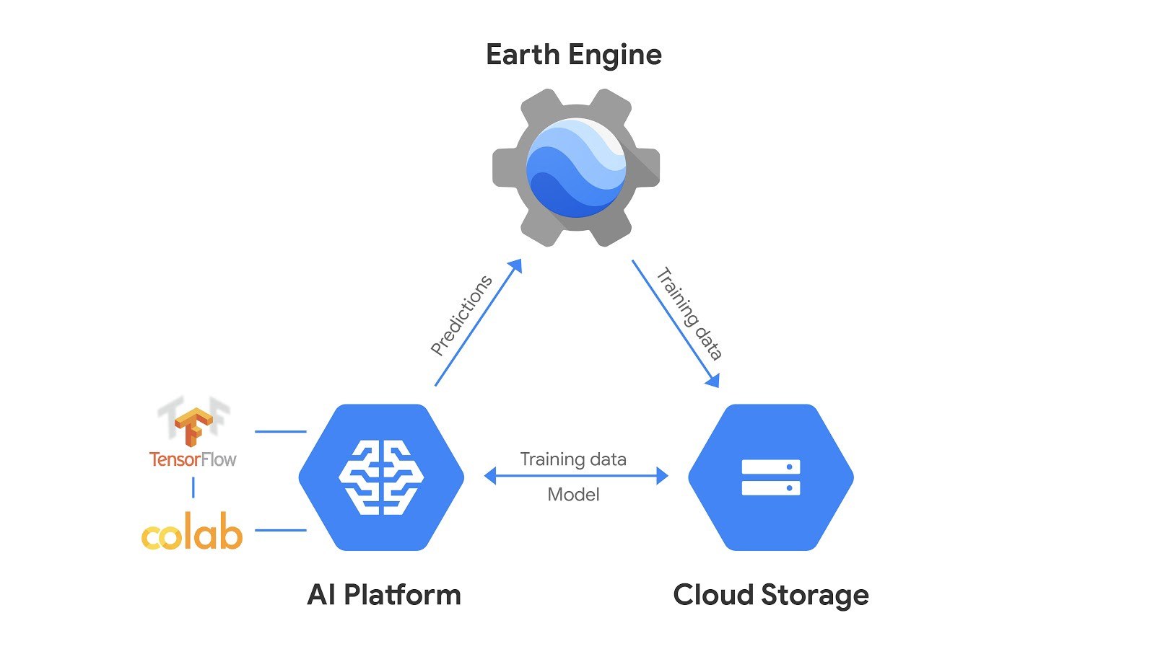





External Databases

Slide 2
