Slide 1
The New Cutoff Time Solution for Payment Module

Slide 2
Background
Cutoff Times and Value Dates management represents one of the most important functionality within the ASM payment module. Cutoff times are important to guarantee the execution of an order according to the specification provided by the sender correspondent while the correct proposal of value dates ensure proper coverage from the treasury perspective.
Currently, cutoff times and value dates are stored in different tables and parameters and this may led to inconsistencies between the proposed value dates and cutoff times and the ones validated upon order processing. Moreover, there is not the possibility to visualize and check the cutoff time and value dates setup directly in Avaloq and on the fly changes or amendmends are not possible as a software deploy is required.

Slide 3
ASSL Vision for the value dates and cutoff management
ASSL is developing a new centralized cutoff solution that:
Is standardized with a pre-defined set of business functionalities and related options. The standardization and centralization will help guarantee consistency and reduce the number of bugs related to these functionalities.
Provides a centralized management system with on the fly edit possibilities subject to 4-eyes principle.
Enhance the old solution including many more options and flexibility.

Slide 4
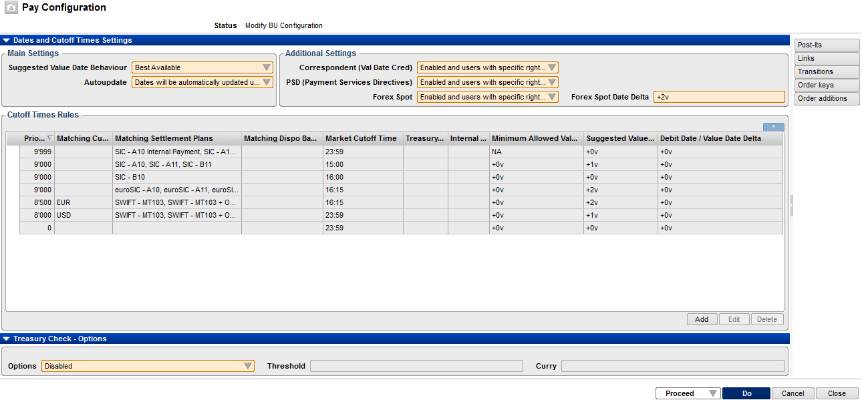
Pay Configuration order

Slide 5
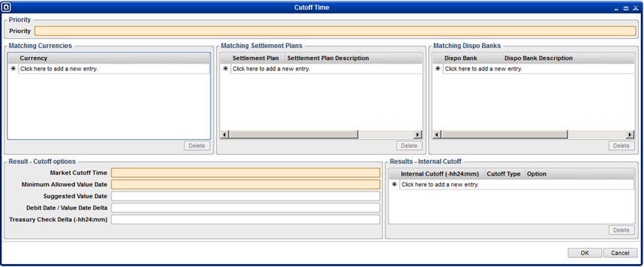
Cutoff Time Record

Slide 6
Cutoff Time Record Values
Priority: According to which the record will be evaluated for determining eventual matching
Matching Criteria:
Currency is in the currency list or currency list is empty AND
Settlement plan is in the Settlement Plan list or settlement plan list is empty AND
Dispo Bank is in the Dispo Bank list or disp bank list is empty
Matching Results:
Market Cutoff Time: after the cutoff time an additional value day is enforced for the suggested and enforced value dates
Min Market Value Date Delta: The minimum number of days in the future that the value date should be for order inserted before the cutoff time (order validation)
Suggested Value Date Delta: The number of days in the future that the value date proposed by the system should have for orders inserted before the cutoff time
Val Date Deb-Cred delta: The suggested difference between the value date debit and credit.
Treasury Check Delta: The number of hours before the cutoff time during which orders should go into treasury check.

Slide 7
Cutoff Time Record Values
Internal Cutoff Times:
Several Internal cutoff times can be specified depending on the user access rights. By default Front Office, Middle Office and Back Office options are present in the system. These times are specified as delta with respect to the market cutoff time.
Internal cutoff time options
Mandatory: After the internal cutoff time the system will ensure that one additional value day is added to the originally proposed value date (i.e. works as the marked cutoff time is anticipated for a given set of user)
Warning: After the internal cutoff time a warning is displayed alerting the user that by company policy the suggested value date for a newly inseted order have been changed and which is the minimum valid value date. The user has to acknowledge the message for proceeding without changing the value dates.

Slide 8
Business Options
Suggested Value Date (SVD)
Best available SVD=max(order date + suggested delta, today + min delta, trade date + min delta)
Add always suggested SVD=max(order date + suggested delta, today + suggested delta, trade date + suggested delta)
Best available for delayed orders SVD=max(order date + suggested delta, today + min delta, trade date + suggested delta)
Auto Update
On The system will automatically recompute the value date upon proceeding. If the order is in a frozen status the system displays a warning message with the dates that will be applied.
Off The system will not automatically recompute the value date upon proceeding. If the order is in a frozen status you need to reject the order and amend the value date to proceed.

Slide 9
Business Options
OV for correspondent
On The minimum value date delta for the specific matching record must be respected for proceeding the order.
On but overridable The minimum value date delta for the specific matching record must be respected for proceeding the order. However, users with specific access rights will have the possibility to insert an order exception (new tab on payment module) to proceed an order not respecting the minimum value date delta.
Off The minimum value date delta is not enforced by the system.

Slide 10
Business Options
PSD
On The PSD will be taken into account for payments towards EU countries in EUR or applicable currencies. The PSD maximum execution time will take precedence when the system proposes the value date to execute the order. If the PSD cannot be respected the validation prevent the order to be completed. The client must be contacted and order re-inserted.
On but overridable The PSD will be taken into account for payments towards EU countries in EUR or applicable currencies. The PSD maximum execution time will take precedence when the system proposes the value date to execute the order. If the PSD cannot be respected users with specific access rights will have the possibility to insert an order exception (new tab on payment module) to proceed an order.
Off The PSD will not be taken into account and no other PSD related validation are executed

Slide 11
Business Options
Forex Spot & Forex Spot Delta
On If the transaction is in a currency that differs from the debit account a minimum of Forex Spot Delta value days is enforced on the value date deb and value date cred. Respecting this minimum number of days is mandatory.
On but overridable If the transaction is in a currency that differs from the debit account a minimum of Forex Spot Delta value days is enforced on the value date deb and value date cred. Users with specific access rights will have the possibility to insert an order exception (new tab on payment module) to proceed an order not respecting the forex spot delta.
Off If the transaction is in a currency that differs from the debit account the standard rules will be applied and no specific validation is raised.

Slide 12
Treasury Check Section: business options
Treasury Check
Enabled Orders will always stop in treasury check during the workflow.
Above a given threshold Orders will always stop in treasury check during the workflow if above a given threshold.
Above a given threshold if cutoff time delta has passed Orders will always stop in treasury check during the workflow if above a given threshold and sufficiently close to the cutoff time.
Above a given threshold if cutoff time delta has passed Orders will never stop in treasury check

Slide 13
Conclusions
The solution provides a standardized, expanded set of business functionalities and related options that offer a greater level of customization.
The system behavior can be changed on the fly via a new, dedicated, order subject to 4-eyes principle.
The centralization of the rules enhance the visibility of the current set-up and virtually eliminates the risk of inconsistencies.

