Slide 1
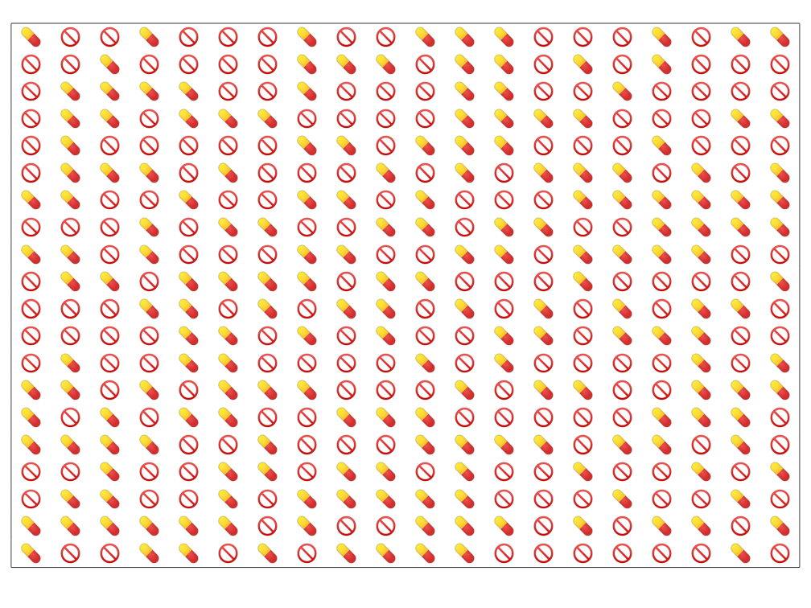
A donation finances
20
vitamin A doses
200

