Slide 1


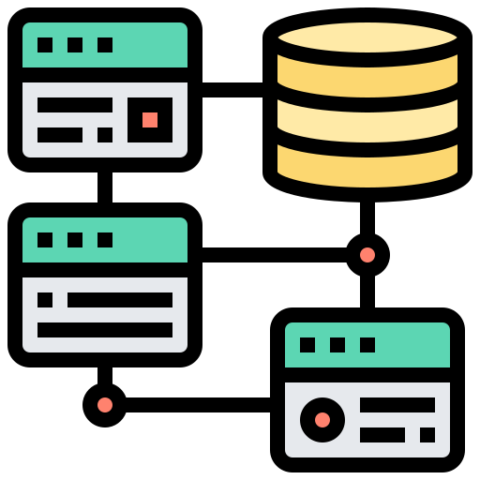





EXTRACT
TRANSFORM
LOAD
Pandas Pymongo Configparser
Pandas Psycopg2 (DB and table creation) SQLAlchemy
PokeAPI
Requests Json Pymongo
Data Modeling
DB creation Table creation Raw load
ORCHESTATION
DEPLOY

