Slide 1


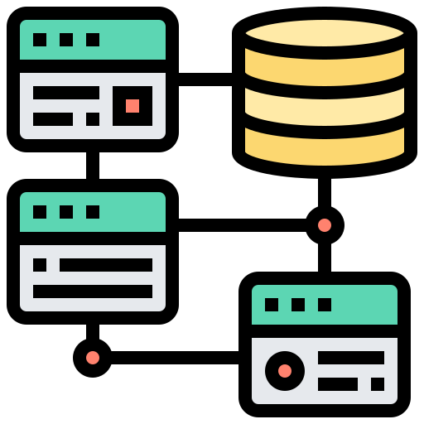


EXTRACT
TRANSFORM
LOAD
Pandas Pymongo Configparser
Psycopg2 SQLAlchemy
Public Web
Selenium Pandas
Data Modeling
Raw Data
Cleansed Data
Upsert Controls
New Data

