Slide 1









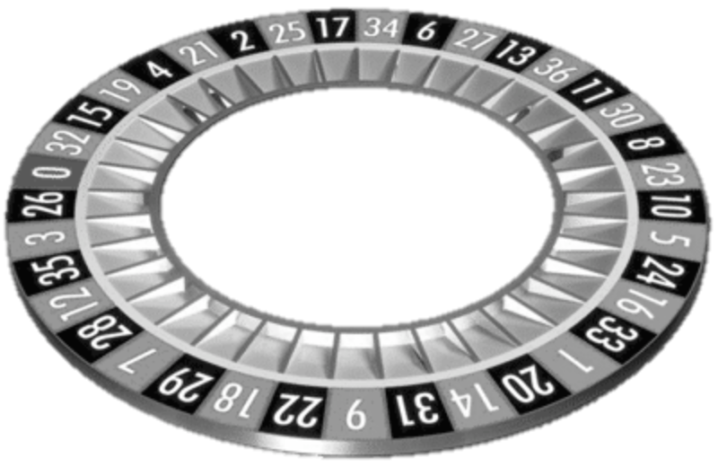
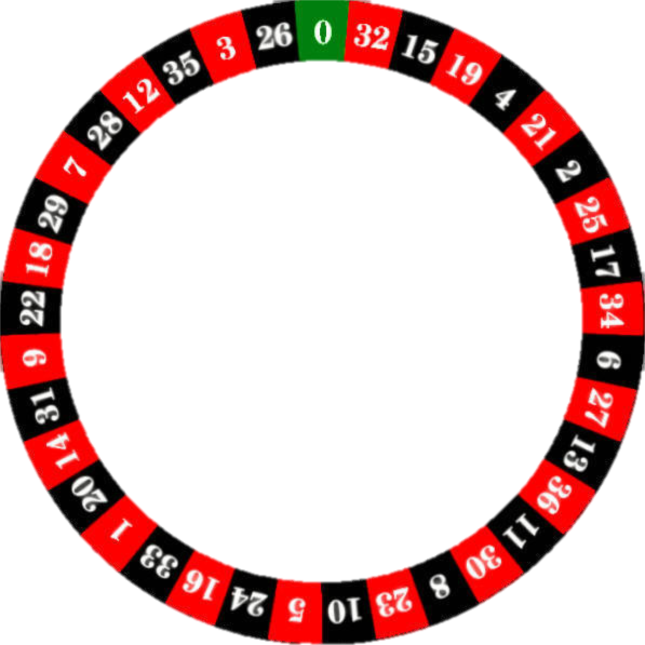

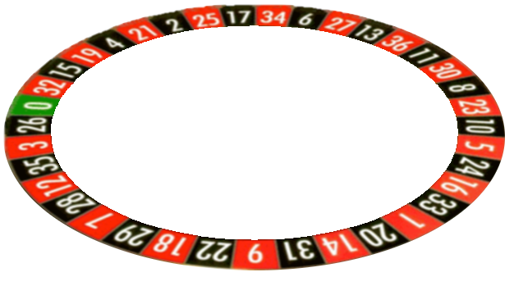
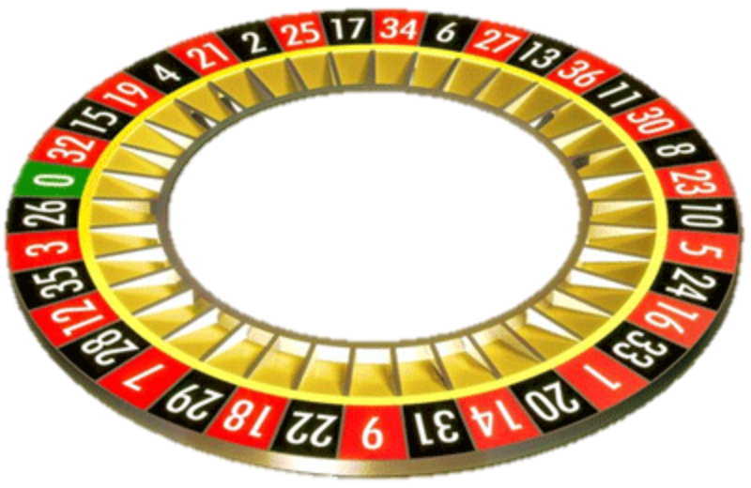
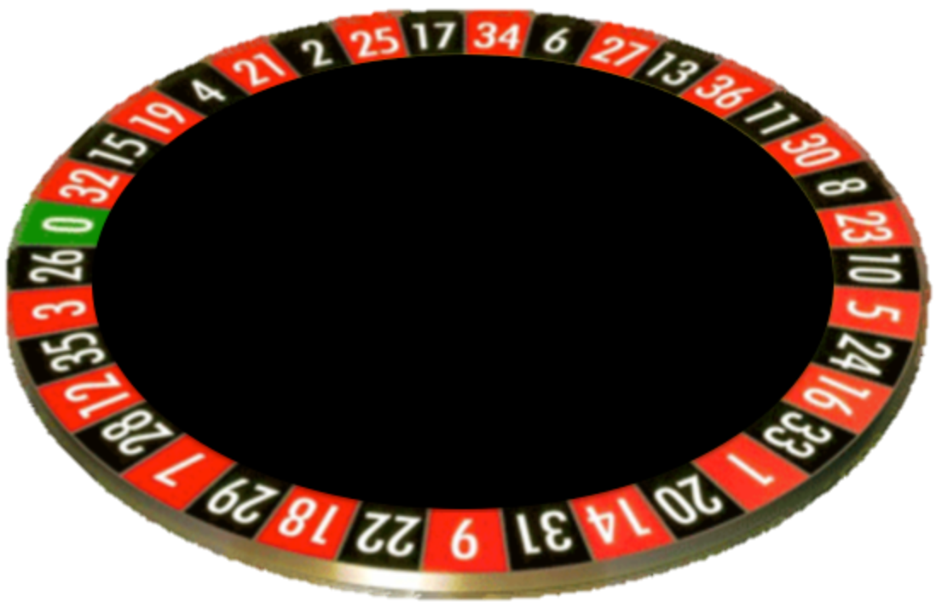
AppRoulette

Slide 2
AppRoulette

Slide 3
App R ulette

Slide 4
App R ulette

Slide 6
W

Slide 7
W

Slide 8
W

Slide 9


