Slide 1
Make a stronger toy
Compiler Design and Implementation Project Report
杨宗翰 2020.6

Slide 2
How a C compiler set works?
Preprocessor
Compiler
Assembler
Linker

Slide 3
What did we do?
Preprocessor
Compiler
Assembler
Linker

Slide 4
Can we do more?
Preprocessor
Compiler
Assembler
Linker

Slide 5
Can we do more?
Preprocessor
Compiler
Assembler
Linker
(It’s too complicated
and target oriented)

Slide 6


Can we do more?
Preprocessor
Compiler
Assembler
Linker
Call of the forge god
By me
Unicorn
By 庄永昊
(It’s too complicated
and target oriented)

Slide 7

Ornn, the fire below the mountain
R: Call of forge god (羊来！)

Slide 8
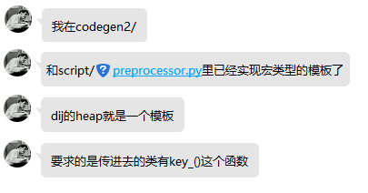
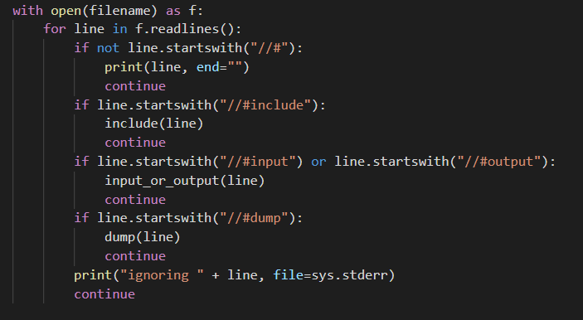

Too simple!
...so I am here today mainly to prove it not that simple

Slide 9
What does preprocessor do?
#include <stdio.h>
#define MSG(msg) #msg
#define DOUBLE_UNDERSCORE(content) \
__##content##__
#define DEBUG
int main() {
#ifdef DEBUG
puts(DOUBLE_UNDERSCORE(DATE));
puts(DOUBLE_UNDERSCORE(TIME));
#endif
puts(MSG(Hello World!));
}
extern "C" {
...(content of stdio.h and files included by stdio.h)
}
int main() {
puts("Jun 6 2020"); puts("23:15:40");
puts("Hello World!"); }

Slide 10
What does preprocessor do?
Character Mapping
Line Splicing
Tokenization
Preprocessing

Slide 11
Line Splicing
Unconditionally,
‘\’ at end of lines will be removed along with line separator.

Slide 12
#include
include the file.
If followed by <>, it will be searched at library paths.
If followed by “”, it will be firstly searched at current position, then at library paths.

Slide 13
#include_next
GNU Extension
Start from the position the same name of file firstly included, include the next file with this name.

Slide 14
#define
Whenever the name is used, it is replaced by the contents of the macro.
#define OBJECT_LIKE_MARCO [definition]
#define FUNCTION_LIKE_MARCO([parameters]) [definition]
Definition can be empty, as well as parameters.
One identifier will always map to at most one definition.

Slide 15
Function-like Marco
#arg : replaced by "arg".
a##b : replaced by ab, as one token.

Slide 16
Is it a valid macro definition?
int main() {
int a = 0, b = 1, c = 2;
#define a b
#define b c
#define c a
printf("%d%d%d", a, b, c);
}
Yes!
int main() {
int a = 0, b = 1, c = 2;
printf("%d%d%d", a, b, c);
}

Slide 17
Replacement rule
A macro will not be effective, if it’s expand from it self.
#define EPERM EPERM // simply define it, with no side effect
#define foo (4 + foo) // every foo is actually (4 + foo)

Slide 18
Replacement rule
#define a b
#define b c
#define c a
a
-> b
-> c
-> a
[stop]

Slide 19
Replacement rule
#define x (4 + y)
#define y (2 * x)
x
-> (4 + y)
-> (4 + 2 * x)
[stop]

Slide 20
Variadic Macros
#define eprintf(...) fprintf (stderr, __VA_ARGS__)
OR
#define eprintf(args...) fprintf (stderr, args)
OR
#define eprintf(format, ...) fprintf(stderr, format, __VA_ARGS__)
OR
#define eprintf(format, ...) \
fprintf (stderr, format __VA_OPT__(,) __VA_ARGS__)

Slide 21
If
#ifdef MARCO
#ifndef MARCO
#if EXPRESSION
EXPRESSION can be any legal C expression
EXPRESSION may contains defined, a special operator indicates ‘ifdef’.
EXPRESSION should support shortcut evaluation, false statements are not effective.
Statements are not effective should not be checked.

Slide 22
Expression evaluation
Seems easy, until I meet these:
#if defined __is_builtin && __is_builtin(...)
#if __cplusplus ? __cplusplus >= 201103L : defined(_libc)
#define __INTRINSIC_PROLOG(name) \
(!defined(__INTRINSIC_DEFINED_ ## name)) && \
((!defined (__INTRINSIC_ONLYSPECIAL)) || \
(defined (__INTRINSIC_ONLYSPECIAL) && \
defined(__INTRINSIC_SPECIAL_ ## name)))
#if __INTRINSIC_PROLOG(_lrotl)
Should carefully handle with parsing and replacing!

Slide 23
#pragma
Only supported in Call of the forge god:
#pragma once

Slide 24
Diagnostics
Halt the compiliation and/or report something using #if with diagnostics directive #error and #warning.
// Check for invalid usage and unsupported mixed-mode use.
# if defined(_GLIBCXX_DEBUG) && defined(_GLIBCXX_PARALLEL)
# error illegal use of multiple inlined namespaces
# endif

Slide 25
#line
#line line_number [file_name]
Change the line number of next line into line_number,
and current file name to file_name.

Slide 26
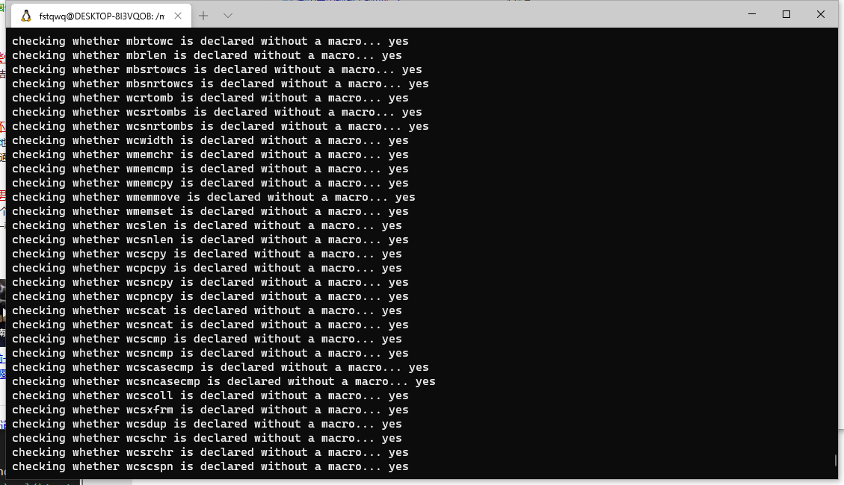
How can we use these directives?
Switching to different code for different target
#ifdef _WIN32
#if __cplusplus >= 201103L
Or checking if compiler works:

Slide 27
How can we use these directives?
Switching to different code for different target
#ifdef _WIN32
#if __cplusplus >= 201103L
Or checking if compiler works:
Debug
#define DEBUG(s) fprintf(stderr, __FILE__ __LINE__ "%s", s)
And do something cooler if you are master!
#define assert(_Expression) \
(void) \
((!!(_Expression)) || \
(_assert(#_Expression,__FILE__,__LINE__),0))

Slide 28
Why we need these directives?
One thing important is that, if you don’t have a preprocessor:
You almost surely can’t write a compiler in a single file.
Even if you are as strong as Erzhi Liu who wrote everything in main.java,
you may also need import org.antlr.v4.runtime.*

Slide 29
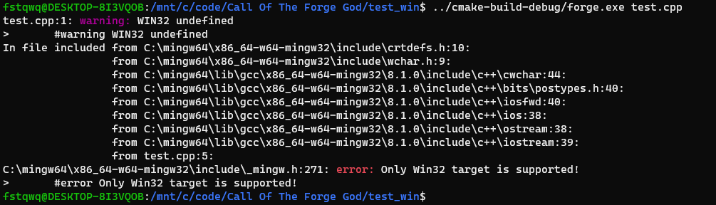
Implementation features
One pass
Cross-platform
Nearly as good diagnostics as GCC!

Slide 30
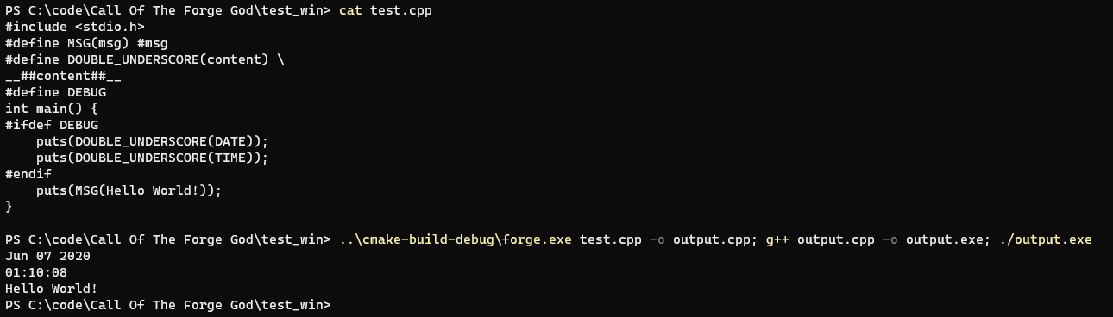
Result: The very first example

Slide 31
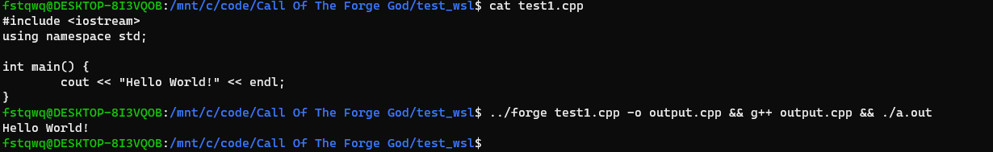
Result: C++ Hello World
* MinGW64 libs are full of non-standard definition, so I give up on making C++ HelloWorld work on windows.

Slide 32
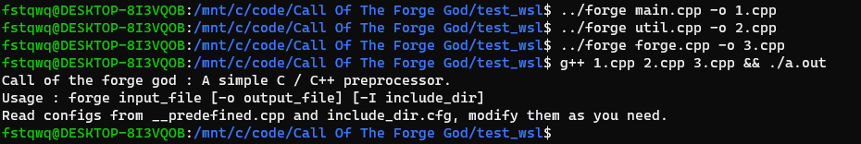
Result: Self Compiling

Slide 33
Timing: Preprocess forge/main.cpp
g++ 7.5.0 (WSL) | 0.104s
clang++ 10.0.0 (WSL) | 0.154s
Call of the forge god (WSL) | 0.362s
It’s actually efficient though,
since most of time spent on allocating memory for std::vector and std::string.
Replacing std::string with a better implementation will cause a huge acceleration.

Slide 34
Another topic: About test data
Who | Score | binary_tree | dijkstra | humble | kruskal | lca | lunatic | maxflow | pi | segtree | sha_1
fstqwq | 47.19 | 228247995 5.00 | 133977086 5.00 | 958167187 3.46 | 142045029 4.09 | 73738410 5.00 | 1975335735 5.00 | 18876095 5.00 | 31263252 3.83 | 879768484 4.83 | 1107696475 5.00
ZYHowell | 45.55 | 565935084 5.00 | 128658416 5.00 | 921352578 3.71 | 140150369 4.17 | 87082128 4.63 | 2316786501 4.34 | 17404710 5.00 | 31836329 3.72 | 922770159 4.58 | 1075575585 5.00
gcc O2 | 45.53 | 189040961 5.00 | 131855329 5.00 | 869017961 4.07 | 142665035 4.06 | 89633147 4.48 | 2104221466 4.86 | 43094679 4.24 | 30400478 4.00 | 901208380 4.71 | 979959397 5.00
Expected optim |  | Tail Call Inline* Memory CSE | Inline Memory CSE | Memory (Strong Localize) Strength Reduction CSE | Inline* (Counter Bad Inline) | Inline Memory Loop Unroll | Loop Memory Loop Unroll | Memory (Naïve Global Localize) | Loop | Inline* Memory CSE Memory Allocate | CSE Loop (Counter Bad Unroll)
Assume Constant Propagation, CFG Simplification, Dead Code Elimination as trivial optimizations
*: Inline parameters matter

Slide 35
Some little suggestions
Test data:
Floyd-Warshall: Strong Loop Optimization Expected
Shallow recursion in small loops: Counter size-based inline
Segment Tree: Use tail call optimizable style return
Lunatic: Eliminate all literals, let it be a useful loop checker as expected
Grading:
Unlock upper bound, and weight decreases exponentially as score increases
Better memory allocation cost calculation
New qualifiers:
Const: Make global const value propagation more reasonable
Static: Make global optimizations more reasonable

Slide 36
Thank you!
Acknowledgements:
感谢庄老师听我bb了两个月，还没有拉黑我
感谢侯老师的代码，没有侯老师的代码我写不动前端
感谢面包老师的ravel以及很多人生建议
感谢董老师的spider，让我没有压着 ddl 才赶完编译器
感谢郑老师，徐老师的 oj 和 codegen tutorial
感谢赖老师、金老师对我的及时帮助
感谢llvm那又臭又长的doc以及随着版本变语法的llvm工具链
感谢龙书让我知道自己有多菜
感谢虎书的祖安口音
感谢鲸书的目录让我知道 SCCP 到底是哪四个单词
感谢《自制编译器》，尽管没什么用
感谢尔之老师让我知道这个世界上真的能有人1500行单文件写完编译器
感谢司宇老师让我知道并不是我太菜而是编译器真的很难
感谢拳头公司没有告我侵权
Make A Stronger Toy - Compiler Design and Implementation Project Report
杨宗翰 2020.6

