Slide 1
Presentation – RISCV CPU
杨宗翰 2020.1.4

Slide 2
Introduction
My CPU is a standard 5 stage pipeline CPU.
So what is my point of this presentation?
My understand of circuits, and
How to achieve high frequency on FPGA?
And the problems I found.

Slide 3

Some jokes

Slide 4


Circuits
Sequential Circuit
Combinational Circuit

Slide 5
Sequential Circuit
Action at the specific signal.
All results of all cases calculated parallelly.
All data used ‘as is’ at the instant of signal occurs.
It will choose answers by cases.
Latency is calculated as maximum case sequences latency or the maximum calculation latency.
Critical path: Memory Controller

Slide 6
Combinational Circuit
Action at the input changes.
For a register that we change, it
Drop data in it
Receive new assignment
So every register we change in the combinational circuits:
CAN’T be a condition
DOSEN’T change in some possible paths
or it will lead to a latch.
Latency is calculated as the maximum calculation sequences latency.
Critical path: ID – REGFILE – ID, IF – CACHE – IF

Slide 7

How to achieve a good frequency？
Good frequency = Low latency
A good design is required!
MEM
IF
WB
PC
EX
ID
Cache

Slide 8
Where are bottlenecks？
Data Forwarding
Branch
Data
Stall Enable
Stall Request
Branch Prediction
STALLBUS
PC_REG
IF
IF/ID
ID
ID/EX
EX
EX/MEM
MEM
MEM/WB
ICACHE
PREDICTOR
REGFILE
MEMCTRL
SCACHE
RAM/HCI

Slide 9
Where are bottlenecks？
ICACHE
STALLBUS
PC_REG
IF
IF/ID
ID
ID/EX
EX
EX/MEM
MEM
MEM/WB
PREDICTOR
REGFILE
MEMCTRL
SCACHE
RAM/HCI

Slide 10
Bottlenecks
Caches are slow
Tag comparation plus RAM addressing is slow
Caches are giant, so the path latency is large.
If implement cache with combinational circuits, there will be 2 levels of slow combinational circuits.
ID is slow
ID needs 2 levels of combinational circuits and 2 levels of big cases.
Data requirements are slow!
Generally, it will need 2 combinational circuits action at the same time.
Memory controller is slow
Very complex sequential circuit
EX can be slow – if use a big case

Slide 11
Some solutions
EX branch
Improve ID performance
With predictor it’s not slow; without predictor JAL can jump at ID.
Sequential cache refresh
Late one cycle improves much on performance
Sequential predictor refresh
Size – latency balanced cache/predictor size
Clear memory controller design
Modularization design of EX
Use parallelism

Slide 12
Module design of EX
MUX
Titan ALU
Small ALU
Small ALU
Small ALU
Small ALU
Much more latency
Lower latency

Slide 13
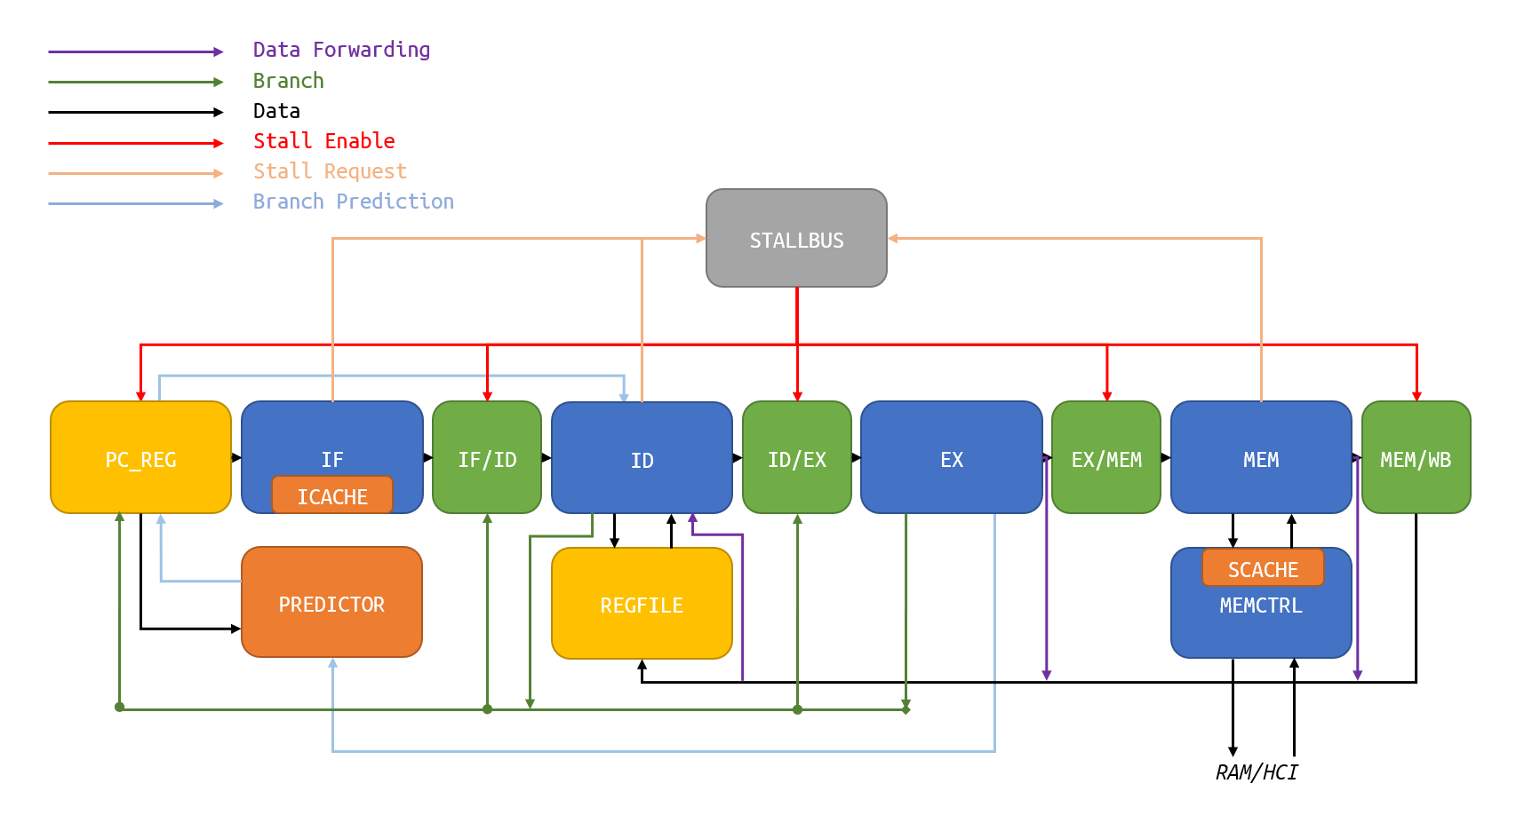
Modularization design of EVERYTHING!
Alei’s Magic
Let's start!
5
5 5 1 6 193
step 1:
4 4 5 192 5
bulgarian.c

Slide 14
My other features
Cache
1KiB Direct Mapped Instruction Cache
128B Direct Mapped Stack Cache
Why Direct Map?
2:1 Cache rule
Lower latency.
I implemented 2-way associative cache, it works worse.
4 cycle instruction fetch (prefetch)
Branch Prediction: 128 lines of BTB

Slide 15

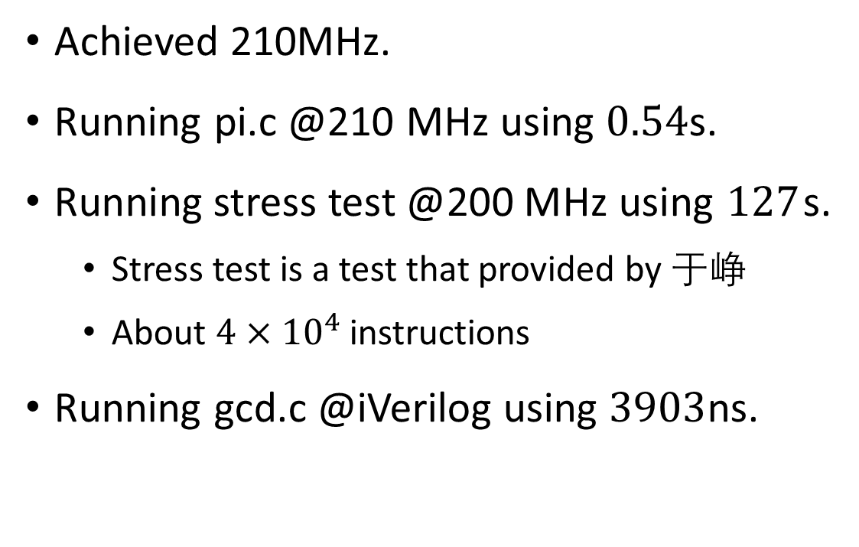
My result
Achieved 210MHz.
Running pi.c @210 MHz using $0.54$s.
Running stress test @200 MHz using $127$s.
Stress test is a test that provided by 于峥
About $4×{10}^{4}$ instructions
Running gcd.c @iVerilog using $3903$ns.

Slide 16
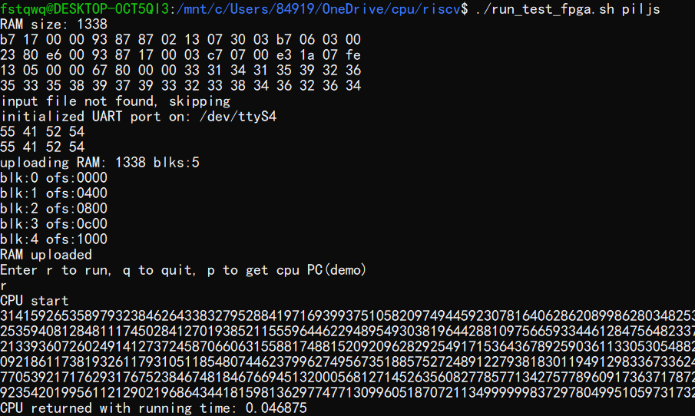

My result
Running piljs.c @210 MHz using $0.046875=\frac{1}{21.33}$ s.

Slide 17

Some jokes
gcd.c
bulgarian.c
qsort.c
testsleep.c

Slide 18
My problems met during implementation
Just some jokes about me.
Implemented BGE with >.
When both stalled and jumped, IF/ID and ID/EX clears wrongly.
I created a test to infer this problem
The first version failed on FPGA, because MEM latched so much that I can't fix.
When I tried to find a way to fetch in 4 cycles, I failed with 7, 8, or even 10 cycles.
assign rst = rst_in | (~rdy_in);
ram_data_o <= {24'h0,sdata[ram_addr_i[``SCacheIndex] + 1],sdata[ram_addr_i[``SCacheIndex]]};

Slide 19
Problems in riscv_top.v
Misbehave of riscv_top.v:
posedge 0:
MCTL send a request in order to access RAM or I/O.
posedge of cycle 1:
TOP access RAM or HCI by the higher 2 bits of address.
posedge of cycle 2:
TOP return the data by the type REQUESTED IN CYCLE 1(should be 0)
Cause:
assign hci_io_en = (cpumc_a[RAM_ADDR_WIDTH:RAM_ADDR_WIDTH-1] == 2'b11) ? 1'b1 : 1'b0;
Solution
Use sequential circuits to refresh hci_io_en.

Slide 20
Problems in pi.c
WRONG ANSWER
314159265358979323846264338327950288…
The original program uses %04d.
But our source uses outl().
That is different.

Slide 21
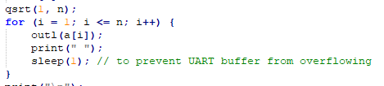
Problems in UART buffer
Buffer size is too small.
I didn’t read the code but as it’s commented in C source, the improvement was not introduced in UART codes.
Question: Is SLEEP the best way to prevent HW drawback?

Slide 22

Some jokes

Slide 23

Questions?
Any questions is welcomed!

Slide 24
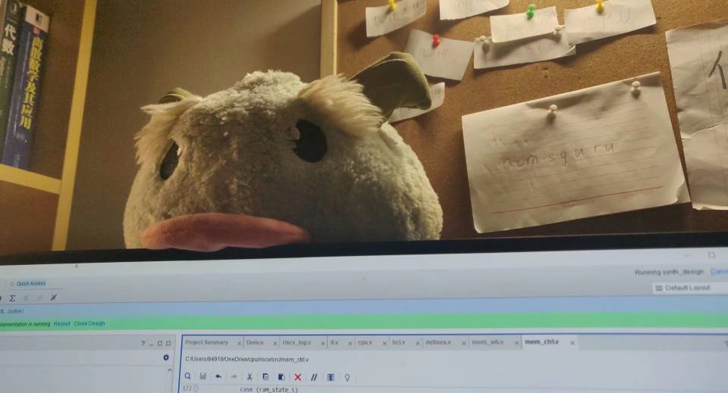
Thank you!
杨宗翰 2020.1.4
And thank you: (in no particular order)
李照宇
张志成
于峥
庄永昊
陈伟哲
姚远
雷思磊（Author of ‘自己动手抄写 CPU’）
And everyone who discussed with me and inspired me
… but the space is too small to mention.

