Slide 1
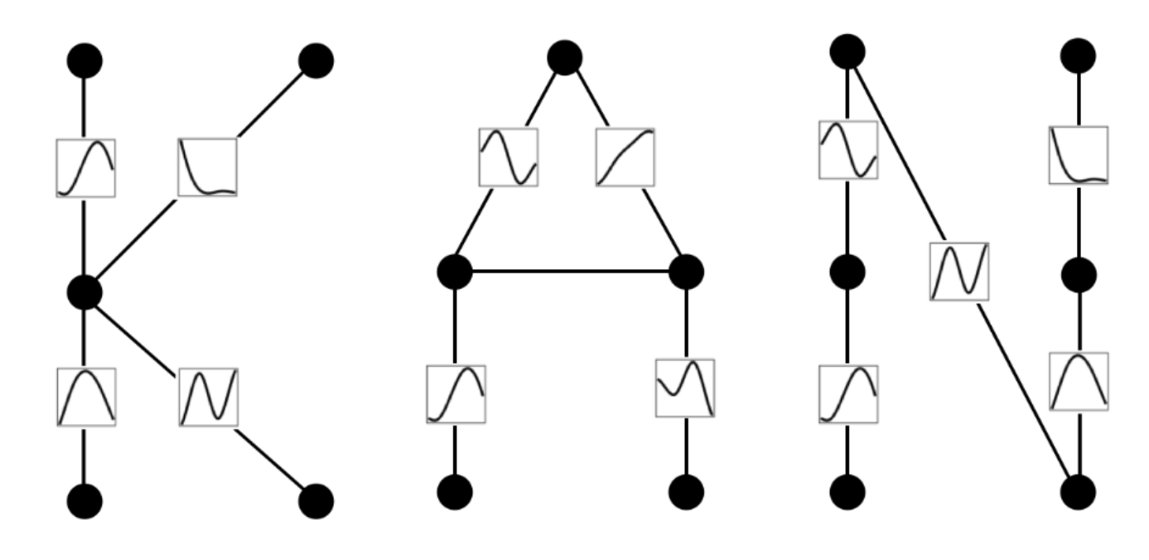

Kolmogorov-Arnold Networks
Jose Miranda

Slide 2
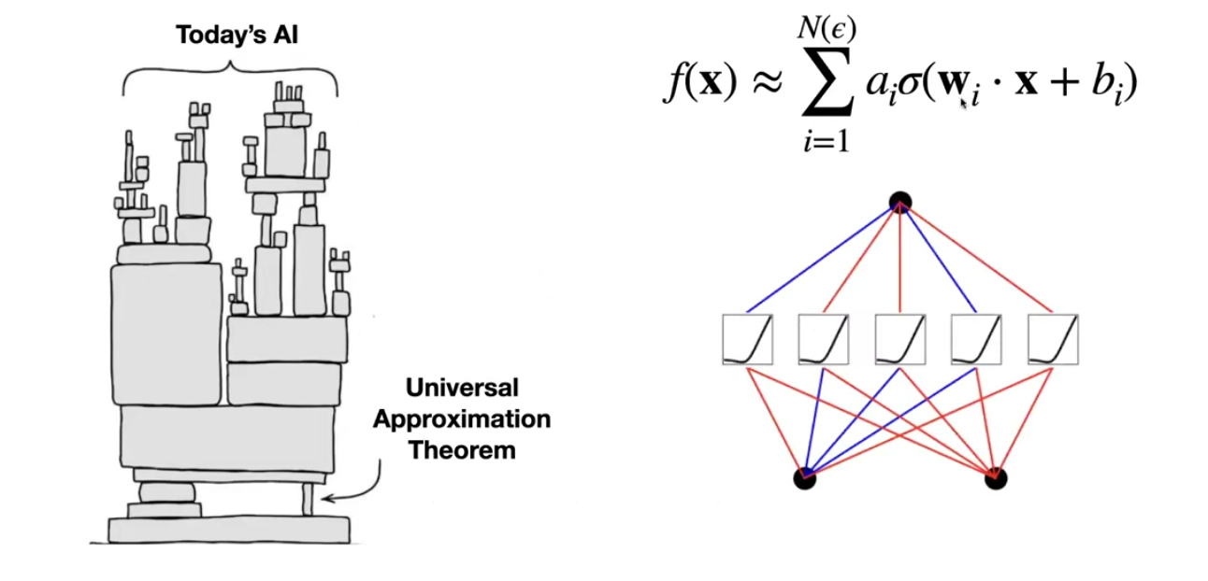
Foundations of AI
Nonlinear activation
High-dimensional function
Basis functions
Source: Liu, Z. 2024
Notes:
To start, let me provide some context regarding today's AI landscape. Modern AI, particularly neural networks, is built upon the universal approximation theorem, which asserts that any high-dimensional function, denoted as \(f(x)\), can be approximated by a linear combination of basis functions applied through nonlinear activations such as the sigmoid or ReLU function. This is the foundation for fully connected neural networks—often called multi-layer perceptrons (MLPs)—which are widely utilized today as a fundamental building block in large language models and other AI systems.

Slide 3
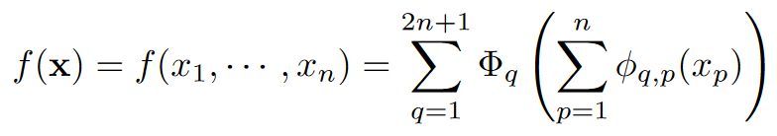
Alternative? Kolmogorov-Arnold Representation Theorem (KART)
If ƒ is a multivariate continuous function, then ƒ can be written as a finite composition of continuous univariate functions and addition.
In 1989, this theorem was deemed irrelevant in the context of networks for learning, since it does not guarantee smoothness of the decomposed functions, which is essential for gradient descent. As result, the theorem was largely disregarded for decades.
Notes:
Another fundamental mathematical theorem that could serve as the foundation for a new kind of neural network architecture is the Kolmogorov-Arnold representation theorem, which posits that any continuous multivariate function can be represented as a composition of continuous functions of a single variable combined with addition operations. In simpler terms, it allows us to decompose a high-dimensional function into a set of one-dimensional functions combined in a particular structure. However, in 1989, Girosi and Poggio published a paper arguing that the Kolmogorov-Arnold theorem was irrelevant to neural network learning. Their primary critique was that the theorem does not guarantee that the decomposed functions are smooth, which is essential for practical learning using methods such as gradient descent. In other words, while the theorem ensures a continuous decomposition, it does not ensure that this decomposition is smooth enough to be trained effectively using standard machine learning approaches. As a result, the theorem was largely disregarded for decades.

Slide 4
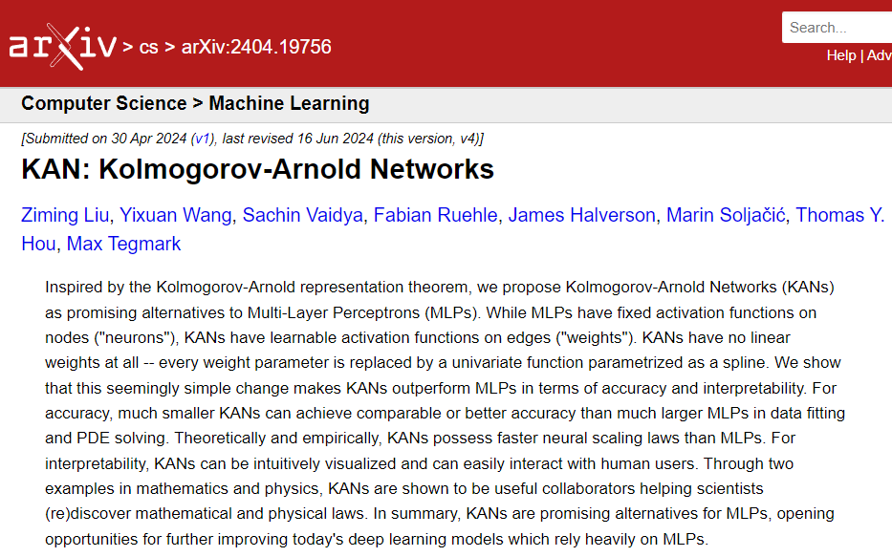
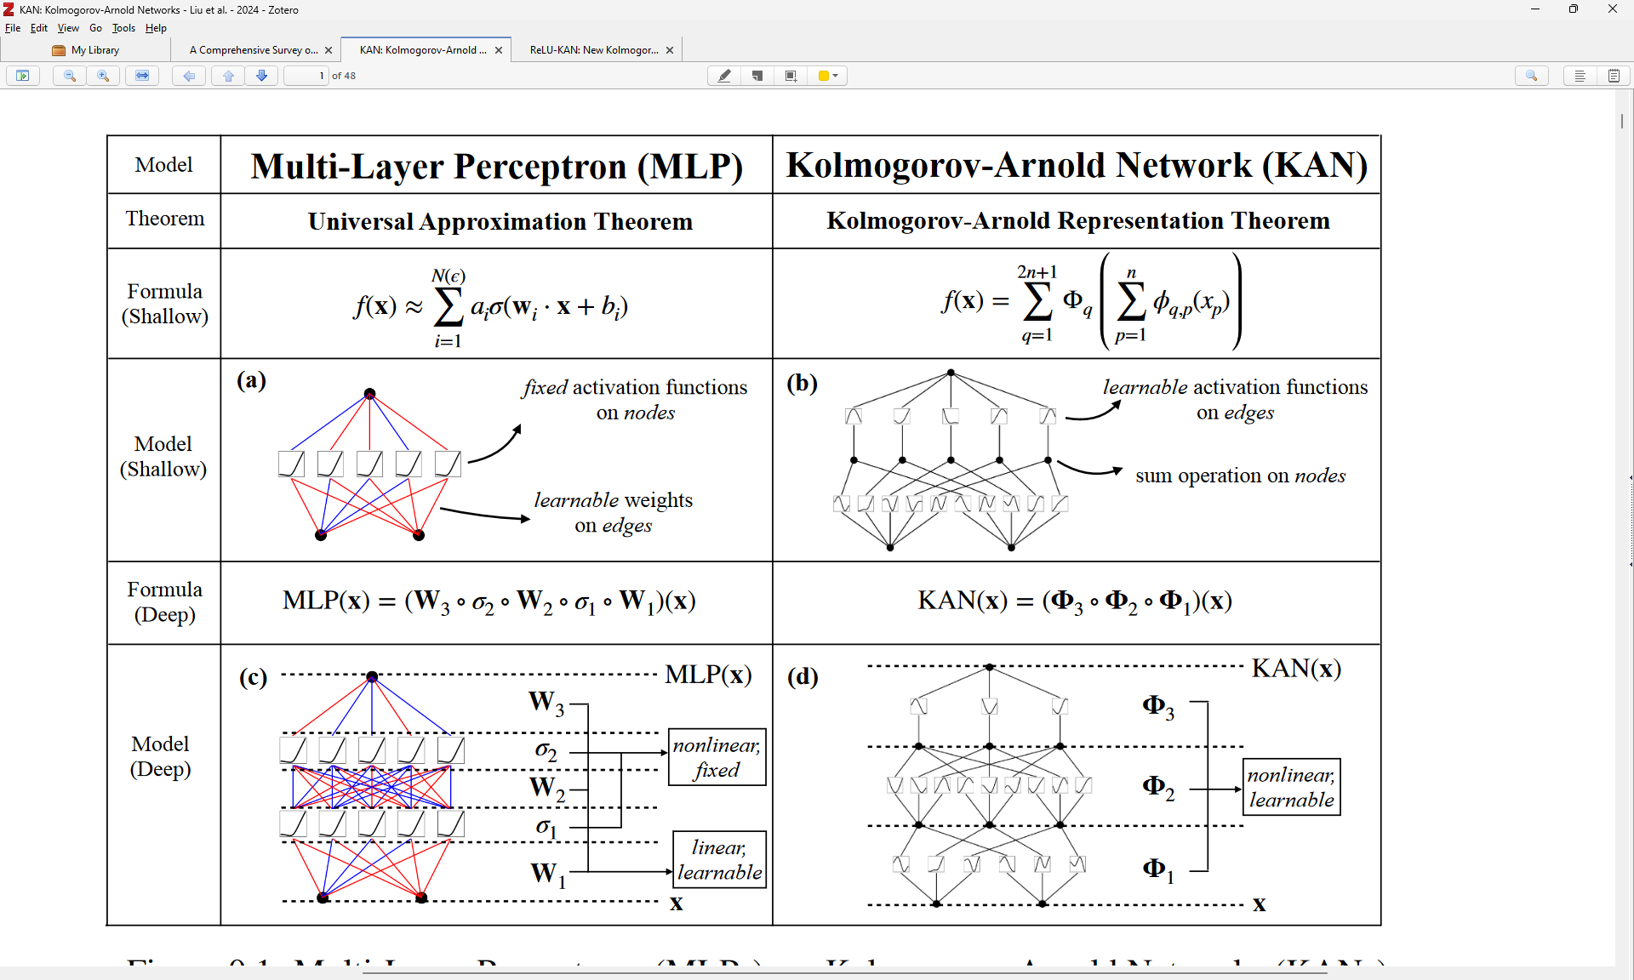

Slide 5
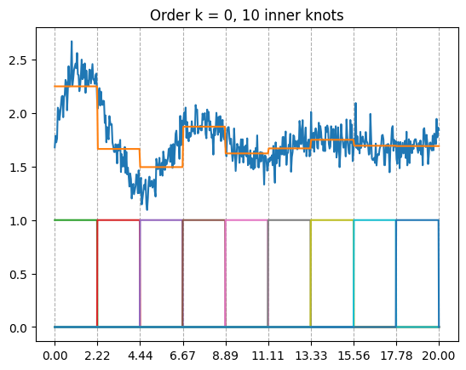
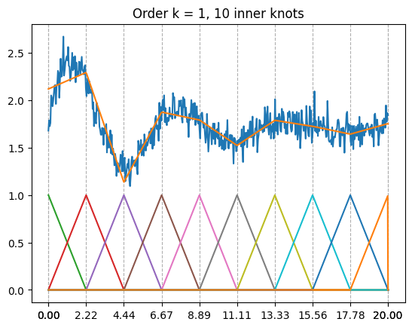
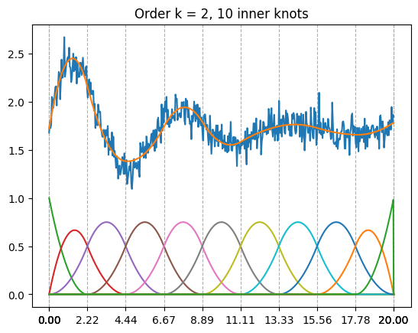
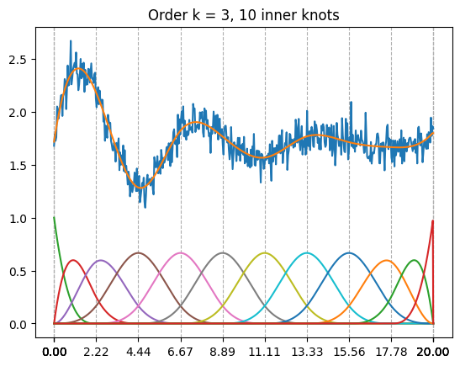
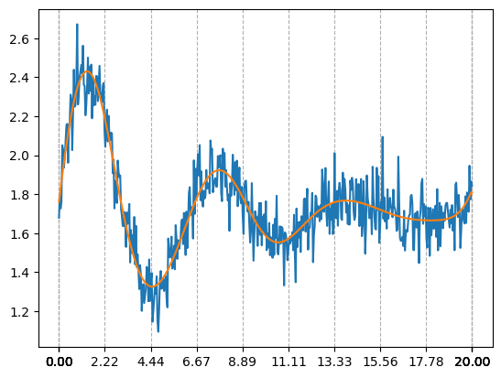
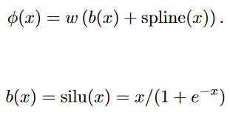

Splines
In KANs, the activation functions are
parametrized as splines:
(similar to residual connectiona)
Control points (c) are learnable

Slide 6
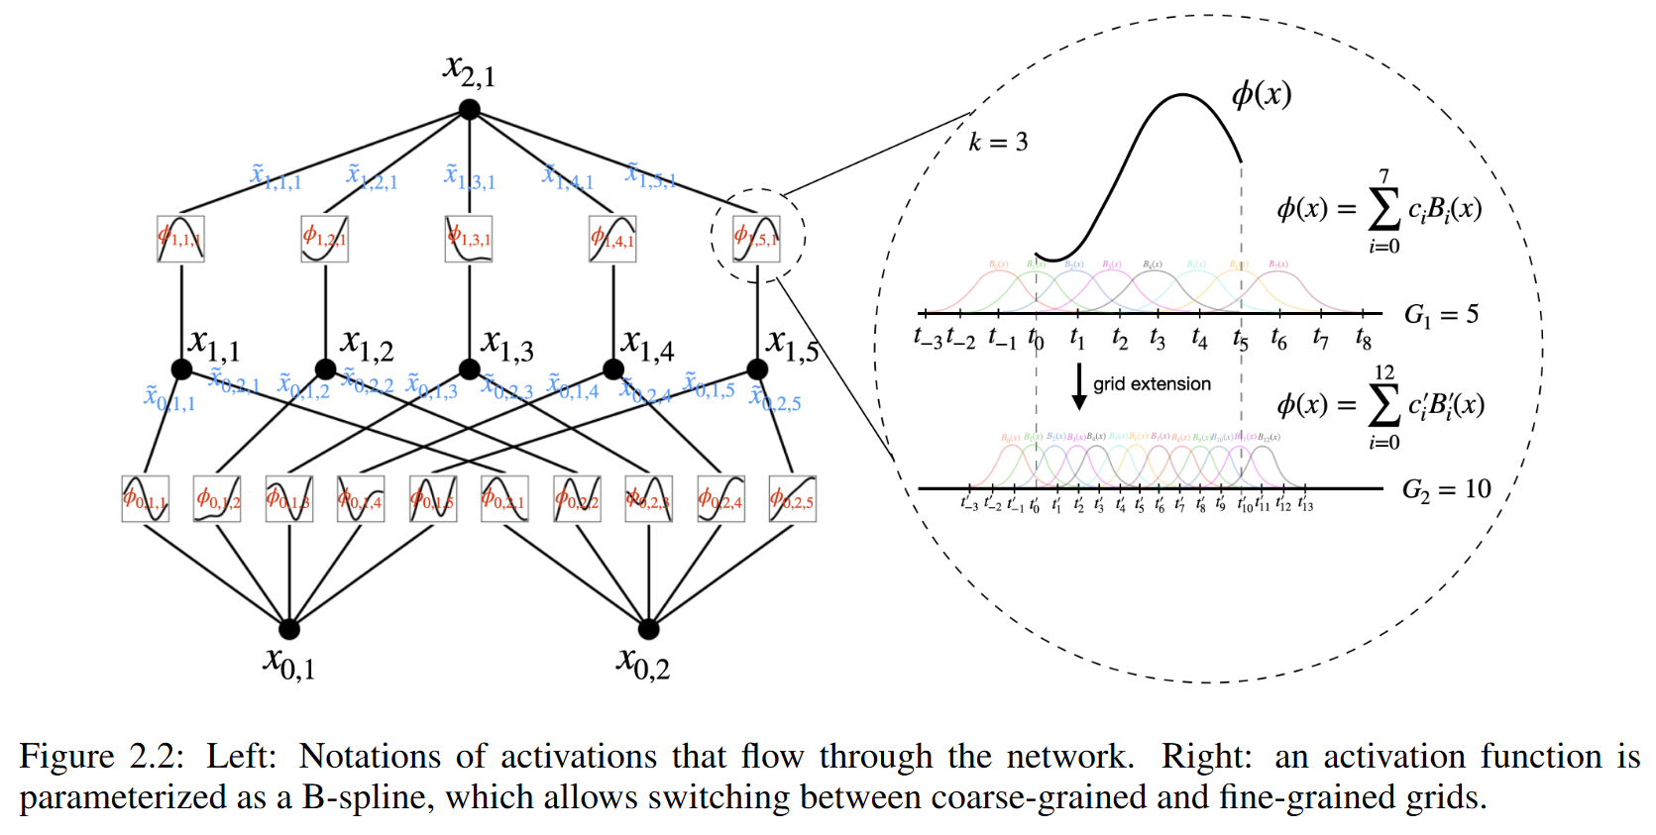


Output dimension $n_{out}$
Least squares
Input dimension $n_{in}$

Slide 7
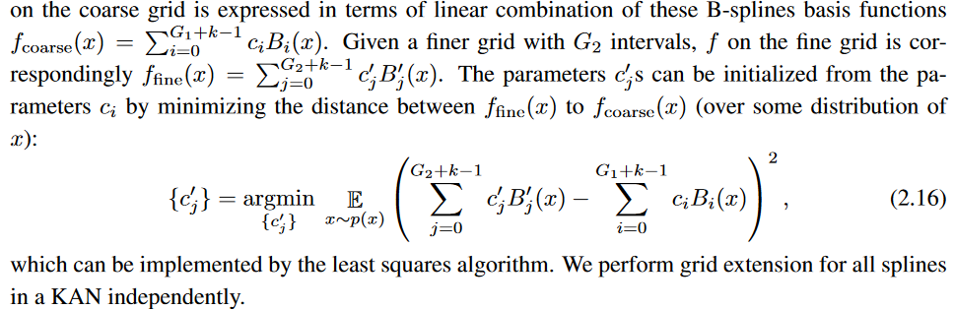
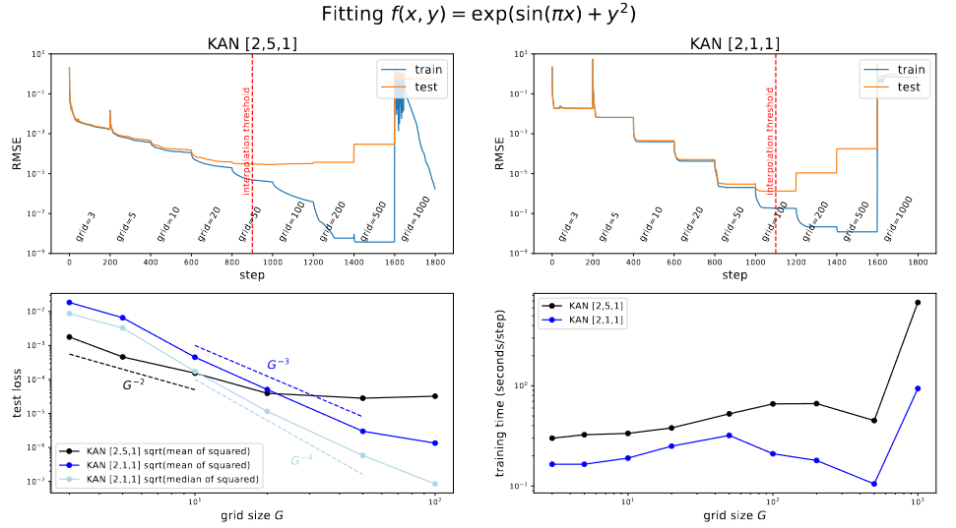
Grid extension

Slide 8

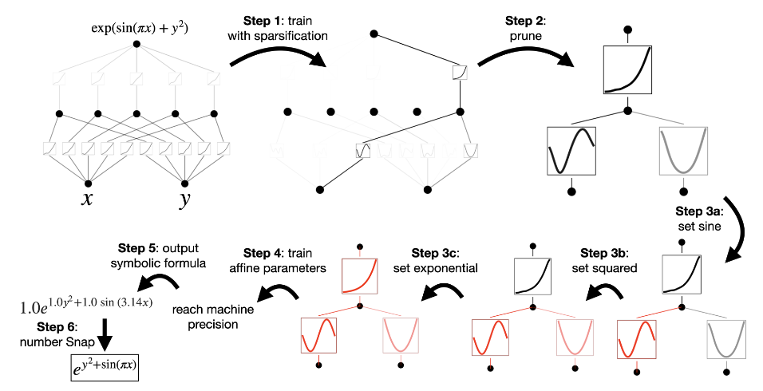
Symbolic regression with KAN
L1 norm
Entropy

Slide 9

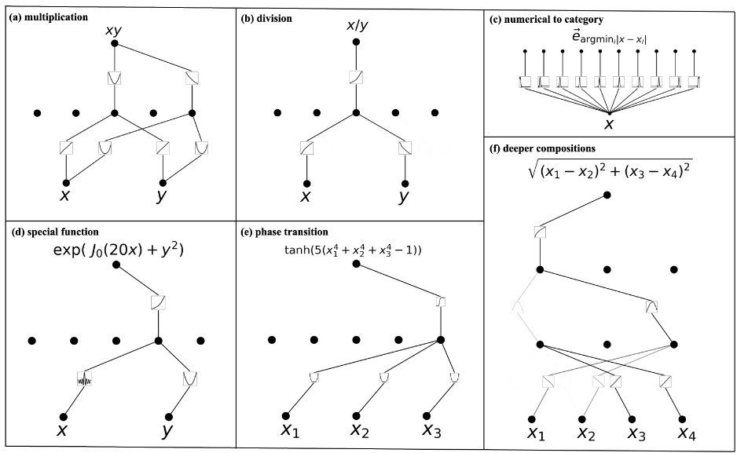
Interpretable

Slide 10
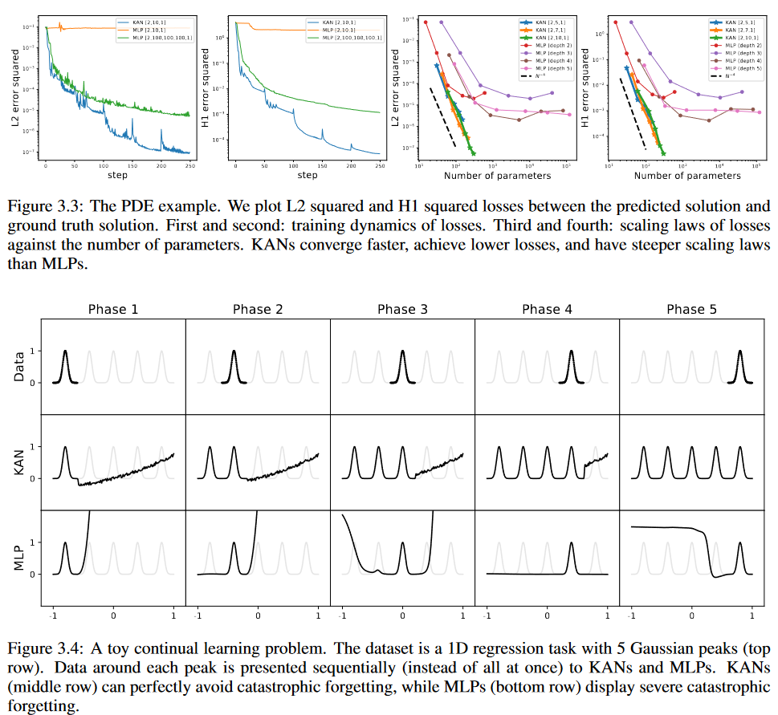
Catastrophic forgetting

Slide 11
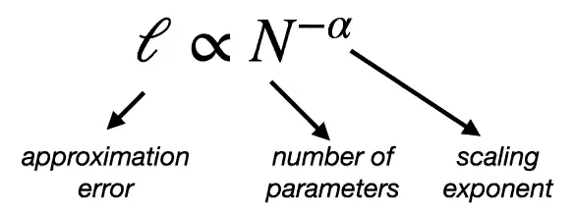
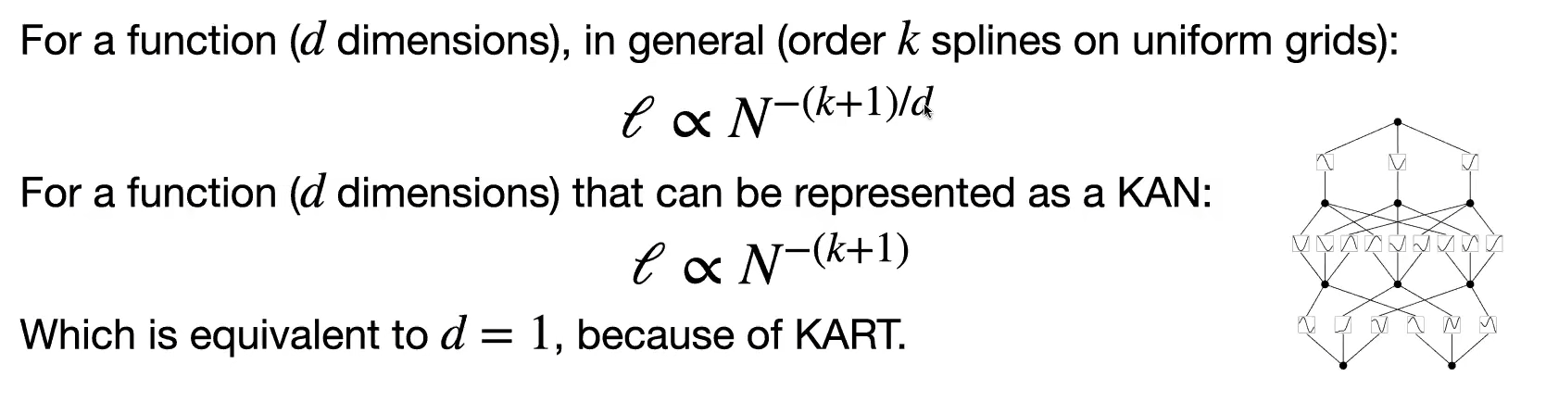
Scaling
C.o.D.!

Slide 12
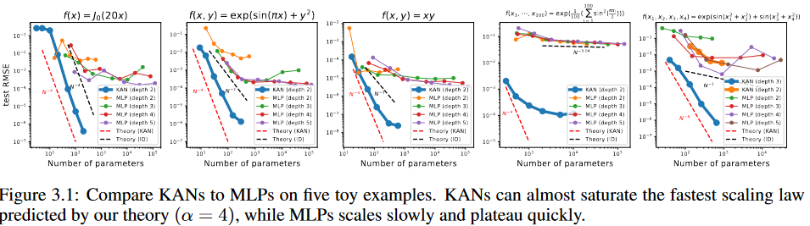
Comparisons with MLP

Slide 13
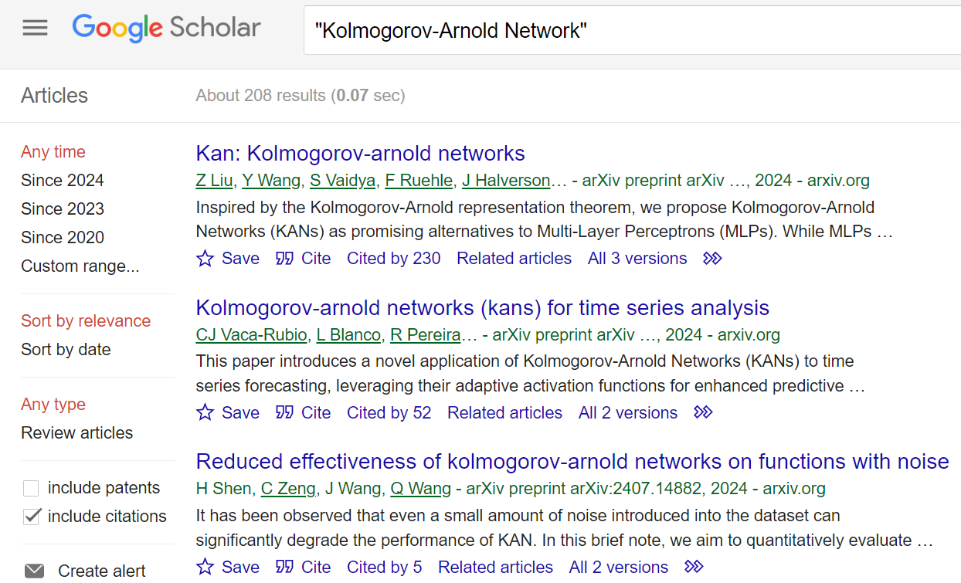

Slide 14
Developments
Faster versions, replacing splines with:
Radial Basis Functions (FastKAN)
Chebychev Polynomials (Chebychev KAN)
Coefficient Generator model (UKAN)
ReLU and multiplications (ReLU KAN)
Function Combination (FC-KAN)
Fourier coefficients (Fourier KAN)
Convolutional (CKAN)
Graph (GKAN)
Time series (Tkan)
Transformer (KAT)

Slide 15
Limitations:
Higher complexity → Slower training
Need to unwrap the parametrization to calculate loss
Restricted domain (basis functions)
Unable to extrapolate
Issues with discontinuous functions
Too recent, not well understood
Conflicting results regarding noise
Higher level of abstraction
Advantages:
Flexibility and adaptability
Adjust activations to data
Higher accuracy
Depends on application
Parameter efficiency
Specially compared to CNNs
Interpretability and expressiveness
Great for highly-dimensional data
Seems to be best to use it in the latent space of a larger model!

Slide 16
References
Alter, T., Lapid, R., Sipper, M., 2024. On the Robustness of Kolmogorov-Arnold Networks: An Adversarial Perspective [WWW Document]. arXiv.org. URL https://arxiv.org/abs/2408.13809v1 (accessed 10.8.24).
Drokin, I., 2024. Kolmogorov-Arnold Convolutions: Design Principles and Empirical Studies. https://doi.org/10.48550/arXiv.2407.01092
Hadj Kilani, B., 2024. Kolmogorov-Arnold Networks: Key Developments and Uses. Qeios. https://doi.org/10.32388/7nncaa
Hou, Y., Zhang, D., 2024. A Comprehensive Survey on Kolmogorov Arnold Networks (KAN) [WWW Document]. arXiv.org. URL https://arxiv.org/abs/2407.11075v4 (accessed 10.8.24).
Li, Z., 2024. Kolmogorov-Arnold Networks are Radial Basis Function Networks.
Liu, Z., Wang, Y., Vaidya, S., Ruehle, F., Halverson, J., Soljačić, M., Hou, T.Y., Tegmark, M., 2024. KAN: Kolmogorov-Arnold Networks. https://doi.org/10.48550/arXiv.2404.19756
Moradzadeh, A., Wawrzyniak, L., Macklin, M., Paliwal, S.G., 2024. UKAN: Unbound Kolmogorov-Arnold Network Accompanied with Accelerated Library. https://doi.org/10.48550/arXiv.2408.11200
Qiu, Q., Zhu, T., Gong, H., Chen, L., Ning, H., 2024. ReLU-KAN: New Kolmogorov-Arnold Networks that Only Need Matrix Addition, Dot Multiplication, and ReLU.
SS, S., AR, K., R, G., KP, A., 2024. Chebyshev Polynomial-Based Kolmogorov-Arnold Networks: An Efficient Architecture for Nonlinear Function Approximation.
Ta, H.-T., Thai, D.-Q., Rahman, A.B.S., Sidorov, G., Gelbukh, A., 2024. FC-KAN: Function Combinations in Kolmogorov-Arnold Networks. https://doi.org/10.48550/arXiv.2409.01763
Xu, J., Chen, Z., Li, J., Yang, S., Wang, W., Hu, X., Ngai, E.C.-H., 2024. FourierKAN-GCF: Fourier Kolmogorov-Arnold Network -- An Effective and Efficient Feature Transformation for Graph Collaborative Filtering.
Yang, X., Wang, X., 2024. Kolmogorov-Arnold Transformer. https://doi.org/10.48550/arXiv.2409.10594

Slide 17

Thank you
Questions? Suggestions? Feedback?

