Slide 1
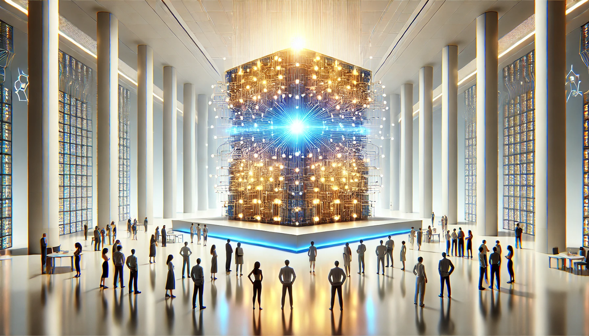
Transformers for Everyone
Kunal Kanawade
Date: 31st January 2025

Slide 2
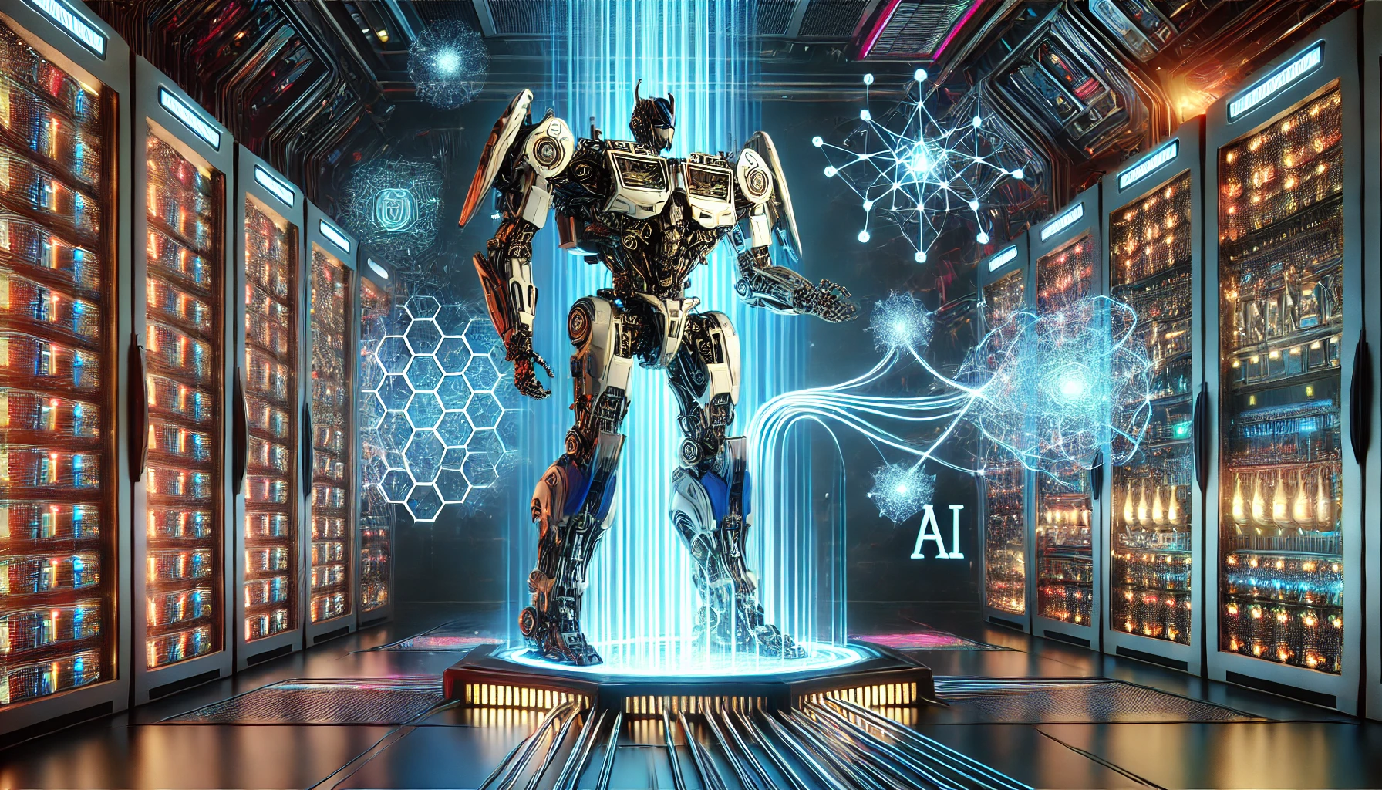
Introduction
A transformer is the backbone of the modern Large Language Models(LLMs) like ChatGPT, Gemini, Claude, etc.
They enable language understanding, translation, and even image processing.
Initially introduced for the accurate language translation tasks.

Slide 3
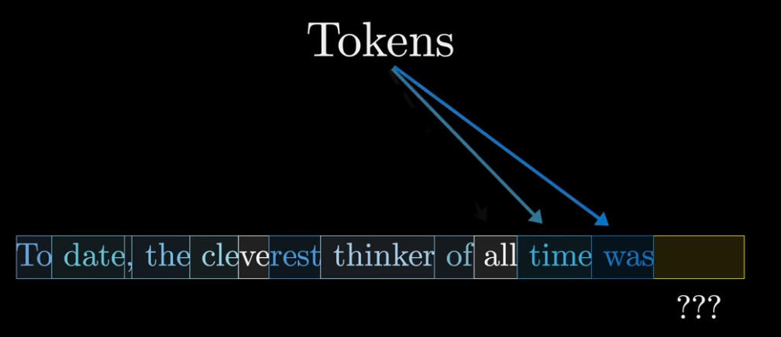
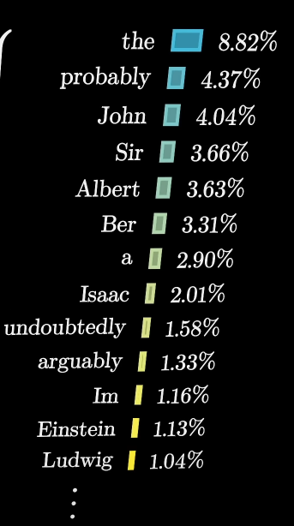
Introduction
Source:Link

Slide 4
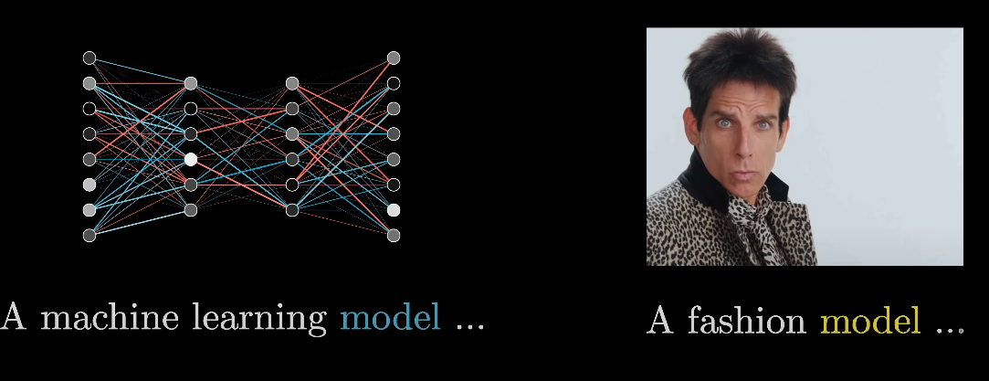
Introduction

Slide 5
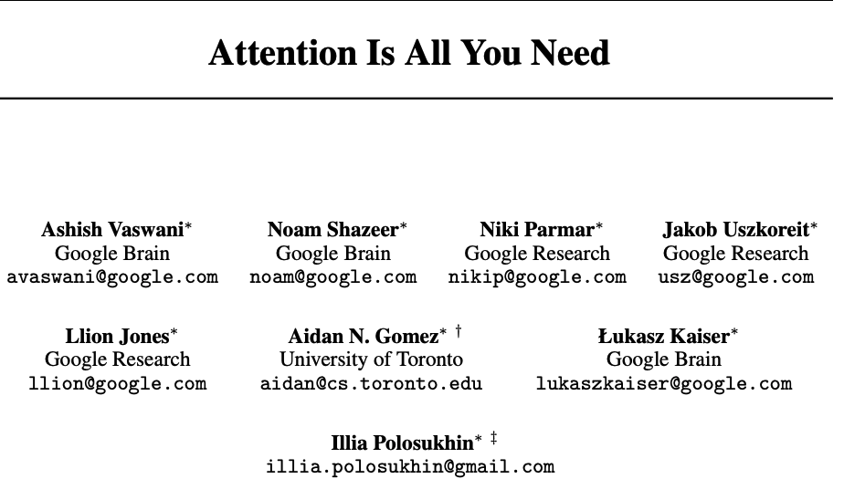
Introduction
Google researchers released their paper in 2017, that started it all
The Transformer uses Attention to understand the relationships between different elements in a sequence
"A word is characterized by the company it keeps"
John Rupert Firth,1957

Slide 6
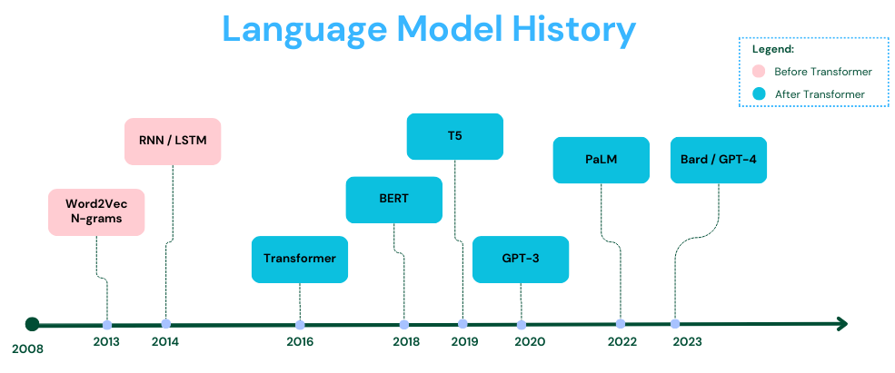
Before Transformers
Source: Medium

Slide 7
Before Transformers
Word2Vec (2013) introduced vector representation of words that capture meaning
Recurrent Neural Networks (RNNs)(2014) – Introduced sequence learning, but suffered from vanishing gradients
Long Short-Term Memory (LSTM) & GRU (2015) – Improved RNNs by addressing long-range dependencies.
Seq2Seq Models & Attention (2017) – Attention mechanisms helped improve machine translation.

Slide 8
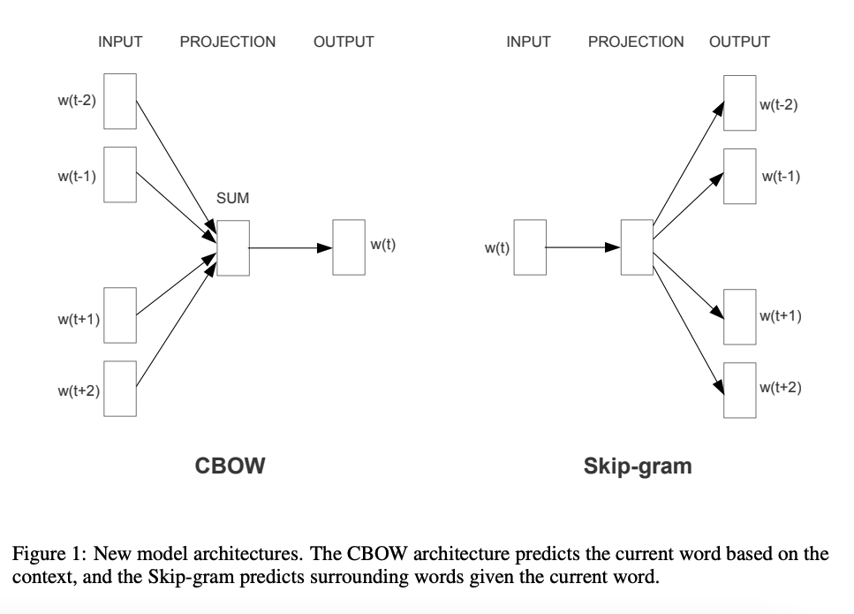
Embedding
Essentially model’s way to represent the word in an orderly manner in high dimensional space
Word2vec used Continuous bag of words (CBOW) and Continuous skip gram
Demo Link

Slide 9
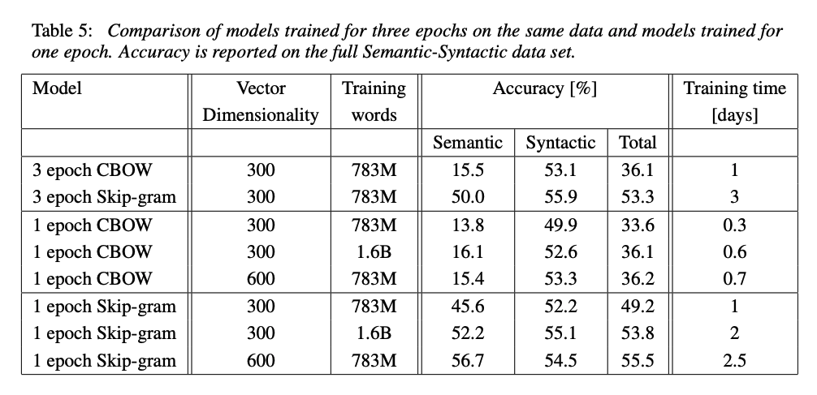
Embedding
Source: Link

Slide 10
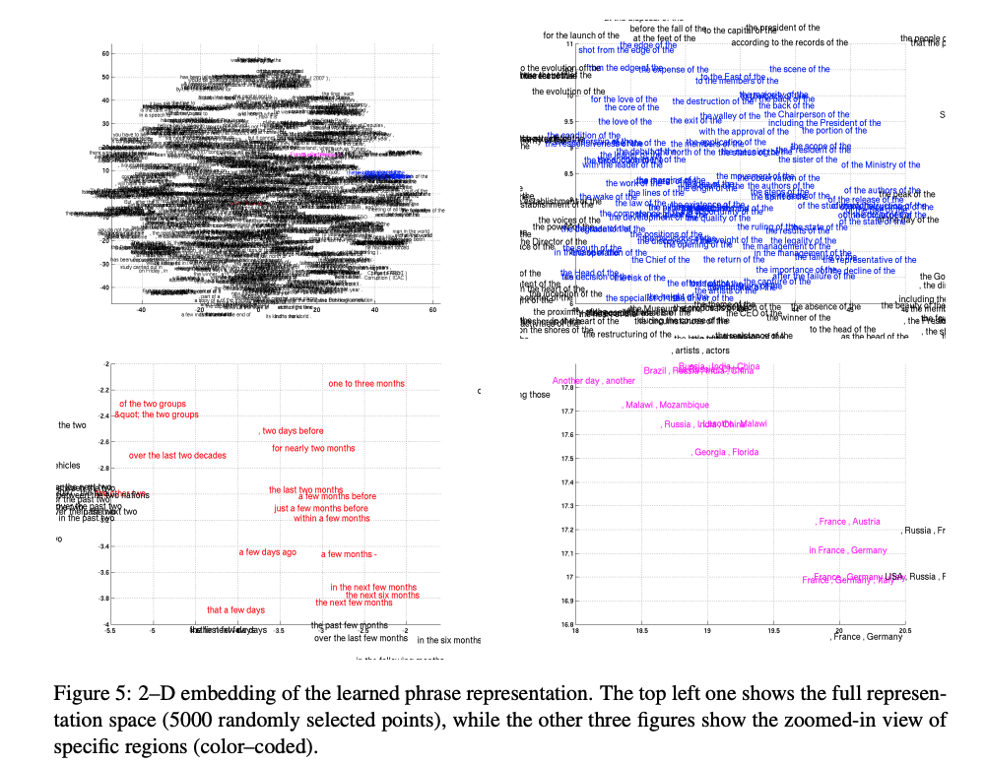
Embedding

Slide 11
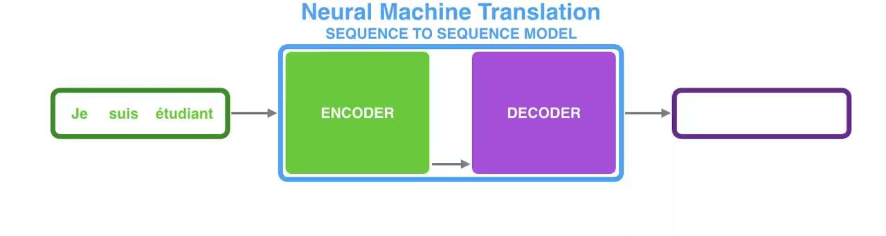
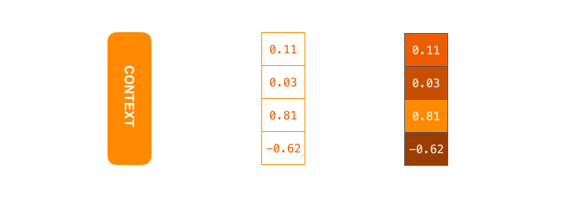
Why Attention is needed ?
Source:Link

Slide 12
Why Attention is needed ?
The use of a fixed-length vector is bottleneck in improving the performance of this basic encoder–decoder architecture,
Bahdanau et al.,2014 proposed a model to automatically (soft-)search for parts of a source sentence that are relevant to predicting a target word, without having to form these parts as a hard segment explicitly.
And hence Attention is needed

Slide 13
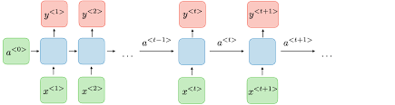
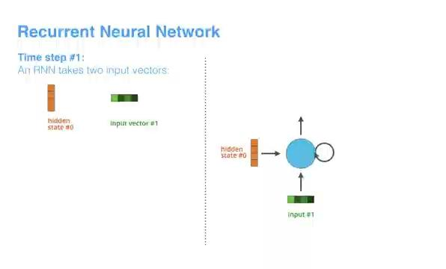
Recurrent Neural Networks
Unlike feedforward networks, RNNs have loops that allow them to retain information from previous time steps

Slide 14
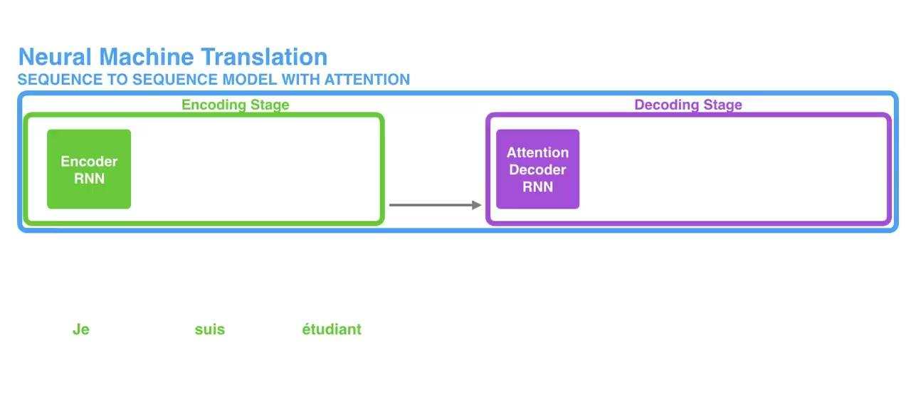
Attention is here
Source:Link

Slide 15
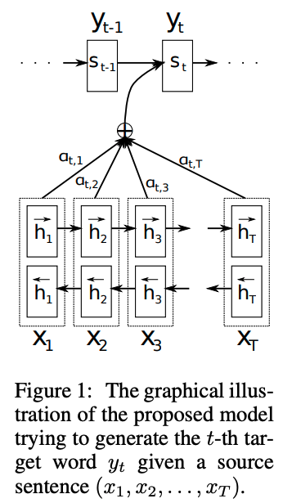
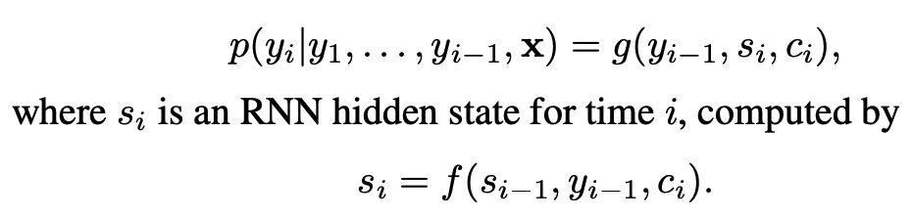
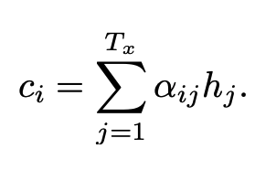
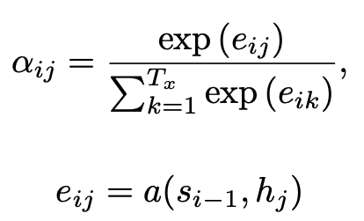
Attention is here
Let αij be a probability that the target word yi is aligned to, or translated from, a source word xj .
Context Vector
Attention
Source:Link

Slide 16
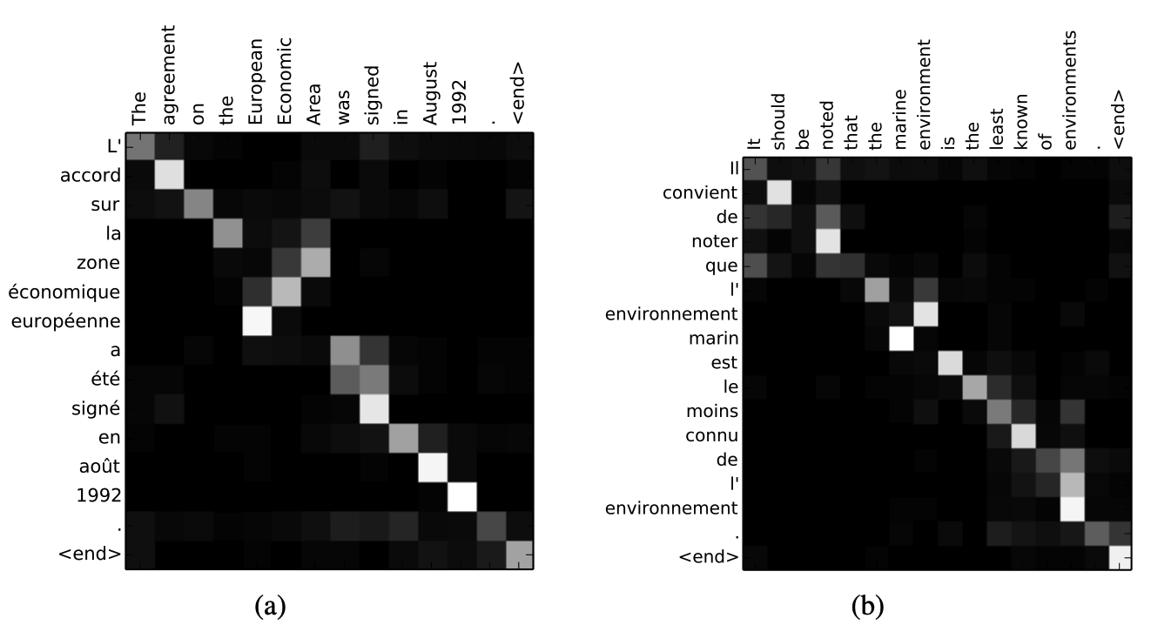
Attention is here
Source:Link

Slide 17
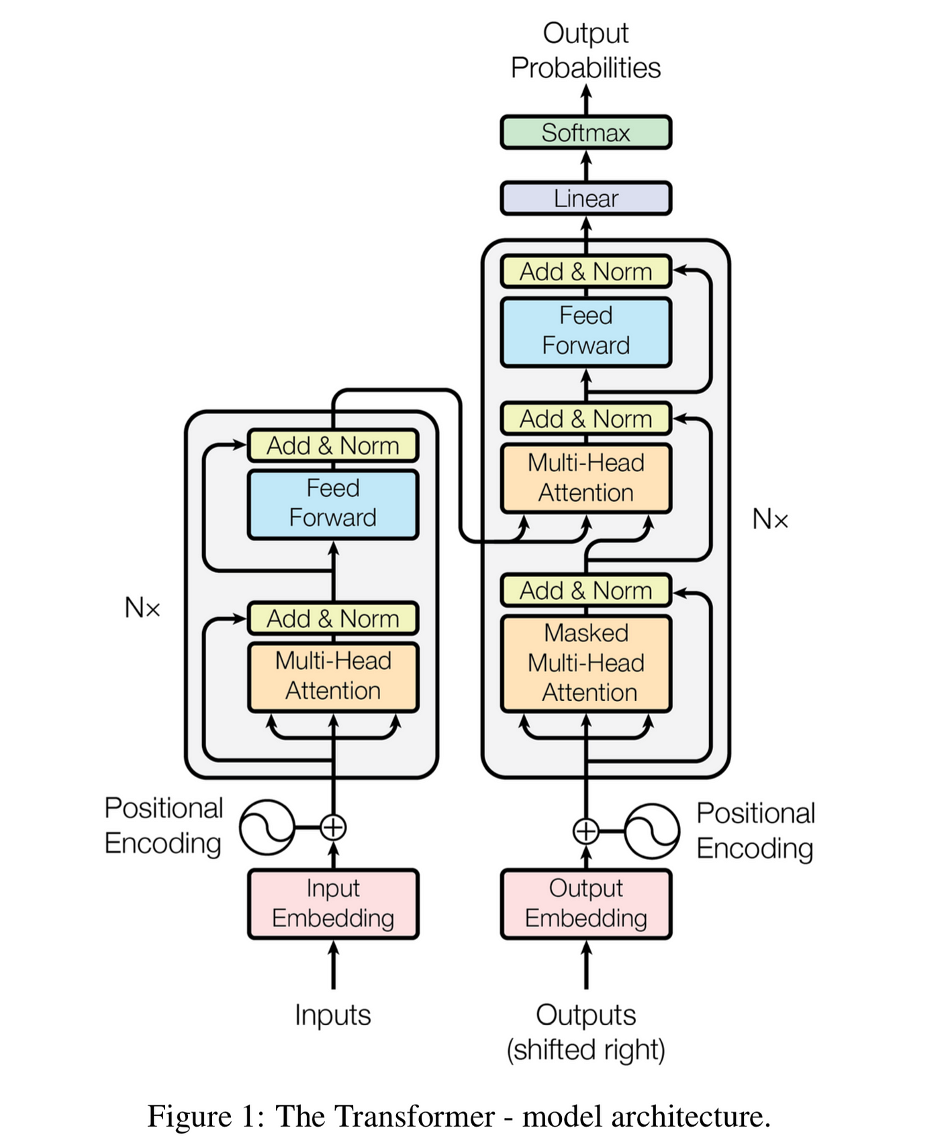
Enter Transformer
Encoder + Decoder architecture
Unlike RNNs and LSTMs, Transformers process entire sequences in parallel, making them more efficient and scalable.
The self-attention mechanism, allows models to capture long-range dependencies
Source:Link

Slide 18
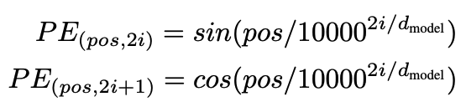
Enter Transformer
Input : A sentence with 6 words.
Output : Sentence with 6 words. (Translation task)
Input/output embeddings : d_model X 6
Positional encodings

Slide 19
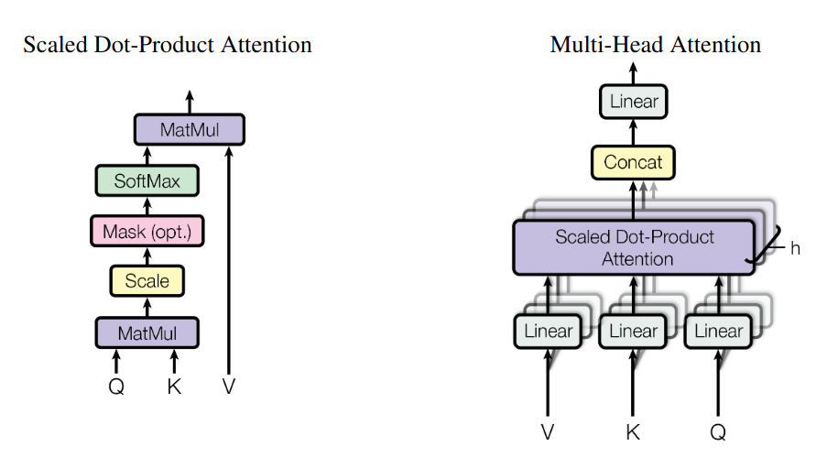
Self-Attention
Source:Link

Slide 20
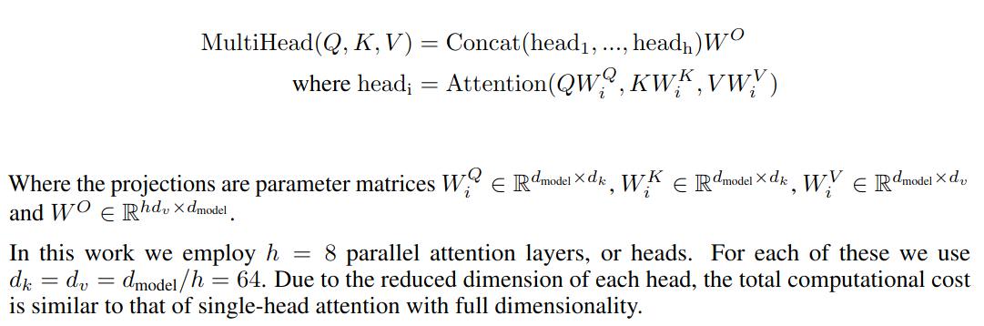
Self-Attention

Slide 21
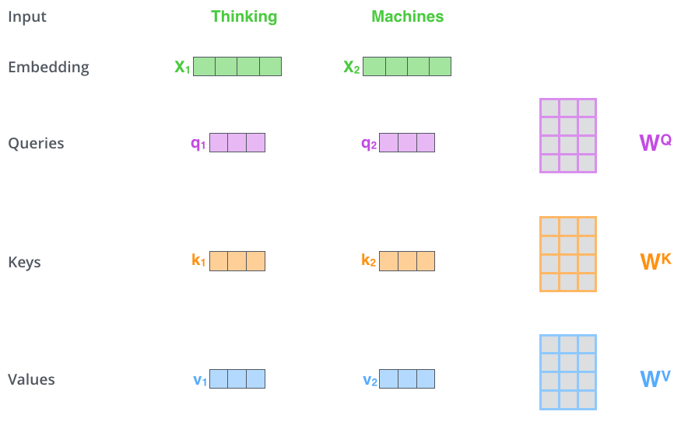
Self-Attention
Using skip connections such that HO = x + f(x)
Source: Link

Slide 22
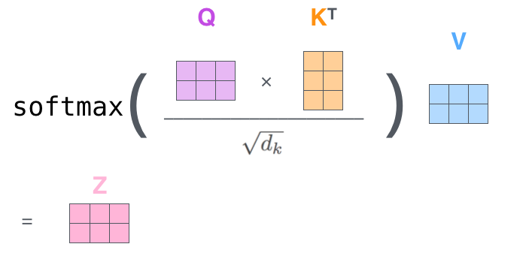
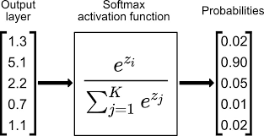
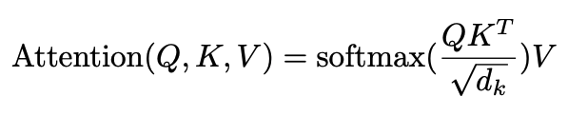
Self-Attention
Although this is only for a single head.
Source: Link

Slide 23
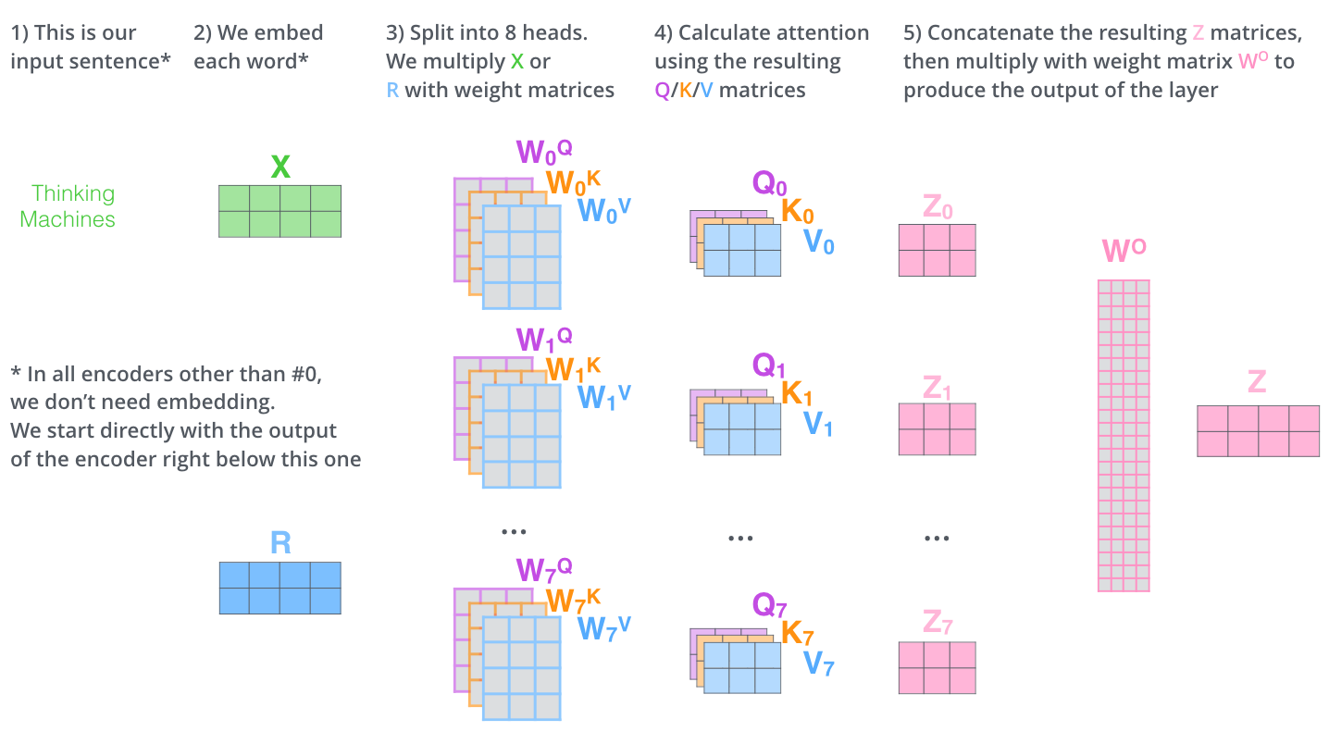
Self-Attention
Source: Link

Slide 24
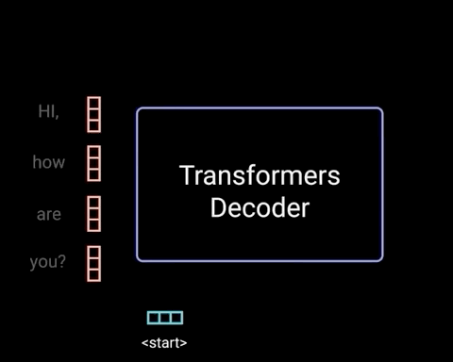
Self-Attention (Decoder)
Source:Link

Slide 25
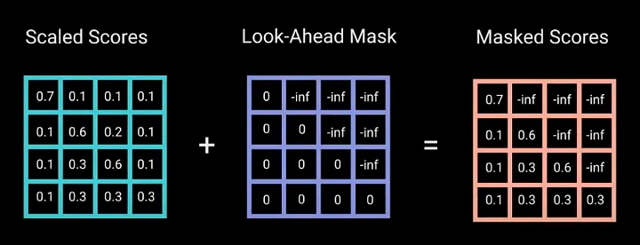
Self-Attention (Decoder)
To prevent the decoder from looking at future tokens, you apply a look ahead mask
This masking is the only difference in how the attention scores are calculated in the first multi-headed attention layer.
Source:Link

Slide 26
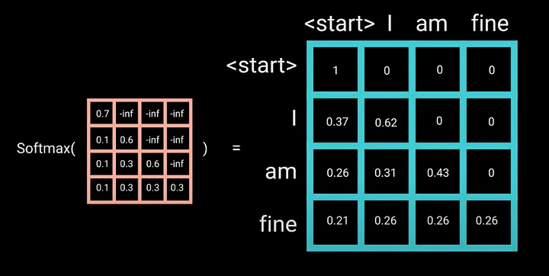
Self-Attention(Decoder)
And the rest is the same
Source:Link

Slide 27
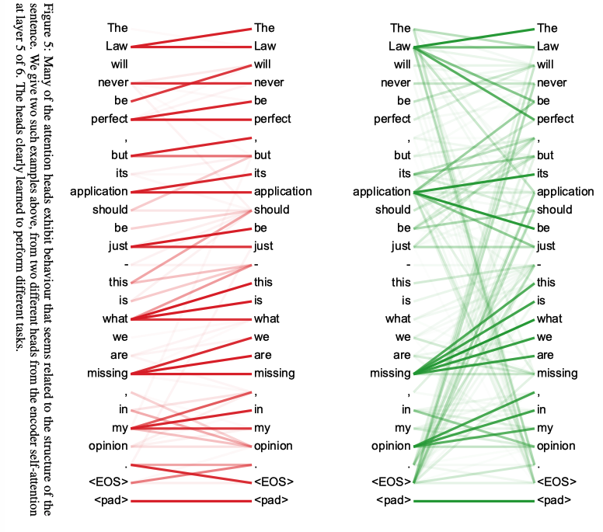
Results
Link

Slide 28
Current LLMs
BERT: Encoder only architecture, Bidirectional model, WordPiece tokenization
ChatGPT: Decoder only architecture, Byte-Pair encoding(BPE)
Gemini: Decoder only architecture, WordPiece tokenization

Slide 29
Thank You

