Slide 1
AI Agents
Nathan Crock

Slide 2
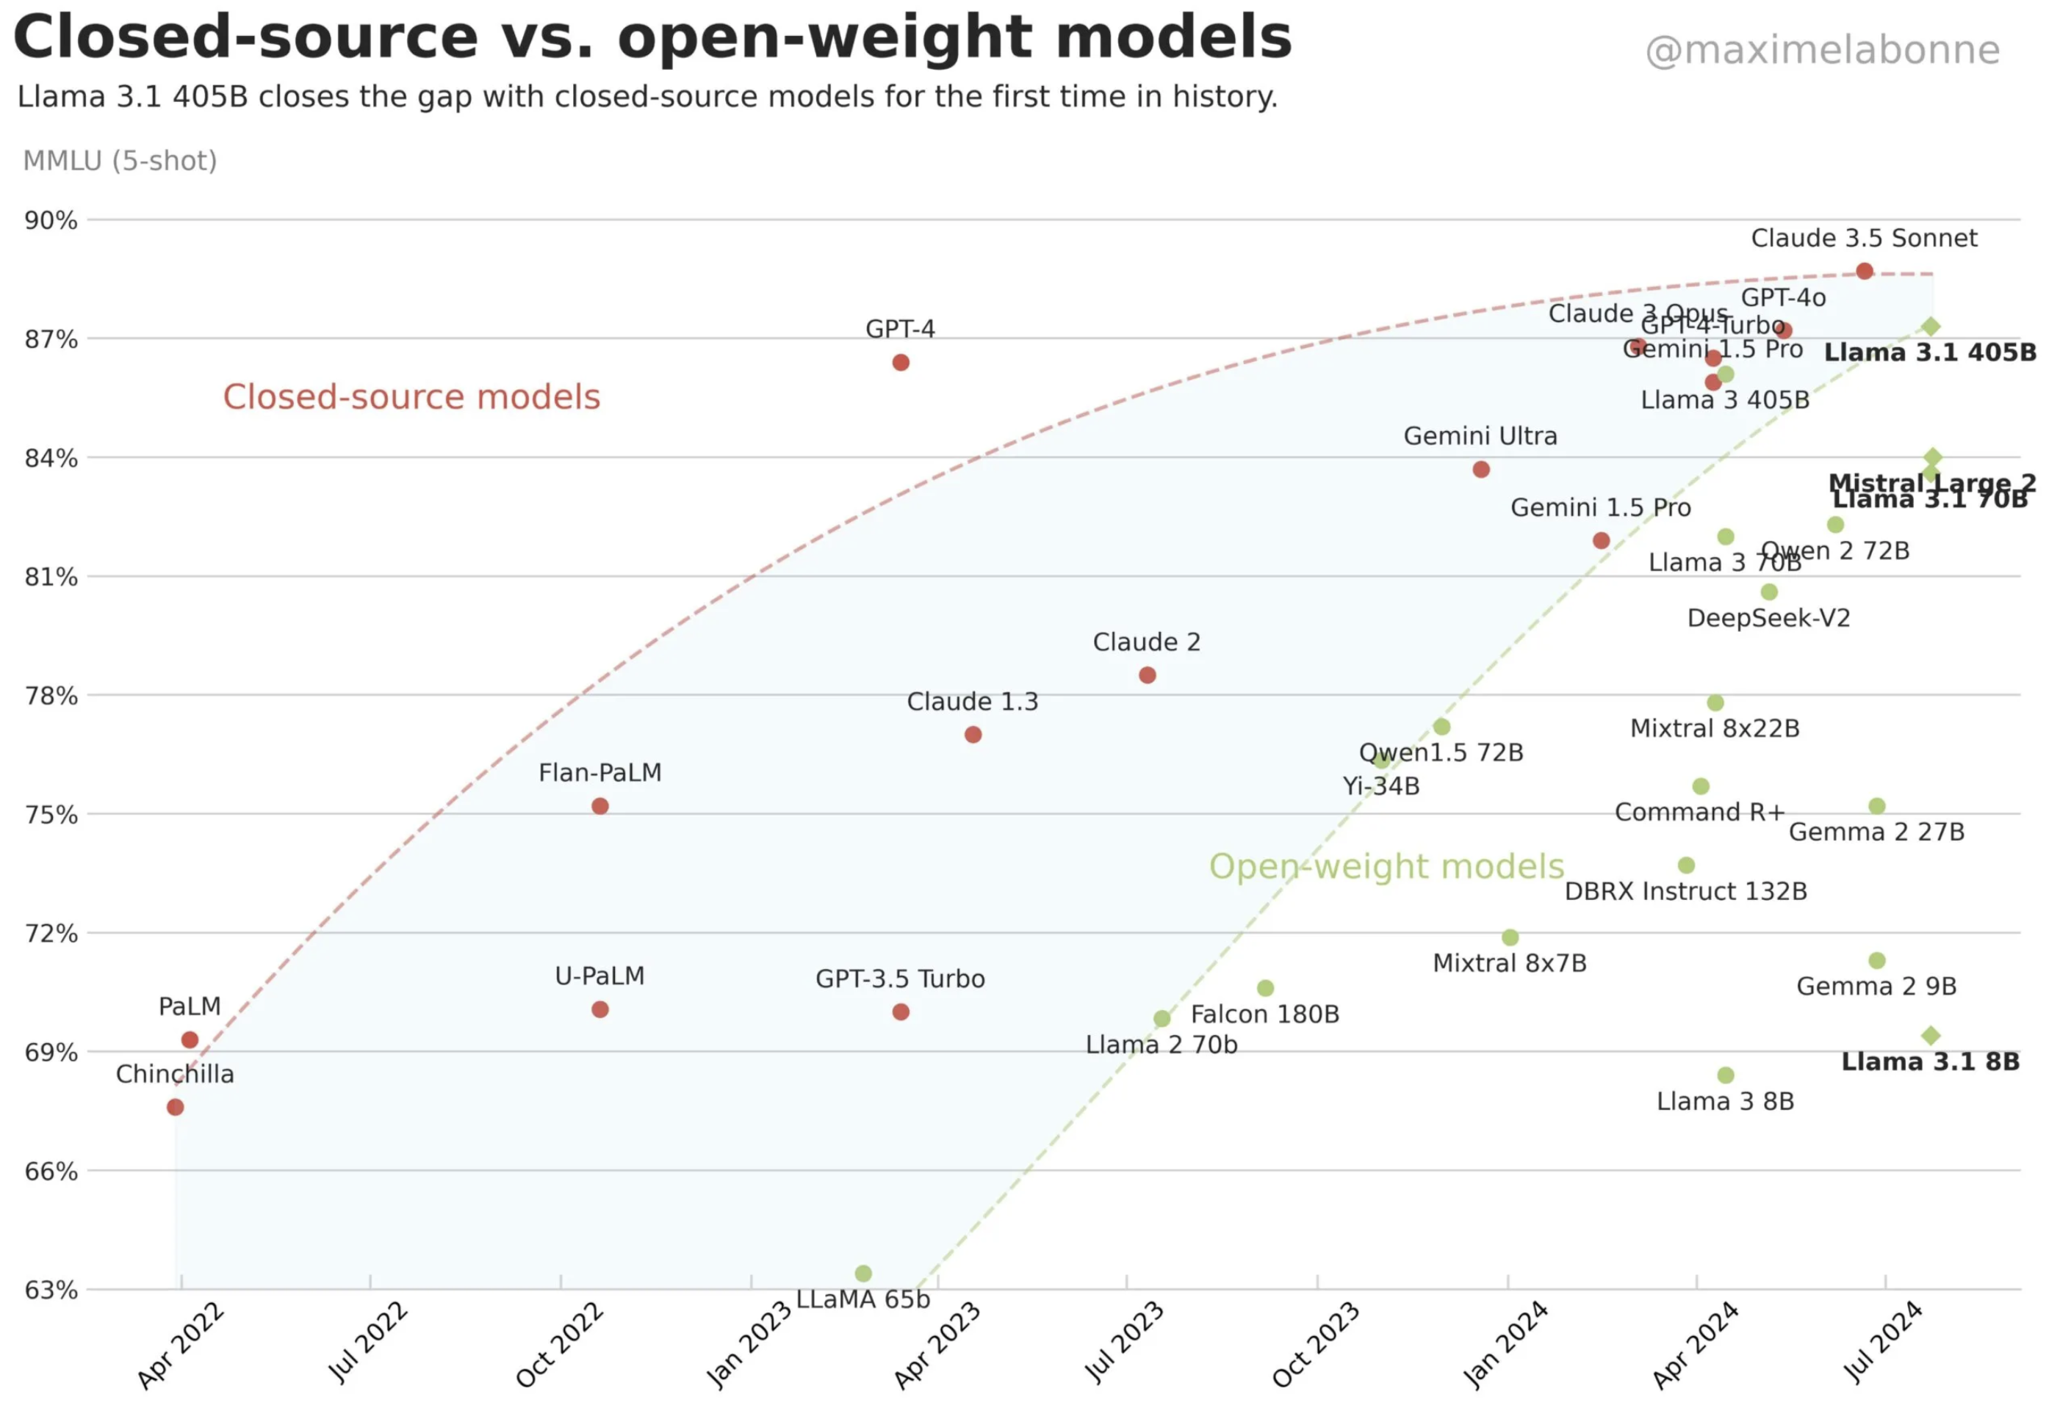
LLM Benchmark Performance is Plateauing
Models trained with cross-entropy loss on next token prediction are plateauing according to standard benchmarks (MMLU)
(@maximelabonne https://x.com/maximelabonne/status/1838170077021053004)

Slide 3
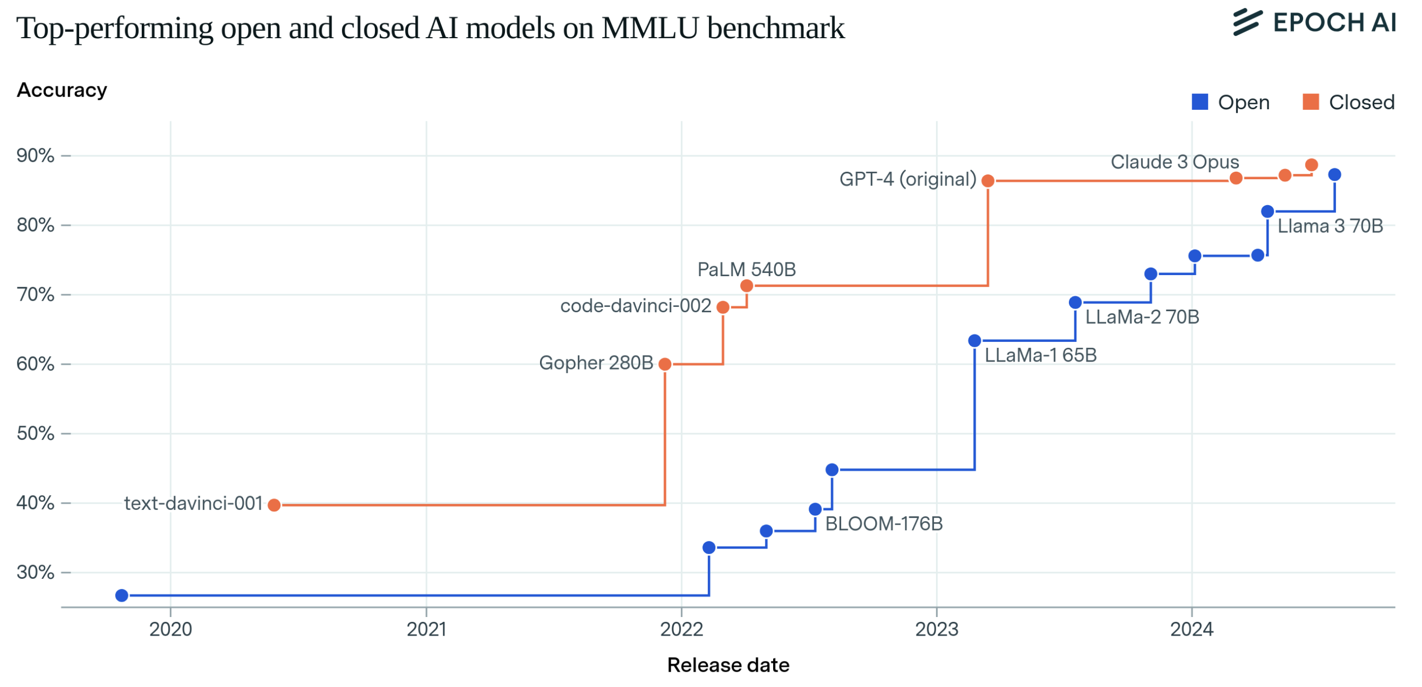
LLM Benchmark Performance is Plateauing
(2024), "How Far Behind Are Open Models?". 'https://epoch.ai/blog/open-models-report'

Slide 4
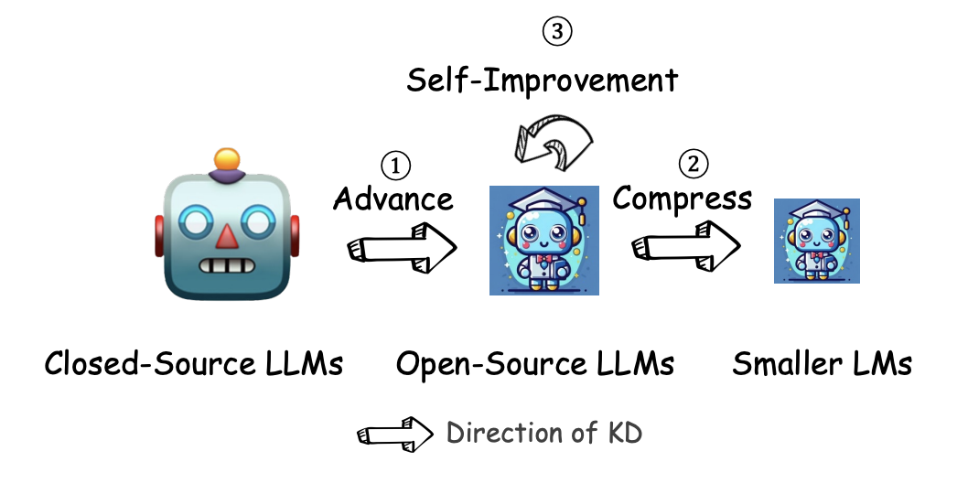
What is left to Optimize?
Speed, Size and Grounding
https://arxiv.org/pdf/2402.13116v4

Slide 5
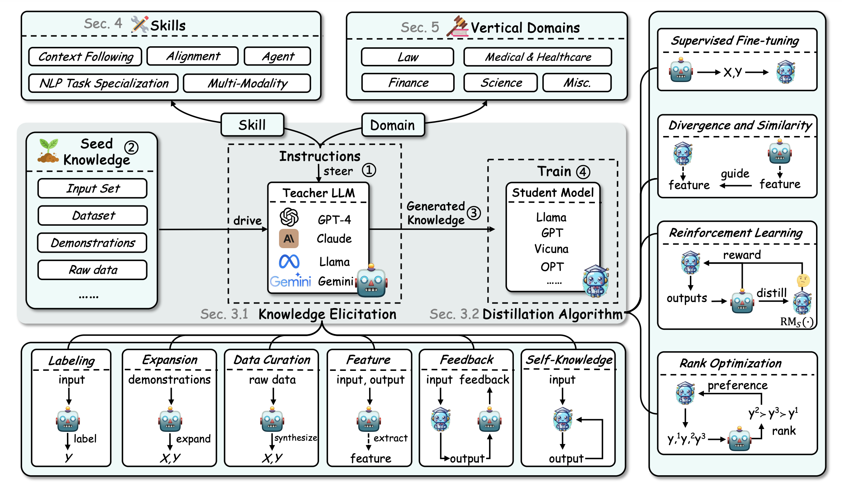
https://arxiv.org/pdf/2402.13116v4

Slide 6
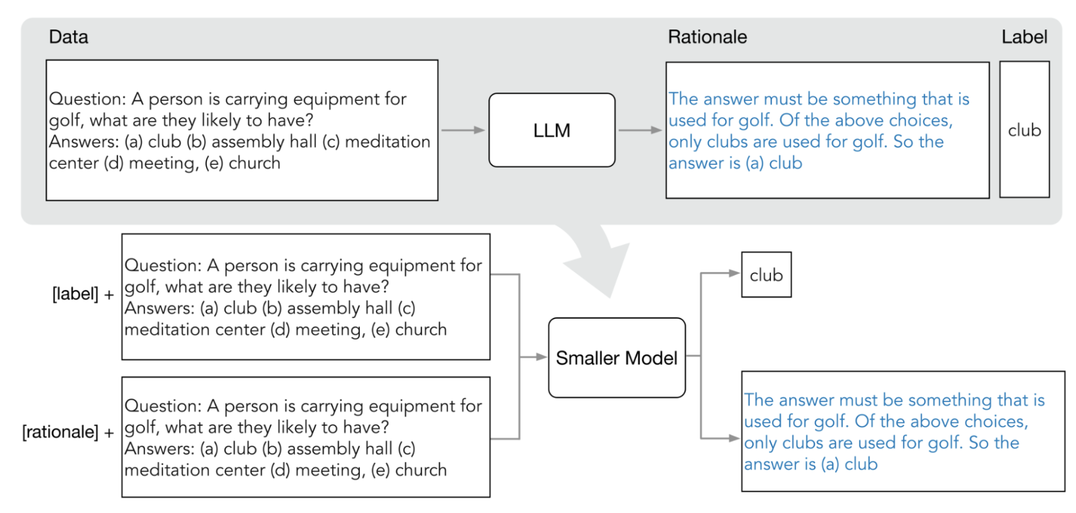
https://research.google/blog/distilling-step-by-step-outperforming-larger-language-models-with-less-training-data-and-smaller-model-sizes/

Slide 7
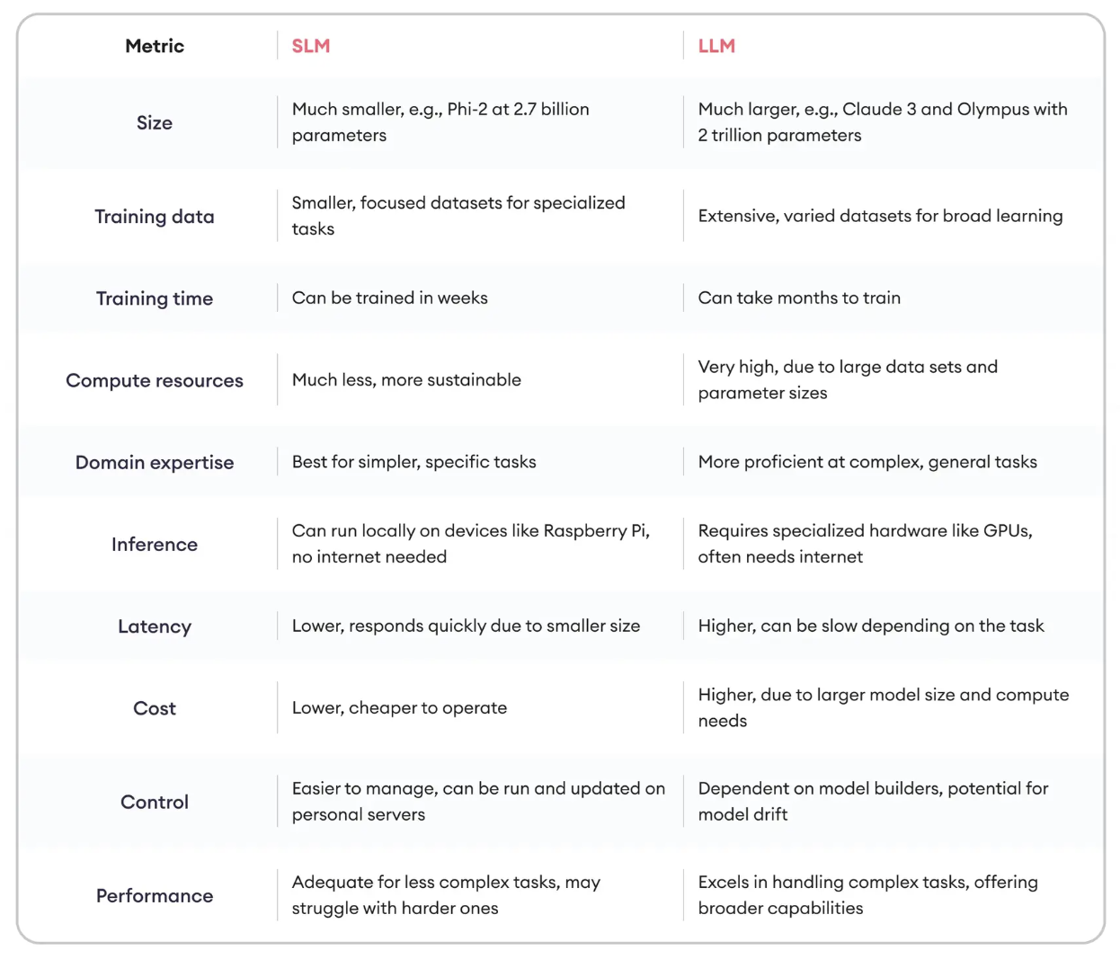
SLM vs LLM

Slide 8
Why AI Agents are the Foreseeable Future
LMs are plateauing, so they’re getting smaller and faster
This allows them to process more content on smaller devices
Faster models on edge devices admits orchestration of many LMs
Grounding mitigates hallucinations/confabulations
Datasets are focusing on the “cognitive reasoning core”
Tools significantly increase LLM capabilities and give them agency
More agency -> more automation = bigger savings $$$
We will need a new breakthrough, like reasoning models trained via RL, before a new paradigm is reached

Slide 9
So How do Agents work?

Slide 10
Query an LLM
User Interface
User Query
AI Response
Backend App
messages =
System Message: “You are a helpful assistant”
User Message: { }
User Query
AI Response = LLM(messages)
🤖

Slide 11

Query an LLM
with RAG
User Interface
User Query
AI Response
Data Warehouse
Backend App
information =
search(User Query}
System Message: “You are a helpful assistant”
User Message: “Answer this {User Query} using this {information}”
messages =
response = LLM(messages)
🤖

Slide 12
Query an LLM
with RAG
User Interface
Retrieval
User Query
AI Response
Data Warehouse
Backend App
information =
search(User Query}
System Message: “You are a helpful assistant”
User Message: “Answer this {User Query} using this {information}”
messages =
response = LLM(messages)
🤖

Slide 13
Query an LLM
with RAG
User Interface
User Query
AI Response
Data Warehouse
Augmented
Backend App
information =
search(User Query}
System Message: “You are a helpful assistant”
User Message: “Answer this {User Query} using this {information}”
messages =
response = LLM(messages)
🤖

Slide 14
Query an LLM
with RAG
User Interface
User Query
AI Response
Data Warehouse
Backend App
information =
search(User Query}
System Message: “You are a helpful assistant”
User Message: “Answer this {User Query} using this {information}”
messages =
response = LLM(messages)
🤖
Generation

Slide 15
Query an AI Agent
User Interface
User Query
AI Response
Tools
System Message: “You create plans”
User Message: “Create a plan to answer this question:
using these tools: {Tools}”
messages =
Tool1
Tool2
Tool3
🤖
{User Query}
plan = LLM(messages)
plan_results =
execute_plan(plan}
Task Manager
System Message: “You answer questions”
User Message: “Answer this question: {User Query} based on this information {plan_results}
🤖
messages =
🤖
response = LLM(messages)
Async Task Execution

Slide 16
Agentic Reasoning Frameworks
Chain of Thought (2022)
Tree Based Models
  Tree of Thoughts (2023)
  Reasoning via Planning (2023)
  Language Agent Tree Search (2023)
Planning with Feedback
  ReAct (2022)
  Reflexion (2023)
  LLMCompiler (2024)
https://div.beehiiv.com/p/need-talk-agents

Slide 17
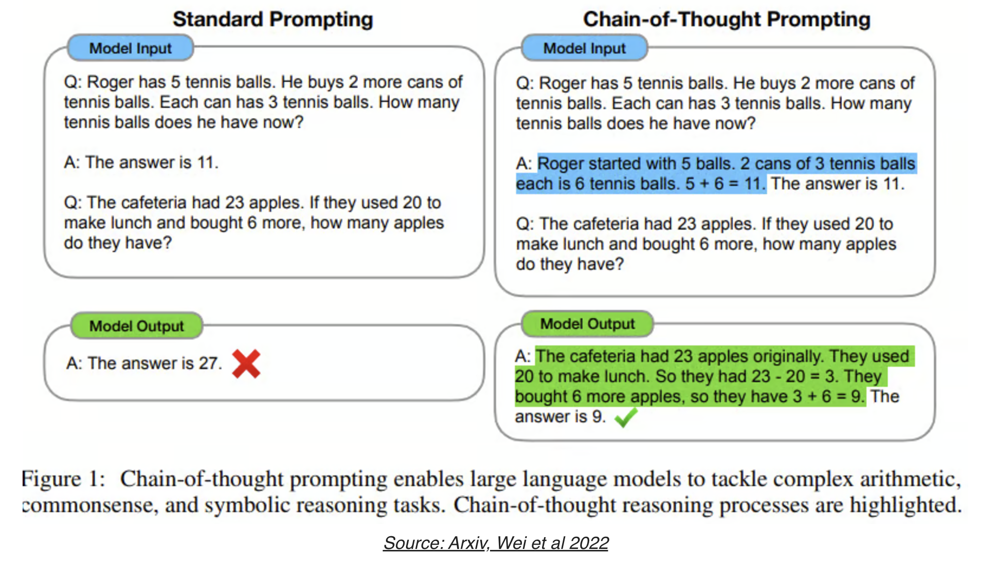
Chain of Thought (2022)

Slide 18
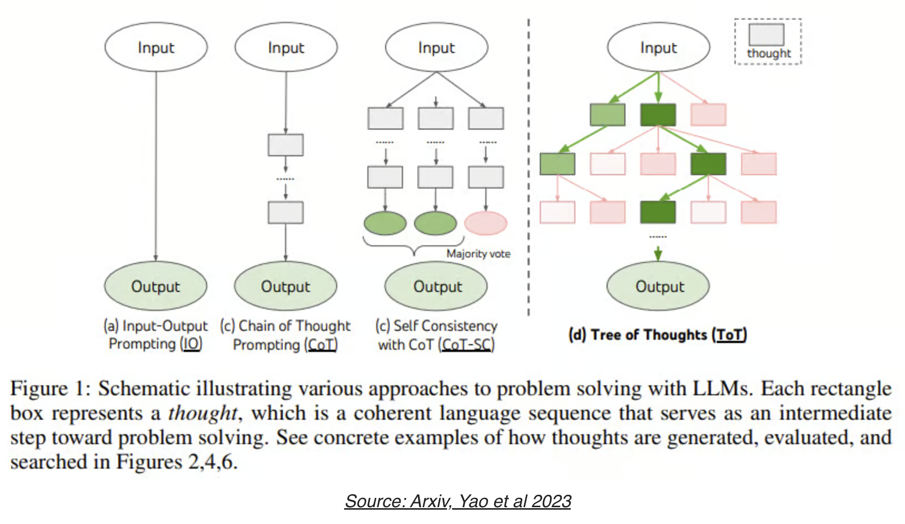
  Tree of Thoughts (2023)

Slide 19
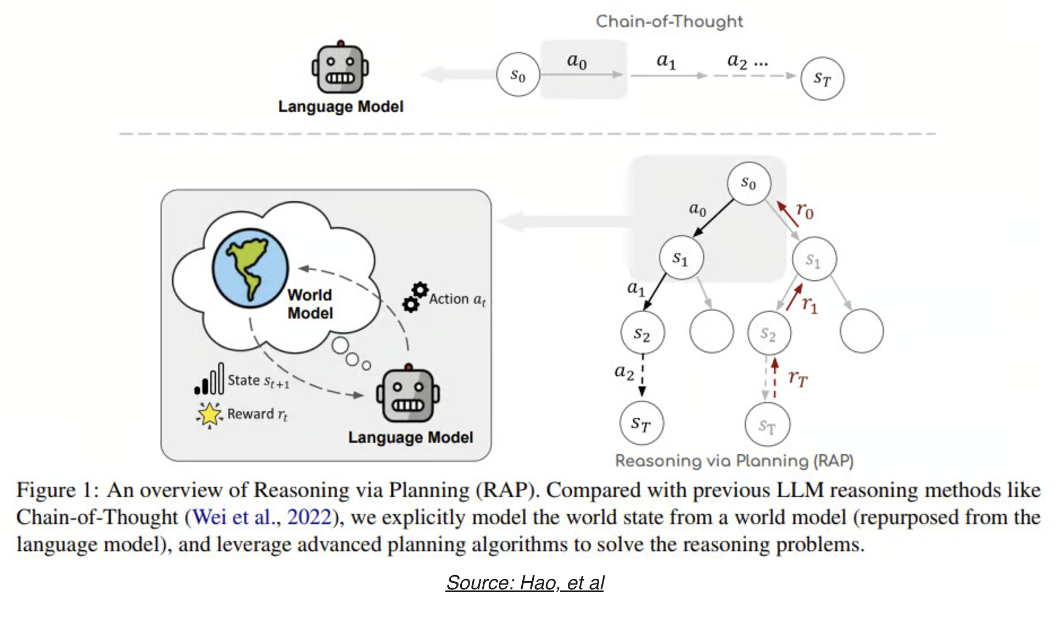
  Reasoning via Planning (2023)

Slide 20
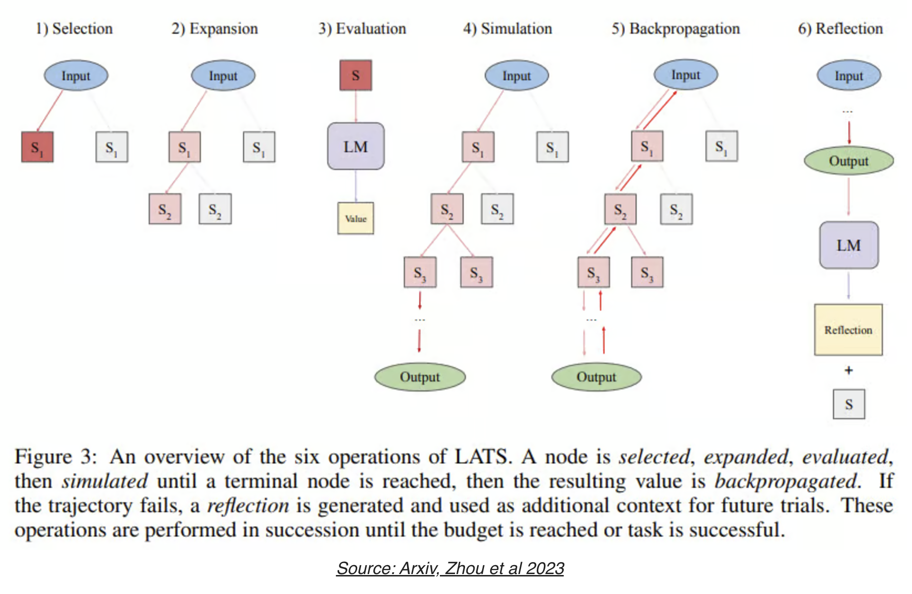
  Language Agent Tree Search (2023)

Slide 21
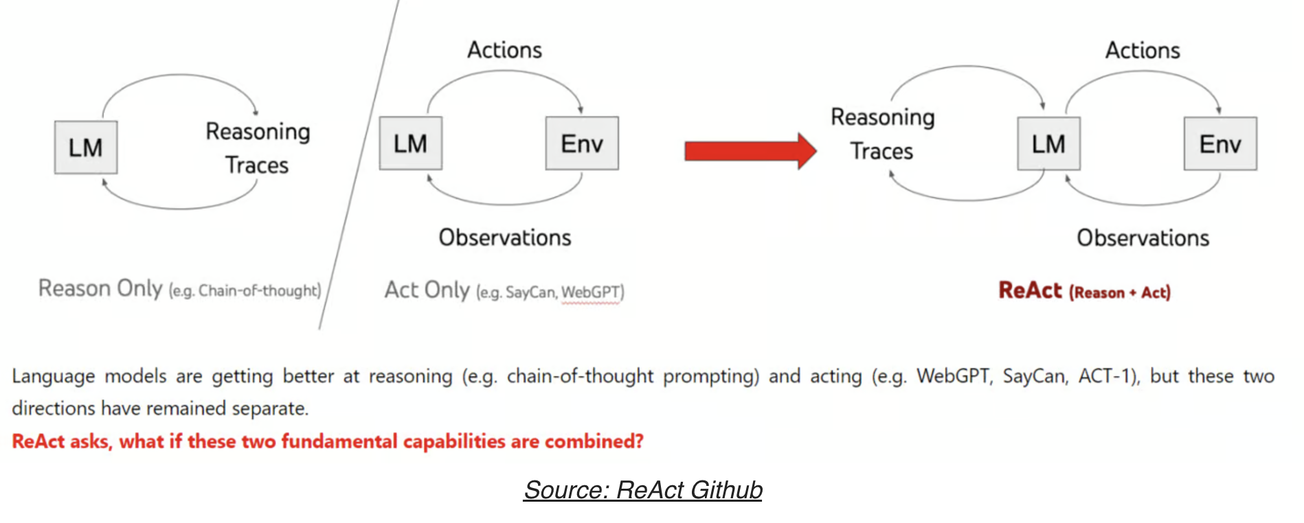
  ReAct (2022)

Slide 22
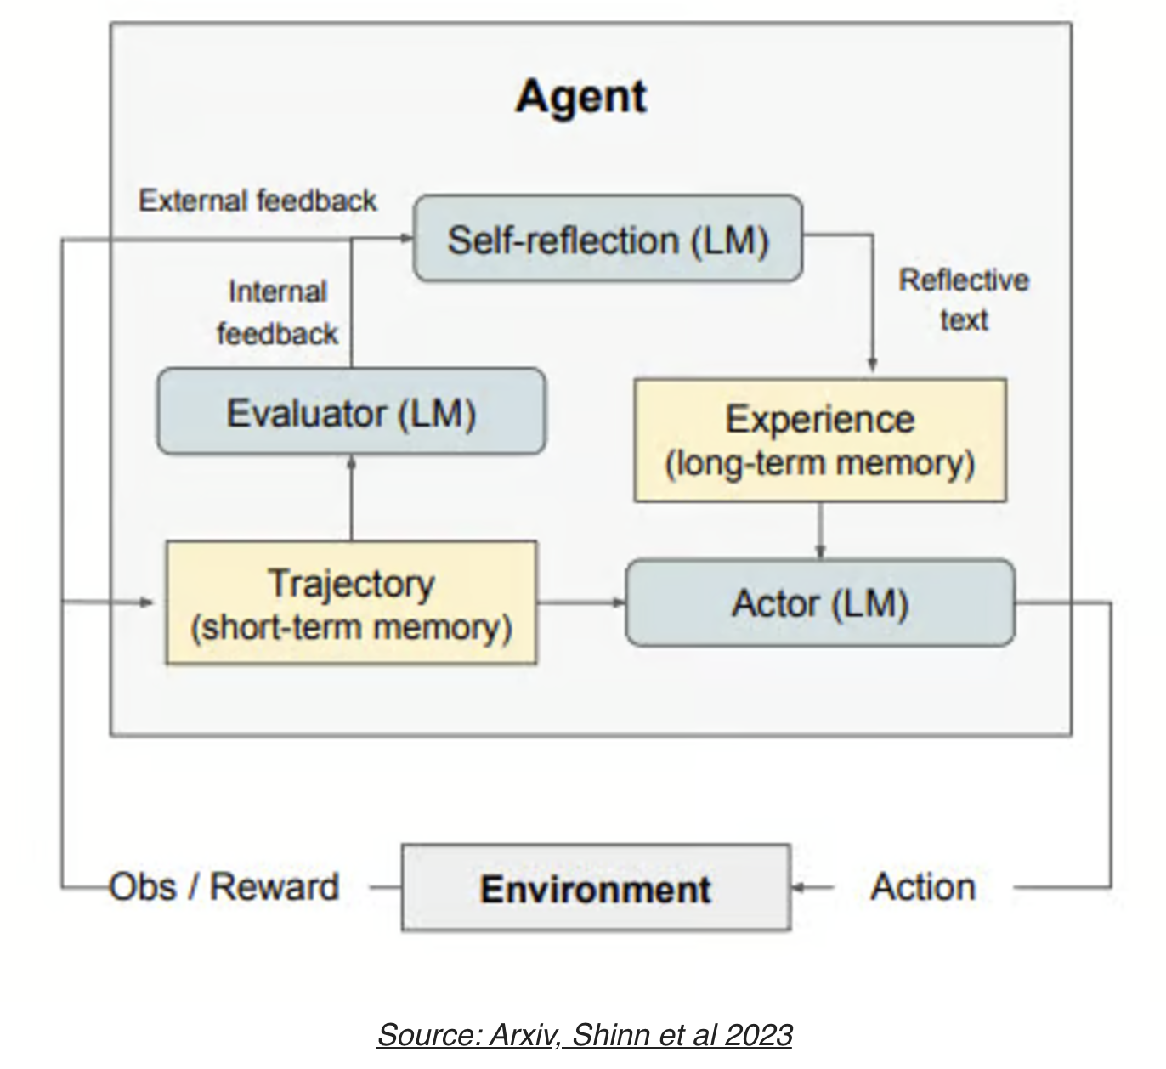
  Reflexion (2023)

Slide 23
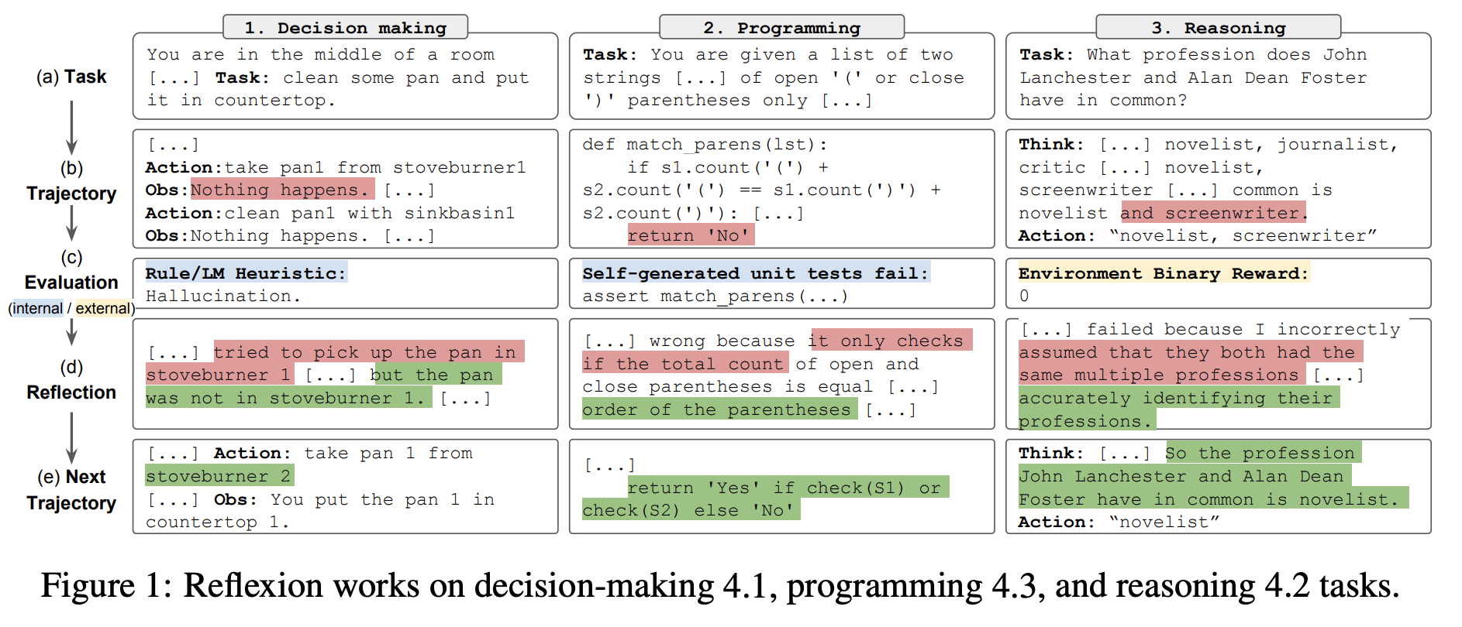
  Reflexion (2023)

Slide 24
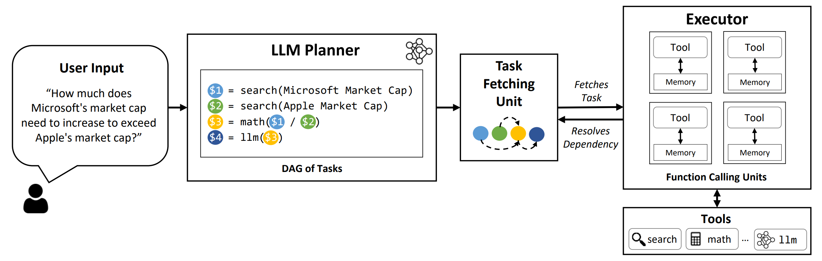
LLM Compiler (2023)
https://arxiv.org/abs/2312.04511

