Slide 1
Degradation Aware Predictive Energy Management Strategy for Ship Power Systems
Satish Vedula*
Mehrzad Mohammadi Bijaieh
Ellis Oti Boateng
Olugbenga Moses Anubi
1

Slide 2
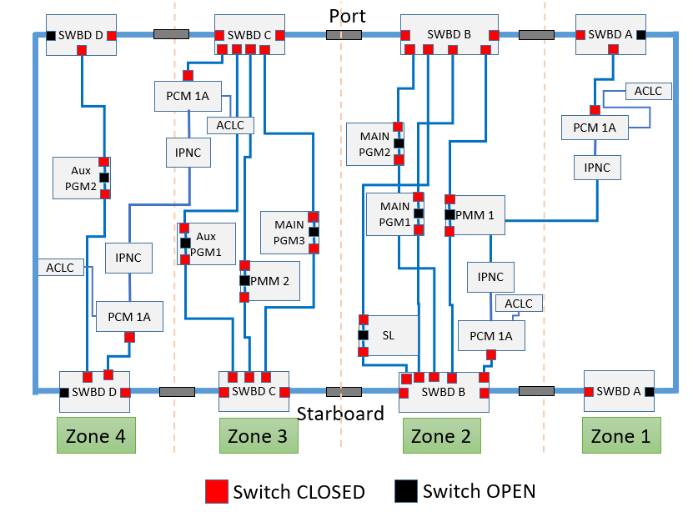
Motivation
Integration of modern defense weapons into ship power systems (SPS) poses a challenge in terms of meeting the high ramp rate requirements of those loads.
Key power supplying sources:
Power Generation Module (PGM)
Power Conversion Module (PCM)
Auxiliary PGM (APGM)
Key power demanding modules:
Propulsion Motor Module (PMM)
Pulse Power Loads (PPL)
High ramp-rate requirements
Addressing the PPL ramp-rate requirements by designing an energy management strategy (EMS).

Slide 3
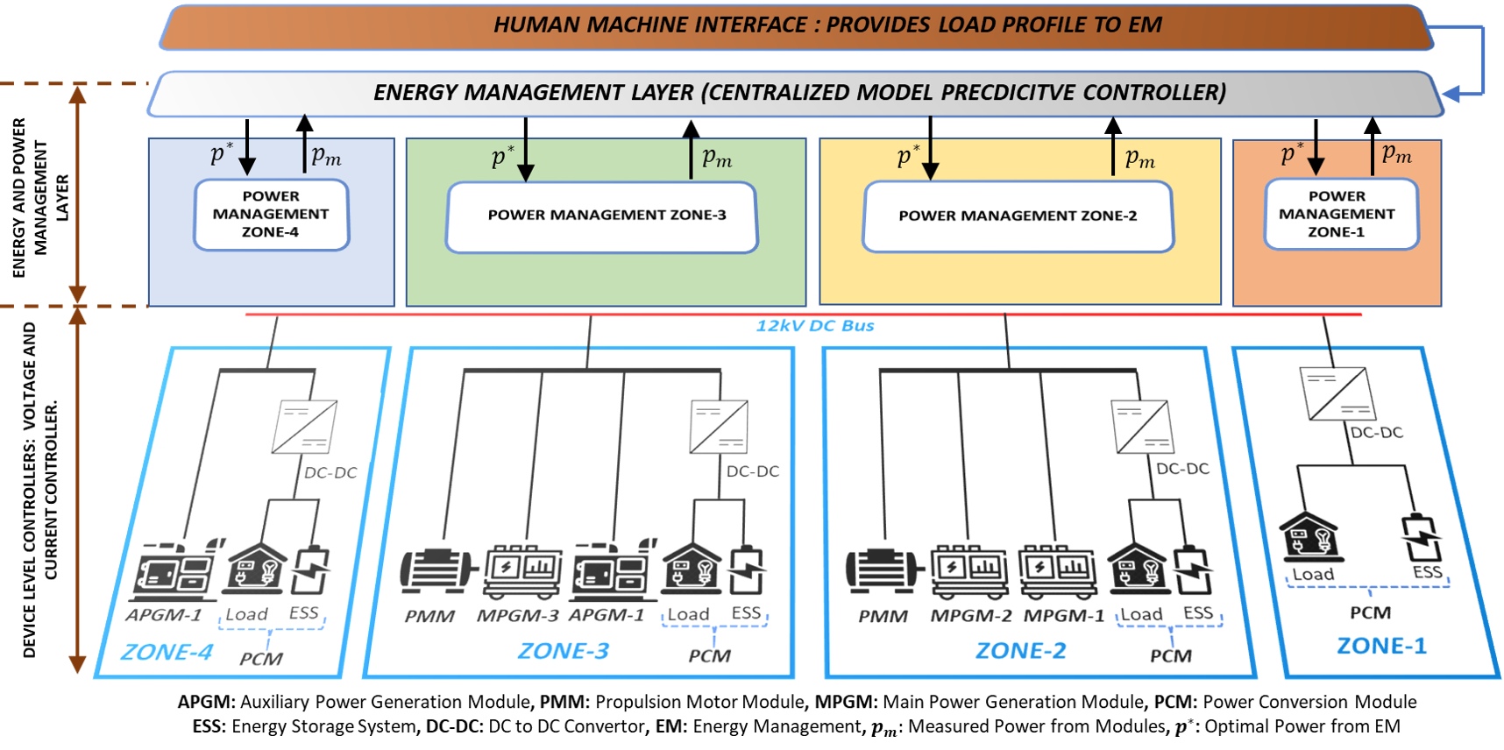
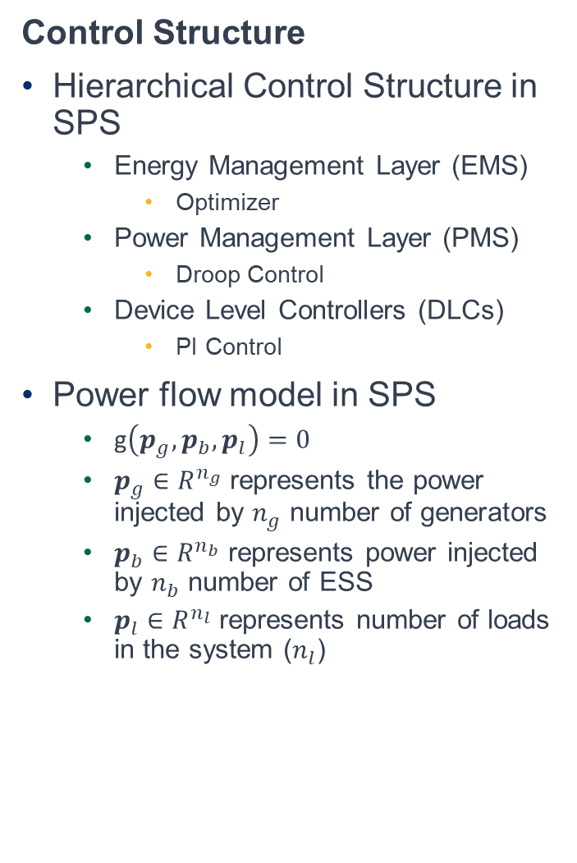
Problem Statement
Control Structure
Hierarchical Control Structure in SPS
Energy Management Layer (EMS)
Optimizer
Power Management Layer (PMS)
Droop Control
Device Level Controllers (DLCs)
PI Control
Power flow model in SPS
g$\left(p_{g},p_{b},p_{l}\right)=0$
$p_{g}∈R^{n_{g}}$ represents the power injected by $n_{g}$ number of generators
$p_{b}∈R^{n_{b}}$ represents power injected by $n_{b}$ number of ESS
$p_{l}∈R^{n_{l}}$ represents number of loads in the system ($n_{l}$)

Slide 4
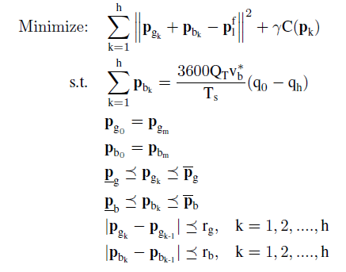

Problem Statement
MPC Formulation
Decision Variables
$p_{g_{k}}$ : Generator Power
$p_{b_{k}}$ : Battery Power
Load Forecast : $p_{l}^{f}$
Decision Variable Initialization
$p_{g_{m}}$ : Measured Generator Power
$p_{b_{m}}$ : Measured Battery Power
Upper and Lower Power Limitations
Ramp Rate Limitations
$r_{g}$ : Generator Ramp Limitations
$r_{b}$: Battery Ramp Limitations
State of Charge (SoC)
$q_{0}$ : Initial SoC
$q_{h}$ : Final SoC (End of Horizon SoC)
Objective
Constraints
13

Slide 5

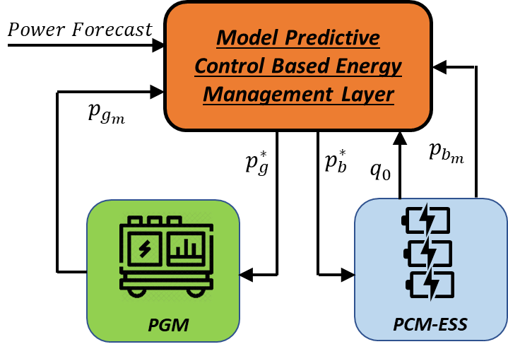
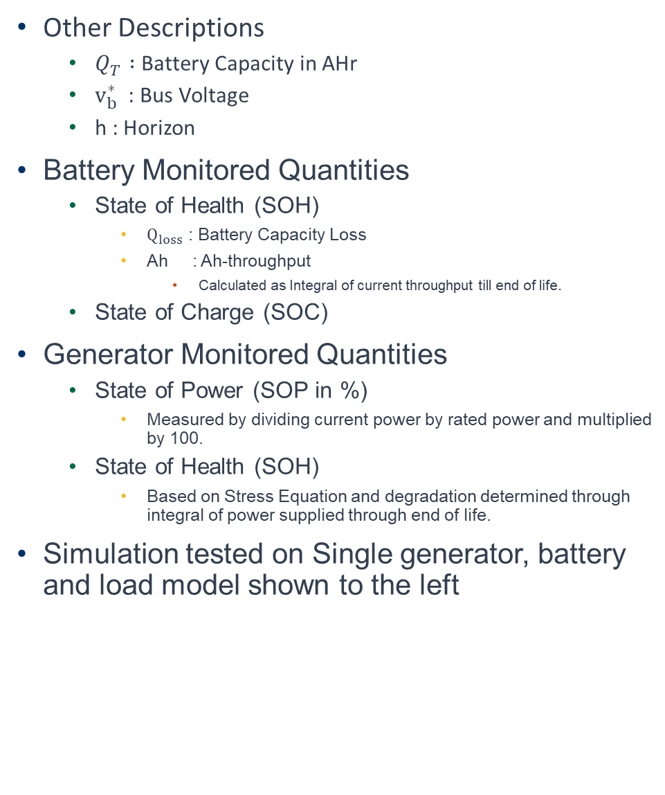
Problem Statement
Other Descriptions
$Q_{T} :$ Battery Capacity in AHr
$v_{b}^{∗}$ : Bus Voltage
h : Horizon
Battery Monitored Quantities
State of Health (SOH)
$Q_{loss}$ : Battery Capacity Loss
Ah : Ah-throughput
Calculated as Integral of current throughput till end of life.
State of Charge (SOC)
Generator Monitored Quantities
State of Power (SOP in %)
Measured by dividing current power by rated power and multiplied by 100.
State of Health (SOH)
Based on Stress Equation and degradation determined through integral of power supplied through end of life.
Simulation tested on Single generator, battery and load model shown to the left
13

Slide 6
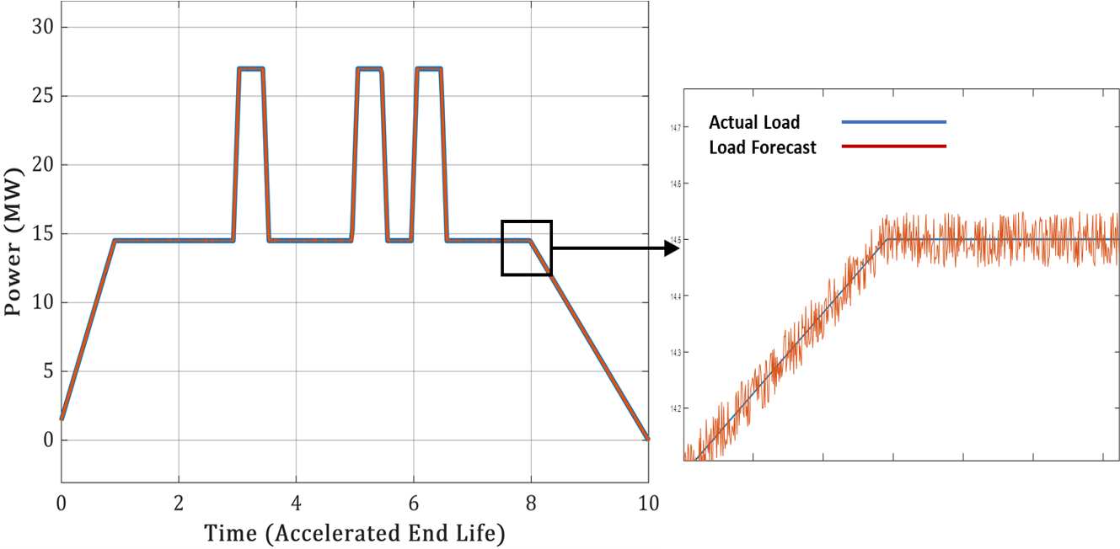
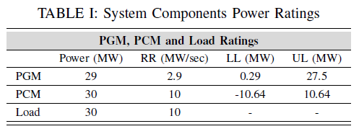
Results
Load Forecast
Power Forecast is generated to replicate the usage of PPLs.
Noise varying from 1% to 10% threshold is introduced to the load forecast as seen in the figure to the left.
The table showing the component ratings for PCM, PGM and PMM used for the simulation.

Slide 7
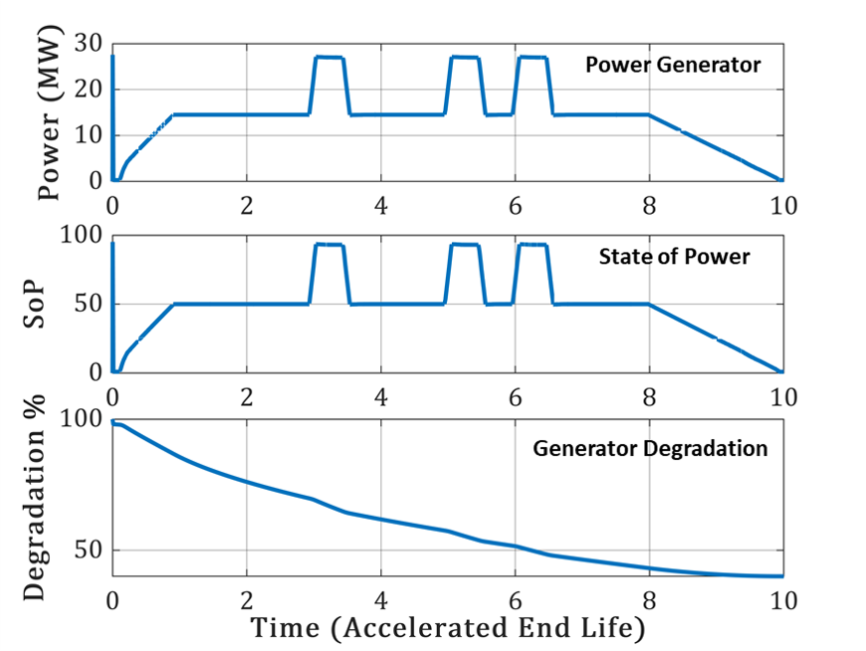
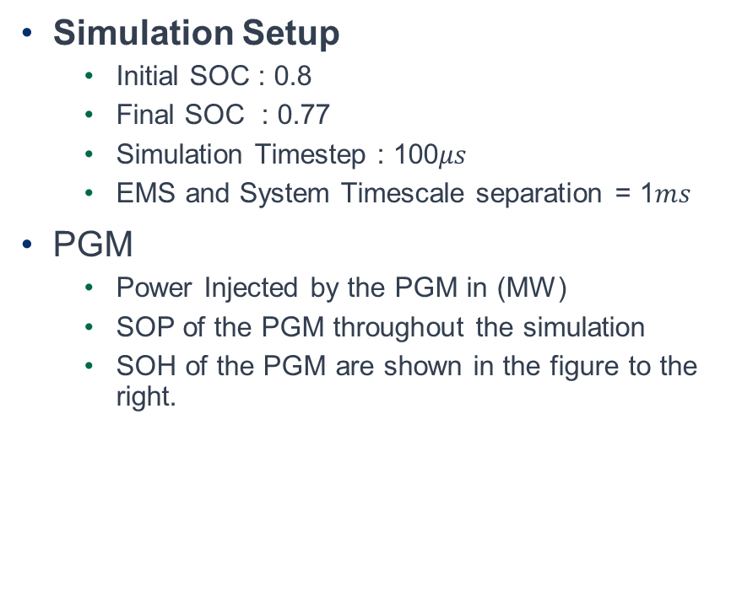
Results
Simulation Setup
Initial SOC : 0.8
Final SOC : 0.77
Simulation Timestep : 100$μs$
EMS and System Timescale separation = 1$ms$
PGM
Power Injected by the PGM in (MW)
SOP of the PGM throughout the simulation
SOH of the PGM are shown in the figure to the right.

Slide 8
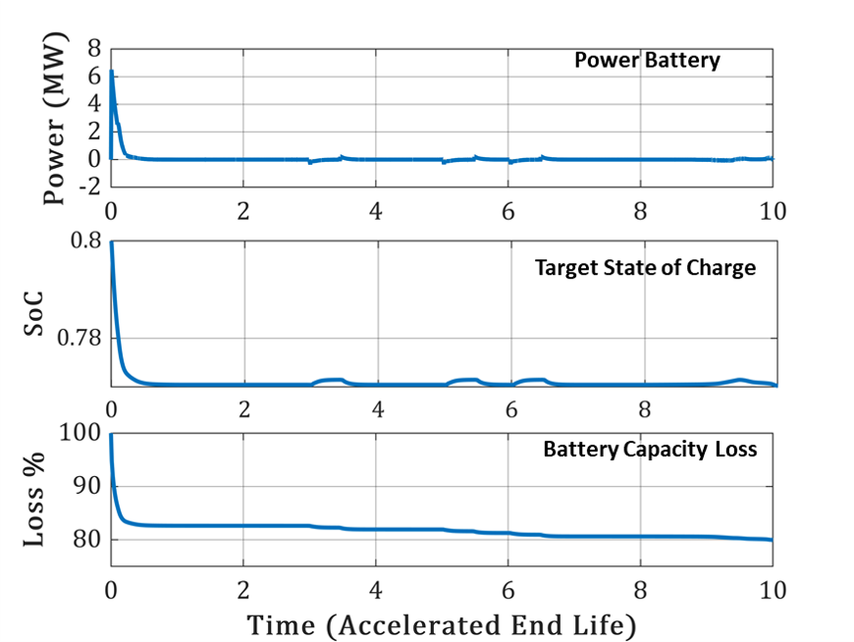
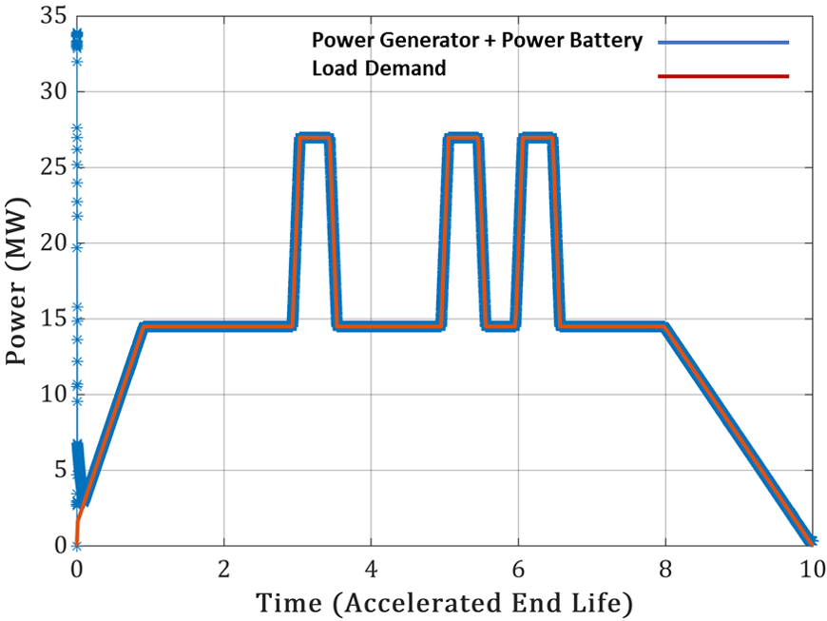
Results
PCM
Power Injected by the battery in (MW)
SOC of the battery throughout the simulation
SOH of the battery are shown in the figure to the right. The simulation run is adjusted to meet the accelerated end of life for components
Combined Power injections by generator and battery compared to power forecast shown in figure below.

Slide 9
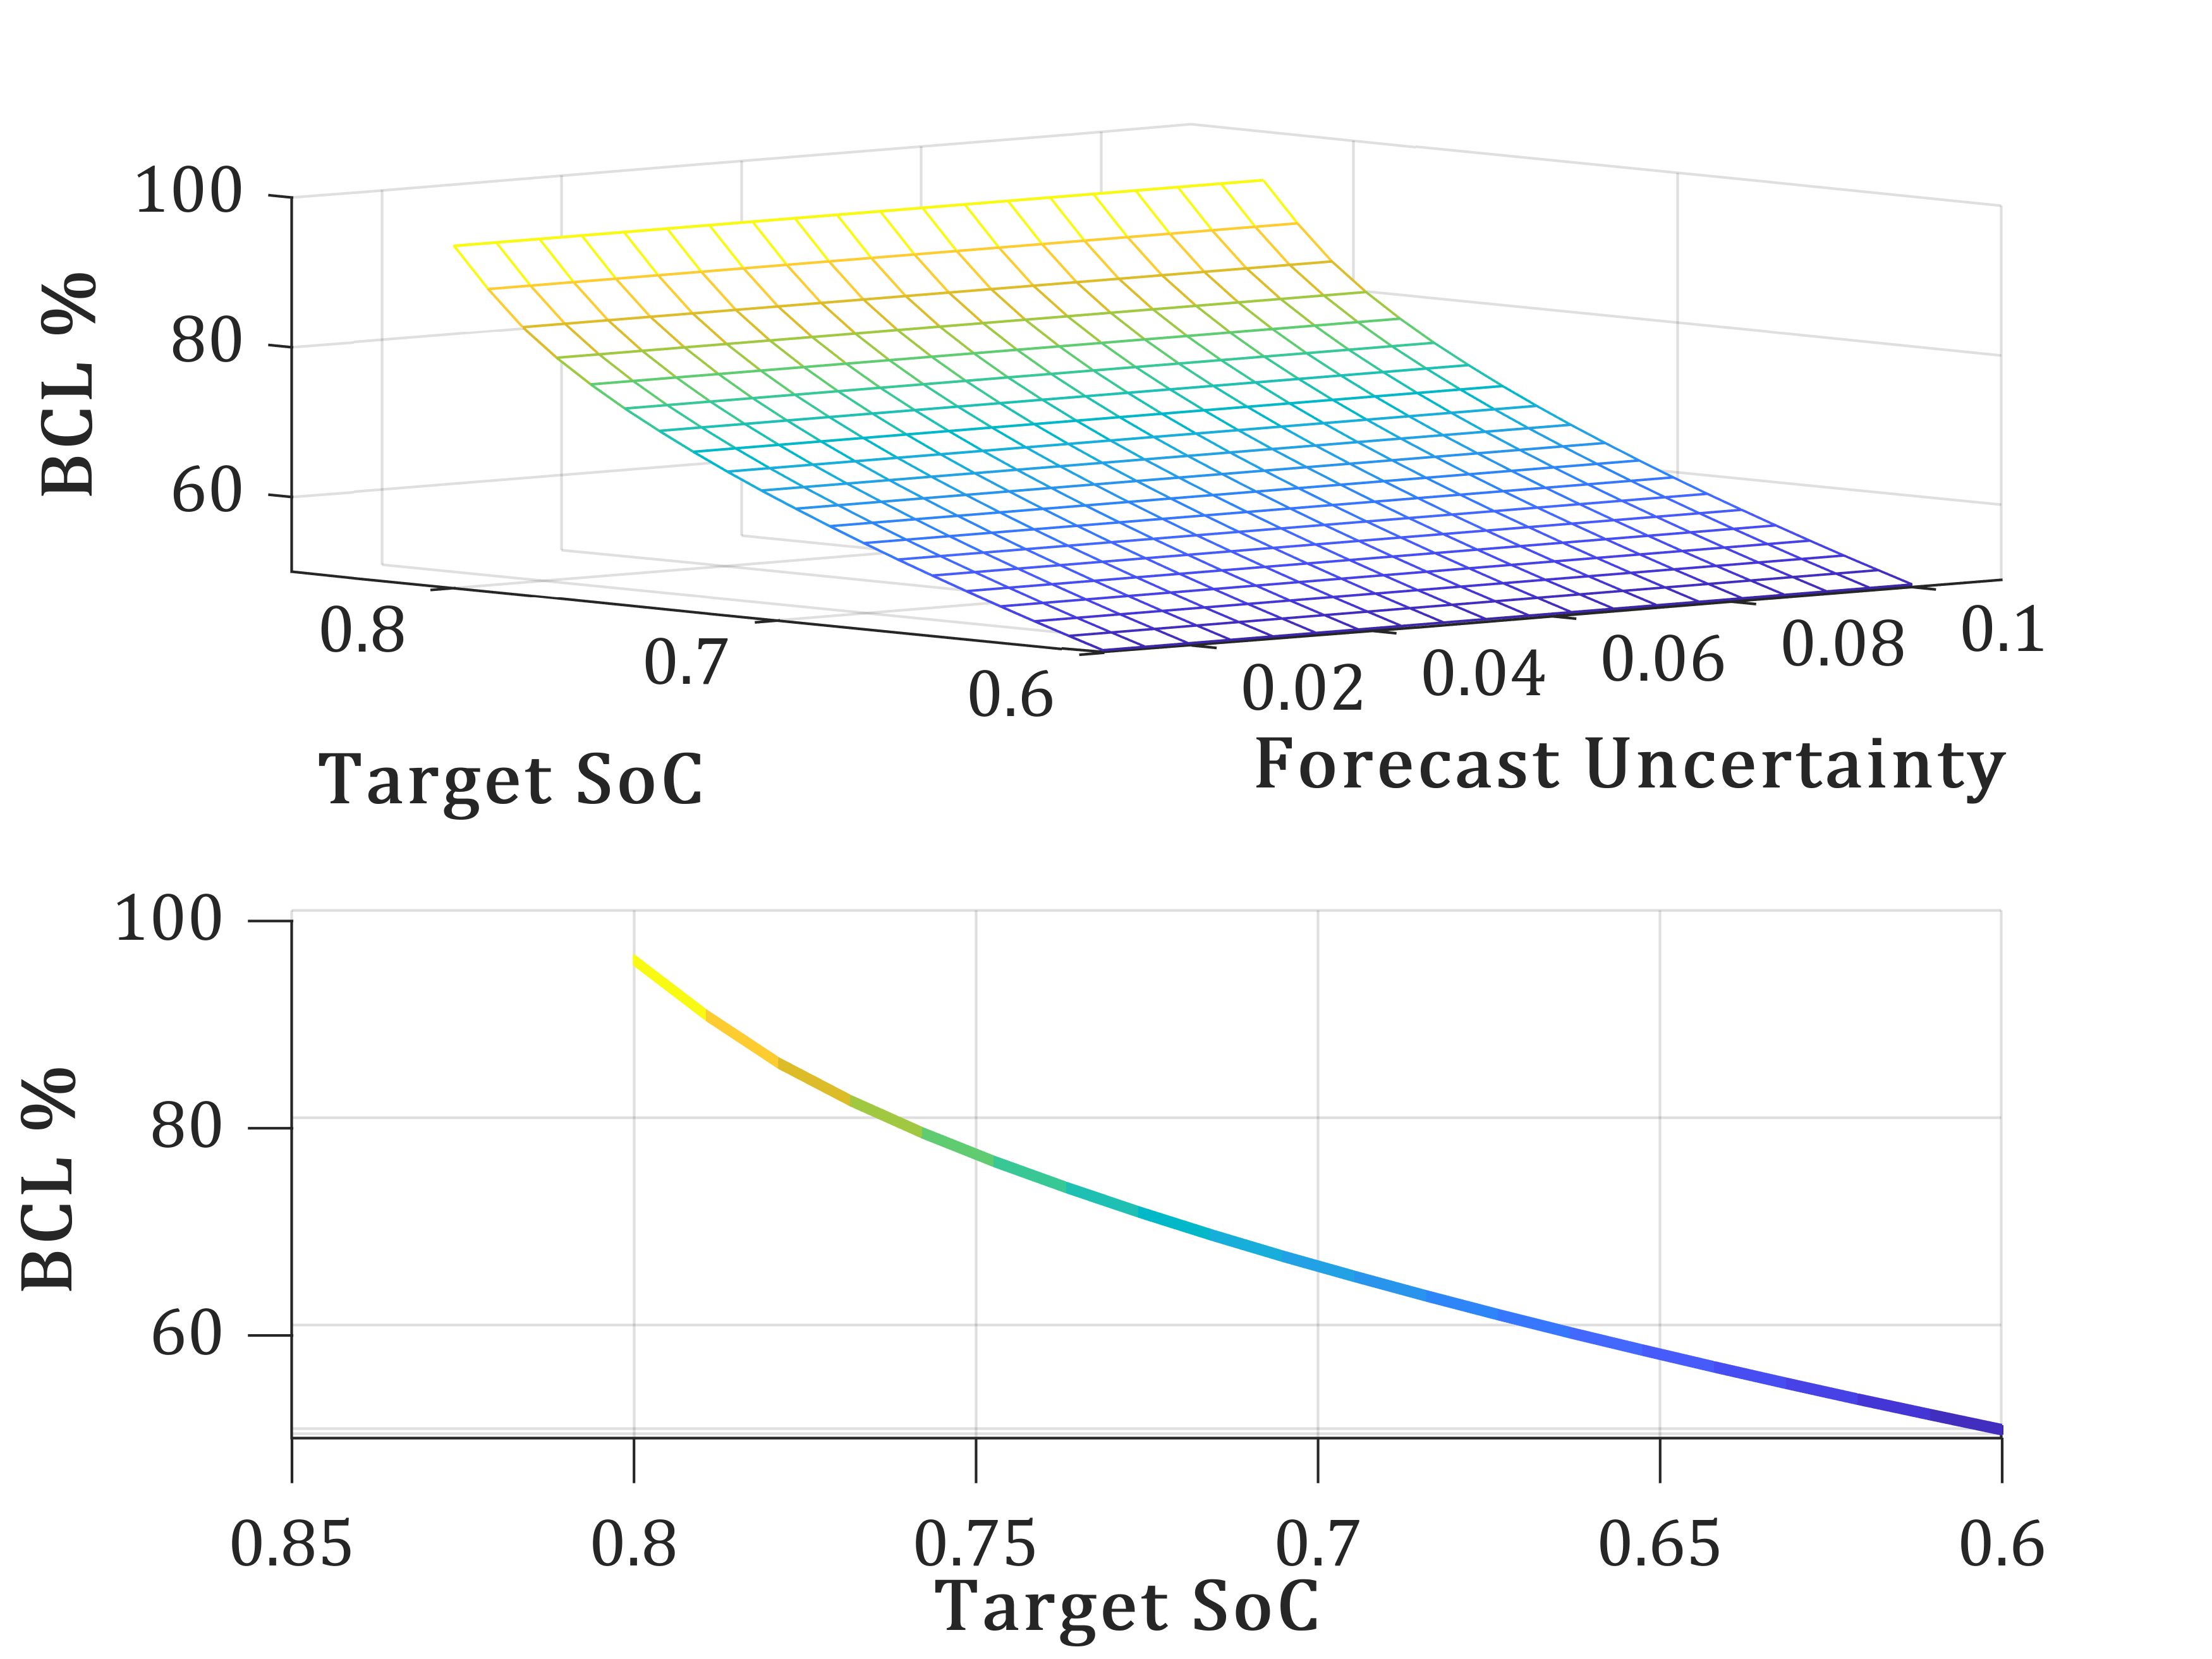
Results
Battery Degradation Data
Varying noise power from 1% to 10% is injected into load forecast and the resulting effect on the robustness of the controller, the battery target SoC and battery accelerated capacity loss is studied.
The target SOC is swept from 0.8 to 0.6
Using parallel simulation (parsim) environment in Simulink the simulation is run 400 times based on situations mentioned above.
The collected data from the simulations is plotted as “degradation curve” shown in the figure to the right.

Slide 10

Conclusions and Future Work
Conclusion
An EMS for SPS considering the ramp-rate limitations of Generator and Batteries is presented.
Power forecast is designed to address the usage of PPLs.
The formulated MPC is validated is run in parsim and the degradation data is collected and plotted.
Future Work
Current simulation results have been implemented on a single generator, battery and load model as shown to the left.
Future goal is to expand this work to multi zone SPS, staring with 2-zone model and then the 4-zone model.
Introducing the collected battery degradation data as the cost function in the objective shown to the right.
Objective
$$Introduce$$
$$Degradation$$
Constraints

Slide 11
THANK YOU
Satish Vedula: svedula@fsu.edu

