Slide 1
Model and Load Predictive Control for Design and Energy Management of Ship Power Systems
Mehrzad Mohammadi Bijaieh
Satish Vedula*
Olugbenga Moses Anubi
1

Slide 2
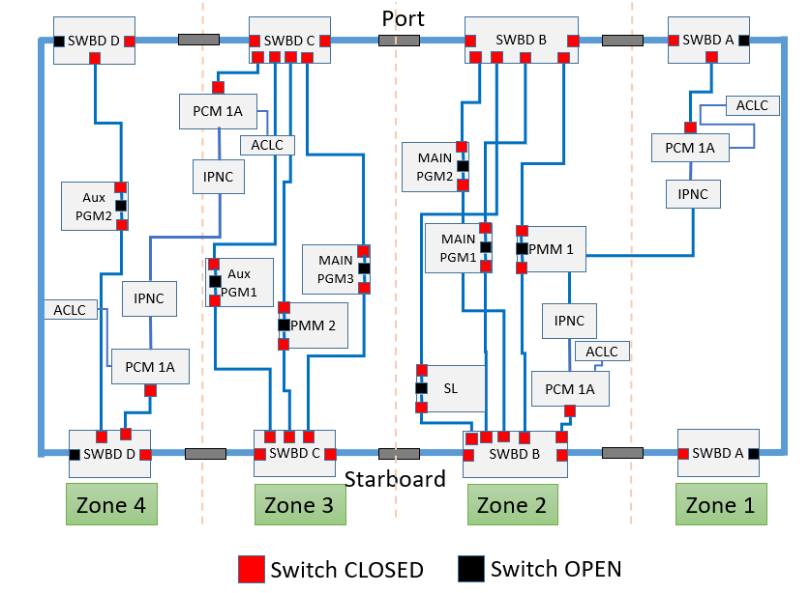
Motivation
In current medium voltage DC (MVDC) shipboard power systems (SPS) multiple sources exist to supply power to common DC bus.
Key power supplying sources:
Power Generation Module (PGM)
Power Conversion Module (PCM)
Auxiliary PGM (APGM)
Key power demanding modules:
Propulsion Motor Module (PMM)
Pulse Power Loads (PPL)
High ramp-rate requirements
Addressing the PPL ramp-rate requirements by designing an energy management strategy (EMS).

Slide 3
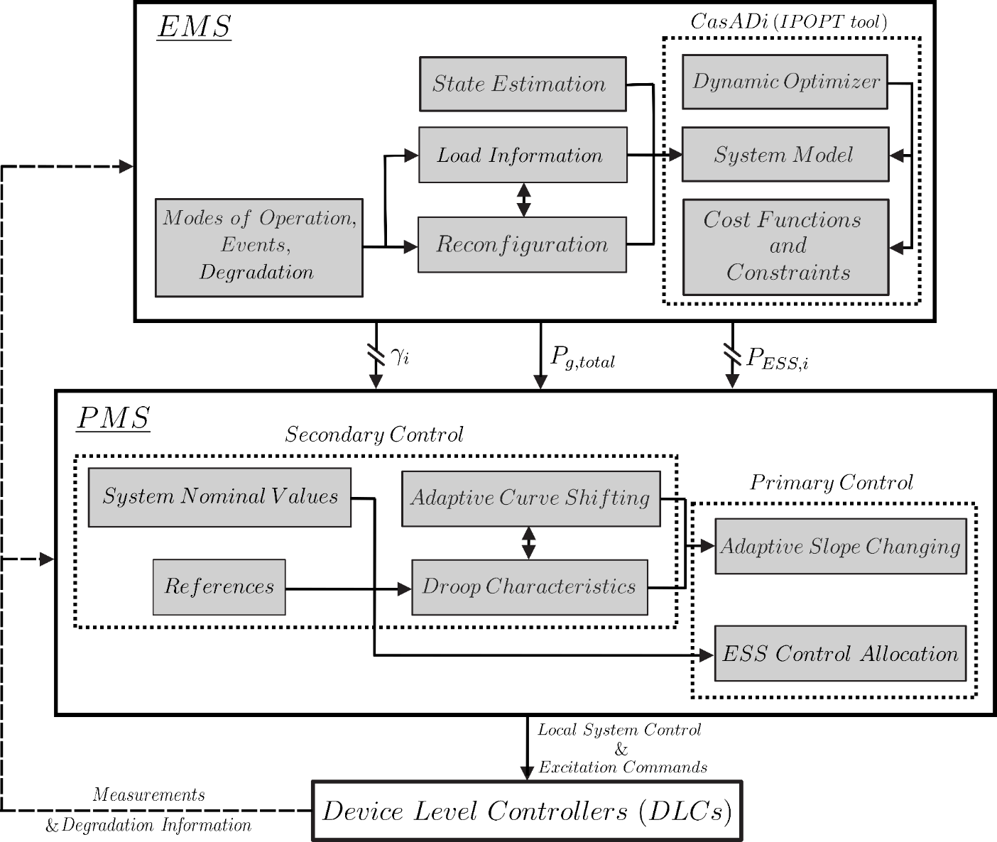
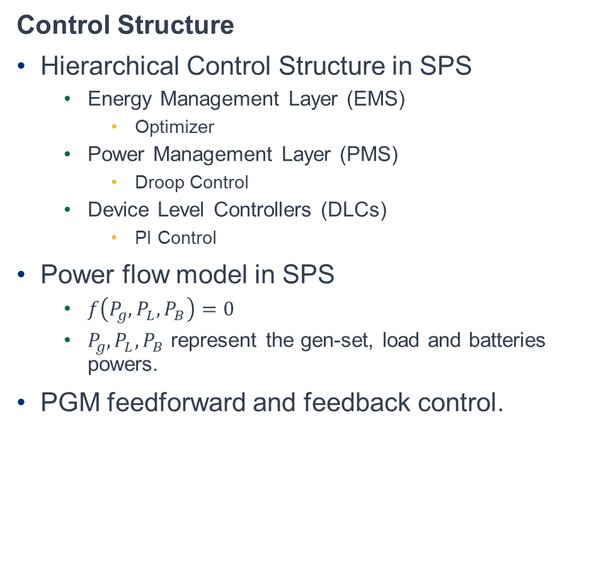
Problem Statement
Control Structure
Hierarchical Control Structure in SPS
Energy Management Layer (EMS)
Optimizer
Power Management Layer (PMS)
Droop Control
Device Level Controllers (DLCs)
PI Control
Power flow model in SPS
$f\left(P_{g},P_{L},P_{B}\right)=0$
$P_{g},P_{L},P_{B}$ represent the gen-set, load and batteries powers.
PGM feedforward and feedback control.

Slide 4
Problem Statement
Component Models
PGM Component Model:
The low band width model consisting of first order filter fed into control dependent voltage source, an RL line, a shunt capacitor and a parallel damping resistor.
PCM Component Model:
Consists of ideal Energy storage system (ESS) which may include single or hybrid storage systems such as battery energy storage systems (BESS).
PMM Component Model:
Controlled current source and a parallel RC pair.
Detailed mathematical description and modelling is available in the paper.

Slide 5

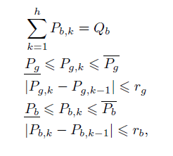

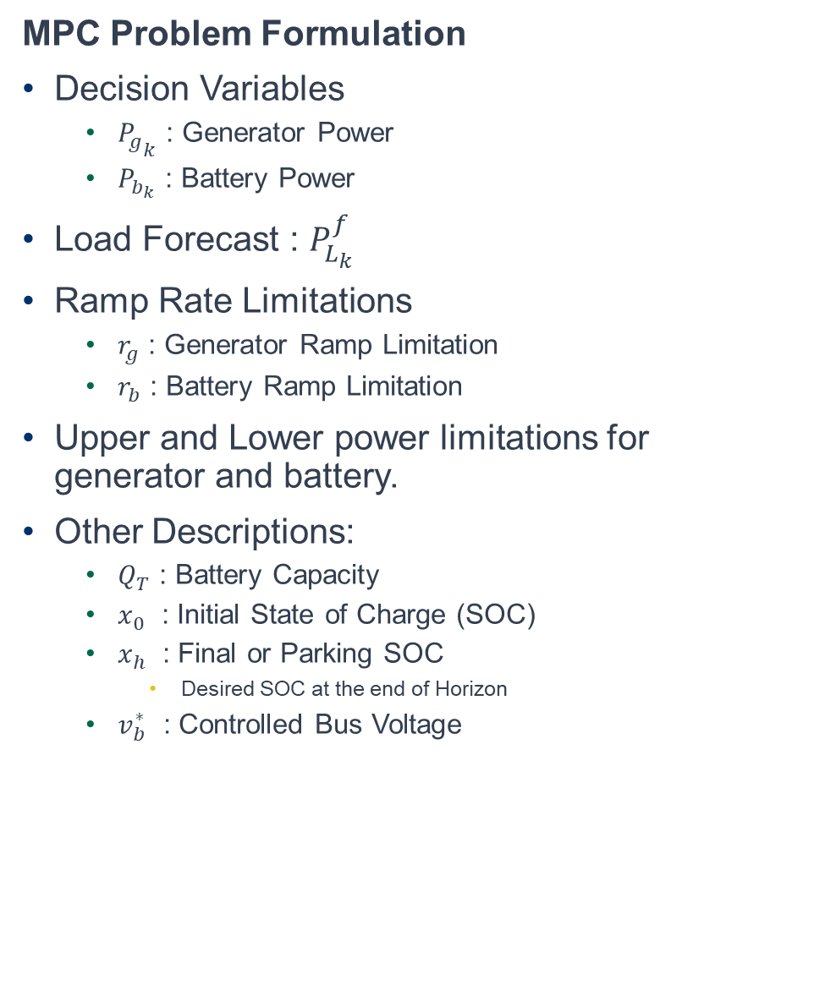
Problem Statement
MPC Problem Formulation
Decision Variables
${P_{g}}_{k}$ : Generator Power
$P_{b_{k}}$ : Battery Power
Load Forecast : $P_{L_{k}}^{f}$
Ramp Rate Limitations
$r_{g}$ : Generator Ramp Limitation
$r_{b}$ : Battery Ramp Limitation
Upper and Lower power limitations for generator and battery.
Other Descriptions:
$Q_{T}$ : Battery Capacity
$x_{0}$ : Initial State of Charge (SOC)
$x_{h}$ : Final or Parking SOC
Desired SOC at the end of Horizon
$v_{b}^{∗}$ : Controlled Bus Voltage
Objective
Constraints

Slide 6
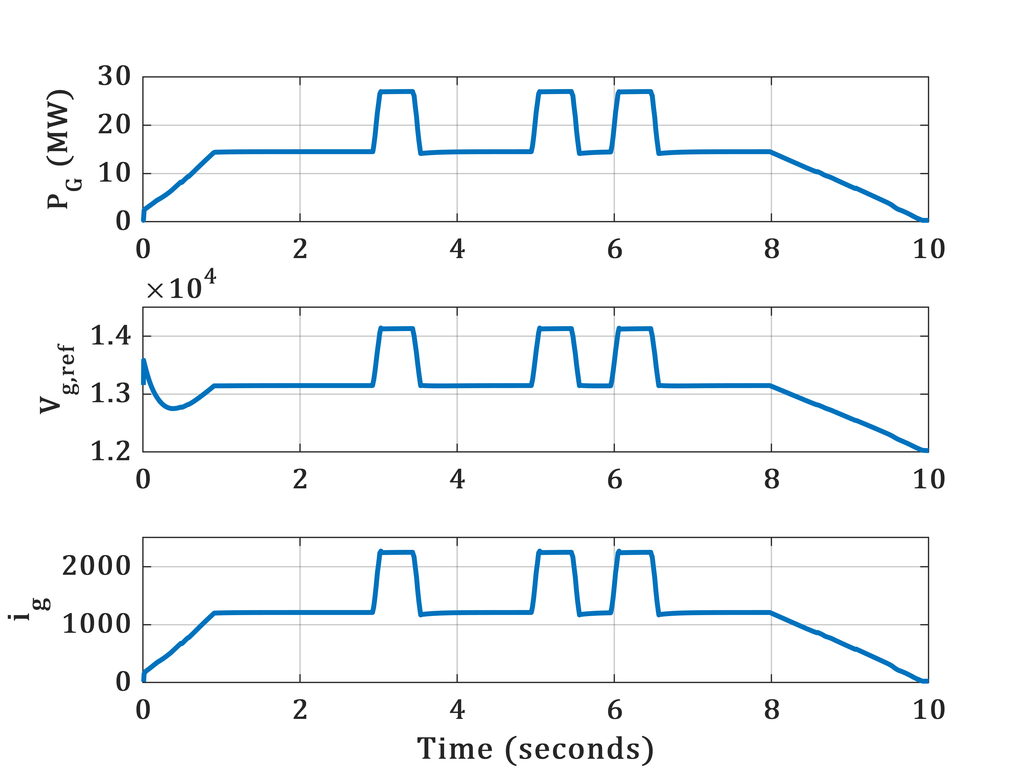
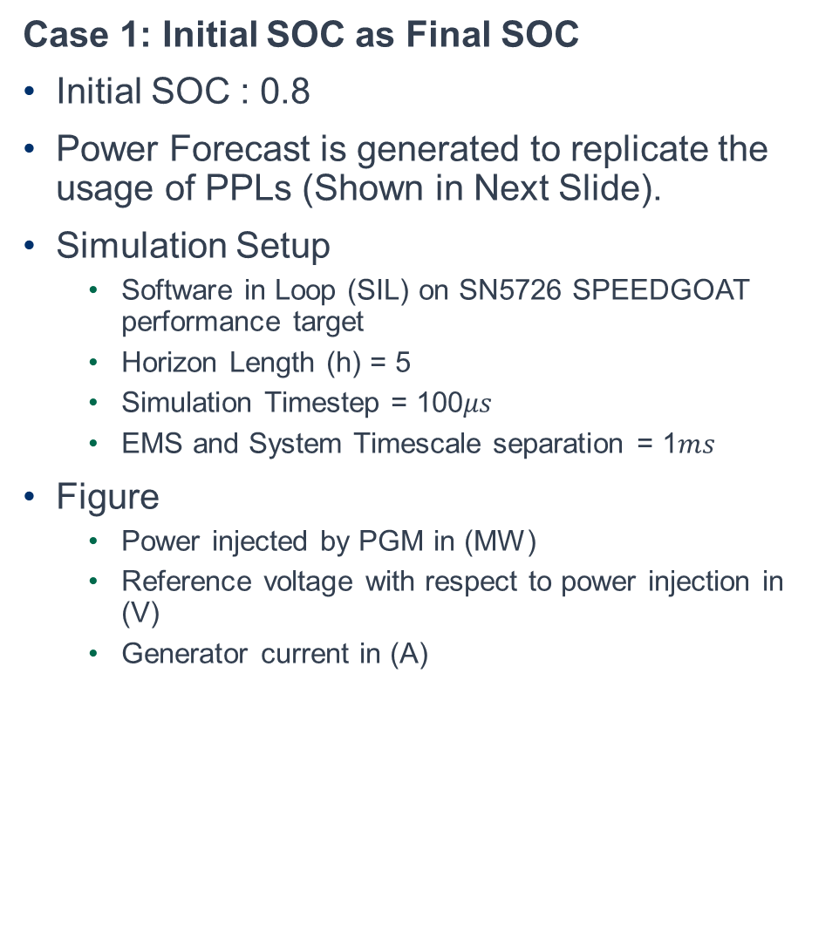
Results
Case 1: Initial SOC as Final SOC
Initial SOC : 0.8
Power Forecast is generated to replicate the usage of PPLs (Shown in Next Slide).
Simulation Setup
Software in Loop (SIL) on SN5726 SPEEDGOAT performance target
Horizon Length (h) = 5
Simulation Timestep = 100$μs$
EMS and System Timescale separation = 1$ms$
Figure
Power injected by PGM in (MW)
Reference voltage with respect to power injection in (V)
Generator current in (A)

Slide 7
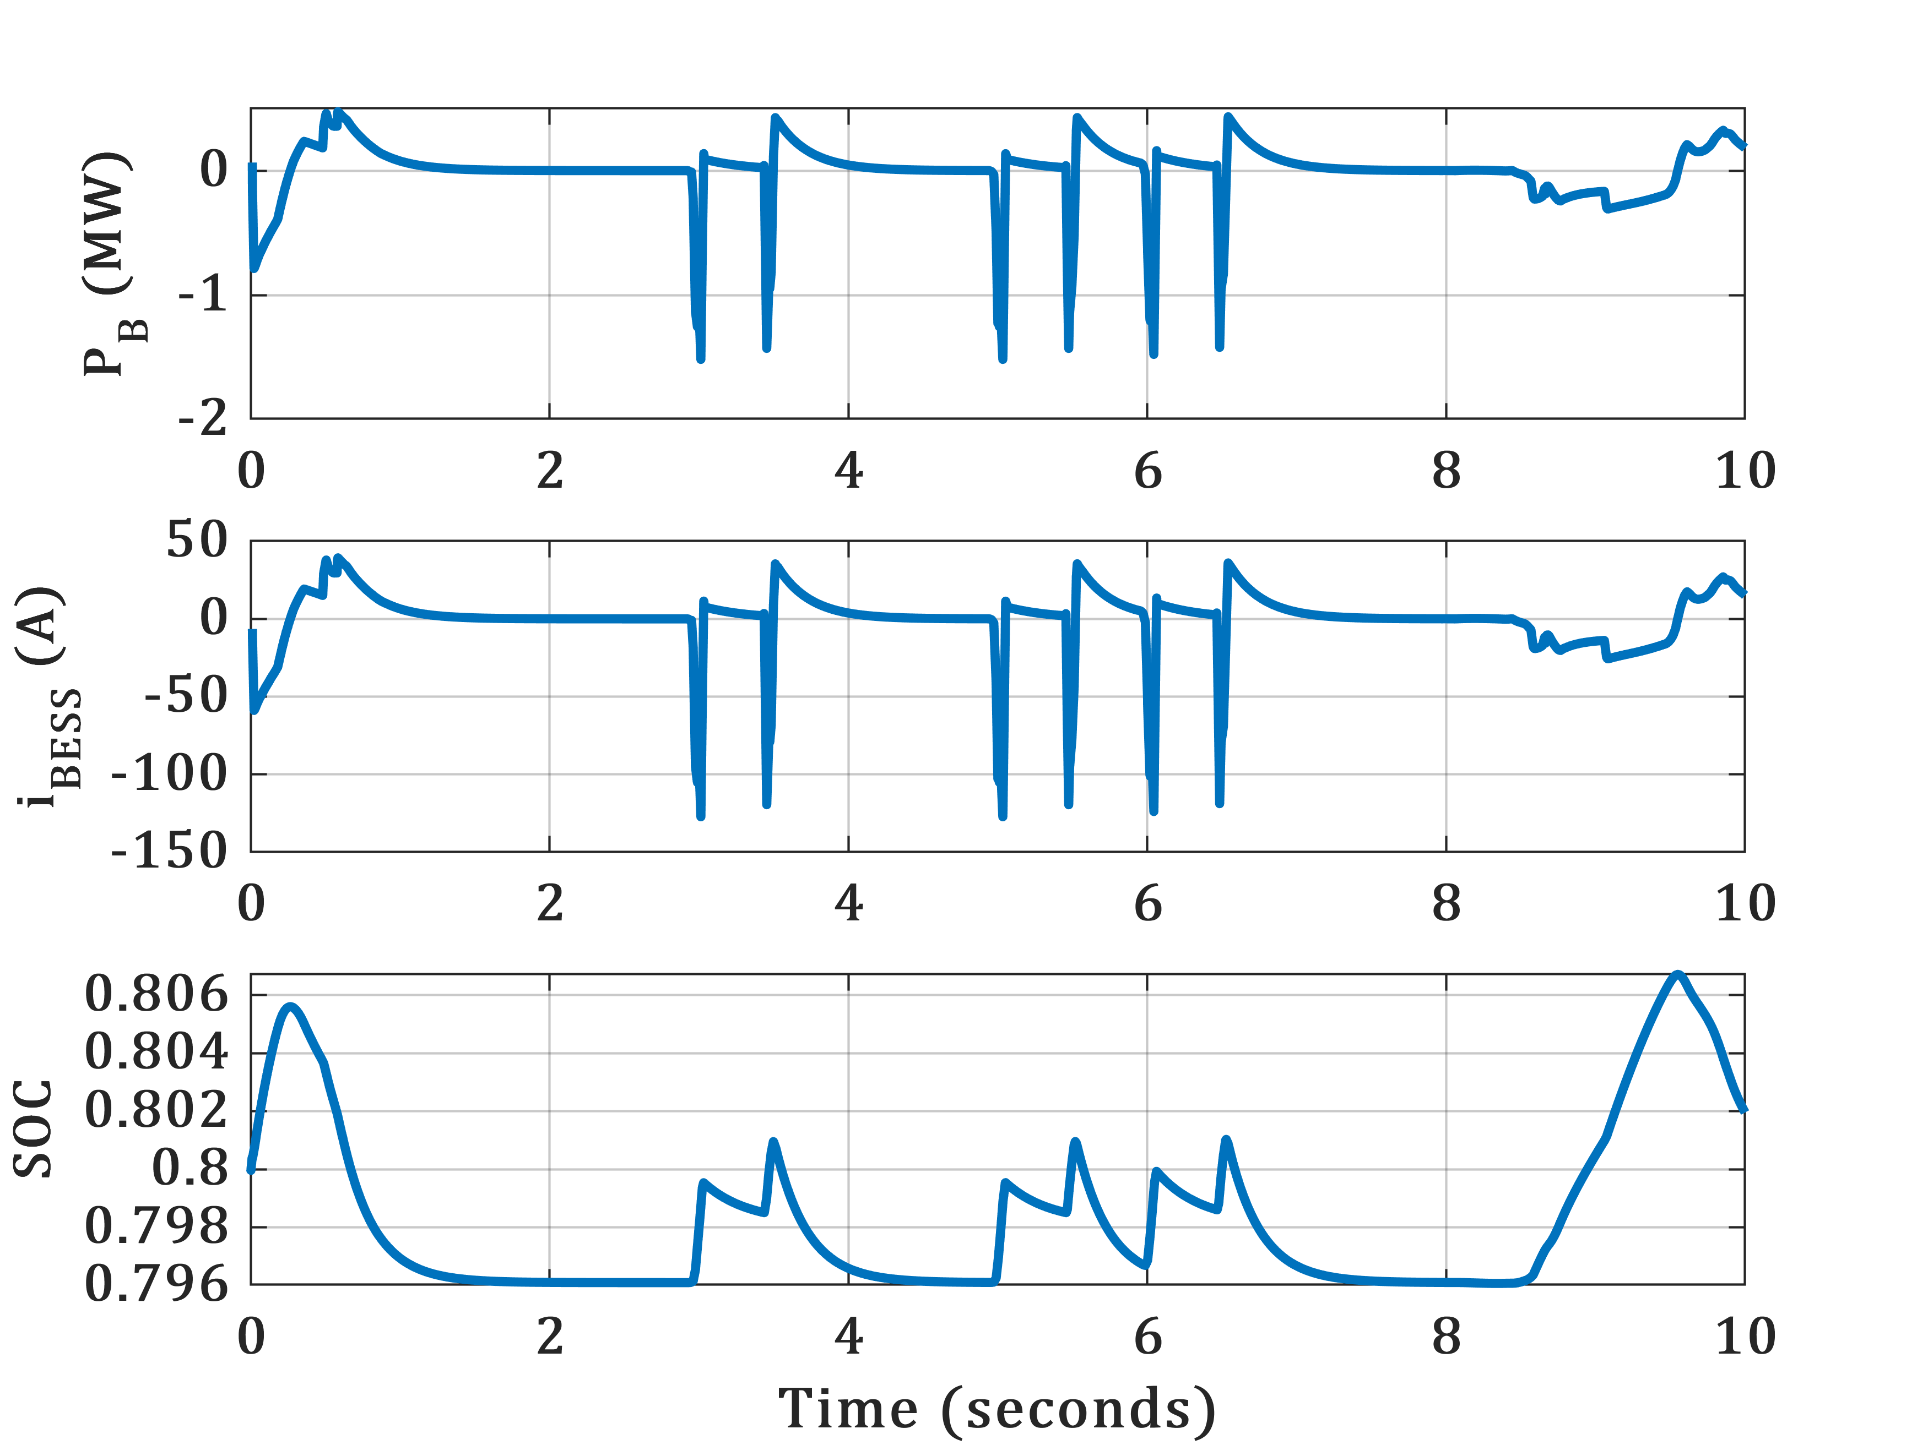
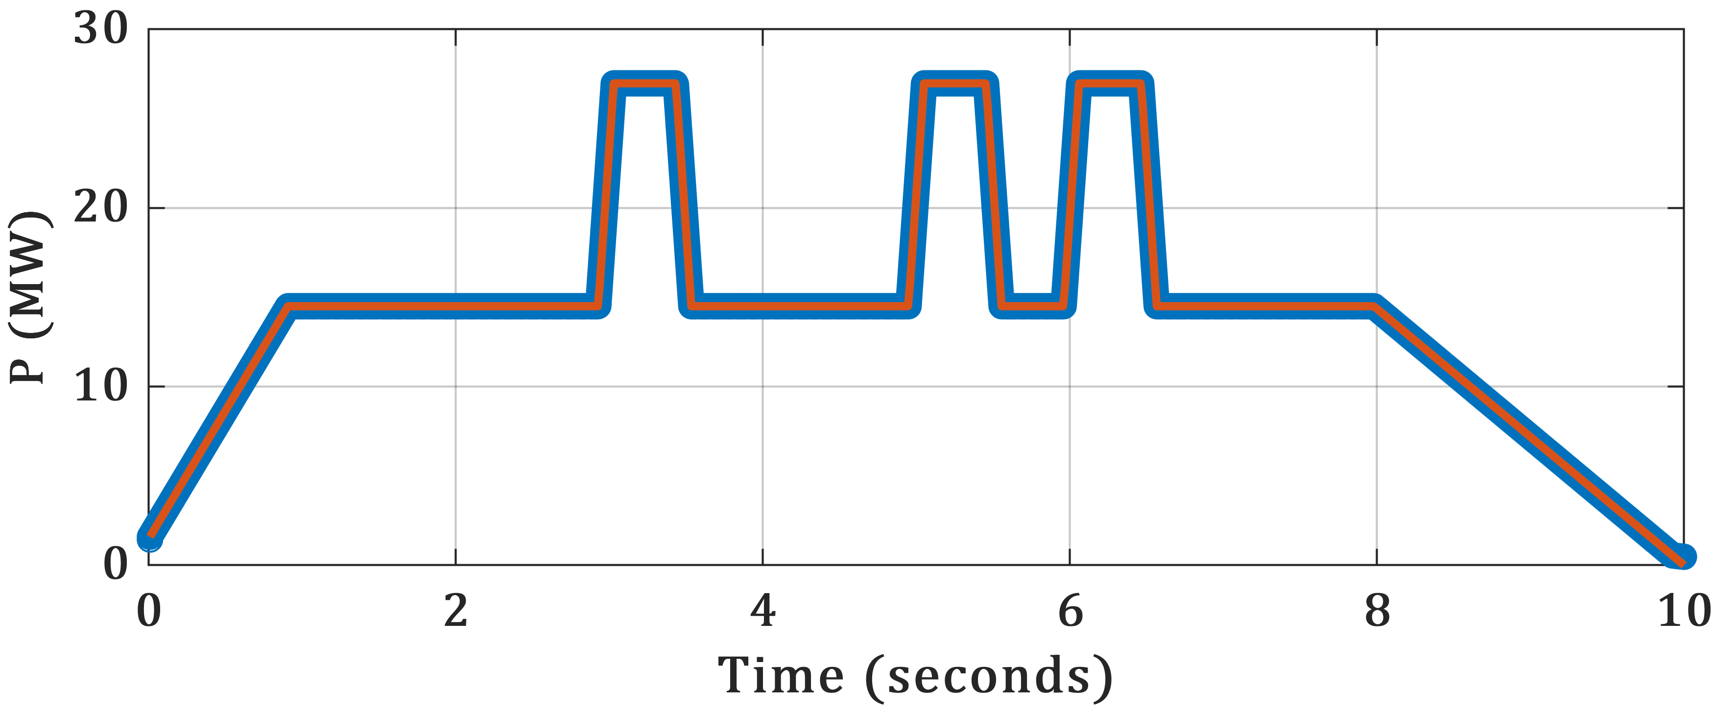
Results
Case 1: Initial SOC as Final SOC
Initial SOC : 0.8
Figure Right
Battery Power Injection in (MW)
Battery Current response to injection in (A)
Battery SOC
Figure Left Bottom
Blue Line : Combined Power Injected by Battery and Generator
Red Line : Power Forecast

Slide 8
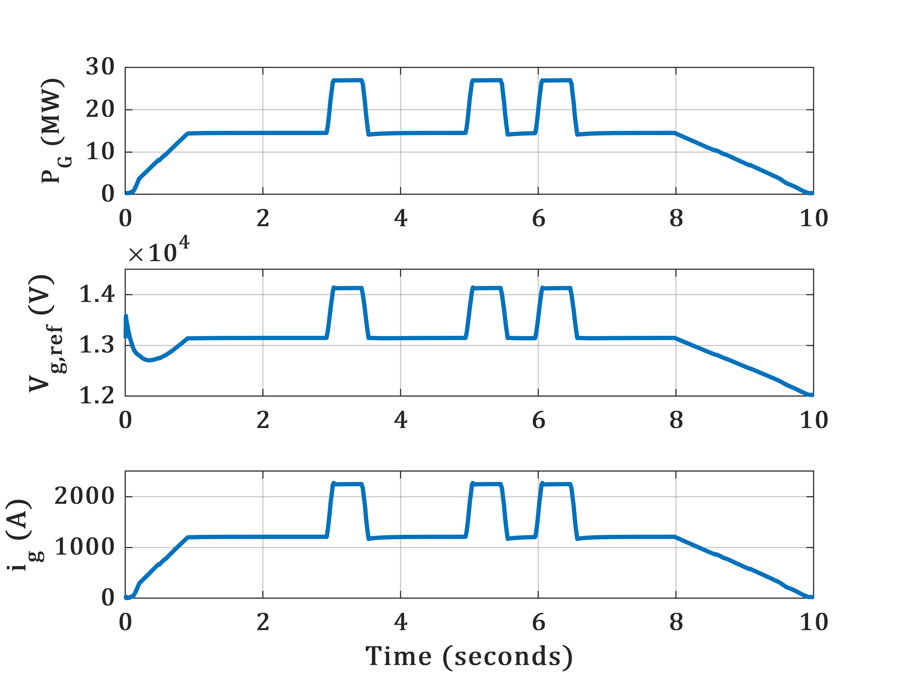
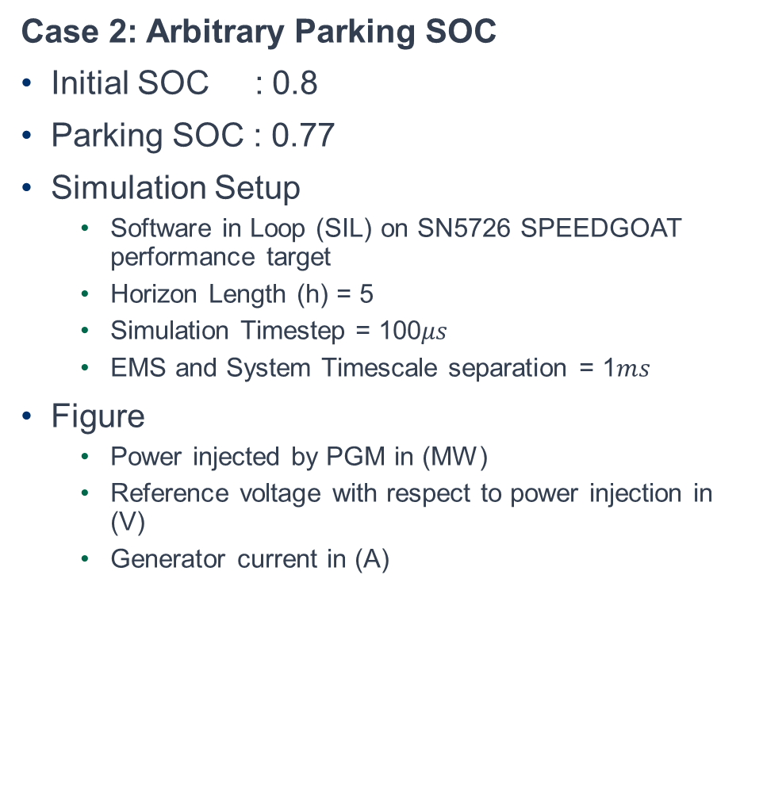
Results
Case 2: Arbitrary Parking SOC
Initial SOC : 0.8
Parking SOC : 0.77
Simulation Setup
Software in Loop (SIL) on SN5726 SPEEDGOAT performance target
Horizon Length (h) = 5
Simulation Timestep = 100$μs$
EMS and System Timescale separation = 1$ms$
Figure
Power injected by PGM in (MW)
Reference voltage with respect to power injection in (V)
Generator current in (A)

Slide 9
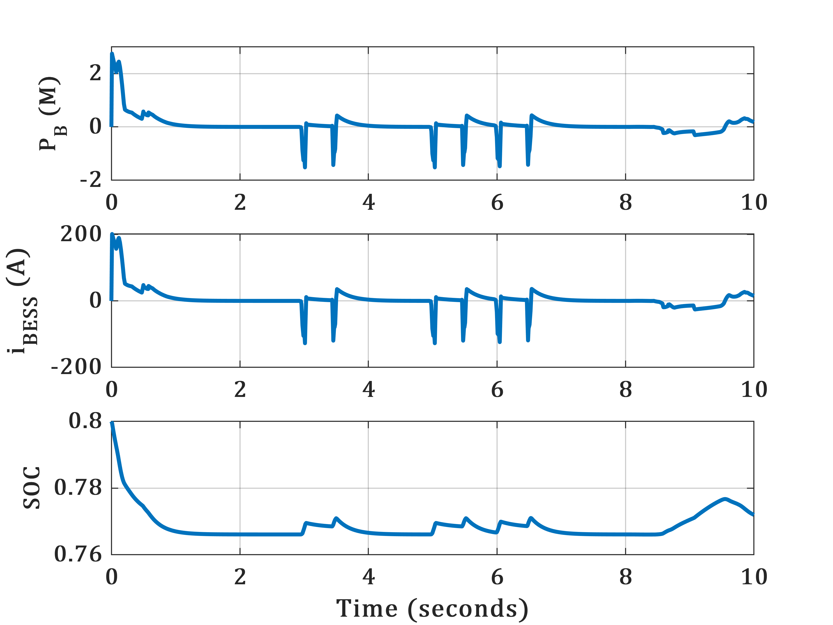
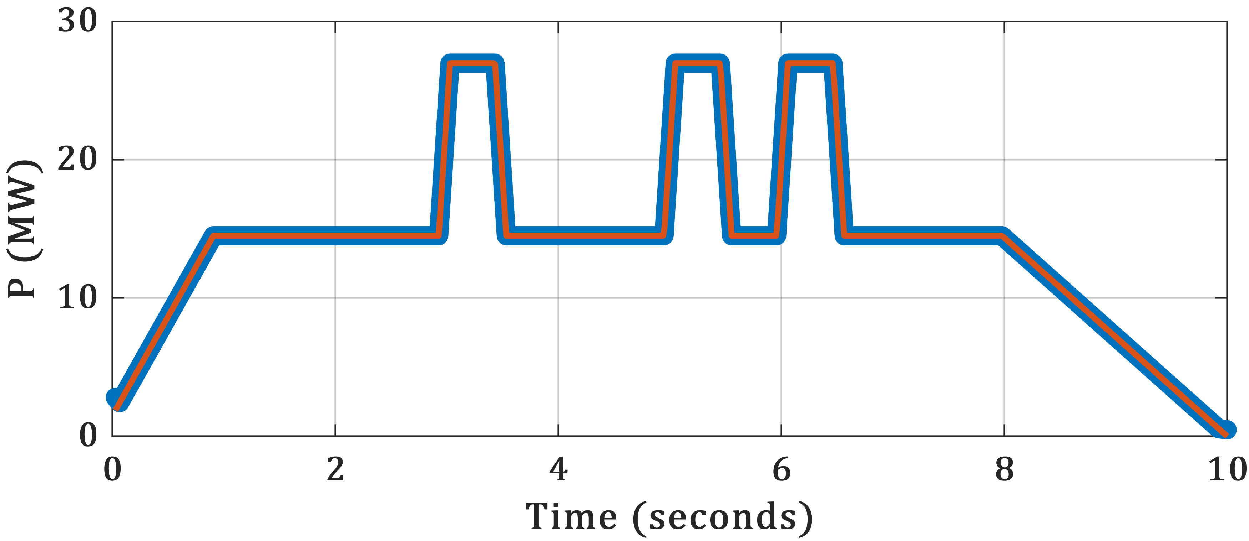
Results
Case 2: Arbitrary Parking SOC
Initial SOC : 0.8
Parking SOC : 0.77
Battery Power Injection in (MW)
Battery Current response to injection in (A)
Battery SOC
Figure Left Bottom
Blue Line : Combined Power Injected by Battery and Generator
Red Line : Power Forecast

Slide 10
Conclusions and Future Work
Conclusion
An EMS for SPS considering the ramp-rate limitations of Generator and Batteries is presented.
Power forecast is designed to address the usage of PPLs.
The formulated MPC is validated in a SIL environment, and the results are presented.
Future Work
Current simulation results have been implemented on a single generator, battery and load model as shown to the left.
Future goal is to expand this work to multi zone SPS, staring with 2-zone model and then the 4-zone model.
The battery and generator component degradation is not considered in this work. The future iterations will include battery degradation model and a degradation based reformulated MPC problem.

Slide 11
THANK YOU
Mehrzad Mohammadi Bijaieh : mmbijaieh@fsu.edu
Satish Vedula : svedula@fsu.edu
Olugbenga Moses Anubi : oanubi@fsu.edu

