Slide 1

Machine Learning on Microcontrollers – Project
Audio Processing
Filippo Svelto
fsvelto@student.ethz.ch
Michele Magno
04/01/22
0

Slide 2
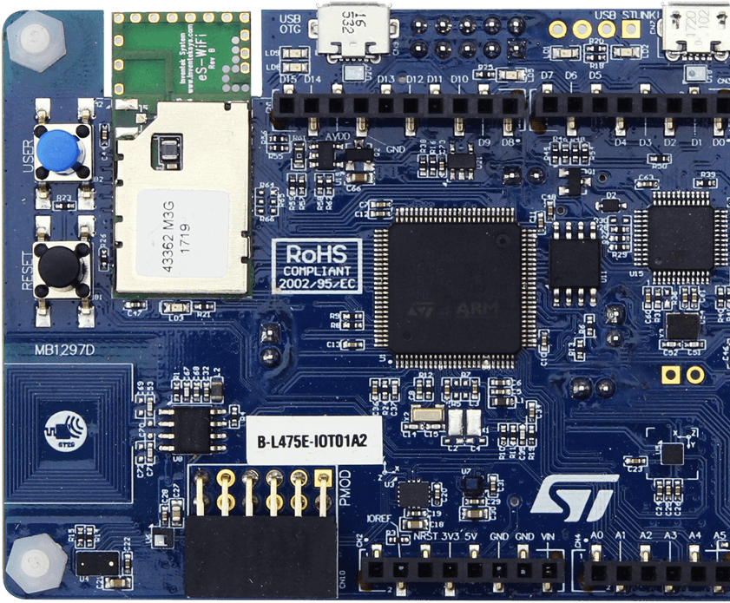
Audio processing - Project
Audio processing on ARM Cortex-M4 Microcontroller;
A B-L475E-IOT01A board was used for the project, featuring a Cortex-M4 microcontroller with a 1MB flash and a 128KB RAM memories;

Slide 3

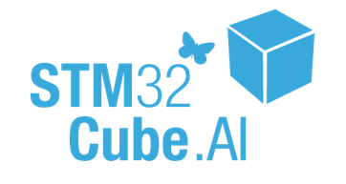
Audio Processing - Intro
Board programmed through STMCube IDE;
The deployment of the network is done through the support of Tensorflow Lite Micro, through the usage of CMSIS-NN;

Slide 4
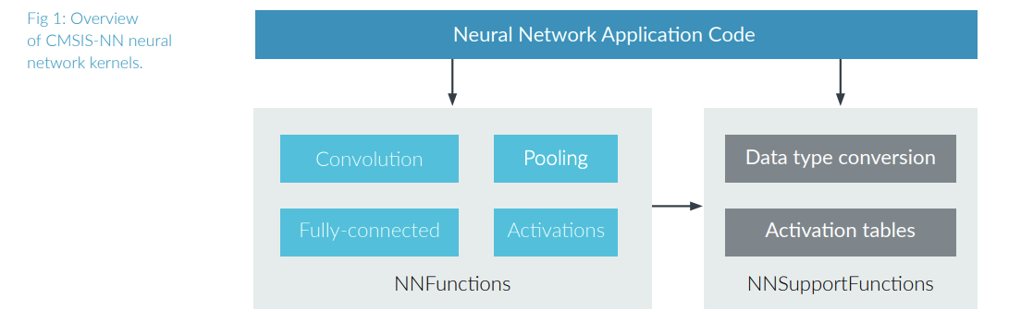
CMSIS-NN
CMSIS-NN can be seen as a collection of efficient neural network kernels developed to maximize the performance and minimize the memory footprint of NNs on Arm Cortex-M processor cores. NN inference based on CMSIS-NN kernels achieves 4.6X improvement in runtime/throughput and 4.9X improvement in energy efficiency;

Slide 5
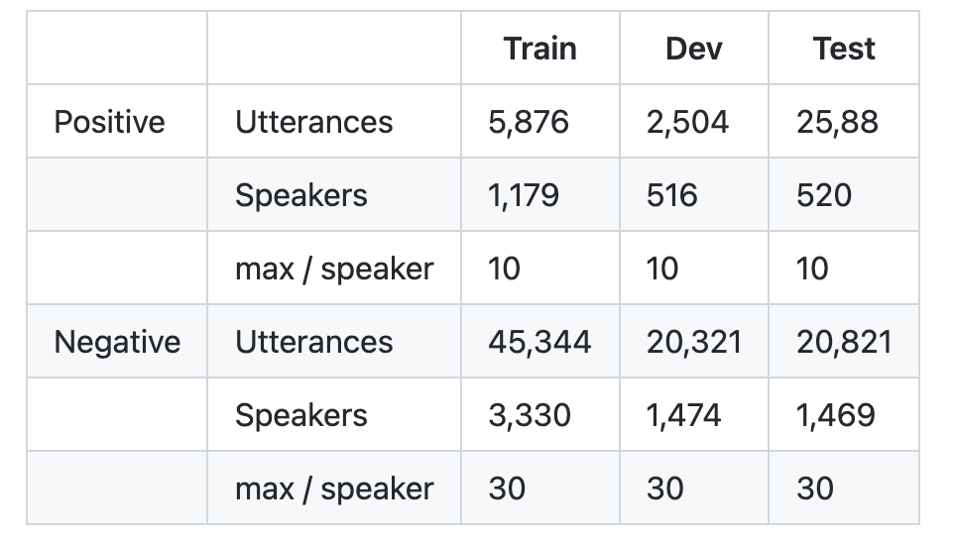
Dataset used
Dataset used : Coucke et al., 2019, «Efficient keyword spotting using dilated convolutions and gating»;
Automatically removing samples of extreme duration (1st and 99th percentiles), or samples with repeated occurrences of the wake word;
Discard any mispronunciations of the wake word (e.g. "Hi Snips" or "Hey Snaips"), leaving the training set untouched;
Around 11K wake word utterances and 86.5K negative examples have been recorded.

Slide 6
Challenges of implementing NNs on microcontrollers
Limited memory footprint: Typical microcontroller systems have 10’s-100’s of KB memory available. The entire NN model has to fit and run within this small memory budget;
Limited compute resources: Many classification tasks have always-on, and real-time requirement, which limits the total number of operations per neural network inference;

Slide 7
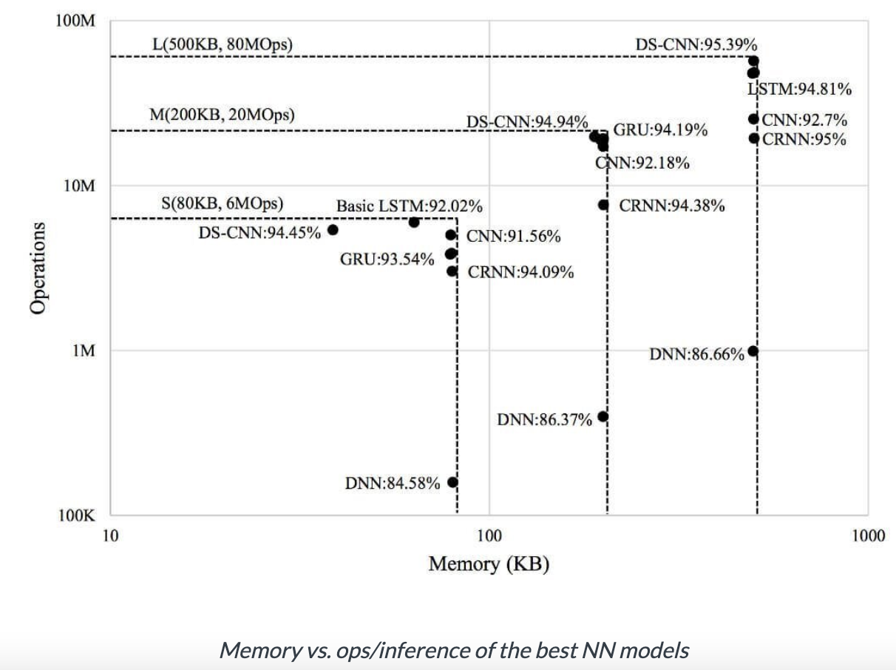
Comparisons between different NNs implemetntations
Reference from “How to Achieve High-Accuracy Keyword Spotting on Cortex-M Processors»

Slide 8
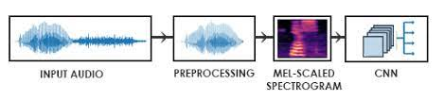
Convolutional approach
Convolutional approach: Mel Frequency Cepstral Coefficients (MFCC) features, a non-linear mapping of frequency spectrum to considerably fewer features;
Many different strategies to go beyond this problem;
CNNs better than Deep Neural Networks (DNNs) in terms of modelling the local, temporal and spectral correlation in the speech features;
INPUT AUDIO
PREPROCESSING MFCC
CNN
INPUT AUDIO

Slide 9
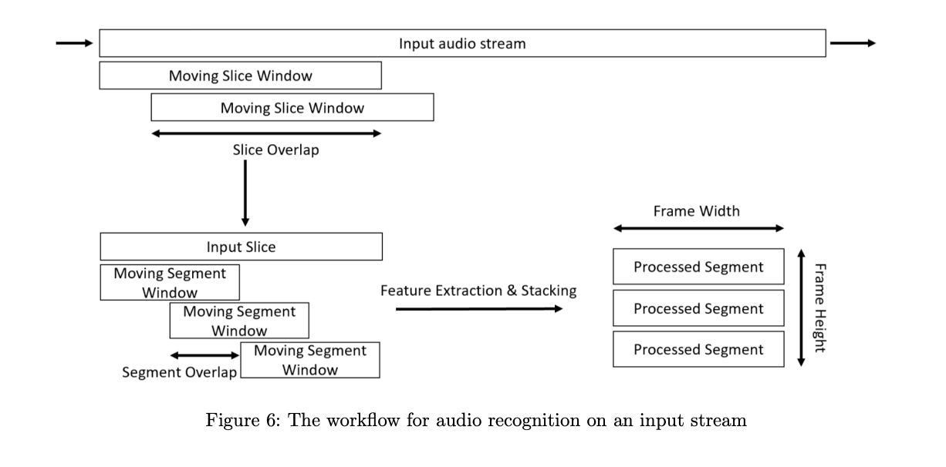
Convolutional approach
CNN: idea of segmenting one slice of a continuous input signal into many segments, do some preprocessing and stack the resulting processed segments over one-another;
End up: 2 Dimensional Frame;

Slide 10
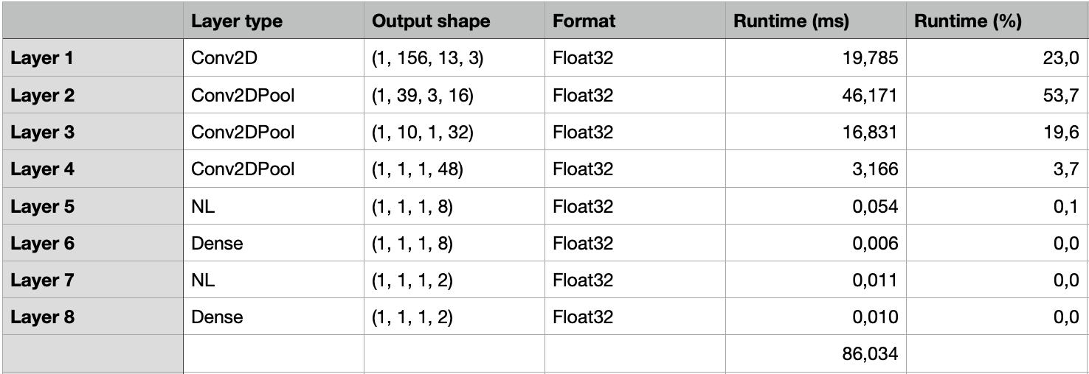
Initial model

Slide 11
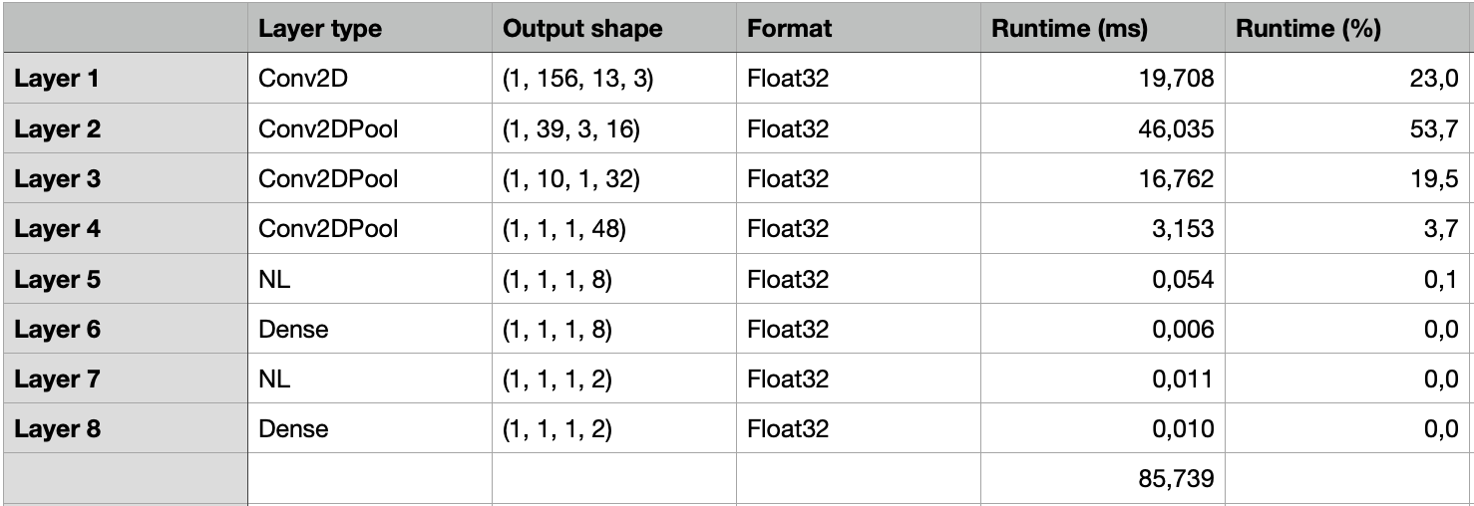
Model after x4 Compression

Slide 12
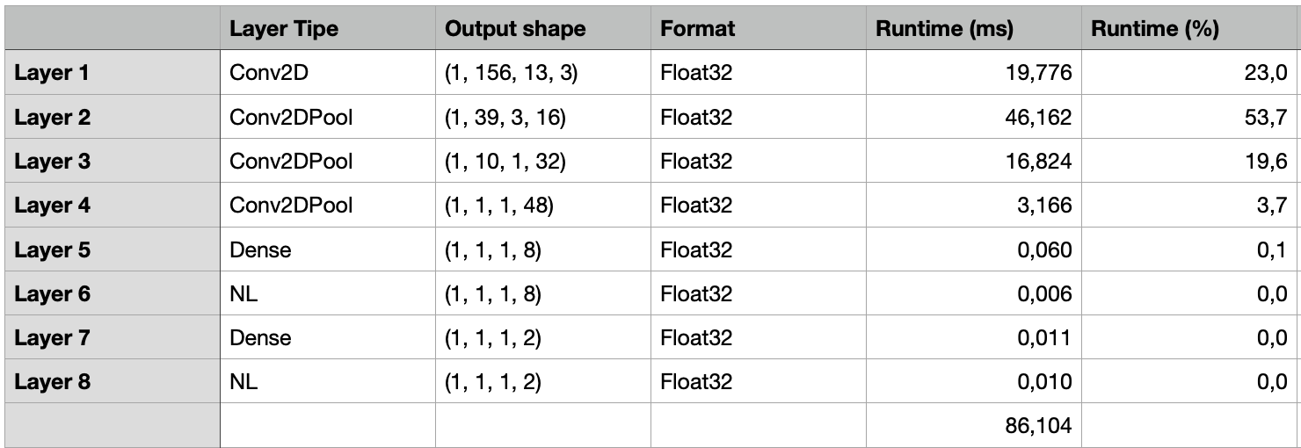
Model after x8 Compression

Slide 13
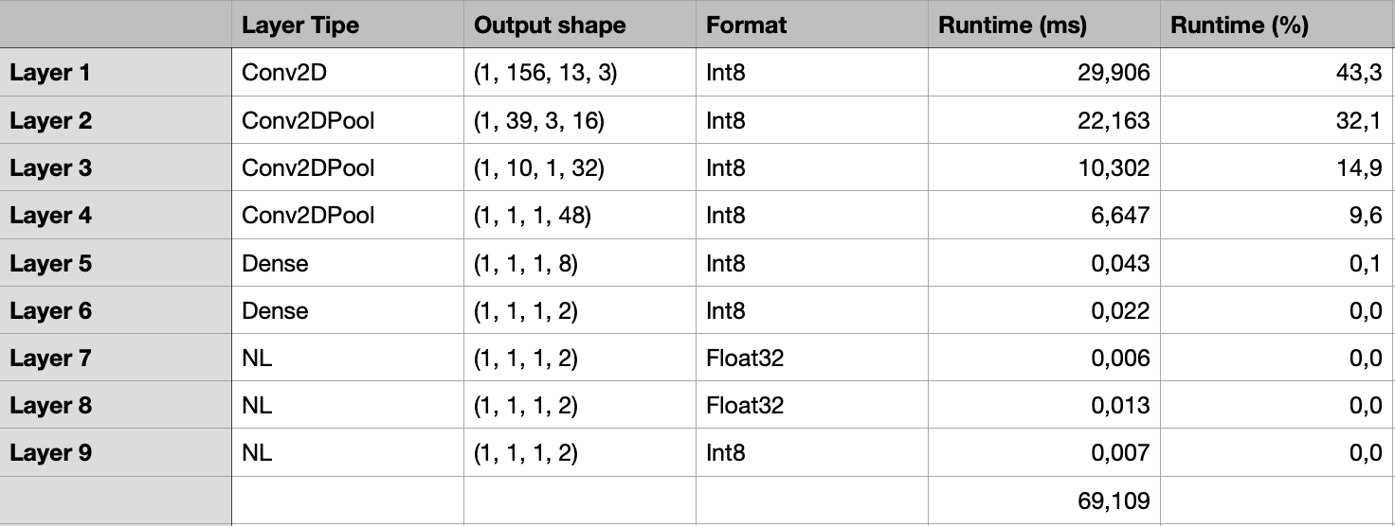
Quantized model

Slide 14
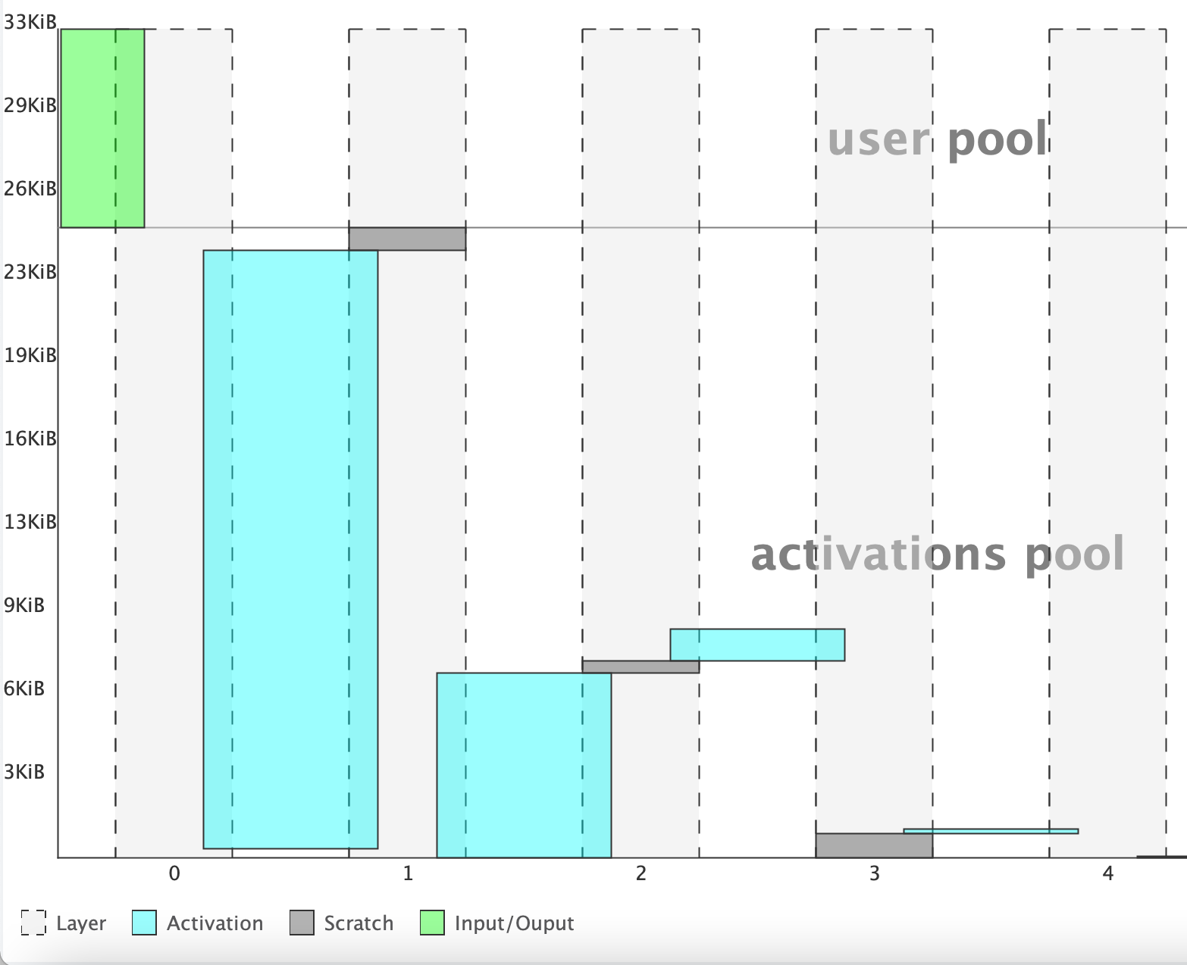
Results obtained
Results obtained with a frequency of 80 MHz
Keras model | Complexity | Flash | RAM
Project.h (No Compression) | 569963 MACC | 75.78 KB (1024 KB present) | 32.92 KB (96 KB present)
Project.h (8x Compression) | 569963 MACC | 75.53 KB (1024 KB present) | 32.92 KB (96 KB present)

Slide 15
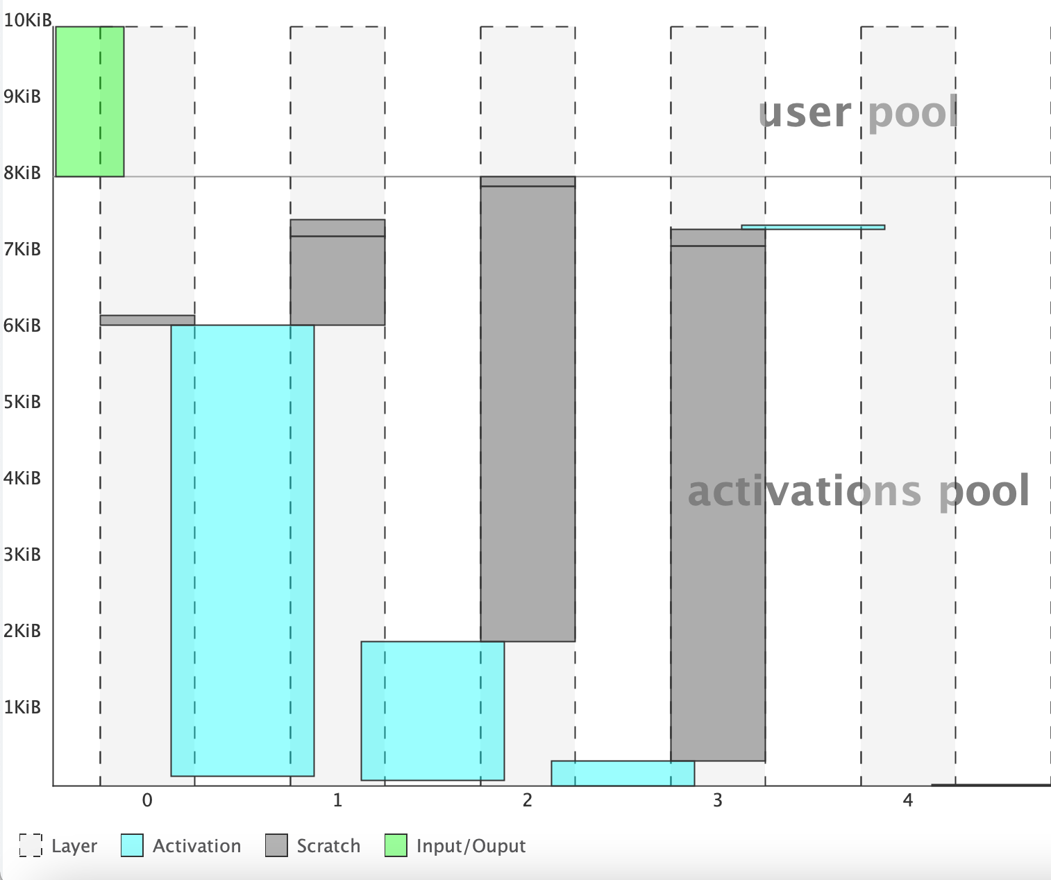
Quantized model
Results obtained with a frequency of 80 MHz
TFLite model | Complexity | Flash | RAM
Project.tflite (No compression) | 553623 MACC | 19.27 KB (1024 KB present) | 10 KB (96 KB present)

Slide 16
Floating point vs quantized model
Most important values : memory occupation and accuracy
 | Memory occupation (Flash + RAM) | Accuracy
Floating point model | 108.7 KB | 95 %
Quantized to int8 model | 29.27 KB | 91.0 %
Huge difference!

Slide 17
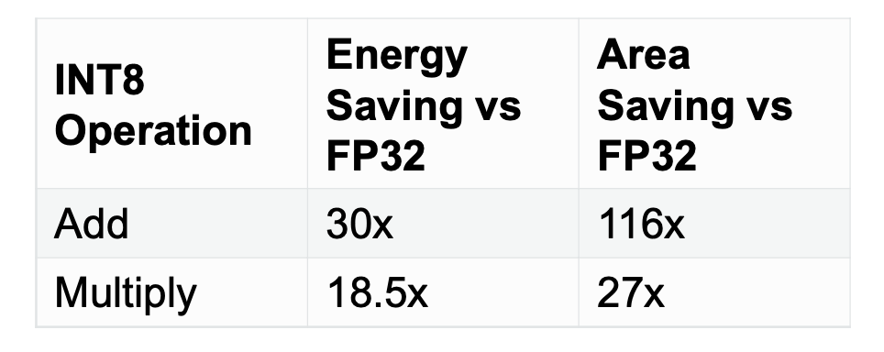
Pros and cons of quantized model
Pros:
Reduce bandwidth and compute requirements;
Cons:
When switching from floating point to fixed point arithmetic, truncation noise and saturation effects are introduced.

Slide 18
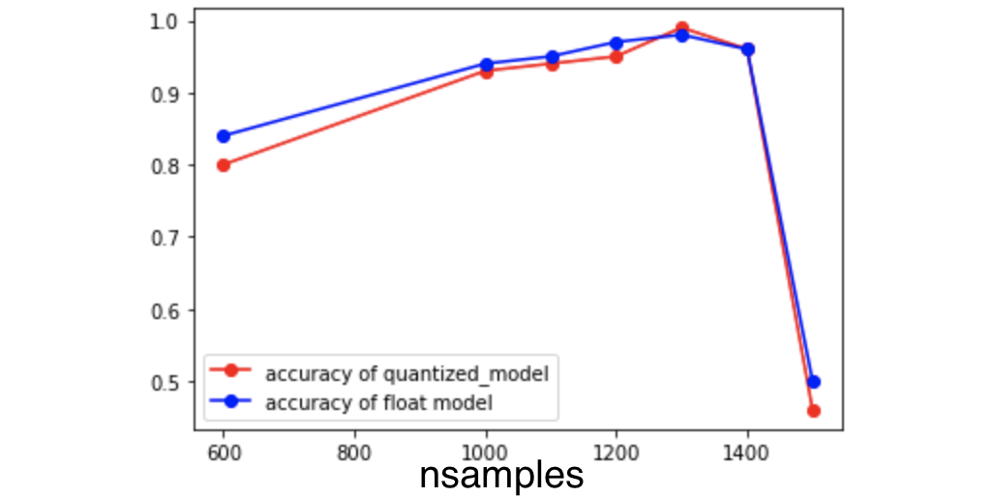
Accuracy related to number of samples
nsamples | trainsize | testsize
600 | 500 | 100
1000 | 900 | 100
1100 | 1000 | 100
1200 | 1100 | 100
1300 | 1200 | 100
1400 | 1300 | 100
1500 | 1400 | 100

Slide 19
Comparison between the results
 | Activations size | Weights size | MACC | CPU cycles | Cycles/MACC
Model.h5 (No compression) | 25588 | 77600 | 569963 | 6882718 | 12.08
Model.h5 (x4 compression) | 25588 | 77600 | 569963 | 6859094 | 12.03
Model.h5 (x8 compression) | 25588 | 76320 | 569963 | 6881159 | 12.07
Quantized model | 8208 | 19728 | 553623 | 5528697 | 9.99
 | # parameters
Model.h5 (No compression) | 19598
Model.h5 (x4 compression) | 19598
Model.h5 (x8 compression) | 19598
Quantized model | 19400
Results for 10 inferences

Slide 20
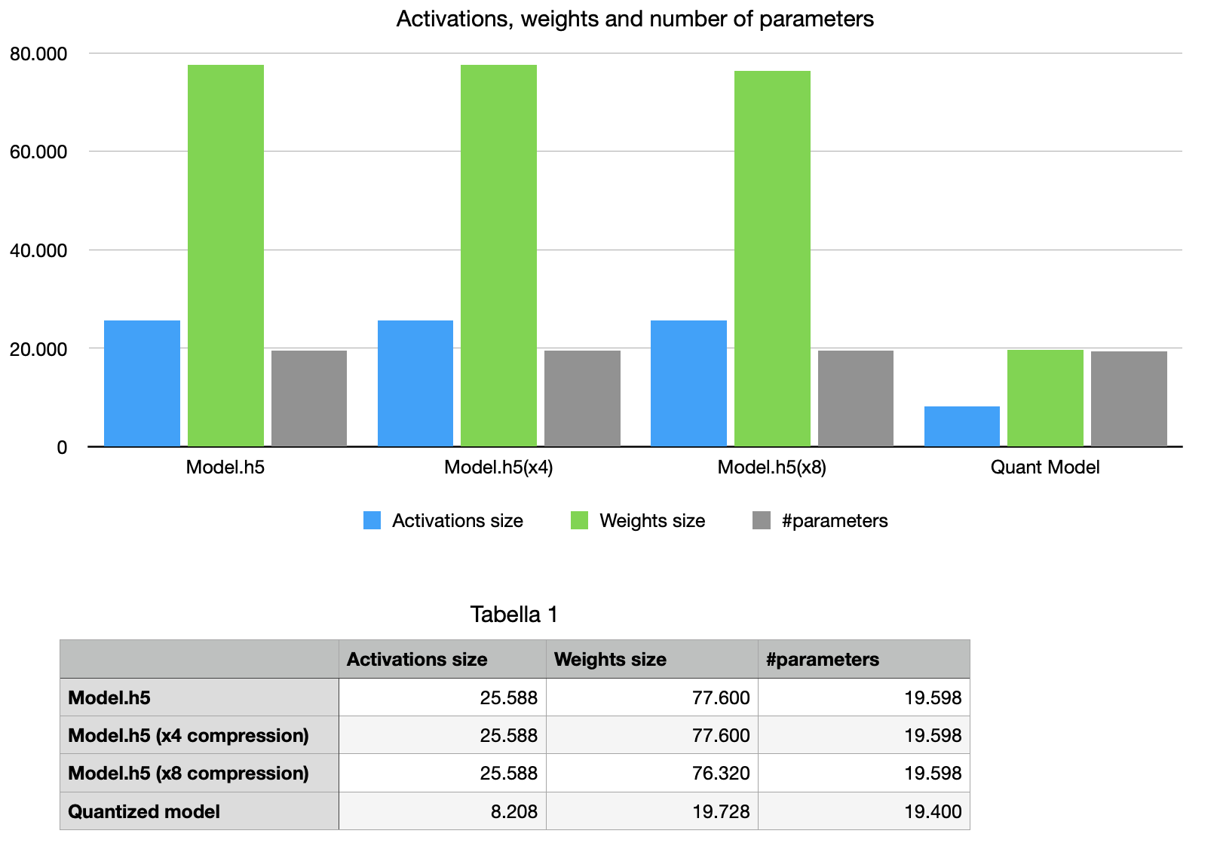

Slide 21
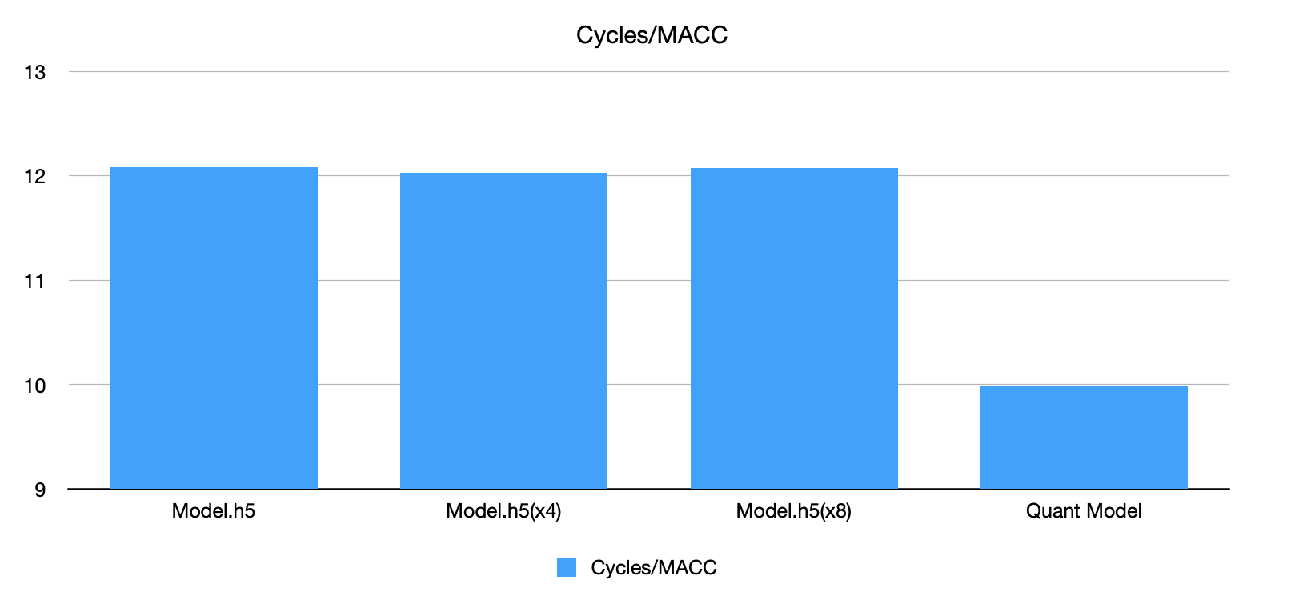

Slide 22
References
«Machine Learning on Arm Cortex-M Microcontrollers» by Naveen Suda and Danny Loh;
«How to Achieve High-Accuracy Keyword Spotting on Cortex-M Processors»;
«Machine Learning on Audio Data: STM Cube AI vs. Tensorflow Lite Micro» (Lab3 of the course).

