Slide 1
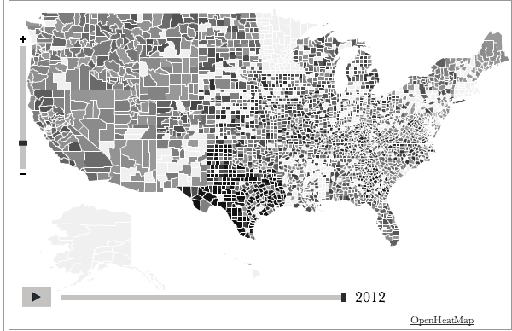
Natural Disasters in America
NON-WINTER STORMS WINTER STORMS EARTHQUAKES & VOLCANOS FIRE FLOOD DROUGHT
Fires
Fires blah blah blah blah blah fires are dangerous they burn things. This is a paragraph all about fires and their scariness and how much they are terrifying and creepy and make me crawl into a bunker.
Blah blah blah blah interesting things
2004
2005
2006
2007
2008
2009
2010
2011
2012
2013
Created by Stephanie Wooten and Florence Lee
Notes:
Quattrocento Sans

Slide 2
Natural Disasters in America
NON-WINTER STORMS WINTER STORMS EARTHQUAKES & VOLCANOS FIRE FLOOD DROUGHT
Coastal Storm
Hurricane
Severe Storm
Tornado
Typhoon
Fires
Fires blah blah blah blah blah fires are dangerous they burn things. This is a paragraph all about fires and their scariness and how much they are terrifying and creepy and make me crawl into a bunker.
Blah blah blah blah interesting things
2004
2005
2006
2007
2008
2009
2010
2011
2012
2013
2005: 34 fires
Created by Stephanie Wooten and Florence Lee
Notes:
Quattrocento Sans

