Slide 1
Employee Ideation Platform
Turning frontline observations into measured improvements
Product overview · Workflow · Bulk employee import
July 2026
Notes:
A multi-tenant employee ideation platform: employees submit improvement ideas, AI scores them for quality, and a structured approval workflow routes them to the right manager. This deck covers what it is, how the workflow runs, and the newly added bulk employee import.

Slide 2
OVERVIEW
What the platform does
Every organisation has employees who can see what is broken. The problem is never the ideas — it is that there is nowhere structured for them to go, and no way to tell a good one from a vague one at volume.
Without a platform
With the platform
Ideas live in email threads, WhatsApp and corridor conversations
No one knows which manager owns a decision, so nothing is decided
Good ideas and throwaway ones arrive looking identical
Nothing is measured, so leadership cannot see any return
One guided form captures the problem, the fix and the expected benefit
Every idea is routed to a named reviewer with a deadline
AI scores each idea 0–100 across six dimensions before a human reads it
Points, ROI and analytics make the programme measurable
2
Notes:
The core argument: the constraint is not idea supply, it is routing, triage and measurement. The platform addresses all three.

Slide 3
WORKFLOW
The idea lifecycle
Every idea moves through five states. Each transition is written to an append-only audit trail with the actor and timestamp.
1
2
3
4
5
Submitted
Under Review
Escalated
Approved
Implemented
Employee completes the 5-step wizard. AI scores it immediately.
›
Routed to their direct manager with an SLA deadline.
›
Auto-climbs the reporting chain if the SLA lapses.
›
A final-approver role signs off the decision.
›
Owner and target date tracked; ROI recorded.
+10 pts
+25 pts
+65 pts
Escalation is the safety net. An idea never dies in someone's queue — if a reviewer misses the SLA, it climbs to their manager automatically, and the review queue flags it in red until someone acts.
3
Notes:
Five states. The escalation step is what stops ideas from silently dying — the single most common failure of email-based schemes.

Slide 4
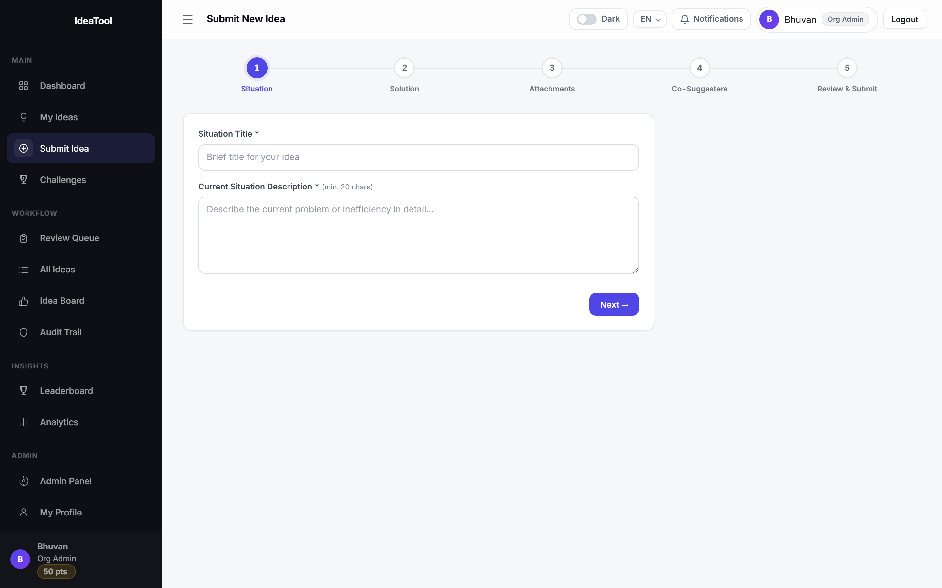
EMPLOYEE EXPERIENCE
Submitting an idea
Five short steps. The form asks for evidence, not just an opinion — which is what makes the ideas scoreable.
1
Situation
What is wrong today, with evidence
2
Solution
The proposed fix, specific and actionable
3
Attachments
Photos, drawings or supporting files
4
Co-Suggesters
Credit colleagues; link an innovation challenge
5
Review & Submit
Step 1 of the submission wizard, with the progress rail across the top.
See the AI score before sending
4
Notes:
The wizard deliberately forces structure: describing the current situation with evidence and a specific solution is what lets the scoring engine tell a real idea from a vague one.

Slide 5
TRIAGE
AI quality scoring
Each idea is scored 0–100 across six dimensions the moment it is submitted, so reviewers read the strongest ideas first.
Problem Clarity
20
Solution Quality
20
Feasibility
15
Scored in the live system
/ 20
/ 20
/ 15
87
"Barcode scanning to cut goods-receipt errors" — quantified problem, named mechanism, costed benefit
Business Impact
20
Measurability
10
Innovation
15
/ 20
/ 10
/ 15
Google Gemini 2.0 Flash scores each idea, with a built-in heuristic model as an automatic fallback — if the AI is unreachable or unconfigured, scoring silently continues offline.
"Improve the canteen queue" — no evidence, no mechanism, no measure
12
Both scores produced by the running system during this review.
5
Notes:
The 87 vs 12 example is real output from the live system, not a mock-up. It shows the engine rewards evidence and a concrete mechanism, and penalises generic phrasing.

Slide 6
GOVERNANCE
Review, escalation and approval
Hierarchical mode
Committee mode
Role ladder
Default
Multi-reviewer
Nine levels of access
Idea routes to the submitter's direct manager
Approval climbs the reporting chain level by level
If the SLA lapses, it escalates automatically
Only a final-approver role can close the decision
An admin assigns several reviewers plus a threshold
Each reviewer votes independently
The system finalises once the threshold is met
At a 100% threshold, any single rejection blocks it
Platform / Super Admin
Admin
Executive
Senior Manager
Manager
Team / Project Lead
Employee
Trainee
Every state change is recorded
The workflow audit trail is append-only: who acted, what they decided, and when. Reviewers see SLA badges — grey when a review is due, red once it is overdue — and can bulk-approve or bulk-reject during high-volume periods.
6
Notes:
Two review modes cover both a normal reporting line and a formal committee. The audit trail is what makes the programme defensible to an auditor.

Slide 7
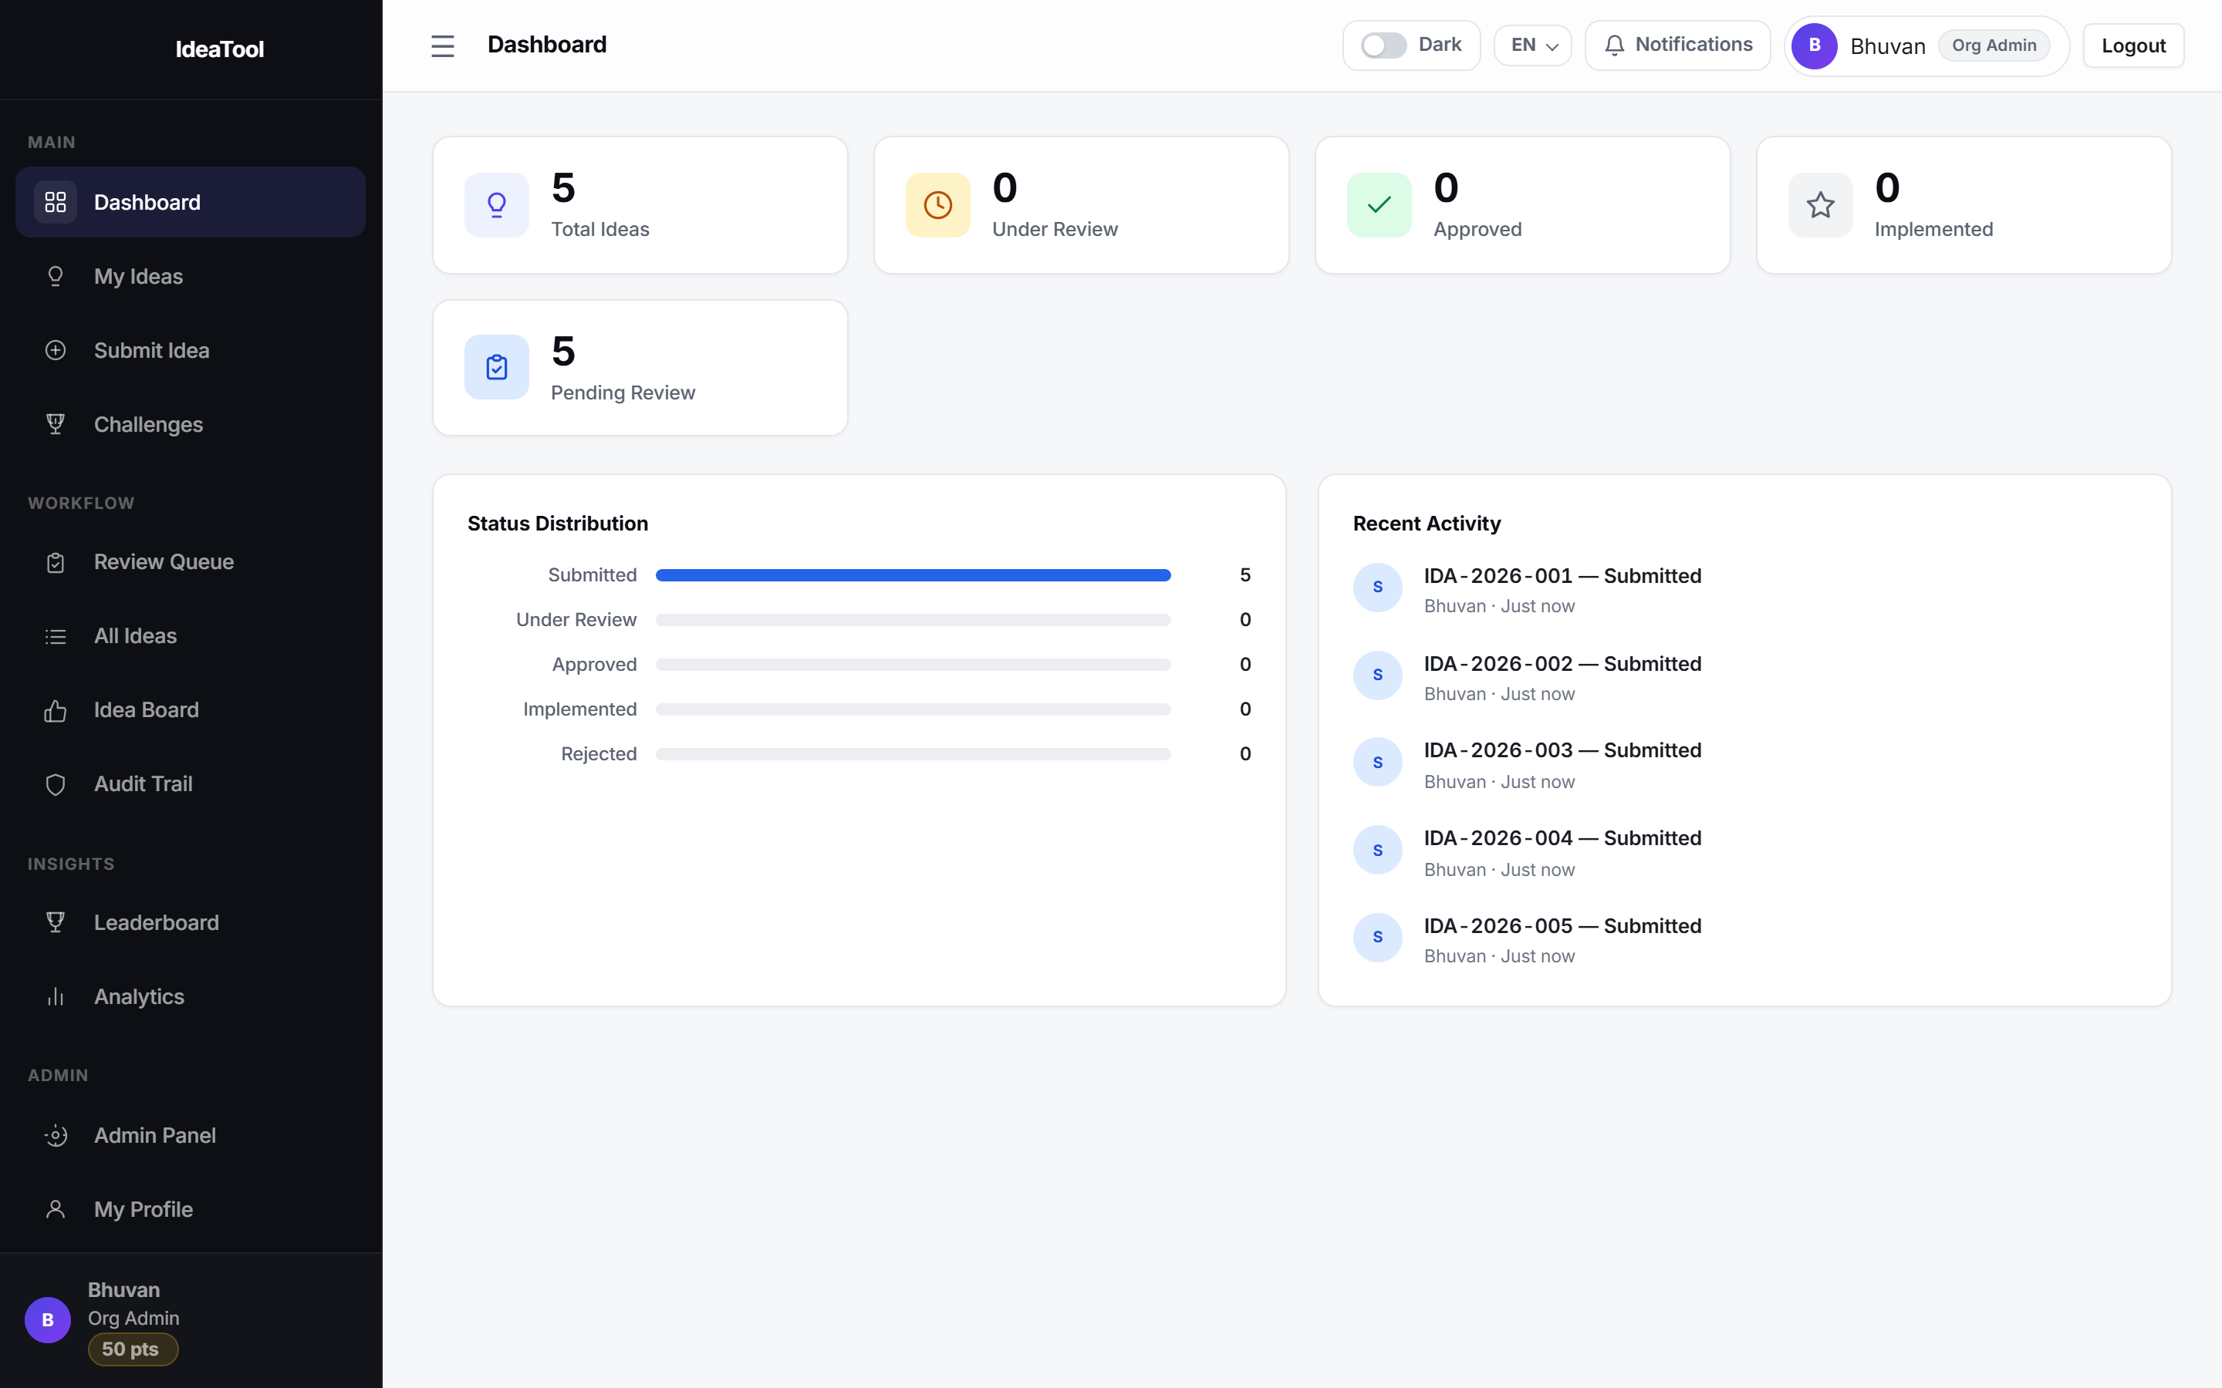
THE PRODUCT
What people see
Personal dashboard
Counts by state, plus what needs the viewer's attention now.
Review queue
Reviewers see only what is theirs, with SLA badges.
Analytics
Department heatmaps, ROI and implementation tracking.
Leaderboard
Points make participation visible and rewarded.
Live dashboard from the running system.
7
Notes:
Screenshot is the real running app. Interface is available in English, Hindi and five regional Indian languages, with light and dark themes.

Slide 8
NEWLY ADDED
New — Bulk employee import
Before an organisation can use any of the above, every employee needs an account. For a plant with 10,000 staff, creating those by hand was the single thing standing between a signed customer and a working rollout.
20,000
~2 min
0
employees per upload
to create 10,000 accounts
downtime while it runs
Hard ceiling per file (15 MB)
About 13 seconds for 1,000
Runs as a background job
How the org admin uses it
1
Download the Excel template
2
Fill one row per employee
3
Upload — see a dry-run preview
4
Confirm — accounts are created
Nothing is written until step 4. The preview is a true dry run — the admin sees exactly what will be created and what will be skipped, before a single account exists.
8
Notes:
Framing matters: this is the onboarding blocker for any large tenant. The timings are measured, not estimated.

Slide 9
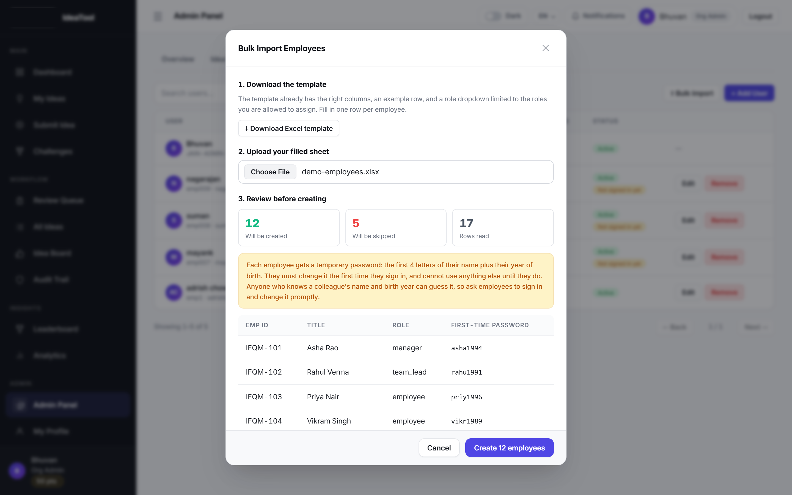
BULK IMPORT
Review before anything is created
A real dry run
The sheet is parsed and validated against the live database. Nothing is written yet.
Counts up front
12 will be created, 5 skipped, 17 rows read — before committing.
First-time passwords shown
The admin can see and distribute them immediately.
Temporary passwords are guessable by design — the server blocks every other action until the employee changes theirs.
Live dry-run preview from the running system.
9
Notes:
This is the actual preview from a real 17-row upload run during this review.

Slide 10
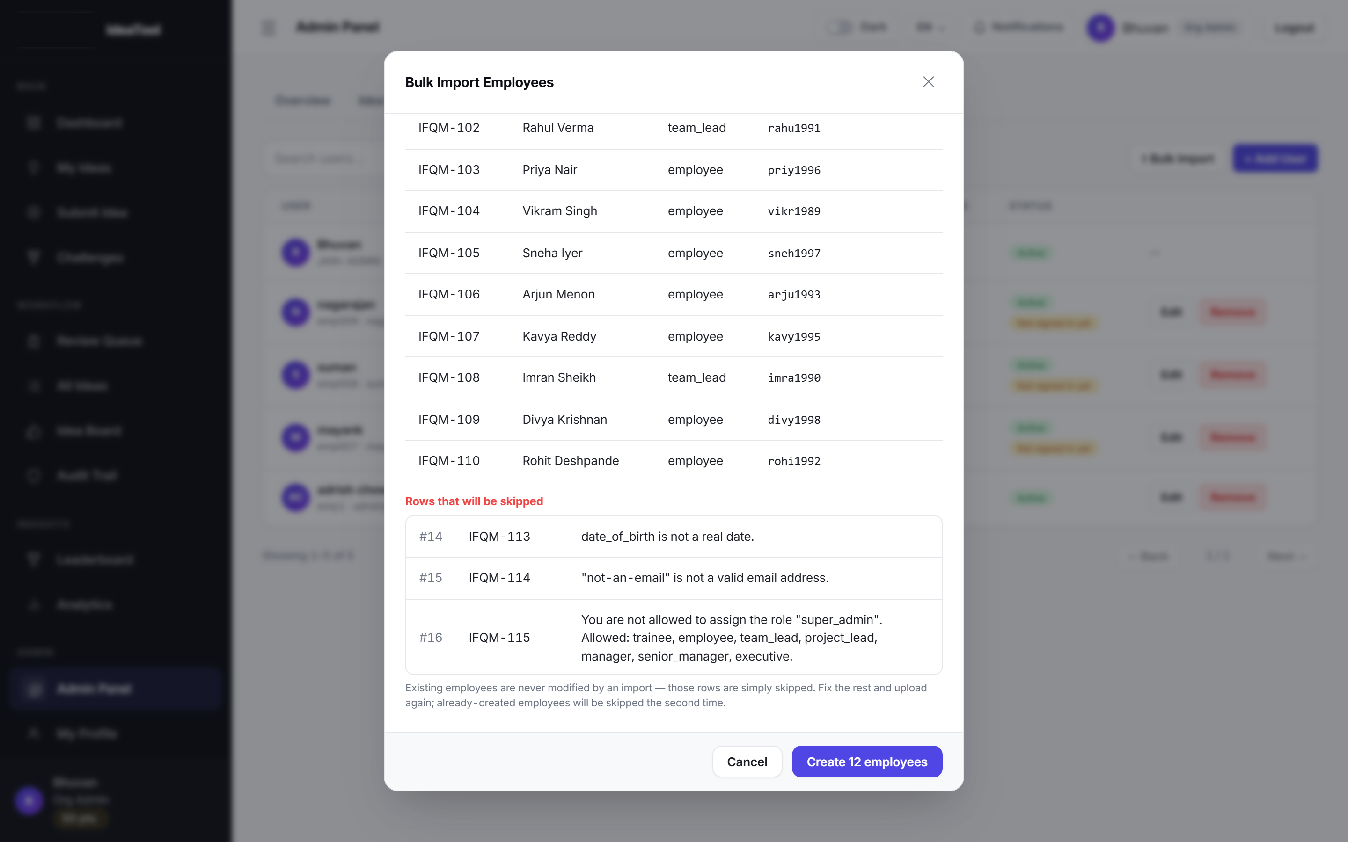
BULK IMPORT
What the import refuses to do
Never modifies an existing user
A duplicate employee ID or email is skipped and reported. An upload can never overwrite a role or reset a password.
Cannot escalate privileges
Every row's role is checked against what that admin may assign. Typing "super_admin" into a cell gets the row rejected.
Rejects circular reporting lines
A reports to B, B reports to A — refused, rather than hanging the org chart.
All-or-nothing
Valid rows insert in one transaction. There is no half-imported state to clean up.
Rejected rows are listed in the preview and downloadable as a CSV. Fix them, upload again — the employees already created are simply skipped.
10
Notes:
Real rejections from the test upload: an impossible date, an invalid email, and a privilege-escalation attempt that the RBAC check refused. These are the guarantees that make bulk import safe to hand to a customer admin.

Slide 11
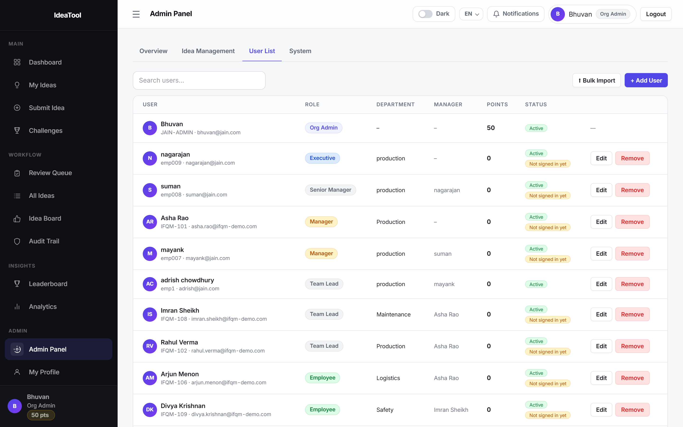
BULK IMPORT
The result
Reporting lines resolved
Managers are linked automatically, even when the manager appears further down the same sheet.
"Not signed in yet" tracking
Flags exactly which accounts still hold a temporary password, so admins know who to chase.
Progress you can watch
The job reports its phase — securing passwords, then creating accounts — and the app stays responsive.
12 employees created · 5 rows skipped
User list after a live import — imported staff, their roles and resolved managers.
11
Notes:
Real outcome of the test import: 12 created, 5 correctly refused, manager chains resolved automatically.

Slide 12
UNDER THE HOOD
Architecture and tenancy
One codebase, one deployment, and a separate database per organisation — so no query can cross a tenant boundary.
FRONTEND
BACKEND
DATABASE
React 18 + Vite
Node.js + Express
MySQL
Single-page app. Light/dark themes. English, Hindi and five regional Indian languages.
REST API. JWT sessions with an 8-hour lifetime. Role checks on every route.
Parameterised queries throughout. One schema per tenant, plus a registry.
Tenant isolation
ifqm_master
›
ifqm_acme
ifqm_tvs
ifqm_lnt
ifqm_jain
Tenant registry
Isolated database
Isolated database
Isolated database
Isolated database
12
Notes:
Tenant names shown are illustrative. Each organisation gets its own MySQL schema, provisioned from a single consolidated schema file; the master registry only maps a slug to a database.

Slide 13
Where it stands
LIVE TODAY
NEXT
Five-step submission with AI scoring
Hierarchical and committee review
Escalation, SLAs and audit trail
Analytics, ROI and leaderboard
Multi-tenant with isolated databases
Bulk employee import
Single sign-on (Azure AD, Google, Okta)
HRMS and ERP integration via webhooks
Digest emails and manager summaries
Excel and PDF board reports
Mobile progressive web app
Questions and discussion
Notes:
Close on what is shippable now versus what is planned. Bulk import is the newest addition and removes the last onboarding blocker for a large tenant.

