Slide 1

<HTML>
Syed Muhammad Anas Bukhari
Hypertext Markup Language

Slide 2
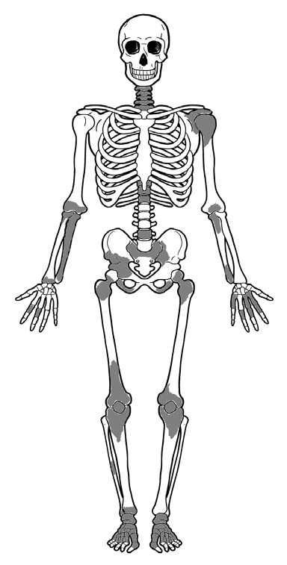
HTML

Slide 3

CSS

Slide 4
JavaScript

Slide 5
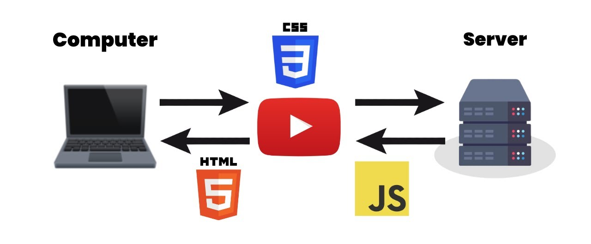
How do websites work

Slide 6
What is HTML?
HTML is a language for describing web pages.
HTML stands for Hyper Text Markup Language
HTML is a markup language
A markup language is a set of markup tags
The tags describe document content
HTML documents contain HTML tags and plain text
HTML documents are also called web pages

Slide 7
HTML Tags
HTML markup tags are usually called HTML tags
HTML tags are keywords (tag names) surrounded by angle brackets like <html>
HTML tags normally come in pairs like <b> and </b>
The first tag in a pair is the start tag, the second tag is the end tag
The end tag is written like the start tag, with a forward slash before the tag name
Start and end tags are also called opening tags and closing tags

Slide 8
HTML Elements
"HTML tags" and "HTML elements" are often used to describe the same thing.
HTML Element:
<p>This is a paragraph.</p>

Slide 9
Web Browsers
The purpose of a web browser (such as Google Chrome, Internet Explorer, Firefox, Safari) is to read HTML documents and display them as web pages.
The browser does not display the HTML tags, but uses the tags to determine how the content of the HTML page is to be presented/displayed to the user

Slide 10
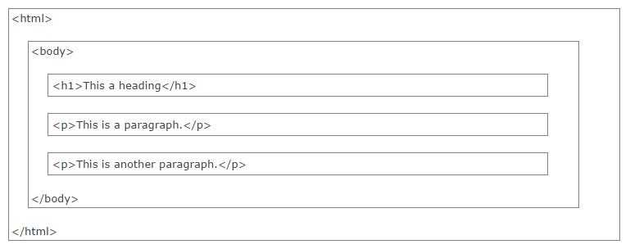
HTML Page Structure

Slide 11
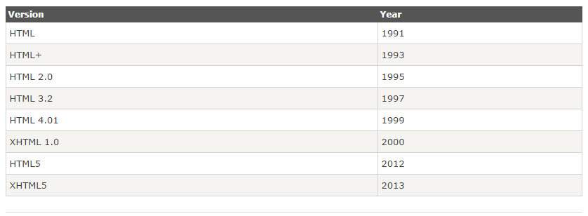
HTML Versions

Slide 12
HTML Editors
HTML can be edited by using a professional HTML editor like:
Visual Studio
Adobe Dreamweaver
Microsoft Expression Web
CoffeeCup HTML Editor
Notepad ++ / Notepad

Slide 13
HTML Basics
HTML Headings
HTML headings are defined with the <h1> to <h6> tags.
Example
<h1>This is a heading</h1> <h2>This is a heading</h2> <h3>This is a heading</h3>

Slide 14
HTML Basics
HTML Paragraphs
HTML paragraphs are defined with the <p> tag.
Example
<p>This is a paragraph.</p> <p>This is another paragraph.</p>
HTML Links
HTML links are defined with the <a> tag.
Example
<a href="http://www.w3schools.com">This is a link</a>

Slide 15
HTML Basics
HTML Images
HTML images are defined with the <img> tag.
Example
<img src="w3schools.jpg" width="104" height="142">

Slide 16
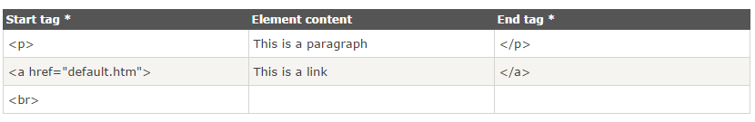
HTML Elements
HTML documents are defined by HTML elements.
An HTML element is everything from the start tag to the end tag.
The start tag is often called the opening tag. The end tag is often called the closing tag
Example

Slide 17
HTML Document Example
<!DOCTYPE html> <html> <body> <p>This is my first paragraph.</p> </body> </html>

Slide 18
Empty HTML Elements
HTML elements with no content are called empty elements.
<br> is an empty element without a closing tag (the <br> tag defines a line break).

Slide 19
HTML Attributes
Attributes provide additional information about HTML elements.
HTML elements can have attributes
Attributes provide additional information about an element
Attributes are always specified in the start tag
Attributes come in name/value pairs like: name="value“
Example
<a href="http://www.mcsoftsis.com">This is a link</a>

Slide 20
HTML Headings
HTML Headings
Headings are defined with the <h1> to <h6> tags.
<h1> defines the most important heading. <h6> defines the least important heading.
Example
<h1>This is a heading</h1> <h2>This is a heading</h2> <h3>This is a heading</h3>

Slide 21
HTML Lines
The <hr> tag creates a horizontal line in an HTML page.
The hr element can be used to separate content:
Example
<p>This is a paragraph.</p> <hr> <p>This is a paragraph.</p> <hr> <p>This is a paragraph.</p>

Slide 22
HTML Comments
Comments can be inserted into the HTML code to make it more readable and understandable. Comments are ignored by the browser and are not displayed.
Comments are written like this:
Example
<!-- This is a comment -->

Slide 23
HTML Paragraphs
Paragraphs are defined with the <p> tag.
Example
<p>This is a paragraph</p> <p>This is another paragraph</p>

Slide 24
HTML Line Breaks
Use the <br> tag if you want a line break (a new line) without starting a new paragraph:
<p>This is<br>a para<br>graph with line breaks</p>
The <br> element is an empty HTML element. It has no end tag.

Slide 25
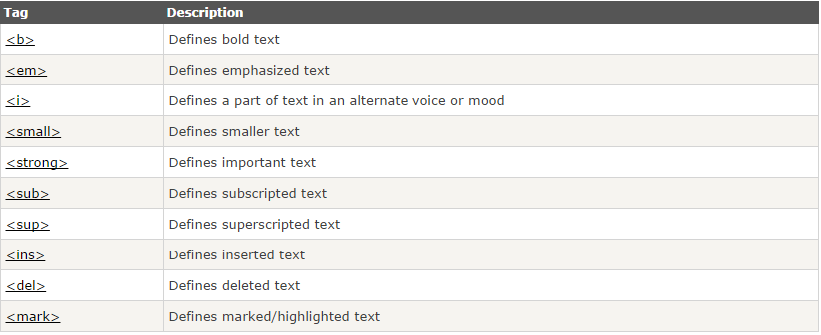
HTML Text Formatting
HTML uses tags like <b> and <i> for formatting output, like bold or italic text.

Slide 26
HTML Hyperlinks (Links)
The HTML <a> tag defines a hyperlink.
A hyperlink (or link) is a word, group of words, or image that you can click on to jump to another document.
When you move the cursor over a link in a Web page, the arrow will turn into a little hand.
The most important attribute of the <a> element is the href attribute, which indicates the link’s destination.
By default, links will appear as follows in all browsers:
An unvisited link is underlined and blue
A visited link is underlined and purple
An active link is underlined and red

Slide 27
HTML <head>
The <head> element is a container for all the head elements. Elements inside <head> can include scripts, instruct the browser where to find style sheets, provide meta information, and more.

Slide 28
The HTML <title> Element
The <title> tag defines the title of the document.
The <title> element is required in all HTML/XHTML documents.
The <title> element:
defines a title in the browser toolbar
provides a title for the page when it is added to favorites
displays a title for the page in search-engine results

Slide 29
The HTML <style> Element
The <style> tag is used to define style information for an HTML document.
Inside the <style> element you specify how HTML elements should render in a browser:
<head> <style type="text/css"> body {background-color:yellow;} p {color:blue;} </style> </head>

Slide 30
HTML Styles - CSS
CSS was introduced together with HTML 4, to provide a better way to style HTML elements.
CSS can be added to HTML in the following ways:
Inline - using the style attribute in HTML elements
Internal - using the <style> element in the <head> section
External - using an external CSS file

Slide 31
HTML Images
In HTML, images are defined with the <img> tag.
The <img> tag is empty, which means that it contains attributes only, and has no closing tag.
To display an image on a page, you need to use the src attribute. Src stands for "source". The value of the src attribute is the URL of the image you want to display.
Syntax for defining an image:
<img src="url" alt="some_text">

Slide 32
HTML Tables
Tables are defined with the <table> tag.
A table is divided into rows (with the <tr> tag), and each row is divided into data cells (with the <td> tag). td stands for "table data," and holds the content of a data cell. A <td> tag can contain text, links, images, lists, forms, other tables, etc.
<table border="1"> <tr> <td>row 1, cell 1</td> <td>row 1, cell 2</td> </tr> <tr> <td>row 2, cell 1</td> <td>row 2, cell 2</td> </tr> </table>

Slide 33
HTML Unordered Lists
An unordered list starts with the <ul> tag. Each list item starts with the <li> tag.
The list items are marked with bullets (typically small black circles).
<ul> <li>Coffee</li> <li>Milk</li> </ul>
How the HTML code above looks in a browser:
Coffee
Milk

Slide 34
HTML Ordered Lists
An ordered list starts with the <ol> tag. Each list item starts with the <li> tag.
The list items are marked with numbers.
<ol> <li>Coffee</li> <li>Milk</li> </ol>
How the HTML code above looks in a browser:
Coffee
Milk

Slide 35
HTML Forms
HTML forms are used to pass data to a server.
The <form> tag is used to create an HTML form:
<form> . input elements . </form>

Slide 36
HTML Forms - The Input Element
The most important form element is the <input> element.
The <input> element is used to select user information.
An <input> element can vary in many ways, depending on the type attribute. An <input> element can be of type text field, checkbox, password, radio button, submit button, and more.

Slide 37
HTML Iframes
An iframe is used to display a web page within a web page.
Syntax for adding an iframe:
<iframe src="URL"></iframe>
The URL points to the location of the separate page.

Slide 38
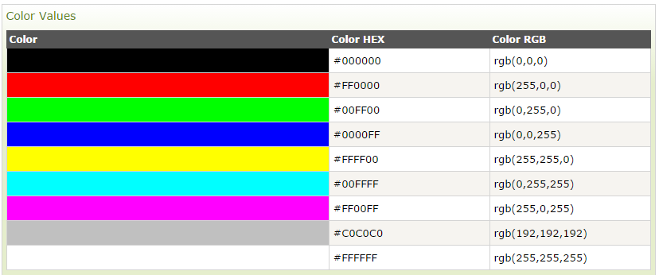
HTML Colors
HTML colors are defined using a hexadecimal notation (HEX) for the combination of Red, Green, and Blue color values (RGB).

Slide 39
THANK YOU

