Slide 1



Linux File System Basics
Presented by:
Peerzada Mohammad Sameem Makhdoomi
CFCS2R INTERN Q1 2024-25
AM-2024PINS1262

Slide 2
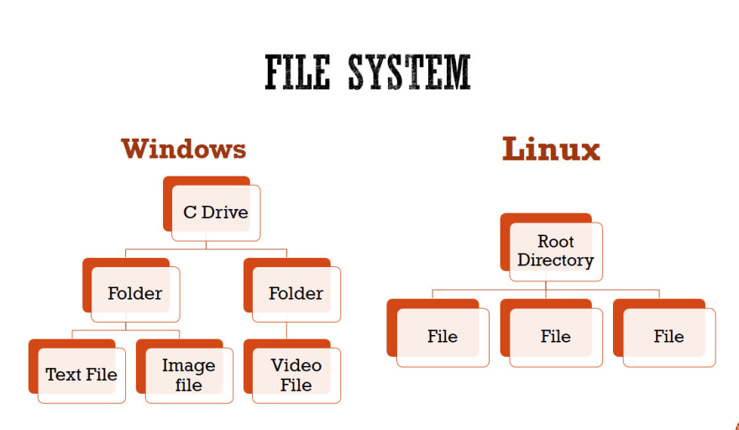
What is a file system?
A file system is the way a computer's operating system organizes and manages files and directories on a storage device.
It provides a structured way to store, access, and manage digital information.
The file system defines how data is stored, named, and accessed, allowing the operating system to keep track of where files are located and how to retrieve them efficiently.
It also handles tasks like creating, deleting, and modifying files and directories.

Slide 3
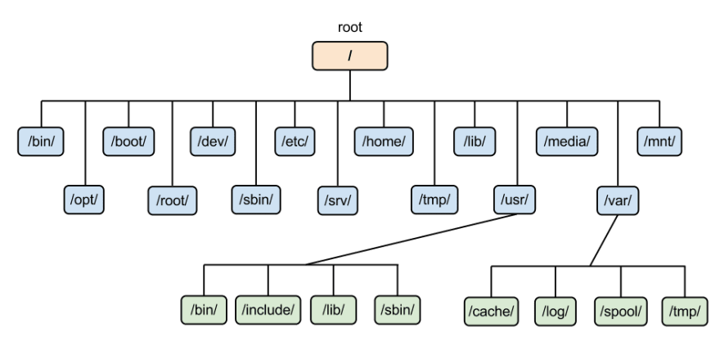
Directory Structure
In the Linux file system, directories are used to organize files in a hierarchical structure.
The top-level directory is called the root directory, represented by the forward slash (/).
Subdirectories branch off from the root, creating a tree-like structure where files and folders can be nested within other folders.

Slide 4

File Types and Extensions
Linux supports a wide variety of file types, each with its own unique extension. These extensions indicate the file's purpose and help the system identify how to handle the file. Common extensions include .txt for text files, .jpg for images, and .mp3 for audio files.
File types are not limited to traditional file extensions. Linux also recognizes files without extensions, such as executable files, which are identified by their permissions rather than their name.
Understanding file types and extensions is crucial for navigating and managing the Linux file system effectively.

Slide 5
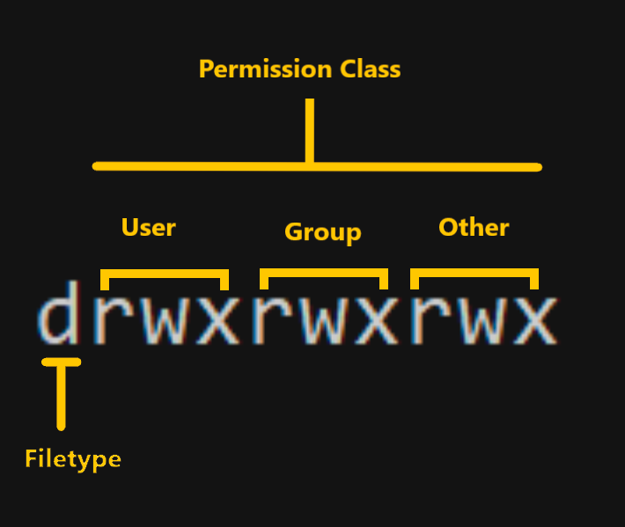
File Permissions
Linux file systems use a permissions system to control access to files and directories.
Each file and directory has an owner, a group, and a set of permissions that dictate who can read, write, or execute the item.
Permissions are displayed as a series of three characters (e.g. rwx) for the owner, group, and others. The 'r' stands for read, 'w' for write, and 'x' for execute.

Slide 6



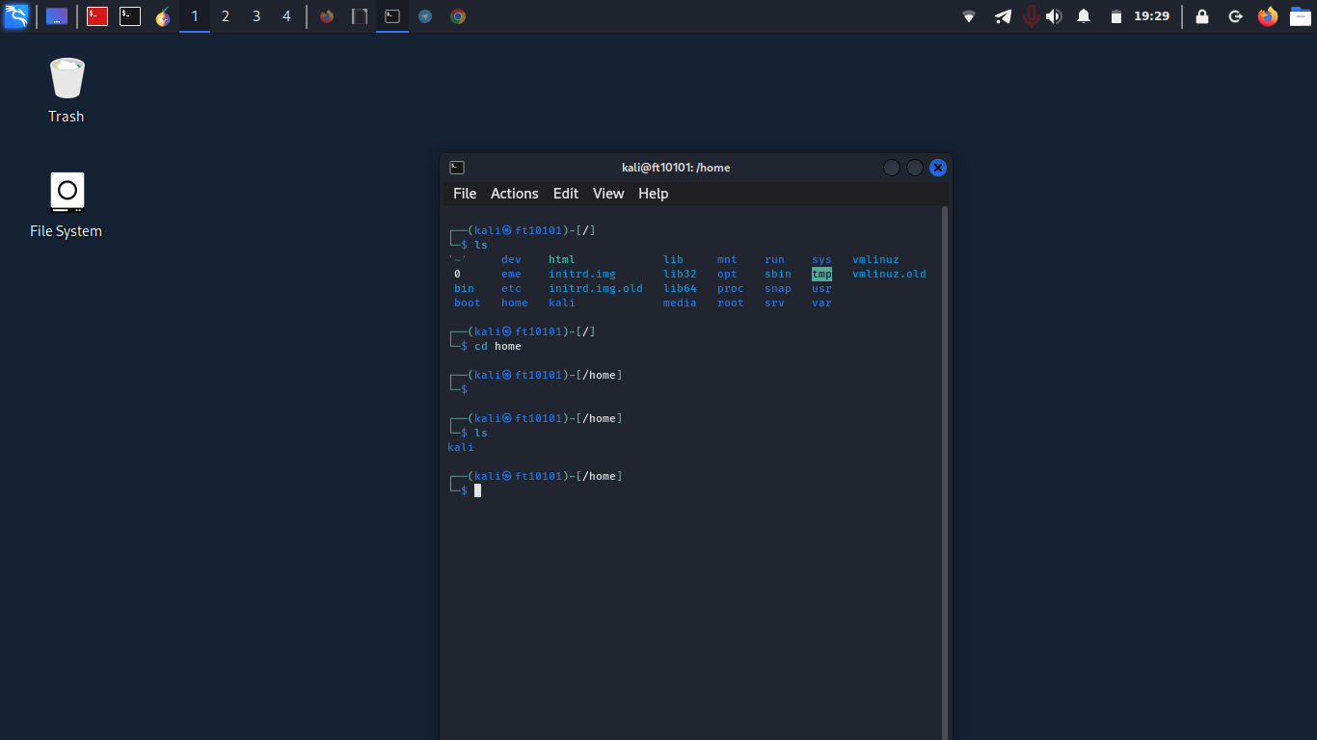
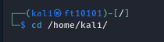
Navigating the File System
Directory Navigation
Listing Files
Path Navigation
Use the cd command to change directories and explore the file system hierarchy.
The ls command shows the contents of the current directory, including files and subdirectories.
Absolute paths define the complete file location from the root directory, while relative paths describe the location relative to the current directory.

Slide 7

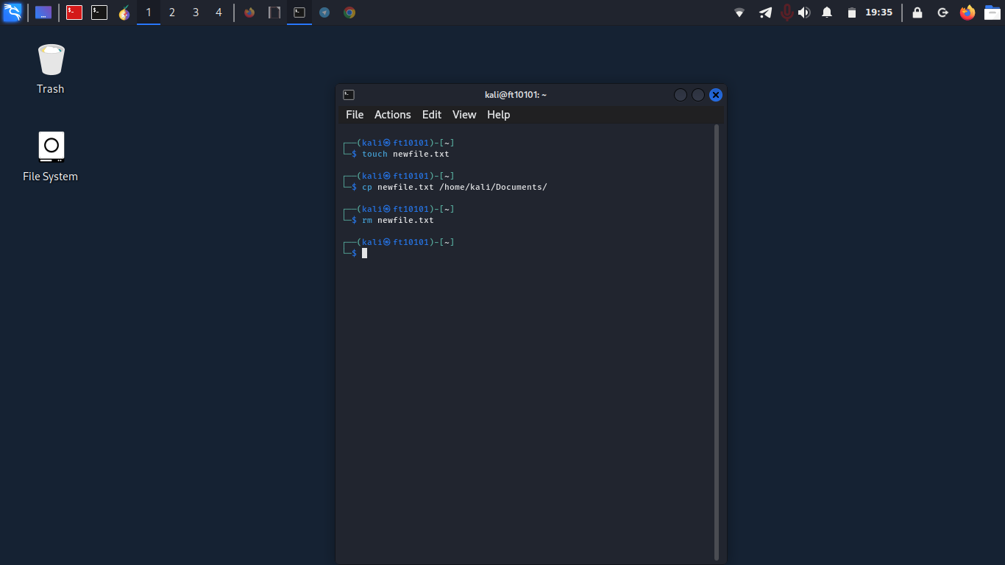


Creating, Copying, and Deleting Files
Creating Files
Use the touch command to create new files. Specify the filename and the file will be created in the current directory.
Copying Files
Utilize the cp command to make copies of files. Provide the source and destination filenames to duplicate a file.
Deleting Files
The rm command will remove files permanently. Be cautious, as deleted files cannot be recovered.

Slide 8
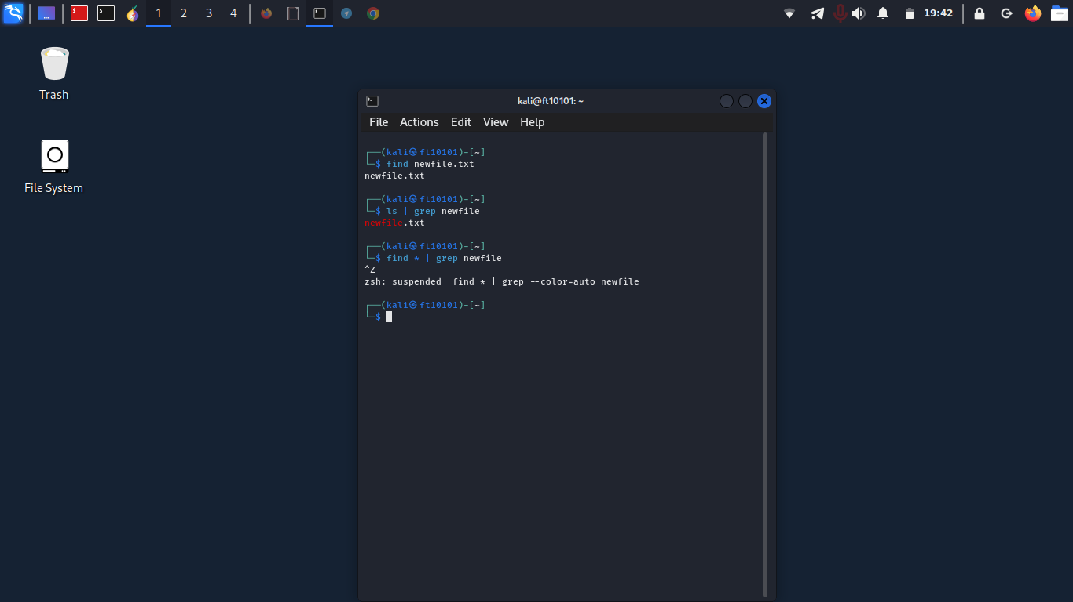
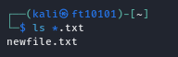
Searching for Files
1
Find by Name
Use the find command to locate files by their name. You can search the entire file system or specific directories.
2
Search Contents
The grep command allows you to search the contents of files for a specific pattern or keyword.
3
Use Wildcards
Wildcards like * and ? can be used to perform more advanced filename searches, matching multiple characters.

Slide 9
Common Linux File System Types
File System Type
Description
ext4 (Extended File System 4)
The default file system for most modern Linux distributions. Provides advanced features like journaling, extended attributes, and larger file sizes.
XFS
A high-performance file system developed by Silicon Graphics. Optimized for large files and metadata-intensive workloads.
Btrfs (B-tree File System)
A modern, copy-on-write file system with features like built-in RAID, snapshots, and sub-volumes.
FAT (File Allocation Table)
A simple file system often used on removable media like USB drives. Provides compatibility with Windows and other operating systems.
NTFS (New Technology File System)
The default file system for Windows. Offers advanced features like encryption, access control lists, and file compression.

Slide 10
Thankyou. :)

