Slide 1
Summary
Background
Study design
Analysis
Conclusion
Discussion
Policy of intervention
contribution

Slide 2
Sugar Sweetened and artificially-sweetened beverage consumption and risk of type 2 diabetes in men
Lawrence de Koning, Vasanti S Malik, Eric B Rimm, Walter C Willett, Frank B Hu
Presented by Feben Asefaha, Xin Zheng, & Yeyi Zhang
(maybe like pictures of a time series graph, a questionnaire, and like regular and diet sodas???)
Notes:
I’m Feben Asefaha
I’m Xin Zheng
And I’m Yeyi Zhang, and we’re here to talk to you about a 2011 research paper published in the American Society for Nutrition. The paper, titled “Sugar Sweetened and artificially sweetened beverage consumption and risk of type 2 diabetes in men”.

Slide 3
”There’s sugar in that?”
Notes:
Many of the excessive sugars we consume are “hidden” from us. Unlike the sugars in fruit, which have their absorption into our bodies slowed down by their fiber content, sugary drinks provide us with a large amount of easily absorbable sugars. Without the fiber, we may not feel satiated, making it easier to consume more of these liquids.

Slide 4
Background

Slide 5
Incidence increases
(A chart showing incidence in separate countries for 4 separate years 80s, 90s, 2000s, 2010s
US, India, South Africa, China, Brazil (or something)
Notes:
Much has been discussed about the increasing incidence and prevalence of type 2 diabetes. Diabetes is an endocrine disorder in which the body cannot properly regulate its blood sugar. Type 2 diabetes is heavily associated with age, and now, lifestyle. Initially a disease primarily occurring among older people, it is now more frequently diagnosed in people young adults, and sometimes childen..

Slide 6
Diabetes risk of sugar sweetened beverages
(Pics of sodas, frappucinos, other sugary drinks)
Notes:
There is a wealth of literature that supports the known risk factors: obesity, sedentary lifestyle, and poor diet. Within dietary behaviors, sugar-sweetened beverages have been identified as major risk factor for diabetes, a behavior that can lead to adiposity, or fat deposition.
(have to cite these major studies)

Slide 7
World Health Organization revises sugar guidelines
Notes:
Recently, the World Health Organization has set forth recommendations for added sugar consumption: no more than 25 grams a day, or about 5% of total daily calories coming from sugar. This is the optimum threshold for health, and WHO classifies the evidence supporting this recommendation as “strong”.

Slide 8
But…..
(Pics of like three different soda brands with an equal sign saying how much soda is in it)
Notes:
The problem? There are approximately 40 grams of sugar in ONE can of soda.

Slide 9
Artificially-sweetened beverages and Type 2 diabetes risk
(Pics of diet sodas ads and these products?)
Notes:
To reduce sugar intake, many people utilize artificial sweeteners; like aspartame, saccharine, and sucralose, marketed as Equal, Nutrasweet, or Splenda, respectively. These are scrutinized, and may come with their own controversies, but many still find them to be a suitable, calorie-free alternative. The researchers are not so convinced, however. Some previous studies have demonstrated an association between these artificial sweeteners and increased type 2 diabetes risk.

Slide 10
Study Purpose
Data
takes an already existing longitudinal survey, and mines it for pertinent data. That data and subsequent analyses is used in an attempt to clarify and strengthen the associations between our exposures, sugar sweetened and artificially sweetened beverages, and our disease, Type 2 diabetes.
Notes:
The last background:The connection between sugar and chronic disease is so strong, that many cities have already administered public health campaigns in order to curb the overconsumption of the liquid sweets, an easy way to mindlessly consume several days worth of sugar. There have also been many proposed ”sugar taxes” on these drinks.

Slide 11
STUDY DESIGN

Slide 12



Study purpose
sugar-sweetened
beverage
Type 2 diabetes
artificially sweetened
artificially sweetened o
other beverage
Notes:
This study takes an already existing longitudinal survey, and mines it for pertinent data. That data and subsequent analysis is used in an attempt to clarify and strengthen the associations between our exposures, sugar sweetened and artificially sweetened beverages, and our disease, Type 2 diabetes.

Slide 13





Study design
Cohort study(longitude)
-follow up over 20 years
data analysis
Select people in HPFS
Find people with type 2 diabetes
Result and conclusion

Slide 14
Select People
Notes:
In the study, we choose 40389 participants form the Health Professionals Follow-Up Study (HPFS). However, not all men included in the study were used for analysis. Men with Type 2 diabetes, cardiovascular disease, cancer, or “implausible energy intake” were excluded from baseline, reducing the number of participants in this particular study to 40,389. These men were followed over 20 years, and were excluded if they developed Type 2 diabetes within the first two years of the study, in order to negate any effects of prior metabolic defects clouding affecting the onset of diseases (such as insulin resistance), rather than the exposures of interest (here, sugary and artificially sweetened beverages).
The Health Professional Follow Up Study implements restriction in its design, by limiting the participants to men. This removes gender based bias in the analysis.
….But that reduces generalizability for half of your population. (sad emoji on next slide)
We are also restricted to health professionals, which includes nurses, veterianarians, physicians, which keeps it above the same socioeconomic status

Slide 15
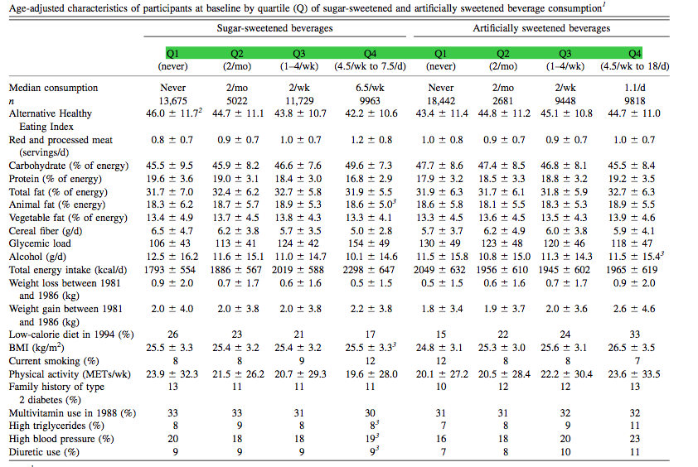
Follow up
over 20 years:
Sent questionnaires every 4 years.
131-item semi-quantitative food-frequency questionnaire
Variables of Interest in the questionnaire
Notes:
This was a prospective cohort study, with data collected via surveys. In the 131-item semi-quantitative food-frequency questionnaire, researchers asked questions about things such as smoking, physical activity, family history of disease, high blood pressure, high triglycerides (in 1986), cardiovascular disease risk, and use of vitamins (post 1988), diuretic. They also looked into energy intake and consumption via detailed questionnaires, to assess what participants dietary behaviors were.

Slide 16
data collection
Find the people with type 2 diabetes;
Notes:
There were 2680 cases over 20 y of follow-up.

Slide 17
Analysis

Slide 18
conclusion

Slide 19
Discussion
Strengths, Limits, etc
FFQ (introduces recall bias)

Slide 20
Policy implications?

Slide 21
Contributions

Slide 22
References
http://www.ucdenver.edu/research/CCTSI/programs-services/ctrc/Nutrition/Documents/Food_Frequency_Questionnaires.pdf

