Slide 1
COMP306 – DBMS
Banu Yobas
Term Project:
Club/Event Activities DB Design and Implementation
Firat Tamur – 60534
Alp Adnan Basar - 60110

Slide 2
Outline
Business Rules
Problem Statement
Logical Design
ERD Diagram
Potential Improvements
Storage
Security
Backup

Slide 3
Problem
At Koç University, we have nearly 80 student clubs. Each club has its active members and committee records. Almost every month some of these clubs organize events, and students from Koc University and other universities are welcomed to join them. We aim to design a database that can manage such club events and activities.

Slide 4
Business Rules
Business rules are defined respect to Koç University’s Clubs and Events.

Slide 5
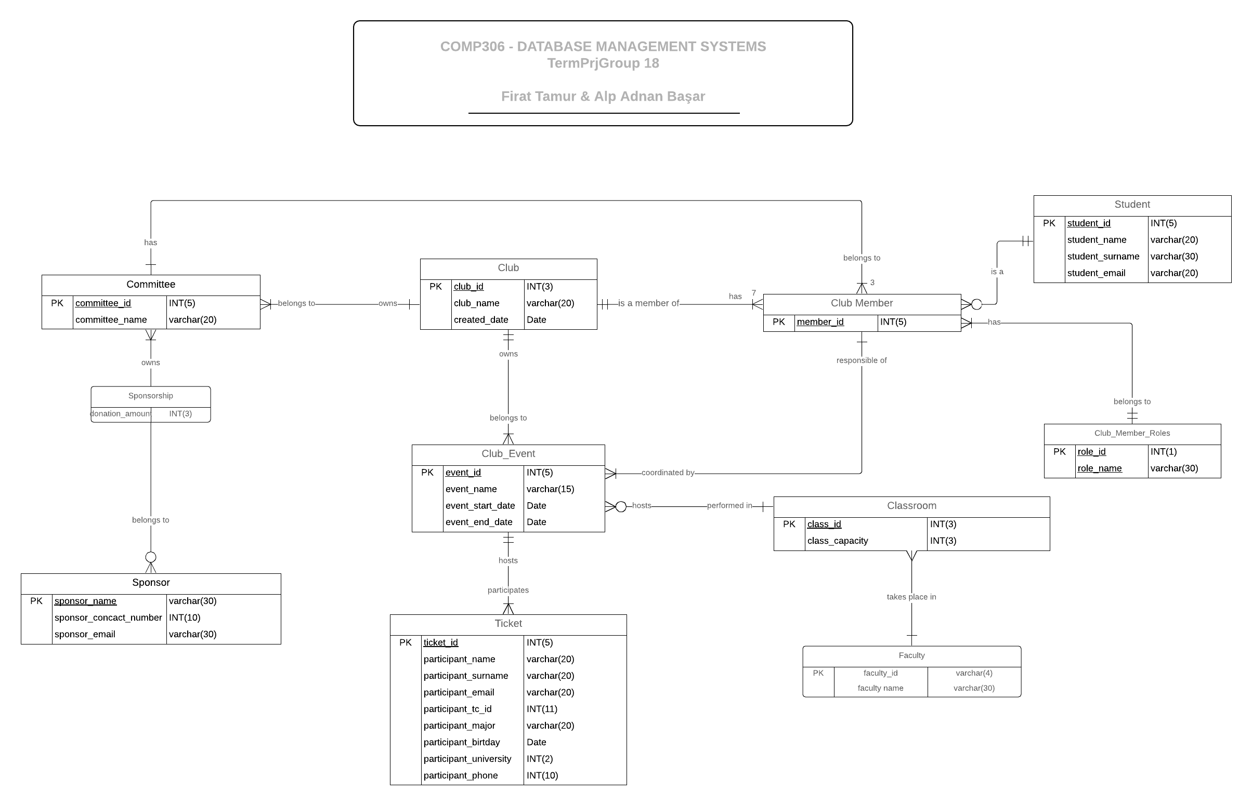
ERD Diagram
Click the link here to access full image.

Slide 6
Logical Design
We converted our all conceptual design to logical design by creating tables, then we applied 1NF, 2NF, 3NF and BCNF to our logical design to remove anomalies and redundancies.

Slide 7
Views
Some of our important views:
  Presidents: Shows list of all club presidents and their club’s names
  Project Leaders: Shows list of all project leaders (responsible from event)
  Committee members: Shows list of all committee members and their committee’s name and club’s name
  Participant Contact Info: Shows list of all participants email and phone numbers
  Events: Shows list of all events organized by clubs.

Slide 8
Triggers
Some of our Triggers:
  Check email validity. Koc university students’ emails must include ‘@ku.edu.tr’
  Check date and class avaibility for events
  Create and assign 3 committees when a new club is created

Slide 9
Storage
Table Spaces and Raid Types:
  Club Table Space: Includes club related tables – Raid 5
  Event Table Space: Includes event related tables – Raid 5
  View Table Space: Includes views - Raid 10

Slide 10
Backup
Full Backup every Friday
Differential Backup every day.

Slide 11
Security
DBA is IT employees at Koç University.
Roles:
  Dean of Students
  Presidents
  Project Leaders
  Sponsorship Committee Members
  Application Users

Slide 12
Future Improvements
If we had two weeks or more time, we would design a website application for our users. Koç university students could directly access the website with their email and student id. Koç university students could join clubs easily via the web interface. Events and tickets could be displayed on the website and participants could join events on the website.

