Slide 1
Seattle Housing Price Predictor
Francis Tan

Slide 2
Goal
Using housing data such as the number of bedrooms/bathrooms, square footage, year built as well as other less intuitive variables as provided by the Zillow API, the aim of this project is to predict the sale price of a property by employing various predictive machine learning models in an ensemble

Slide 3
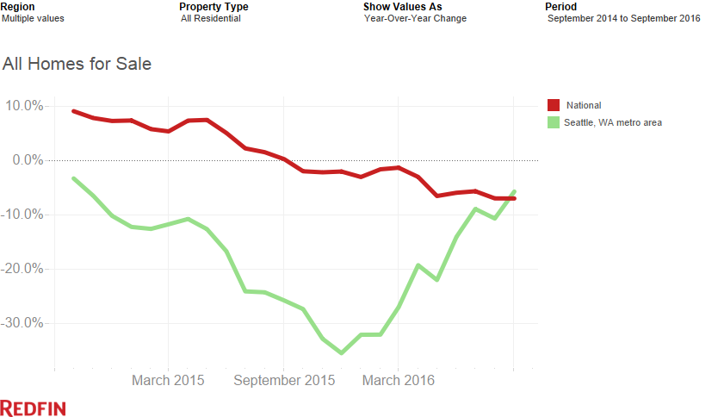
The State of Seattle Housing
“The fundamental demand drivers: job growth, income growth and in-migration all look great in the six-county area, and we’re seeing Millennial buyers enter the market in larger numbers in recent months. The result – we’re forecasting ongoing demand”
-- Kate Knight, Redfin

Slide 4
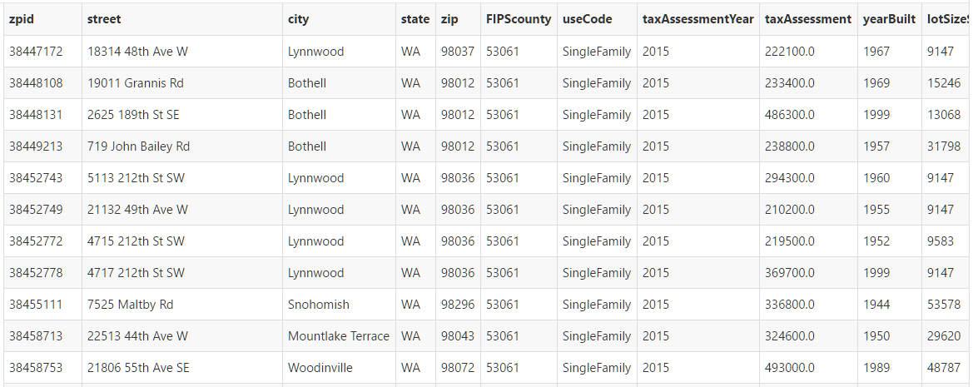
The Data
Address
Region
Zestimate
Last Updated
30-day Change
Valuation (low and high)
Valuation percentile
Home type (Single, Condo, etc)
Tax assessment
Year Built
Square Footage
Lot Size
# of Bedrooms
# of Bathrooms
Last Sold Date
Last Sold Price
2827 Observations
23 Columns
All data provided by Zillow API
*Imputation may be required to determine blank regions

Slide 5
Strategy
Three Part Structure:
ML Processor
Combine the results of multiple models through ensemble
RESTful interface
JSON
Frontend

Slide 6
Demo

