Slide 1
Seattle Housing Price Predictor
Francis Tan

Slide 2
Goal
Using housing data such as the number of bedrooms/bathrooms, square footage, year built as well as other less intuitive variables as provided by the Zillow API, the aim of this project is to predict the sale price of a property by employing various predictive machine learning models in an ensemble

Slide 3
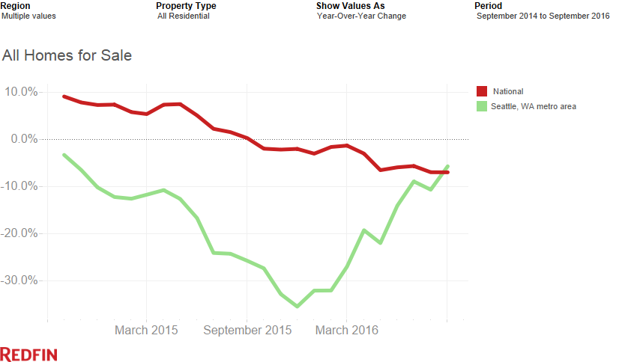
The State of Seattle Housing
“The fundamental demand drivers: job growth, income growth and in-migration all look great in the six-county area, and we’re seeing Millennial buyers enter the market in larger numbers in recent months. The result – we’re forecasting ongoing demand”
-- Kate Knight, Redfin

Slide 4
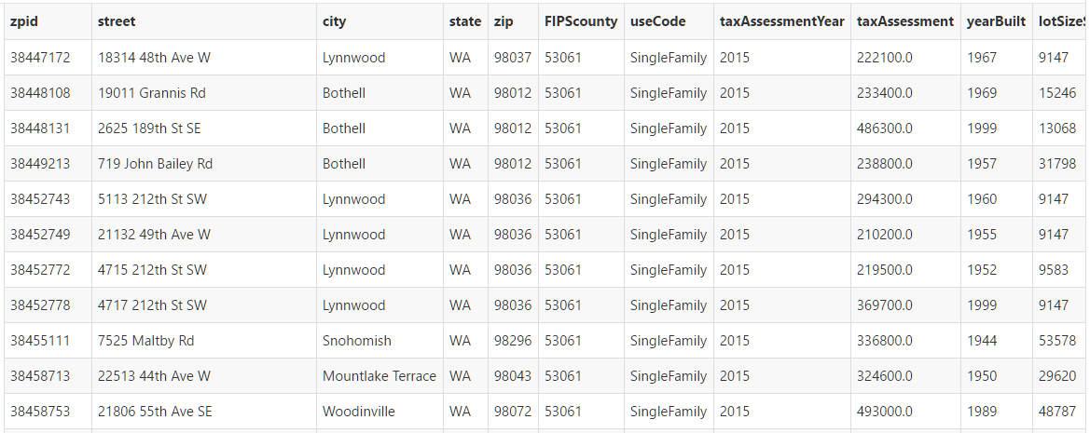
The Data
Address
Region
Zestimate
Last Updated
30-day Change
Valuation (low and high)
Valuation percentile
Home type (Single, Condo, etc)
Tax assessment
Year Built
Square Footage
Lot Size
# of Bedrooms
# of Bathrooms
Last Sold Date
Last Sold Price
2827 Observations
23 Columns
All data provided by Zillow API
*Imputation may be required to determine blank regions

Slide 5
Strategy
Three Part Structure:
ML Processor
Combine the results of multiple models through ensemble
RESTful interface
JSON
Frontend

Slide 6
Strategy
Three Part Structure:
ML Processor
Combine the results of multiple models through ensemble
RESTful interface
JSON
Frontend

Slide 7
Data Preprocessing
Data
In Sample – 80%
Out-of-Sample – 20%

Slide 8
Data Preprocessing
Typecast to proper data types
Numeric types: taxAssessmentYear, taxAssessment, yearBuilt, lotSizeSqFt, finishedSqFt, bathrooms, bedrooms, zestimate, zestimateValueChange, zestimateValueLow, zestimateValueHigh, zestimatePercentile, lastSoldPrice
Datetime types: lastSoldDate, zestimateLastUpdated

Slide 9
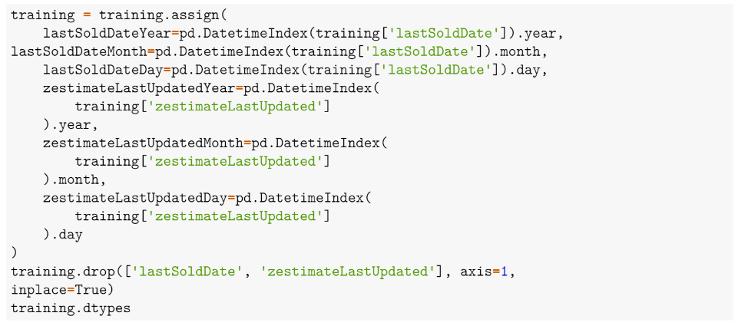
Data Preprocessing
Split datetime objects into separate year, month, and day columns

Slide 10
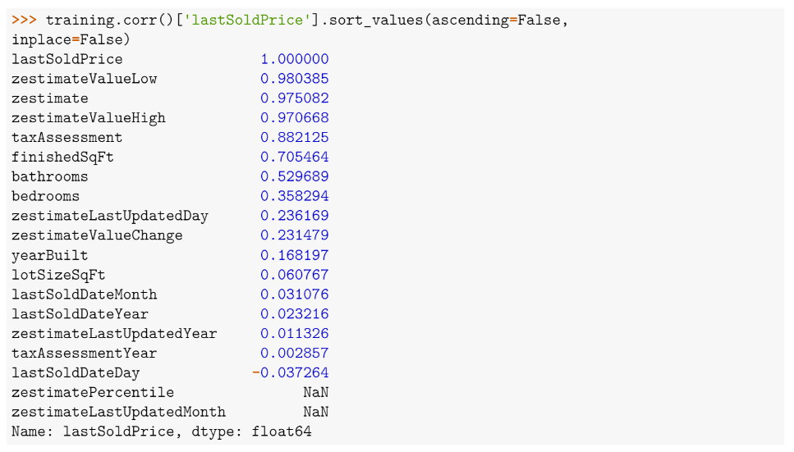
Data Preprocessing
Column correlations against dependent variable reveal zestimate columns to be highly correlation. Exclude

Slide 11
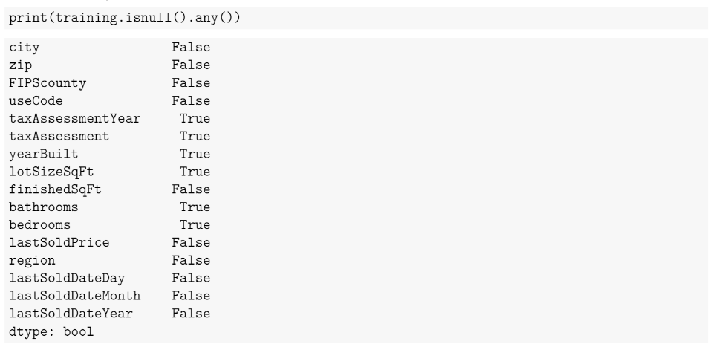
Data Preprocessing
Remove NaNs. Imputing not a sensible solution so we exclude

Slide 12
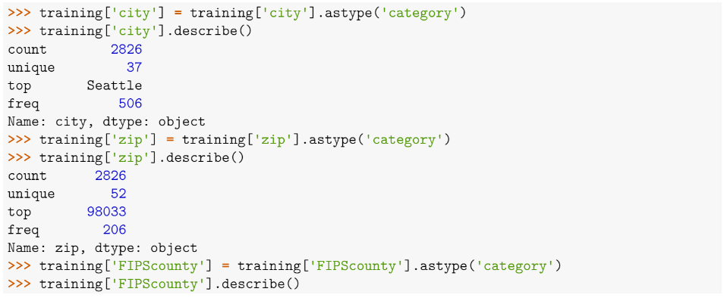
Data Preprocessing
Convert categorical data to dummy variables

Slide 13
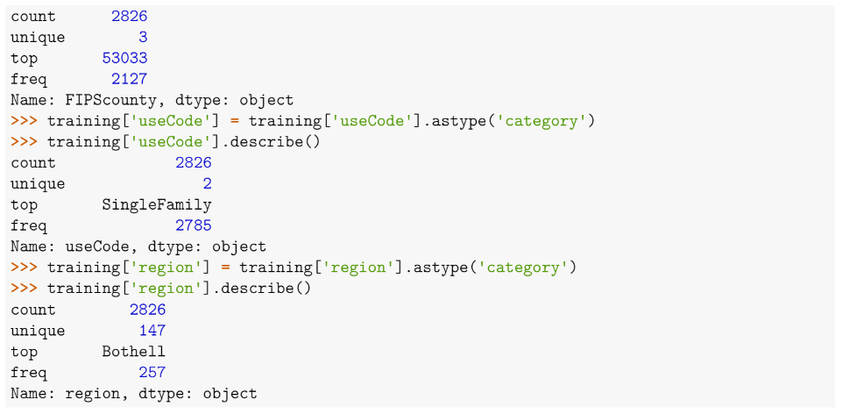
Data Preprocessing
Convert categorical data to dummy variables

Slide 14
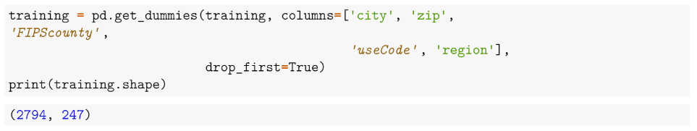
Data Preprocessing
Convert categorical data to dummy variables

Slide 15
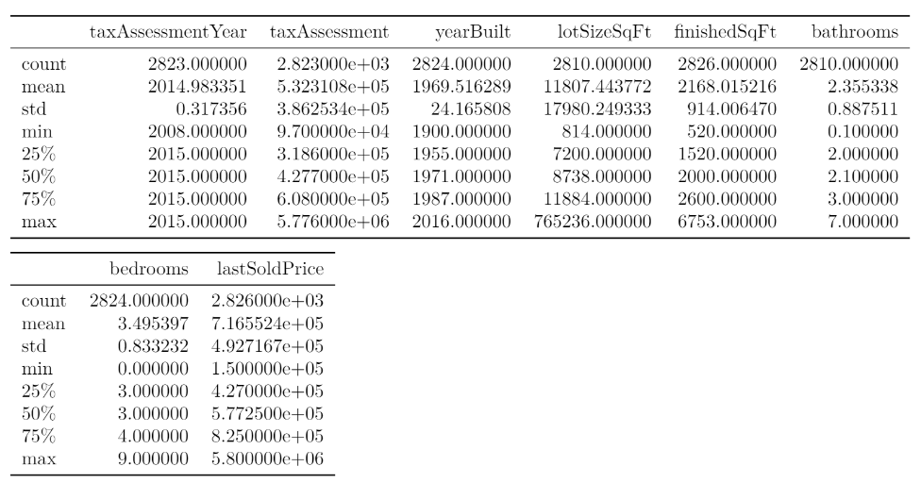
Data Summary
Median price of $577,000
High variability reveals that data is representative of many different types of properties

Slide 16

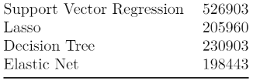
Training
10-Fold cross-validation running in parallel
Grid Search for parameter tuning
Scoring metric: RMSE
Estimators:
Ridge Regression – alpha: (0.1, 10, 0.1)
Support Vector Regression – C: [0.0001, 0.001, 0.1, 1, 5]
Lasso – alpha: [0.001, 0.01, 0.1, 1.0, 5]; max_iter: [5000, 10000]
Decision Tree
Elastic Net – alpha: [0.001, 0.01, 0.1, 1.0, 5, 10]; l1_ratio: (0, 1, 0.1)

Slide 17
Ensemble: Random Forest
Original plan was to use individual predictions as input for ensemble model using boosted methodology (soft vote, majority vote, stacking)
Limited computing resources and time
Poor individual results
Random Forest – n_estimators: 1500

Slide 18
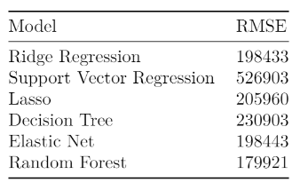
Results
Random Forest best CV RMSE
Out-of-sample RMSE on 20% held out data: $150,472

Slide 19
Conclusion
As anticipated, an ensemble method performed better than any individual estimator
Parameters had a significant impact in results. Grid search is most popular method for parameter search, but randomized search has shown to yield better results
Biggest challenge is time vs accuracy
Next step: Deeper dive into individual estimators and corresponding parameters, neural nets/deep learning (CNN, RNN, LSTM, Neural Turing Machine)

Slide 20
Links
My Github: ftan84 (https://github.com/ftan84)
Report: (https://github.com/ftan84/housing_price/blob/master/report.pdf)
Pweave + Pandoc
train(DataScience) (http://traindatascience.com/)
Update!!!

