Slide 2
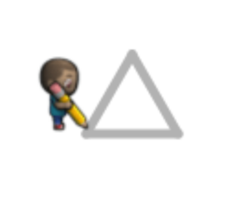
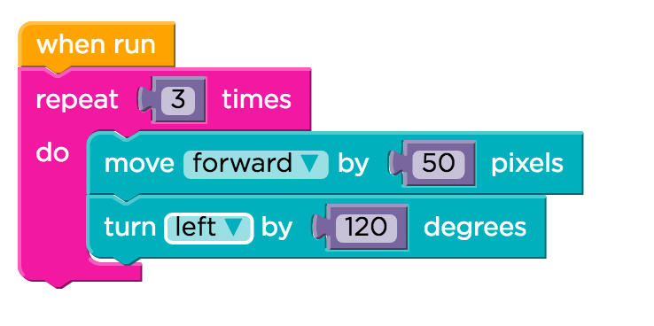

Slide 3
Repeat
Color
Invariance
Angle
DontGet
Repeat
GetRepeat
Angle360
Invariance
ThinkSquare
ThinkTriangle
Multiple
Bodies
UsingLoop
DontInvert
Angle
ThinkAngle
Inversion
3Sides
3Sides
Move
Amount
LoopNesting
Confusion
Default
Move
Correct
Move
LeftRight
Confusion

Slide 4
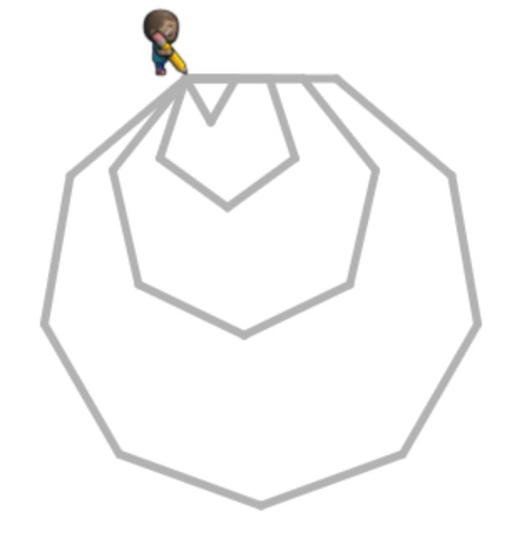
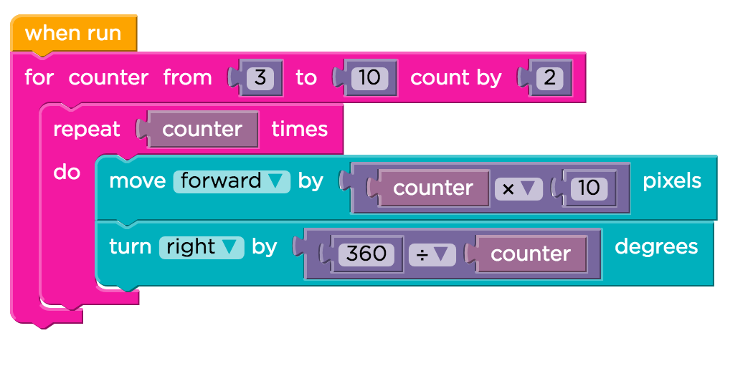

Slide 6
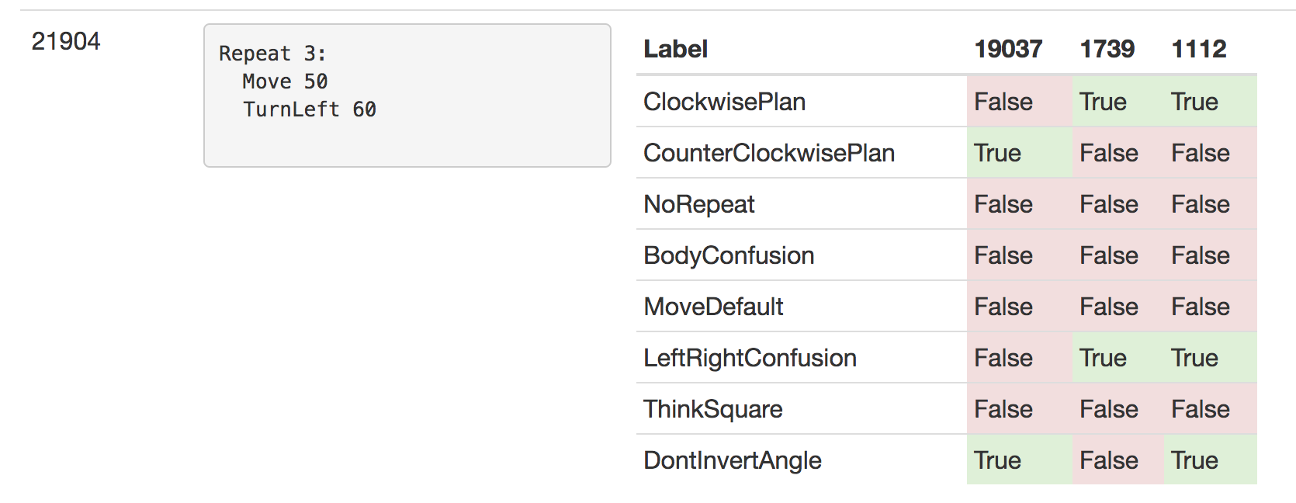

Slide 7
