Slide 1

Spotify Music Playlist Recommender
Claire Medina, Ferdie Taruc, Psalm Masaya

Slide 2
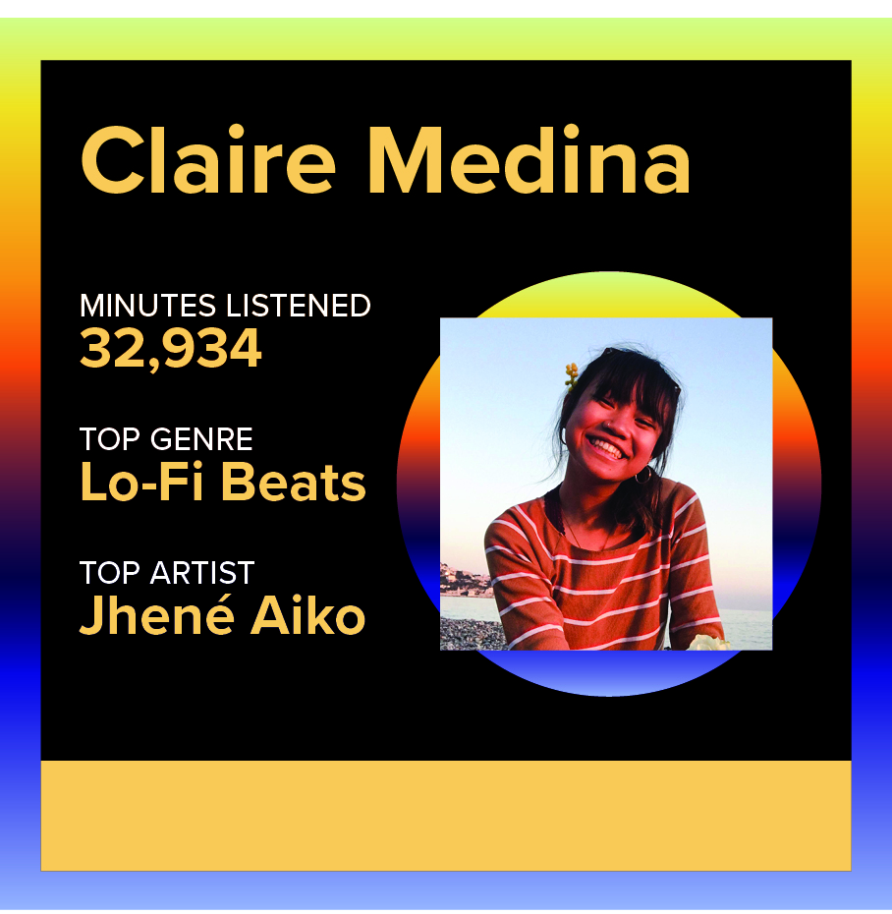
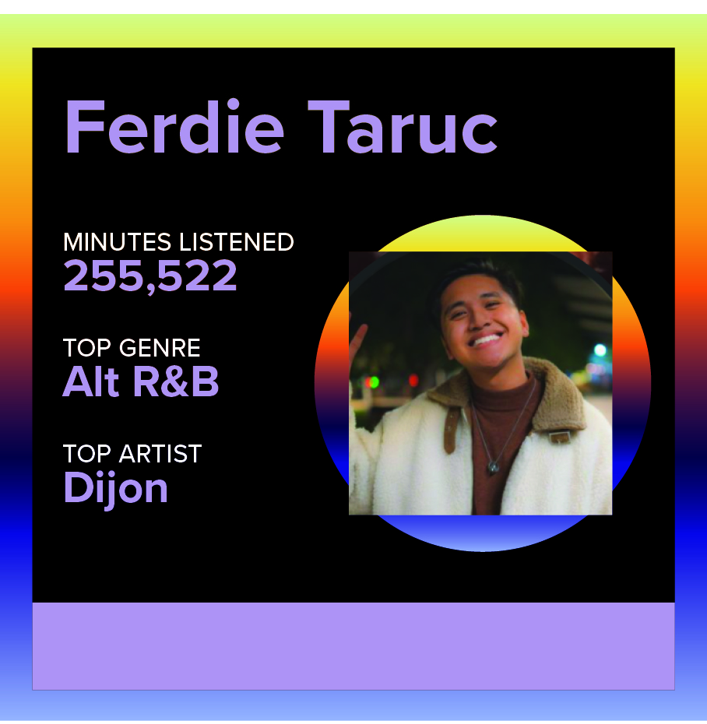
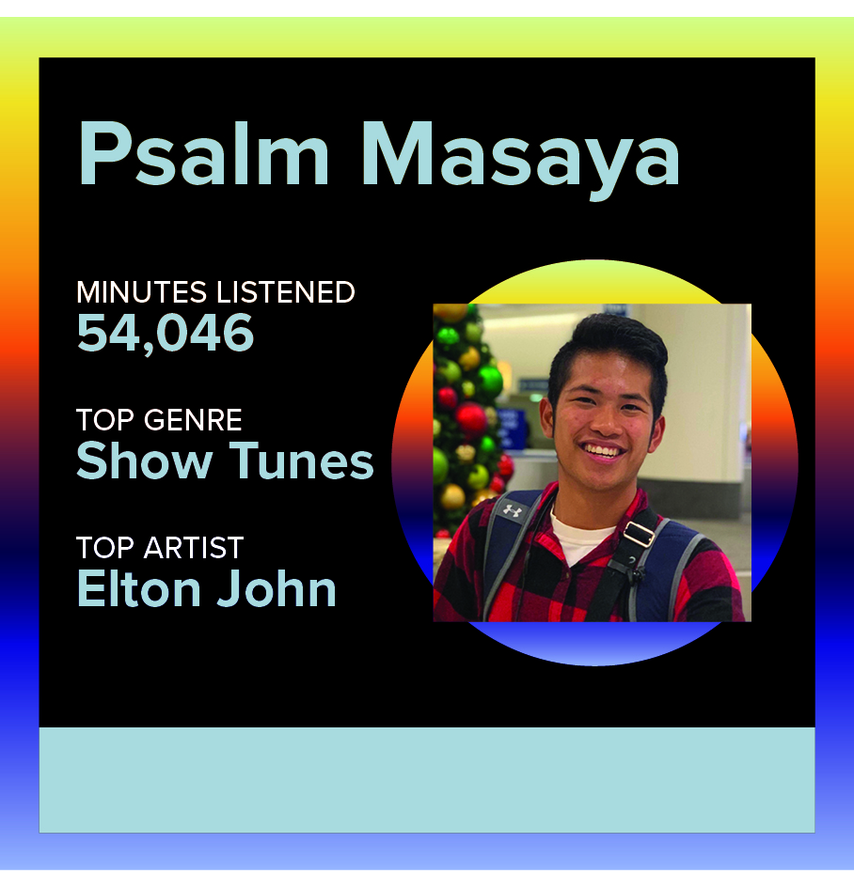
Team

Slide 3



Context
Streaming services revolutionized accessibility of music
Notes:
Within the past decade, streaming services has revolutionized how music is accessed and shared among peers.
Streaming services like iTunes/Apple Music, Pandora, and more notably Spotify.

Slide 4
Given user preferences, how can we create a playlist that can encompass the interests of different people?
Research Question:

Slide 5
Motivation
Creation of shared playlists with others
Catering to different interests
Current Projects: Recommending Songs based on mood, etc.
This Project: Appealing to Different Users
Notes:
Many people find themselves creating shared playlists with individuals. They need to cater not only to their wants and interests, but also to other individuals’.
A lot of the current projects with Spotify Data deal with recommending songs for an individual based on their mood, preferences, etc.
This project is now taking into consideration a variety of preferences.

Slide 6

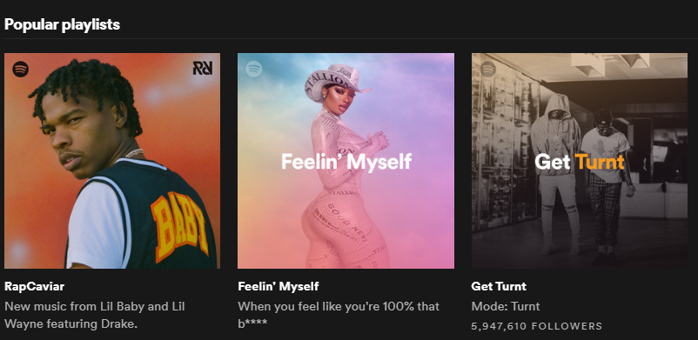
Definition of “Playlists”
Unit composed of songs in some ordering
Subjective
Definition: Group of songs that fit a certain theme or genre
Notes:
Playlists are a unit component composed of songs in some ordering, which can be discovered and recommended, just like artists, songs and albums.
Given the subjectivity of what constitutes a “proper” playlist, we will limit this definition to fit the context of our model.
A “playlist” is defined as a group of songs that fit a certain theme or genre, so that similar songs contain similar audio features and capture similar user preferences.

Slide 7


Limitations to this Definition
Why this definition?
Difficulty in Dimension Reduction
Can no longer capture:
Context of the playlist
Content-based filtering
Notes:
Why this definition?
It is hard to apply dimensionality reduction into meaningful features that can be used in our model.
Can no longer capture: the context of the playlist through features such as song positions in a playlist and the relation of songs among each other in the playlist.
This is why we are not using collaborative filtering, but its counterpart: content-based filtering.

Slide 8
Music Recommendation Systems
Collaborative Filtering:
Exploits interactions between users and items
Identifies similarities between users
Content Based Filtering:
Intrinsic Audio Features
Textual Metadata
We will use the latter method of filtering for our model.
Notes:
Due to the influx of research from movie recommendation systems from Netflix data, several ideas came about in the past decade:
Collaborative Filtering:
Collaborative filtering approaches exploit interactions between users and items, which are represented in a user–item matrix . CF identifies similarities between users and/or items either in a low-dimensional joint representation, and in the context of playlists: other users and their playlists.
Content Based Filtering:
Collaborative filtering derives song or artist representations (embeddings or latent factors) from intrinsic audio features or textual metadata such as artist biographies or user-generated tags.
We will use the latter method of filtering for our model.

Slide 9
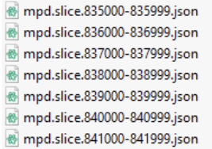
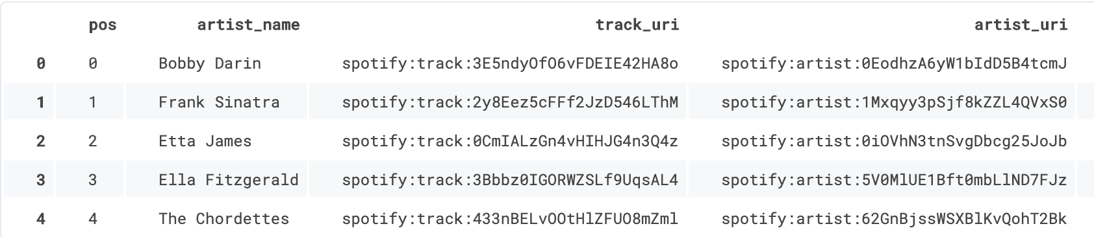
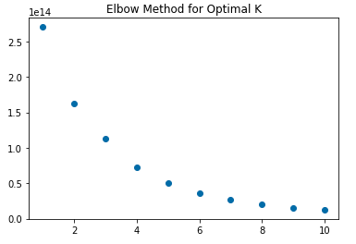
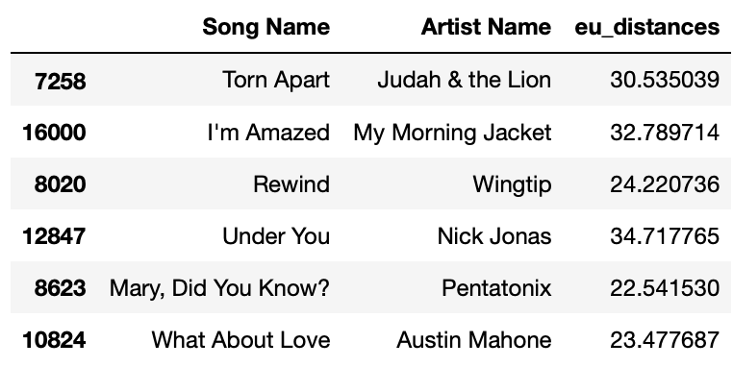
Introduction to Approaches
take .json files
convert dataset into dataframe
find optimal k given data, cluster using k-means
given song input, create a playlist of similar songs
Notes:
Thank you claire, I will now provide an overview on how we built our final dataset and how we used it to create a playlist recommender given one or multiple songs.
> First, given the files that Spotify provides, we create a final dataset using Spotify’s Web API to engineer features for each song. Then, given an optimal K, we cluster using K-means to create a playlist of similar songs.

Slide 10
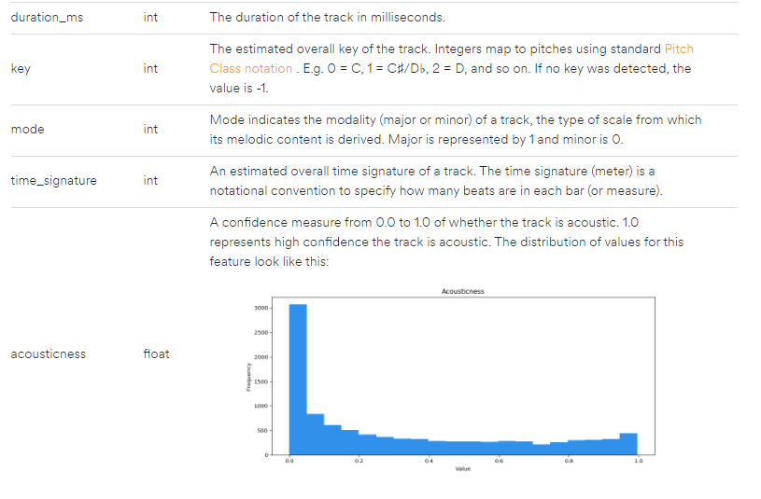
Spotify Web API
Spotify’s Web API
Spotipy
Other interesting audio features it provides:
Danceability, energy, instrumentalness, liveness, loudness, speechiness, valence (positiveness), tempo (BPM)
Explicitness, Release Date of Song
More information about audio features: https://developer.spotify.com/documentation/web-api/reference/tracks/get-audio-features/
Notes:
Spotify’s Web API provides interesting features that we can use for our model.
In order to use it efffectively with jupyter notebooks, we used Spotipy, a python library dedicated to their API.
Some r interesting audio features it provides:
Audio features like the key of the song, danceability, energy, loudness, valence (positiveness), tempo (BPM)
Metadata like Explicitness, Release Date of Song

Slide 11
Spotify Million Playlist Dataset
Enable research for music recommendation systems in 2018.
Captures 1 million playlists of over 2 million unique tracks.
Re-released September 2020 by AICrowd
Dataset source: https://www.aicrowd.com/challenges/spotify-million-playlist-dataset-challenge
Notes:
Similar to Netflix, Spotify’s released their own dataset to push for research for music recommendation systems in 2018. They released the “Million Playlist Dataset”, which as you can tell by the name, captures 1 million playlists of over 2 million unique tracks that was sampled by over 4 billion playlists in the United States.
Although this was released on Kaggle I believe in 2018, it was re-released again this year in September by the website AICrowd.

Slide 12
Dataset Statistics
All playlists were generated by users from the United States:
Gender
45% Male | 54% Female | 0.5% Unspecified | 0.5% Nonbinary
Age
13-17: 10%
18-24: 43%
25-34: 31%
35-44: 9%
45-54: 4%
55+: 3%
Notes:
As you can see from the demographics of the dataset, the majority of users were female, and the majority age was those between 18 and 24.
How about those under 13? Well, Spotify placed a limitation on which users were sampled -- completely ignoring those who were under 13 years old.

Slide 13
Dataset: Playlist Criterion
Playlists that meet the criteria are selected at random:
Contains at least 5 tracks and no more than 250 tracks
Contains at least 3 unique artists and at least 2 unique albums
Was created after January 1, 2010 and before December 1, 2017
Does not have an offensive title
Etc.
Other modifications made to some playlists
Notes:
We can see that Spotify placed even more limitations to what constitutes a playlist or which users were sampled. This criterion places a biased sample of songs that can be predicted with our model, given that certain playlists and users were not sampled and thus not included in our dataset.
For example, an 54 year old man who included 300 Kidz Bop songs was not included -- and thus its possible that certain artists or songs were not included at random.
Playlists that meet the following criteria are selected at random:
Created by a user that resides in the United States and is at least 13 years old
Was a public playlist at the time the MPD was generated
Contains at least 5 tracks and no more than 250 tracks
Contains at least 3 unique artists and at least 2 unique albums
Has no local tracks (local tracks are non-Spotify tracks that a user has on their local device)
Has at least one follower (not including the creator)
Was created after January 1, 2010 and before December 1, 2017
Does not have an offensive title
Does not have an adult-oriented title if the playlist was created by a user under 18 years of age
Modifications made to some playlists:
- Potentially offensive playlist descriptions are removed and tracks added on or after November 1, 2017 are removed

Slide 14
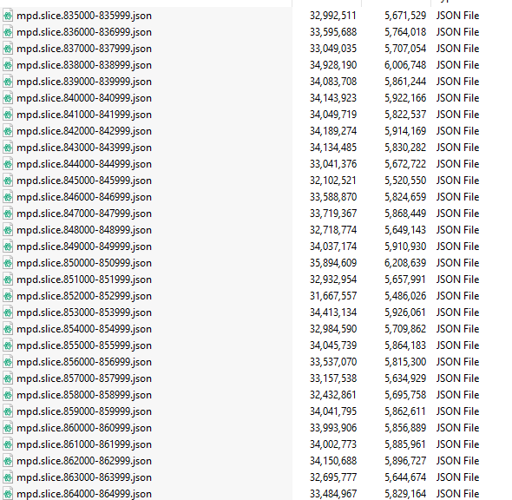
Dataset Formatting
Approx. 33 GB
Stored as .json files
Approx. 1000 slices
1000 playlists within each slice
Huge Database
Notes:
The initial dataset is large, it has approximately 33 GB of information on user-playlists.
The zip file that Spotify provides stores 1000 slices of json files, each holding 1000 playlists.
This puts in perspective how large Spotify’s database must be given this is only a small sample of playlist data they currently have from 2018.

Slide 15
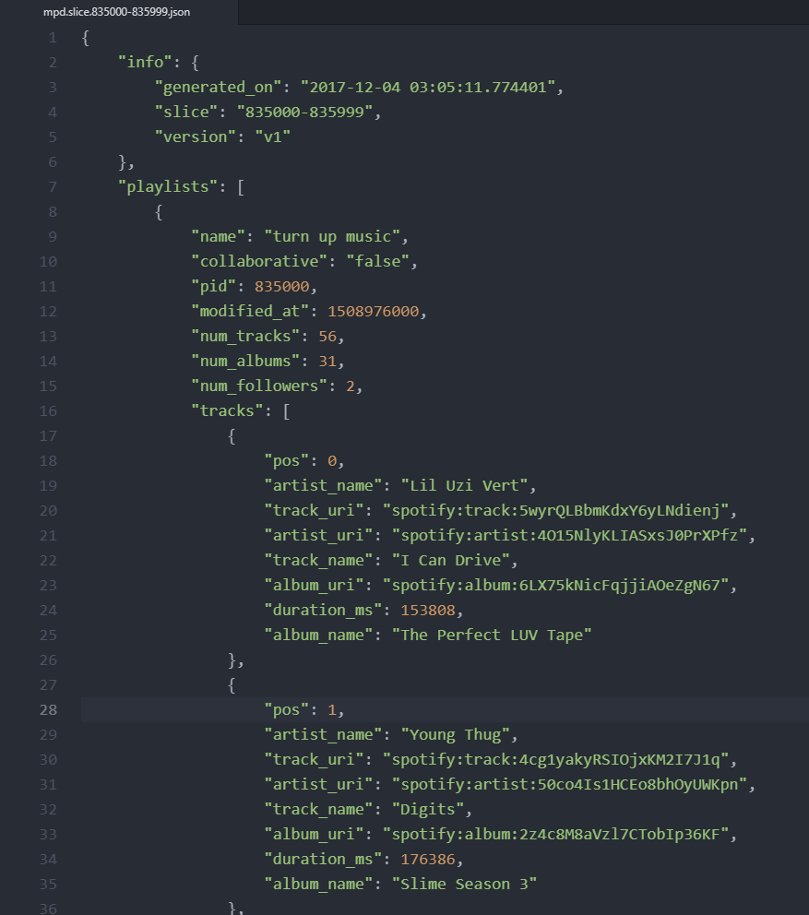
Example of .json
Playlist information provided:
Name of playlist
PID (unique identifier)
Collaborative
Last Modified
Etc.
“URI” (song and artist identifier) used to query specific information from Spotify’s API.
Notes:
Now looking at each .json file individually, it contains a summary of each slice (creation date and slice number).
It also provides a list of song and playlist metadata that is useful when using Spotify’s Web API.
So to just name a few:
Name of playlist
Number of tracks/albums/followers
Song metadata and their position number in the playlist
Etc.
And for future context: URI unique identifier used to query specific information from Spotify’s API.

Slide 16
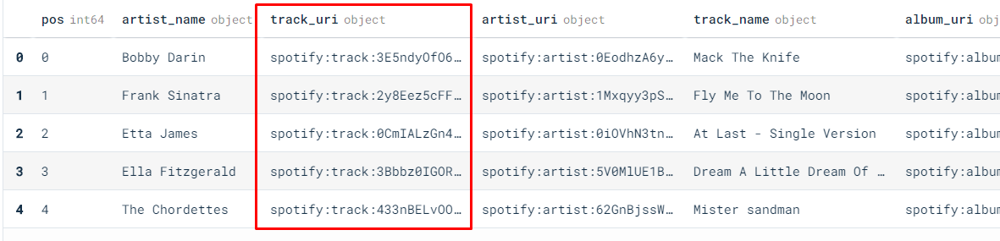
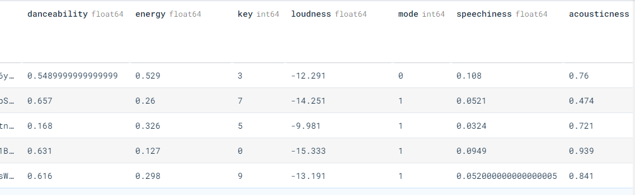
Dataframe Example
Notes:
So as an example, From the top picture: this is what a dataframe may look like after loading one .json file.
Then to build our final dataset, we used Spotify’s Web API to get audio features and also other important metadata (like if the track is explicit or its release datae) for each song given its unique identifier.

Slide 17
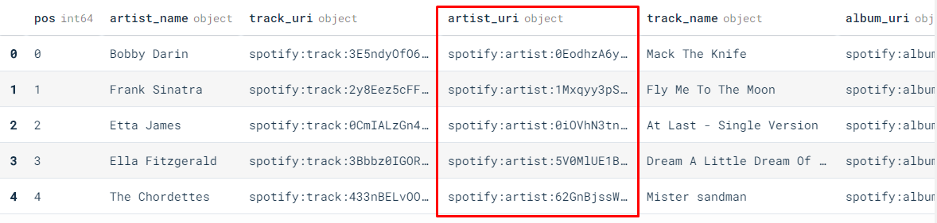
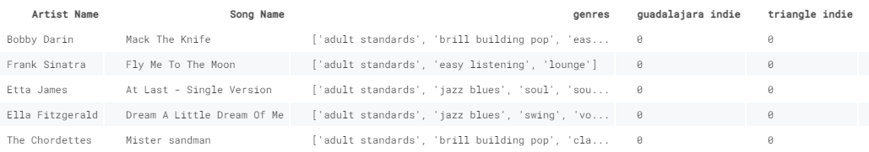
Dataframe Example (2)
Notes:
Similarly, we did the same to generate the list of genres for each song using the artist’s URI. We then applied one-hot-encoding on the list of genres for each song to create a pretty sparse dataframe.
We then appended all these dataframes together into one final dataset. After dropping for duplicates, we had information on around 90000~ unique songs.

Slide 18
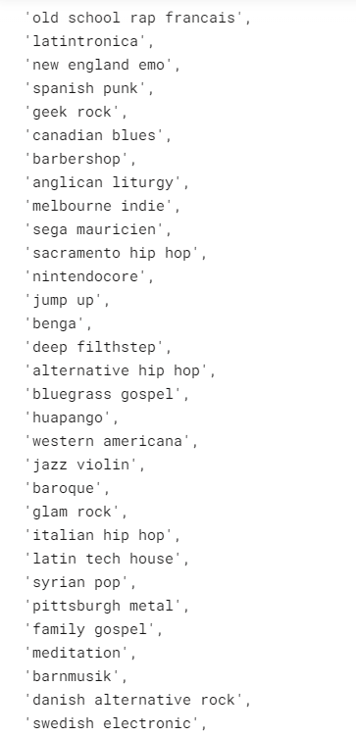
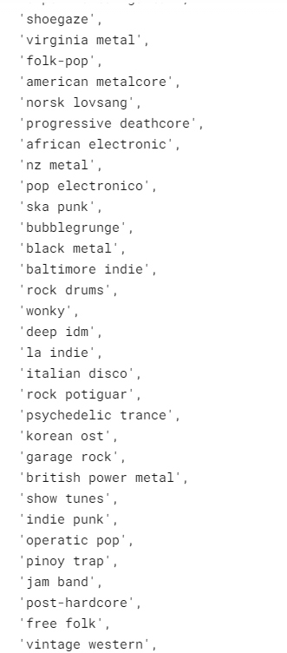
Adding Artist Genres
Approximately 5,071 distinct genres to describe artists in Spotify
Echonest applies ML on audio features to classify genres
Classify genre of song based on genre of artist (has limitations!)
Notes:
So, Spotify automatically classifies almost 5,071 genres to artists on their platform.
How does Spotify ascribe genres to music?
Well, an AI music company acquired by Spotify known as Echonest, classifies multiple genres of artists using machine learning on audio features or even metadata of songs. As you can see on the right, these genres get oddly specific. One in particular I like is Pinoy Trap.
So how does this tie to our model? Unfortunately for us, Spotify does not classify genres of specific songs but artists. So, we assume for each song they share the same list of genres as the artist. Obviously this is a huge assumption and our model’s accuracy can be worsened. For example, artists can drop covers of songs that deviate from their normal sound, or even they may embark on new sounds every album.
//
The owner, McDonald, has provided a visual representation of the subtle sonic differences at everynoise.com, which maps music along a spectrum where mechanical sounds reside at the top, organic at the bottom, atmospheric on the left and bouncy on the right.
Echnoest acquired by Spotify in 2014
Flaws with algo: At one point, the computers confused the sound of the banjo with human singers, simply because not enough banjo samples had been entered. In another instance, Indonesian dangdut was classified as near-identical to American country because, McDonald said, the computers had no protocol to account for twang.

Slide 19
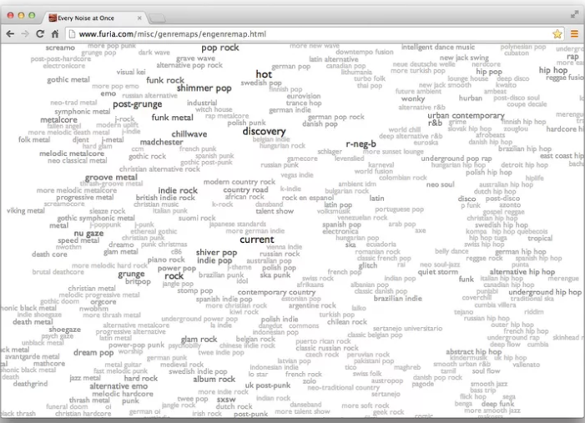

Adding Artist Genres (everynoise.com)
Mechanical instrumentation (techno music)
atmospheric
bouncy/upbeat
Organic instrumentation (classical)
Notes:
This company provides the genres of artists on a public website: everynoise.com, where near the bottom of the picture you see i searched for frank ocean and it came with his respective genres.
They also provide a visual representation of the sonic differences for genres, which maps genres and artists along a 2d plane. where mechanical sounds reside at the top, organic at the bottom, atmospheric on the left, and bouncy on the right.
So if you are interested how music map spatially, please check it out!

Slide 20
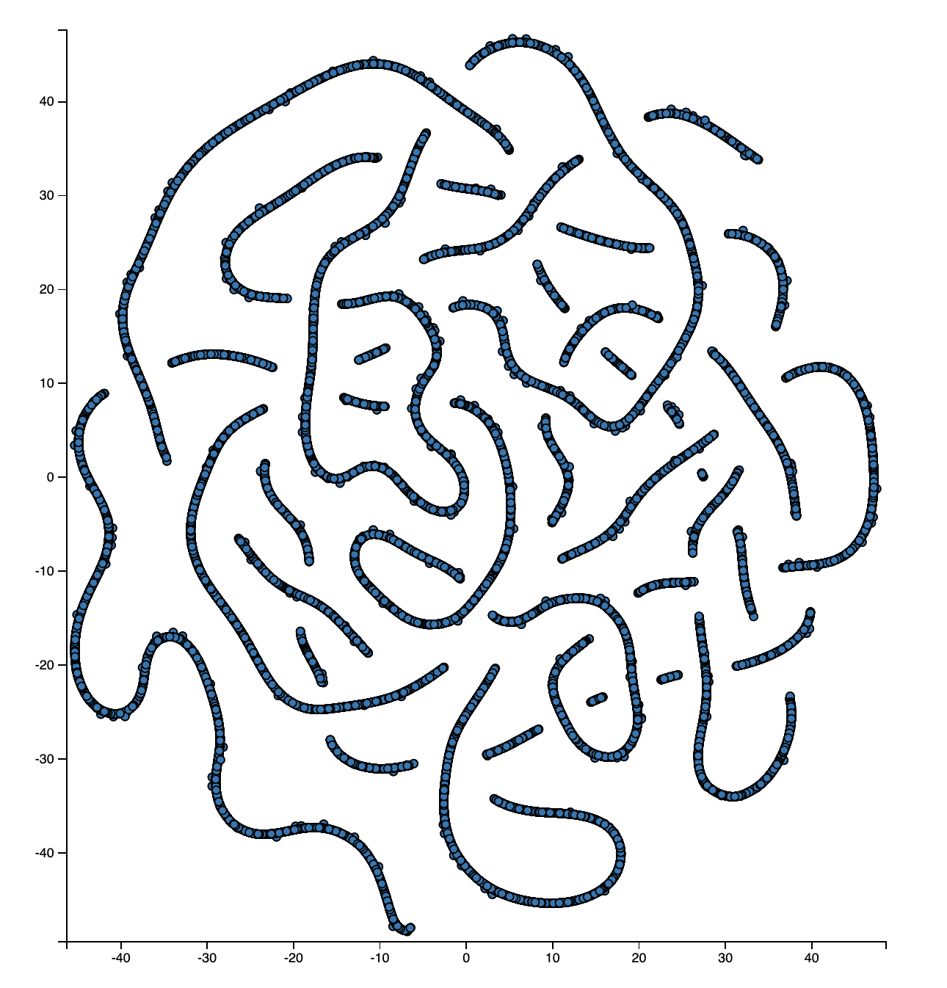
T-SNE Visualization
Pop Songs with a lot of Mechanic Instrumental
Organic Instrumental/ More Classical
Upbeat and Radio Edited Songs -Britney Spears
-Drake
Slower Music like Jazz or Christian Music
Notes:
So now given this final dataset, we used TSNE on the songs’ audio features and metadata to see if we can find any cool patterns.
To our surprise, we have a pattern similar to everynoise.com where at each quadrant in the plane, it has their own different features:
Songs with more mechanical instrumentation appear as you go up, left
And songs that are more upbeat as you go down, right,
Now, we’ll have Psalm discuss how we then used this final dataset to build our playlist recommender model.

Slide 21
The Playlist Recommendation System

Slide 22
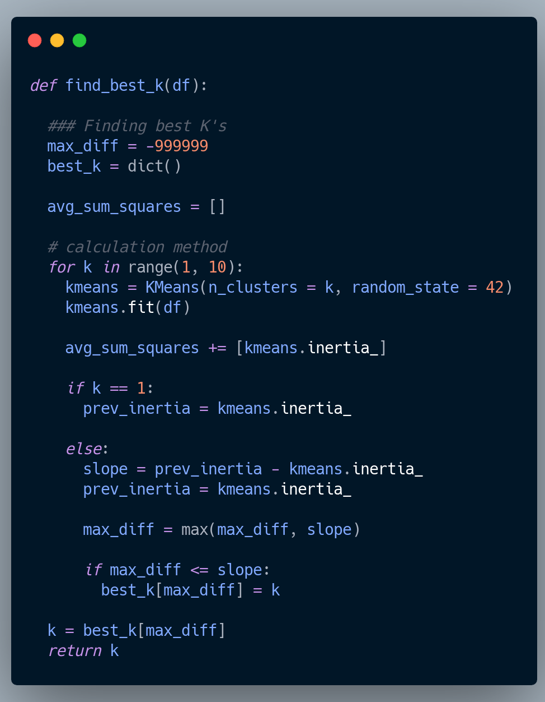
K-Means Clustering
Elbow Method
Notes:
As Ferdie briefly mentioned, our recommendation system relies on the k-means clustering method. To find the number of clusters present, we utilize the elbow method as discussed in class, which in this instance, returns k = 2.
Thus, each song in the dataset would be labeled as either 0 or 1, based on its integer attributes like danceability or tempo (this also includes categorical values we applied one-hot encoding to, such as artist genre).

Slide 23
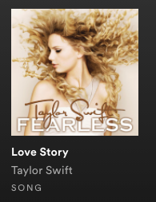
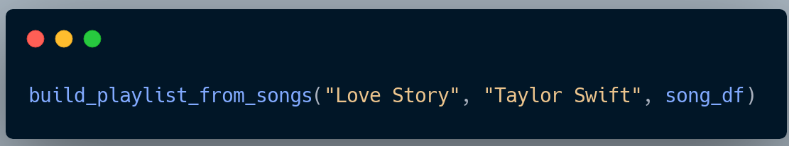
Building a Playlist
Input = Song Name, Artist Name, Spotify DataFrame
Randomized selection of 30000 rows from csv due to hardware limitations
Notes:
We started off with a simple example, using just 1 song.
This input included the Song Name, Artist Name, Spotify DataFrame
The default setting was set to 2 songs being recommended.

Slide 24
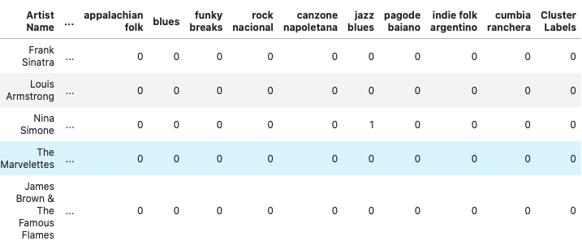
Building a Playlist
Train the KMeans model on the given DataFrame
Append cluster labels to the DataFrame for each row using kmeans.labels_
Notes:
Drop all non-integer columns from the Spotify DataFrame.
We train the model on the dataframe comprised of 30000 rows
Then, we append the cluster labels to the DataFrame for each row using kmeans.labels_

Slide 25

Building a Playlist
Preprocessing for the input.
Predict cluster label for input song.
Notes:
Recreate features from the original dataset for input with only a song and artist name using the Spotipy library using the preprocessing pipeline.
Drop all non-integer columns from the input before prediction.

Slide 26

Building a Playlist
Filter out dataframe by cluster label
Calculate euclidean distances and sort based on minimum distance
Pick top n songs (n = 2 for example)
Notes:
Once we are given a cluster label in this case 1, we are able to filter out the DataFrame such that we keep cluster labels that are 1.
Afterwards, we calculate the euclidean distances from each row to the input value’s row; sort it based on ascending distance and pick the top n songs (n =2 in this case).
If the input song/artist appears in the dataset used to fit the model, associated rows are discarded in favor of making a new recommendation.

Slide 27



Building a Playlist: n-songs Input
Inputs:
List of Lists → [ [Song Name, Artist Name], [Song Name, Artist Name],... ]
Spotify DataFrame
Number of Songs to Recommend / Song
Notes:
Now, we want to expand this solution to apply to multiple songs.

Slide 28

The Example

Slide 29
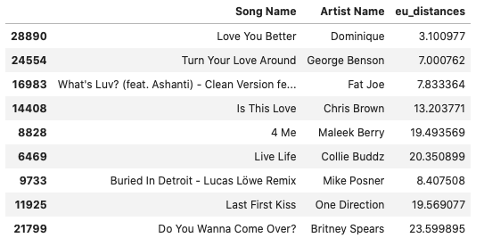
Output

Slide 30
Output

Slide 31
Output
Notes:
3.5 hours

Slide 32
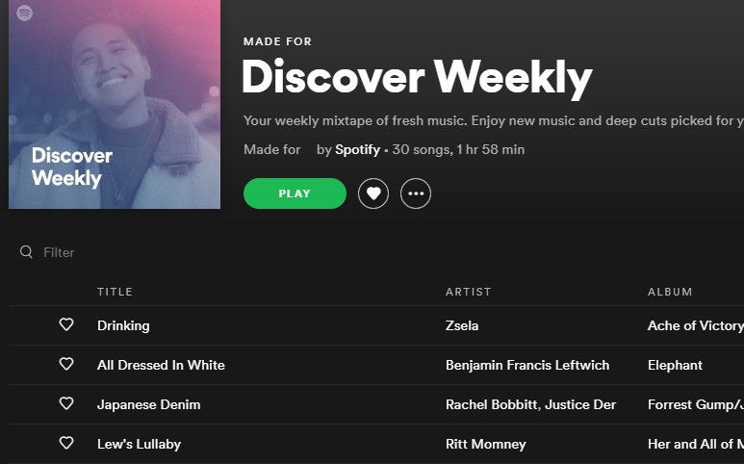
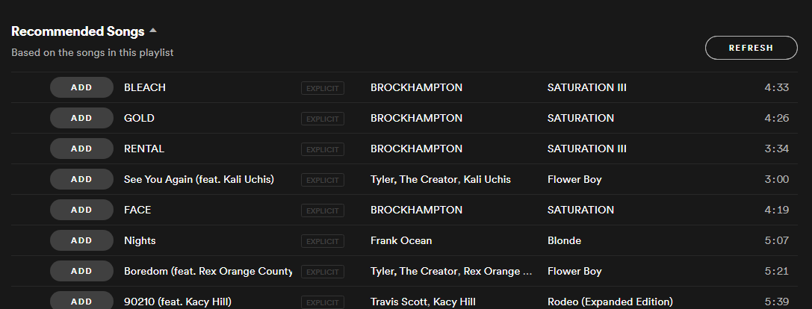
Limitations of Dataset
Only used 4 slices (500MB) of .json files
Limited to only a small amount of songs
Playlist criterion also creates a biased sample.
Unable to represent all genres
Smaller in comparison to larger recommendation systems like:
Notes:
We have used only 4 slices (500MB) of .json files given memory and hardware limitations.
Given a small sample, our model will be limited to only a small amount of songs (30,000) in which it can predict.
Playlist criterion also creates a biased sample from the true population of songs/playlists. Thus our model is limited to predicting songs from a biased population.
not all genres are represented due to the sample size, so some inputs may not have their genres represented and thus dropped.
Much smaller in comparison to larger recommendation systems like Spotify’s Discover Weekly or their automated recommended songs below each user-created playlist.

Slide 33

Conclusion
Real-World Implications
Ability to create a playlist off of different user preferences
Notes:
Would you say it's ready to be used in the real-world yet? If not, what needs to be solved before you would say it was ready?
Scale Up that data, like we mentioned before we only used 4 slices of the json files because our local machines couldn’t handle more data.
Collaborative Filtering - the context of the playlist through features such as song positions in a playlist

Slide 34
Next Steps: Ready for the Real-World?
Ready for the Real-World?
Scale Up
Playlist metadata
Ensemble of Collaborative Filtering with Content Based techniques
Notes:
Would you say it's ready to be used in the real-world yet? If not, what needs to be solved before you would say it was ready?
Scale Up that data, like we mentioned before we only used 4 slices of the json files because our local machines couldn’t handle more data.
12809 sec ~ 3.5 hours to run code for input of 3 songs
Playlist metadata:
We are not using playlists as the unit component, but just individual songs and their metadata. As as result, we lose contextual meaning of what a playlist encompasses by not including the ordering of songs in relation with each other. Ignores users who includes sequential ordering of songs for playlists.
Incorporating Collaborative Filtering:
We are completely ignoring how similar users with similar listening preferences should have similar playlists. By incorporating collaborative filtering techniques with our initial model, we should be able to improve the overall accuracy of our predictions.

Slide 35
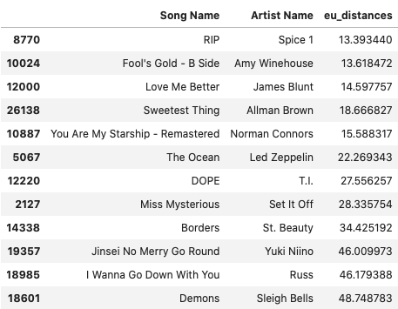
Thank You!

Slide 36
Questions?

