Slide 1
2023 Travelers Analytics Case Competition Farah Ahmed Deepika Mitta Jithendar Kasa Madhukar Reddy

Slide 2
Problem Statement
In this contest, our main aim is to leverage historical auto claim data to devise a potent rating plan for InsNova Auto Insurance Company. The target is to construct a sturdy predictive model for claim cost that refines the company's pricing approach and boosts its competitive stance in the Australian auto insurance market.

Slide 3
Data Summaries
22619 rows and 21 columns for training dataset
22620 rows and 18 columns for validation dataset
No missing values
Feature types
Features types: Object, int, float
Categorical features: veh_body, veh_age, gender etc.
Continuous features: veh_value, exposure, credit score etc.

Slide 4
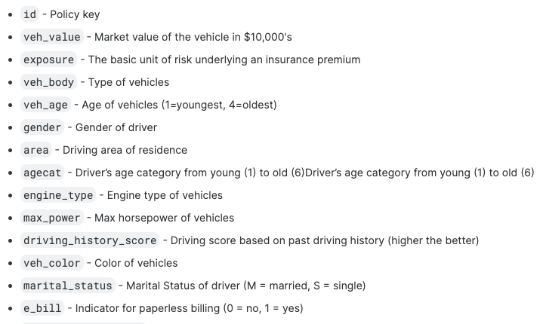
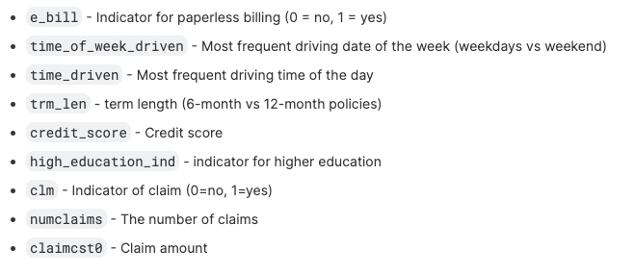
Variable Descriptions

Slide 5
Model Building Approach
Training Data: Consists of ‘clm’ , ’ numclm’, ’clmcost’
‘clm’ - Claim Indicator
‘numclm’ - Number of Claims
‘clmcst’ - ‘Claim Cost’
Validation Data: Prediction of clmcost involves prediction of clm, numclm.

Slide 6
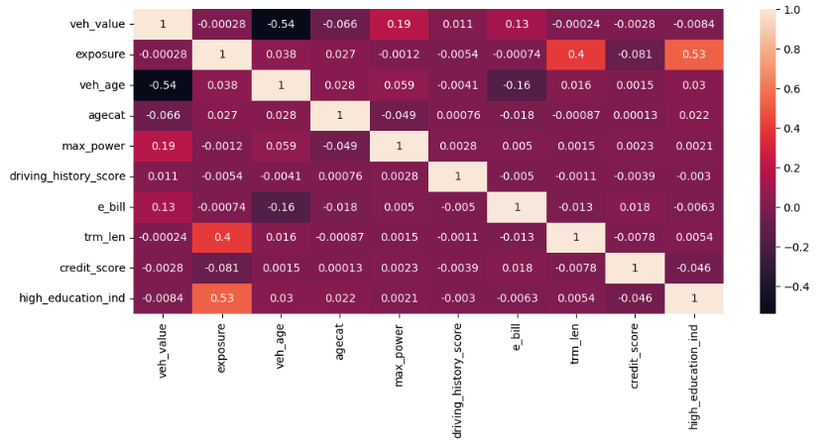
Correlation Matrix

Slide 7
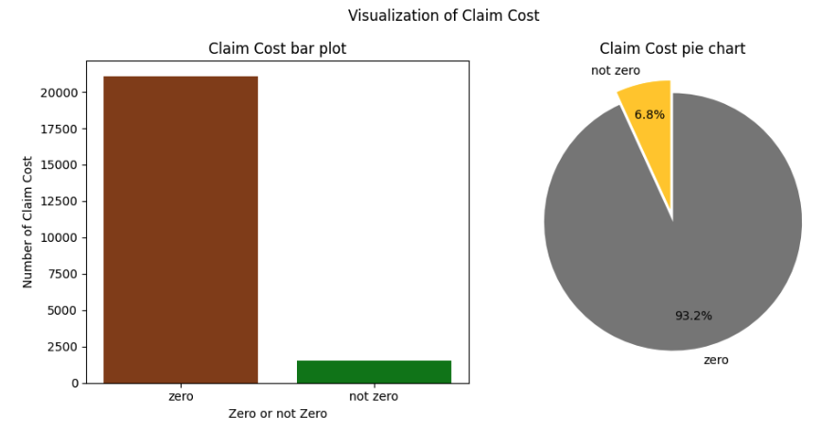
Visualization of Target Feature

Slide 8
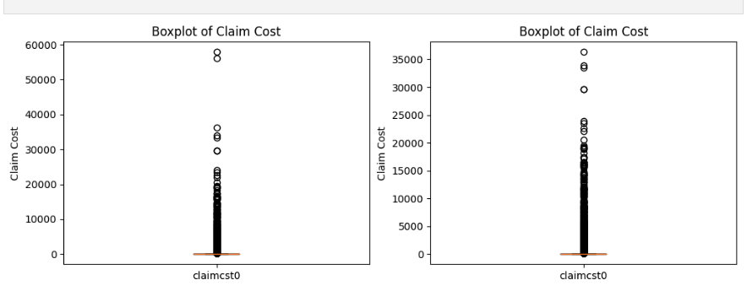
Visualization of Target Feature
Boxplot before removing outliers vs after removing outliers

Slide 9
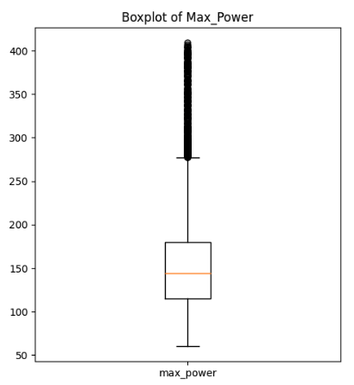
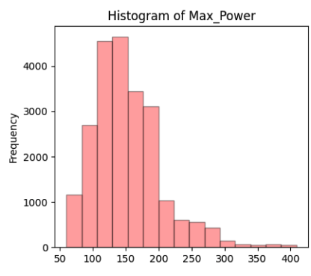
Visualization of Continuous Features
Boxplot and Histogram of Max_Power before Transformation

Slide 10
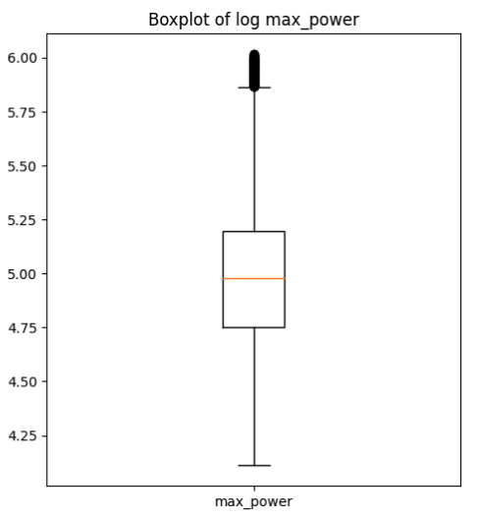
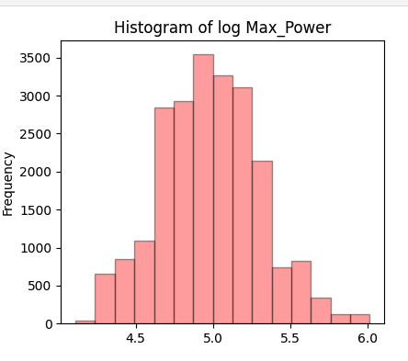
Visualization of Continuous Features
Boxplot and Histogram of Max_Power after ‘log’ Transformation

Slide 11
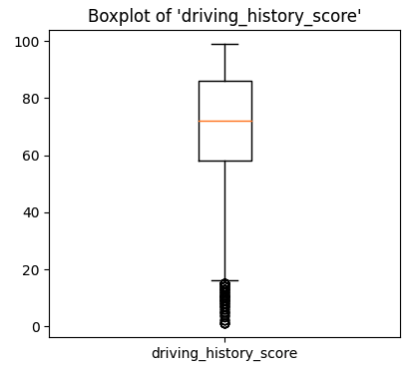
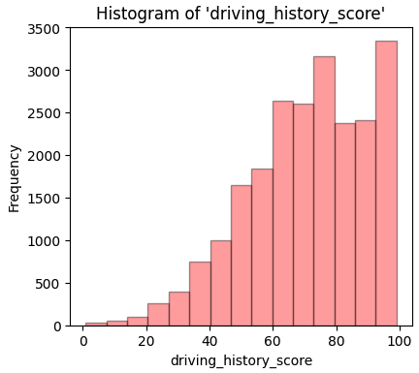
Visualization of Continuous Features (cont.)
Boxplot and Histogram of driving_history_score before Transformation

Slide 12
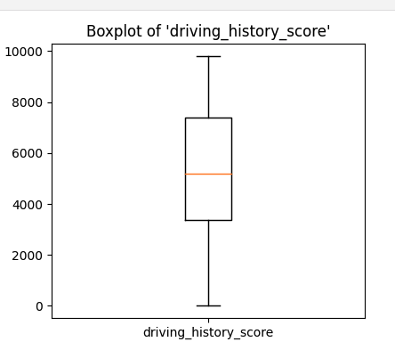
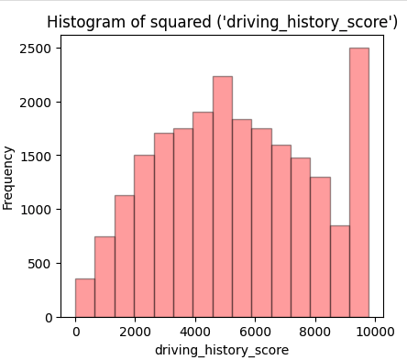
Visualization of Continuous Features (cont.)
Boxplot and Histogram of driving_history_score after ‘squared’ Transformation

Slide 13
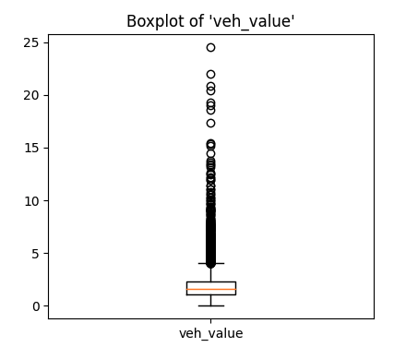
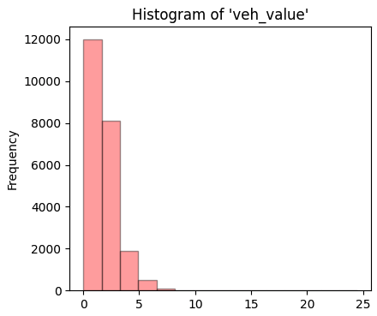
Visualization of Continuous Features (cont.)
Boxplot and Histogram of veh_value before Transformation

Slide 14
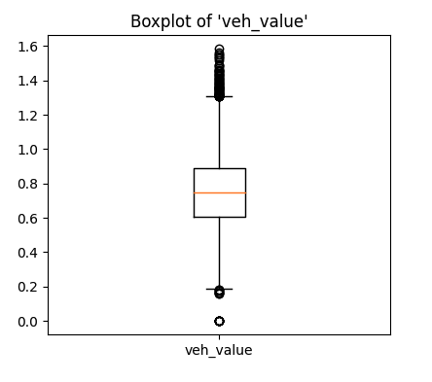
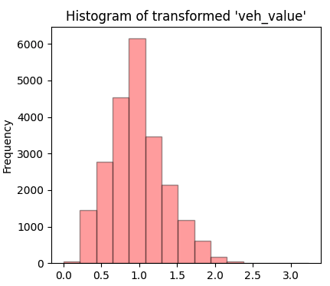
Visualization of Continuous Features (cont.)
Boxplot and Histogram of veh_value after log Transformation

Slide 15
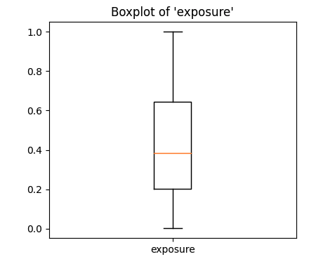
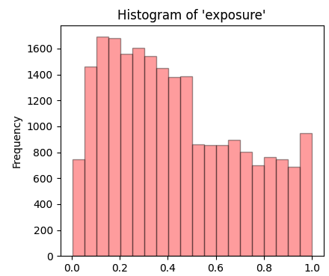
Visualization of Continuous Features (cont.)
Boxplot and Histogram of exposure before Transformation

Slide 16
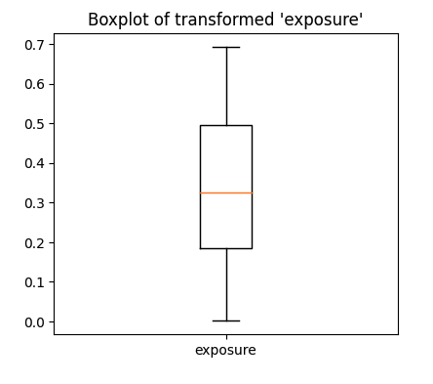
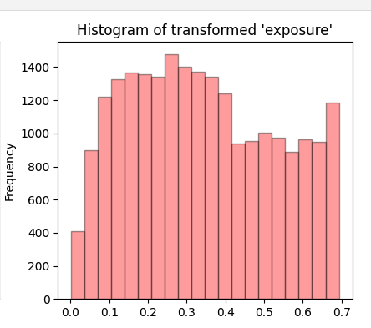
Visualization of Continuous Features (cont.)
Boxplot and Histogram of exposure after ‘log’ Transformation

Slide 17
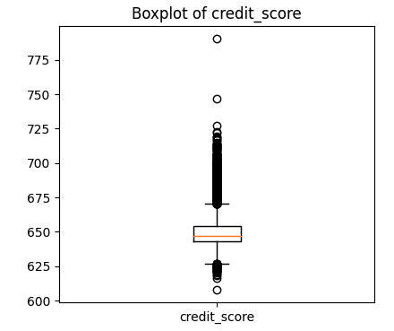
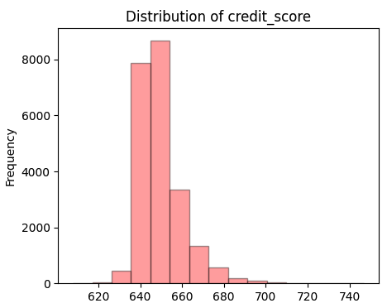
Visualization of Continuous Features (cont.)
Boxplot and Histogram of credit_score before Transformation

Slide 18
Predictive Models
Claim Indicator
(Classification)
Number of Claims
(Regression)
Claim Cost
(Regression)
KNN
LogisticRegression
DecisionTree
Random Forest
NearestCentroid
XGBoost
LassoCV
RidgeCV
ElasticNetCV
Random Forest
GradientBoosting
XGBoost
LassoCV
RidgeCV
ElasticNetCV
Random Forest
DecisionTree
XGBoost

Slide 19
Normalization
MinMaxScaler: Transform the data to a specific range, [0, 1]
StandardScaler: Standardizes data by subtracting mean and dividing by standard deviation
Cross Validation
5-fold
10-fold
Hyper-parameter Tuning
Grid Search: Hyperparameter tuning method that systematically searches for the optimal parameters for machine leaning model

Slide 20
Resampling for Claim Indicator
SMOTE: Generates synthetic samples for the minority class
RandomOverSampling: The minority class are randomly duplicated to balance class distribution.
RandomUnderSampling: The majority class are randomly duplicated to balance class distribution.
Evaluation Metrics
F1 Score
ROC AUC
Accuracy Score
Confusion Matrix

Slide 21
Evaluation Metrics for Number of Claims
MSE
MAE
R^2 Score
Evaluation Metrics for Claim Costs
MSE
MAE
R^2 Score
Gini Index

Slide 22
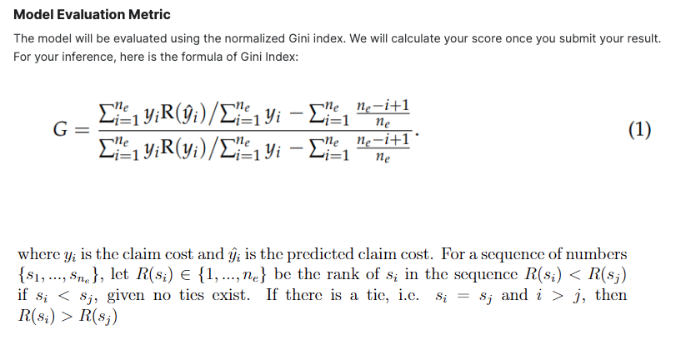
Gini Index

Slide 23
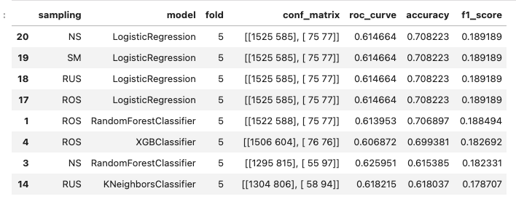
Results
Evaluation Metrics for ‘Claim Indicator’

Slide 24
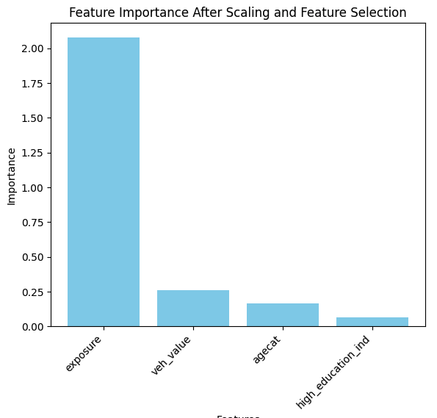
Recursive feature elimination is a feature selection technique that works by recursively removing the least important features from the model until the desired number of features is reached
Feature Selection Using RFE

Slide 25
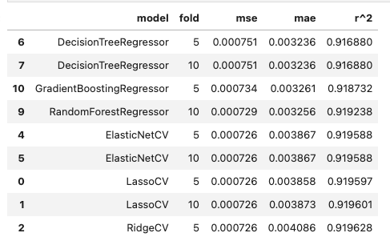
Results
Evaluation Metrics for ‘Number of Claims’

Slide 26
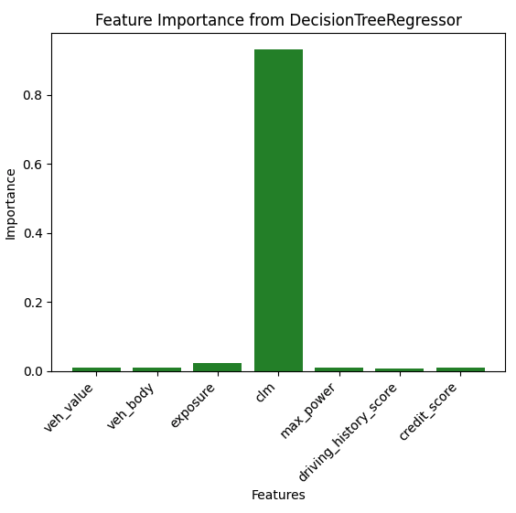
Feature Important Plot for ‘Number of Claims’

Slide 27
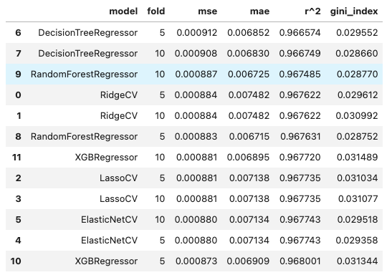
Results
Evaluation Metrics for ‘Claim Costs’

Slide 28
Team Challenges
Description: Dealing with an imbalanced dataset where one class (e.g., claims) is significantly
more prevalent than the other.
Impact: Biased models that may not generalize well to the minority class, leading to suboptimal predictions.
Solution: Explore resampling techniques (oversampling, undersampling, SMOTE), choose appropriate evaluation
metrics (precision, recall, F1-score) that consider class imbalance.
Description: Finding the right balance in class weights and selecting appropriate resampling methods.
Impact: Suboptimal model performance due to imbalanced class distribution
Solution: Regularly assess and adjust class weights based on model performance.
Description: Determining important features and selecting the right set for modeling.
Impact: Limited understanding of which features contribute significantly to predictions.
Solution: Utilize tree-based models to extract feature importance. Experiment with recursive feature elimination for
feature selection

Slide 29
Division of Labor
Farah: Data pre-processing and transformation for analysis, Data Visualization, Model build for ‘clm’ and hyperparameter tuning and validation
Deepika: Model build for ‘numclm’ and hyperparameter tuning and validation
Jithendar: Model build for ‘claimcst’ and hyperparameter tuning and validation
Madhukar: Model build for ‘claimcst’ and
hyperparameter tuning and validation

Slide 30
Thank You

