Slide 1

Estimating illicit financial flows:
Meaningful metrics for post-2015
Jakarta, 20 October 2015
Financial Transparency Coalition annual conference
alex@taxjustice.net @alexcobham

Slide 2

IFF in the SDGs: Success!
16.4 By 2030, significantly reduce illicit financial and arms flows, strengthen the recovery and return of stolen assets and combat all forms of organized crime
17.1 Strengthen domestic resource mobilization, including through international support to developing countries, to improve domestic capacity for tax and other revenue collection

Slide 3
IFF in the SDGs: Now what?
By 2030, significantly reduce illicit financial flows
Requirements:
Definitional consensus (<unanimity?)
IFF statistics baseline: global, national for 2015
Ability to track consistently over time
Notes:
Bad news: None of these three exist.
Good news: FTC is ideally placed, in terms of expertise and convening power, to ensure progress.

Slide 4
IFF definitions…
Illicit = illegal (e.g. GFI)
  “Illicit financial flows (IFFs) are illegal movements of money or capital from one country to another. GFI classifies this movement as an illicit flow when the funds are illegally earned, transferred, and/or utilized.”
Illicit ≠ illegal
  Illicit: “forbidden by law, rules or custom” (OED)
  Illicit > illegal (e.g. tax); illicit < illegal (e.g. B’burg & Khan)
  But in all cases, for legal or social reasons, illicit = HIDDEN

Slide 5
…and content
By aim (e.g. Raymond Baker, 2005)
  Commercial tax evasion
  Laundering of criminal proceeds
  Corruption and bribery of public officials
By channel
  Trade (and debt) mispricing
  Investment ‘mispricing’
  Public contract mispricing
  Anonymity in investment, contracting
Key point: channels and aims do not map 1:1.

Slide 6
Towards a broad typology
Market/regulatory abuse
Tax abuse
Abuse of power (including theft of state funds and assets)
Proceeds of crime
Each can be situated in terms of
capital legality; and
transaction licitness

Slide 7
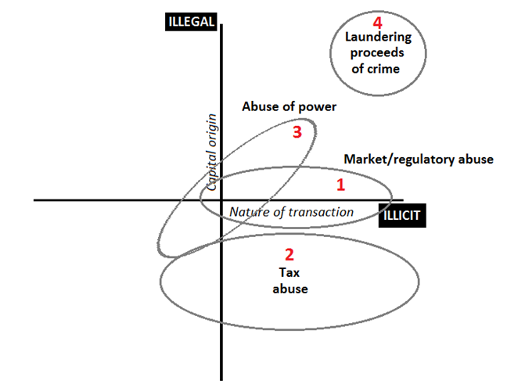
IFF by capital and transaction type
Notes:
Source: Cobham, A., 2014, ‘The Impacts of Illicit Financial Flows on Peace and Security in Africa: Study for Tana High-Level Forum on Security in Africa 2014’: http://bit.ly/tanastudy.

Slide 8
From definition to estimation
Anomaly-based estimation dominates, e.g.
  Trade mispricing (GFI, B&N, UNECA, Pak…)
  Capital account measures (Dooley et al, GFI, B&N)
  Undeclared wealth (Henry/TJN, Zucman)
  Multinational tax BEPS (TJN, OECD, UNCTAD, IMF)
Specific channel case study, e.g. stolen assets (StAR, GW, TI); tax incentives?
New avenue: vulnerability to financial secrecy (Mbeki and 2016…)

Slide 9
Directions of progress
Anomaly-based estimation: Data is key
  Quality (confidence anomalies are real – trade!)
  Quantity (coverage, comparability – eg CBCR)
  Granularity (disaggregation, detail, proof cases)
Specific channel case studies: Resources
Vulnerability to financial secrecy: both! But much data in Financial Secrecy Index →2016...

Slide 10
Next steps
Data: SDGs are golden opportunity
  What does an IFF data revolution look like?
  Which organisations need to deliver?
  Who’s talking to them? Are you??
Resources: as above. Major funders have embraced 16.4, must ensure deliver baseline+
FTC: responsibility as leading experts.
  First step: forthcoming paper surveying existing estimates & looking ahead. Your role?

Slide 11
Estimating illicit financial flows:
Meaningful metrics for post-2015
Jakarta, 20 October 2015
Financial Transparency Coalition annual conference
alex@taxjustice.net @alexcobham

