Slide 1
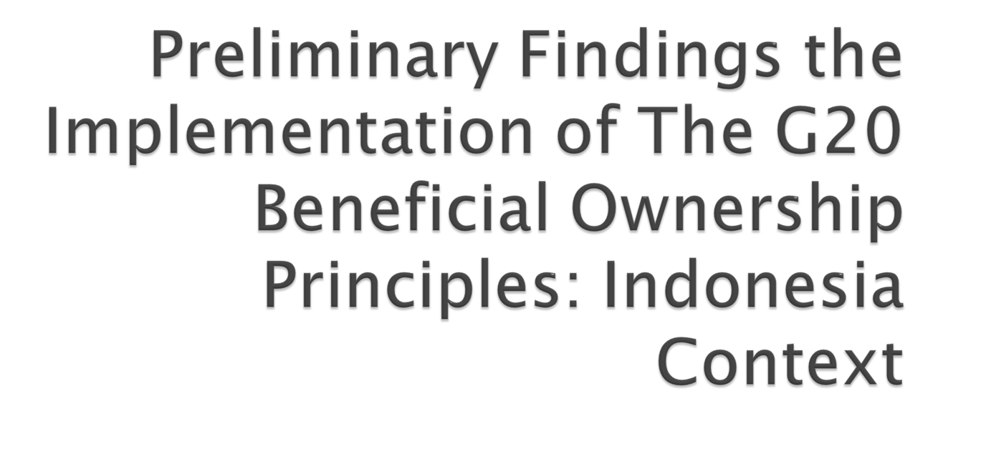
Dedi Haryadi
Deputy Secretary General
Transparency International Indonesia

Slide 2

Magnitude of Illicit financial flows globally in 2012 is around US $ 991.2 billion, or USD 6,6 T during 2003-2012
Indonesia’s illicit financial flow magnitude is the 7th rank in the world
Beneficial Ownership is one among instrument or tools to address illicit financial flows
  Automatic Information Exchange
  Country to Country Report
  Anti Money Laundering Law
  Transfer Mispricing
G-20 meeting in Brisbane 2014 agreed on Ten Beneficial Ownership Principles
Readiness G-20 individual member country to implement Ten G20 BO principles
National legal framework assessment on BO principles

Slide 3

No | Principles | Score (%) | urgency of intervention
1 | BO definition | 50 | +
2 | Identifying and mitigation risk | 0 | -----
3 | Acquiring Accurate BO information | 29 | ----
4 | Access to BO Information | 36 | ---
5 | Trusts | 75 | ++++
6 | Access to BO of Trusts | 33 | --
7 | Duties of Business and Professions | 32 | -
8 | Domestic and Internal Cooperation | 54 | ++
9 | BO information and tax evasion | 58 | +++
10 | Bearer shares and nominee | 100 | +++++

Slide 4

In general legal framework for G20 BO principles implementation is still weak
Action should be taken to improve legal framework for the implementation of G20 BO principles mainly in the area of
  Identifying and mitigating risk
  Acquiring accurate BO information
  Access to BO information
  Access to BO Trusts
  Duties of business and professions
C20 and its member could engage further in the improvement of government readiness in the implementation of Ten G20 BO principles

Slide 5

Thanks You

