Slide 1

Game-Changers:
Data Journalism,
FOI Community of Practice
By Malou Mangahas, Executive Director, PCIJ
Many Voices, One Purpose: The 6th Financial Transparency Conference, Jakarta, Indonesia, Oct 20-21, 2015

Slide 2
About the PCIJ
WHAT: An Independent, non-profit media agency founded in 1989 to help nurture a culture for investigative reporting and harness the poer of media to foster good governance and build democratic instiutions,
  PROGRAMS:
  Investigative reports across multimedia platforms
  Training seminar-workshops for print, radio, TV, Netizens, CSOs
  Data journalism and online publications: Documentatries, books,, and training/resource tools for journalists, CSOs, students;
  Advocacy and networking on FOI, FOE, media killings, good governance, campaign finance, transparency, etc.
  Founding member of Southeast Asian Press Alliance (SEAPA), Global Investigative Journalism Network (GIJN), Freedom Fund for Filipino Journalists (FFFJ), and Right to Know, Right Now! Coaltion.

Slide 3
About the PCIJ
OUTPUT/OUTCOME: In 25 years:
    1,000+ investigative reports; 1,000+ feature and analysis stories
    170+ Gigabytes of data/documents on 6,000 elective and appointive officials, public funds, campaign finance, corporate files, public policy issues, etc.
    200+ training seminar-workshops in PHL, Southeast Asia, the Pacific Islands, and Africa
    Dozens of video documentaries;
    Dozens of books/monographs on journalism, campaign finance, governance, environment, education, women and children, health, etc.
    Over 150 various awards and citations from national and international institutions and agencies

Slide 4
PCIJ Reports: A sampling
  The Wealth of Presidents and Public Officials
    Fidel V. Ramos, PEA-Amaru: ‘The Grandmother of all Scams’
    Joseph Estrada: ‘Millions, Mansions, and Mistresses’
    Gloria Arroyo: ‘Wealth rises faster than Estrada, Ramos, Cory Aquino’
    Benigno S. Aquino III: Campaign donors and sudden uptick in wealth after rise to presidency
  The Supreme Court, Judiciary: The undisclosed wealth of ‘the Gods of Padre Faura’, “the best Supreme Court that money can buy”
  Asset records and accountability issues: Senators, congressmen, local elective and appointive officials
  Politics, political clans, conflicts of interest, the ties that bind
  Campaign Finance: Candidates, donors, election expenditures
  The environment and extractive industries: logging, mining, protected areas
  Donors and development aid: ‘Seven in 10 ODA projects fail to deliver promised benefits’
  Civil Works contracts: Bad projects, corruption and collusion of bidders
  Public utilities: power, water, energy
  Health, education, women, children, disease outbreaks, MDGs
  The armed services: Contracts, corruption in the Armed Forces and Police
  Internal conflict, peace and order, national security
  Human rights: Media murders and attacks on civil liberties
  Indigenous peoples, internal refugees, migration
  Media freedom, practices, and journalism ethics Who own the media?
  Investigating the investigators and integrity agencies: the Ombudsman, Commission on Audit, Commission on Elections, Commission on Civil Service, Commission on Human Rights, quasi-judicial disciplinary agencies

Slide 5
Meet moneypolitics.PCIJ.org
CONCEPT: A data journalism project and citizen’s resource and research tool on elections, public funds, and governance
GOALS: Political Numeracy, Access to Information Practice
AUDIENCE: Journalists, students and teachers, civil society advocates, public officials and civil servants, election regulators, development agencies, and Filipino voters
FOUNDATION: A dozen public documents with strategic governance and accountability metrics that PCIJ has acquired in its 26-year existence
STRUCTURE: MoneyPolitics connects data, digits, documents, to vest time-series numbers with meaning.

Slide 6
By the Numbers
6,463 files (7,584 files as of April 2015)
The PCIJ digital library currently houses over 5,000 unique public records. PCIJ continues to acquire more documents every year, i.e. SALN, SECE, COC, CONA, List of Candidates, PDS, budget and public finance records, corporate records, project documents, etc.
170 GB (110 GB in PCIJ Digital Library, Dec 2014)
The PCIJ digital library has over 60 gigabytes of files that had been scanned, digitized, encoded, and organized in databases for MoneyPolitics.

Slide 7
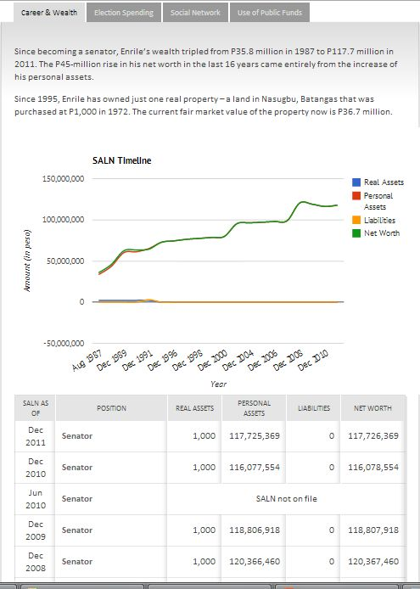
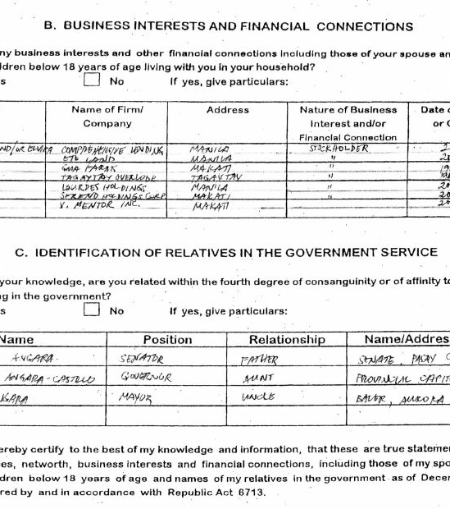
The Wealth of Public Officials
Raw document
Time-series data

Slide 8
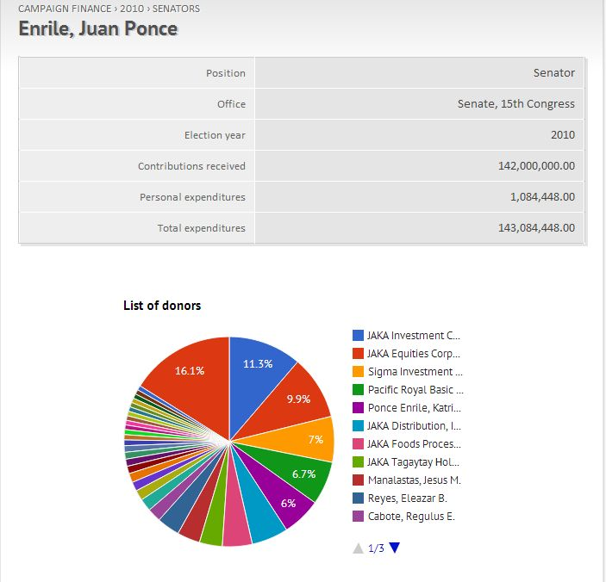
Candidates, campaign donors, social networks

Slide 9
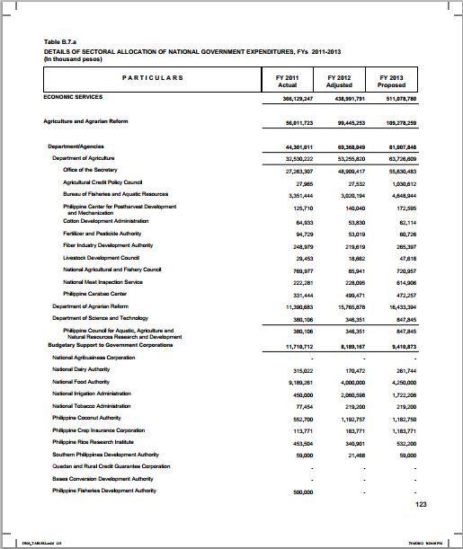
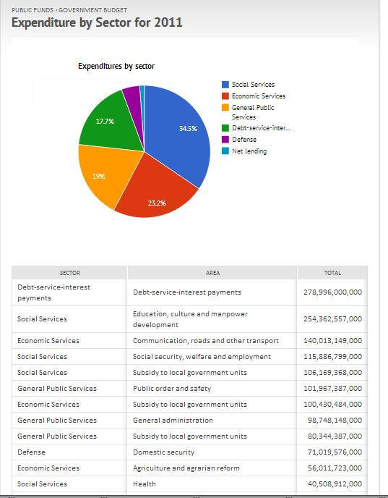
How officials spend public funds

Slide 10
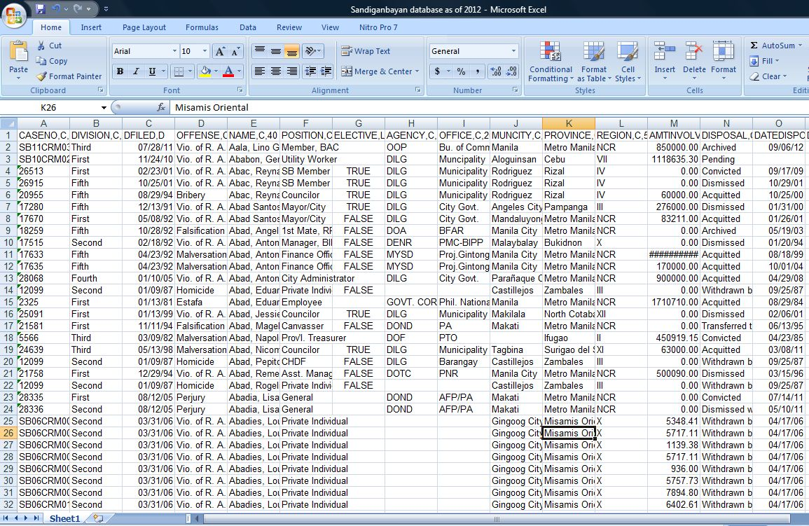
Private purses, public contracts, etc.

Slide 11
http://moneypolitics.pcij.org
Check it out!

Slide 12
FOI Community of Practice:
Media, CSOs, Integrity Agencies
By Malou Mangahas, Executive Director, PCIJ

Slide 13
Media, CSOs, Good Governance
Rights offline are rights online
Threats offline are threats online
FOI, FOE, Press Freedom: Integral, indivisible rights of all citizens
Print, TV, radio, online, social media: All media, community of communicators
Transparency, accountability, good governance, and citizen empowerment: All-hands on deck projects!

Slide 14
A moving picture
The Right to Know is a universal right of all citizens of the world (United Nations instruments)
The Right to Know is the bedrock and the enabler of most other rights (to education, health, livelihood, land, property, life, security, safety of abode, informed choice, good government, happiness!)
Government’s disclosure of some information on its terms is NOT good enough. Technology is not a bypass mode for transparency and accountability.
FOI is, first and last, the citizen’s right to access information in the custody of government that are vested with public interest (involving use of public funds).

Slide 15
A confluence of concepts
Freedom of Information
Freedom of Expression
Press Freedom
Internet Freedom
  = Building blocks of Transparency, Accountability, Good Governance

Slide 16
The Philippines: Rights deficit
Fear and Freedom in Media: One of the liveliest presses in Asia but also one of the the deadliest places in the world for journalists: About 170 journalists killed since 1986 People Power Revolt, majority in the line of duty. Last stories of most victims: local crime and corruption.
Culture of Impunity: Police investigation work bad, courts too slow, witness protection program weak, powerful “state actors” in political alliances with more powerful persons.
State policy but not state practice. In Constitution and jurisprudence, clear and absolute guarantees of freedom of speech, press, assembly but… No FOI Law. New laws also restrict the ambit of freedom.

Slide 17
Media, CSOs: FOI advocacy on all fronts
  Legislative lobbying by citizens, CSOs, journalists, citizen media -- 15 years and four Philippine Congress terms (Indirect People’s Initiative - People’s FOI Bill - filed with 16th Congress)
  Public awareness campaign for FOI by the Right to Know, Right Now! Coalition of 160 CSOs and 237 student and youth organizations of the FOI Youth Initiative
  Civic engagement via all imaginable platforms and formats: conferences, town hall meetings, online/offline petitions (80,000 signatories and counting), advocacy fun-runs, public service advocacy ads, mass actions online and offline -- across sectors, across the regions.
  FOI Community of Practice – media, CSOs, citizens filing requests for information/data relevant to their sector and advocacies

Slide 18
Game-changer?
Media + CSOs + Constitutional Commissions + Regulators = Integrity Community
The campaign for global financial transparency, and good governance should be
… a non-partisan project
… insulated from politics
… outlast political administrations
  … a community enterprise
  … a public good!

Slide 19
Pioneer FOI Practice Teams
  Objective: Build public demand for FOI and nurture a community of practice – citizens/CSOs claiming their right to information
  How? Methodical, evidence-based research. Documentation, and simultaneous filing of requests for information -- according to standards in law of accessing information/documents in custody of public agencies
  Who? Media, CSOs, and citizens engaged with integrity agencies mandated in law and the Constitution to enforce transparency and accountability policies and norms, and to combat corruption

Slide 20
Pioneer FOI Practice Teams
(from the Right to Know, Right Now! Coalition)
12 volunteer CSOs organized in 3 groups
Trained in two-day workshop conducted by PCIJ and Right to Know Coalition on procedures in law, and evidence-hinged research (the PCIJ method of work)
Reporting templates, form letters, log sheets, documentation standards (must-report data, i.e. number of phone calls made, number of letters sent, who did/did not respond from public agencies and reasons given, content of documents secured, etc.

Slide 21
Pioneer FOI Practice Teams
(from the Right to Know, Right Now! Coalition)
Groups chose focus/theme of FOI Practice project, according to the data/documents they need in their programs, sectors, advocacies
Groups trained to follow deadlines, procedures in filing access to information requests, and to document every step of the process by keeping log sheets of data, hard copies of documents received, names/designation/contact details of persons who responded and did not to the requests

Slide 22
Pioneer FOI Practice Teams
(from the Right to Know, Right Now! Coalition)
12 CSOs in all
Group 1: Transparency and Good Governance: Budget, Health, and Elections
Group 2: Industrial Policy (ASEAN Economic Community)
Group 3: Welfare and Rights of Farmers, Migrant Workers, Civil Servants, and Consumers

Slide 23
Agencies approached by CSOs
Department of Trade and Industry (DTI)
Department of Foreign Affairs (DFA)
National Economic and Development Authority (NEDA)
House of Representatives (HoR) Committee on Economic Affairs, Committee on Trade and Industries, and Committee on Foreign Affairs
Offices of various members of the House of Representatives

Slide 24
Agencies approached by CSOs
Department of Agrarian Reform- Public Assistance and Media Relations and Bureau of Agrarian Reform Relations Department
Department of Environment and Natural Resources-Public Information Division
Land Bank of the Philippines-Agri-Agra Social Concerns Committee
Development Bank of the Philippines-Corporate Affairs Department
House of Representatives-Committee on Agrarian Reform

Slide 25
Agencies approached by CSOs
Department of Health-National and Public-Private Partnership Office
Select pilot public schools in San Jose, Occidental Mindoro (one primary school and four secondary schools), the Office of the Mayor of San Jose, Occidental Mindoro, and Department of Education Division Office
Securities and Exchange Commission
Senate Committee on Finance
House of Representatives Committee on Banks and Financial Institutions

Slide 26
Agencies approached by CSOs
Insurance Commission
Overseas Workers Welfare Administration
Department of Foreign Affairs-OUMWA unit in charge of migrant workers
National Labor Relations Commission
Department of Labor and Employment
Office of the President - Overseas Preparedness and Response Team
Philippine Overseas Employment Administration

Slide 27
Agencies approached by CSOs
Commission on Elections Records and Statistics Division
National Center for Health Facilities Development – Department of Health
Infectious Diseases Office-Department of Health
Disease Prevention and Control Bureau-DOH
Barangay Council of Sambag 1, Cebu City
Offices of the District Representatives of Cebu City in Congress
Office of the Ombudsman for Luzon

Slide 28
Documents requested by CSOs
Public-Private Partnership Contracts in the Health Sector
School Improvement Plans, Annual Implementation Plans, Work and Financial Plans
National Achievement test results for school years 2008-2013

Slide 29
Documents requested by CSOs
Minutes of meetings, studies, policy papers of the Departments of Trade, Foreign Affairs, and Economic Planning, and House of Representatives’ committees on the AEC and industrial policy
List of commitments of the country, studies on impact evaluation, etc. that are relevant to researches on the Preparation of the Philippines for the ASEAN Economic Integration and the Industry Roadmap Process in the Philippines

Slide 30
Documents requested by CSOs
Composite accomplishment reports on the Comprehensive Agrarian Reform(CARP) and CARPer implementation, 1988-July 2014
Number of foreclosures related to agrarian reform areas
Number of farmers who have paid/not paid their amortization
Report of Program Beneficiaries Development (1998-2014)

Slide 31
Documents requested by CSOs
Implementing rules of Executive Order No. 34 creating the Overseas Preparedness and Response Team
Complete blueprint and implementing guidelines of rapid response program based on EO 34
Proposed, approved, and annual budget and summary of actual expenditures per OFW crisis situation from 2011-2014

Slide 32
Documents requested by CSOs
Statement of assets, liabilities, and net worth of some local officials
Statistics on number of youth and first-time voters in the Philippines
List of budget allocation per region of the country for health facilities development
Projected number of senior citizens who should receive influenza and pneumococcal vaccines under the 2015 requested budget

Slide 33
In sum: FOI Practice Teams
Letters sent: (delivered, emailed, faxed, sent by special service mail): 50 plus
Phone calls made: 120 plus
Days spent on research: 90 days per group
Agencies approached: 60 plus
Researchers engaged by Pioneer FOI Practice: 18-20 CSO leaders

Slide 34
Gaps in narrative
How connect the dots? Open Data, Financial Transparency, Open Government, SDGs, ICCPR, UNCAC, etc.
How bridge gaps: In law/theory and in practice; global, regional, national picture?
Technology and the Web: Inclusion or exclusion? Platforms or Content? Open data we want, open data we need,, not close-open government?
How vest numbers with meaning? Global & local voice/content, capacity in excess & deficit?

Slide 35



