Slide 1

Whistleblower Protection Regimes :
Trends and Challenges
Iftekhar Zaman
Executive Director
Jakarta, 20 October 2015

Slide 2
Whistleblower protection regimes:
A relatively recent trend
Growing menace of corruption & Illicit financial flow
UNCAC commitment
Civil Society demand, active media
Donors expectation
Electoral pledges
Rapidly popularizing across all regions (60+ countries; 10-12 in Asia-Pacific region)
Stand-alone or complementing legal provision as part of other anti-corruption laws or access to information laws

Slide 3
Whistleblower Protection Law and Corruption Perception in Asia-Pacific Region
Countries that have WBP Law |  | Countries that don’t have WBP Law
Country name | CPI Score/Rank | Country name | CPI Score/Rank
Australia | 80 (11) | Afghanistan | 12 (172)
Bangladesh | 25 (145) | Cambodia | 21 (156)
Bhutan | 65 (30) | China | 36 (100)
Brunei (A-C law) | - | Indonesia | 34 (107)
Hong Kong (A-C law) | 74 (17) | Laos | 25 (145)
India | 38 (85) | Maldives | -
Japan | 76 (15) | Nepal | 29 (126)
Malaysia | 52 (50) | Pakistan | 29 (126)
Myanmar | 21 (156) | Papua New Guinea | 25 (145)
New Zealand | 91 (2) | Singapore | 84 (7)
Philippines (draft) | 38 (85) | Sri Lanka | 38 (85)
South Korea | 55 (43) | Thailand | 38 (85)
Taiwan (A-C law) | 61 (35) | Vietnam | 31 (119)

Slide 4
Potential for effectiveness
Comprehensive and robust law for protection and security having a broad scope and coverage
Clear-cut specific and adequate alternative channels of reporting both internally and externally including anonymous reporting and confidentiality
Specific protection from all forms of retaliation and discrimination against whistleblowers
Legal remedies and compensation including interim remedy and protection

Slide 5
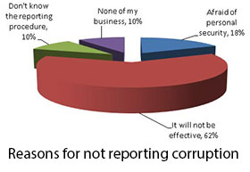
National Youth Integrity Survey Bangladesh 2015 http://www.ti-bangladesh.org/beta3/index.php/en/research-policy/99-cross-country-study/4664-national-youth-integrity-survey-2015-full-report-english

Slide 6


Anti-corruption agency:
Toothless Tiger?

Slide 7
WBP Law Necessary, Not sufficient
Complementary legal regime, such as
  Anti-corruption law
  Anti-money laundering law
  Right to Information Act
Effective enforcement
Conducive Institutional capacity
  Anti-corruption agencies
  Law enforcement agencies
  Independent judiciary
  Effective legislative body (Parliament)
Public awareness, active media
Political will without fear or favour

Slide 8
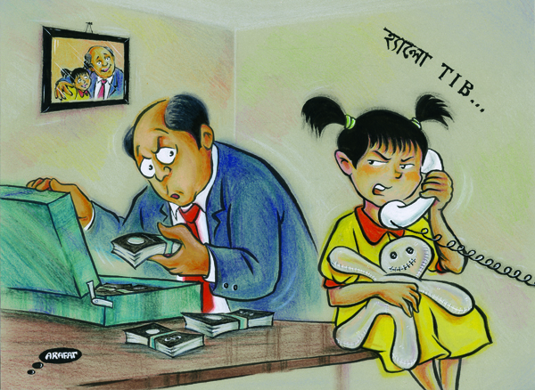
Thank you
edtib@ti-bangladesh.org
www.ti-bangladesh.org

