Slide 1
Illicit Financial Flows:
Who, What, Why, Where and When?
Joseph Stead – Senior Economic Justice Adviser, Christian Aid
jstead@christian-aid.org
Notes:
So here to give an intro to illicit financial flows, or the who, what, why, where and when. Actually won’t do all of them, as some of my distinguished colleagues will be covering them, and won’t necessarily be doing them in that order, but will doing some combination, starting with What.

Slide 2
What?
Money that is illegally earned, transferred or spent
  Corruption
  Criminal activities
  Fraudulent commercial activities
  Tax dodging
The 3 sins
  Sin at origin – funds acquired illegally
  Sin at transfer – not properly recorded
  Sin abroad – not declared
Notes:
Wikipedia tells us that IFFs is money that is illegally earned, transferred or spent. Activities include corruption, criminal activites (drugs, trafficking etc), fradulent commerical activites – so where companies deliberately alter the prices they charge to enable cash to be shifted, and tax dodging usually ends up as a result either deliberate or not of all of these, cash ends up somewhere else, often not declared and no tax paid.
There is another way of looking at this, and maybe because I come from Christian Aid I find it useful to look at it in relation to sin, and we can see three sins, one or more of these, and we’re looking at an IFF
- sin at origin – the funds are acquired illegally – looking especailly at the corruption and criminal activities here
Sin at transfer – when the funds are moved something dodgy happens – here we’re looking at the trade and transfer mispricing
Sin abroad – once the funds have gone somewhere else, they’re not declared, either the funds are not declared, or the owners of the funds are not declared
So what are IFFs, they are a financial sin.

Slide 3
What? - Impact
Outflows have a significant impact on development
Lost tax revenue
  Taxes are the primary source of funding
Lost capital for investment
  SDGs face an investment gap of $2.5trillion
Perpetuates culture of corruption and evasion
Notes:
That’s what they are, but the more pertinent question is what is the impact.
Impact is significant:
As said, most of these flows should have had taxes paid on them – taxes that could be used to fund public services. The poorest, and especially women, suffer the most from these losses.
But it’s not just the taxes, it’s also the capital, the money itself that is lost to the country – yet many developing countries desperate for investment. For most countries domestic capital is the main source of investment, if that is disappearing abroad then going to suffer
And it’s more than just the money – it’s about the attitudes and culture that develops. By enabling corruption and tax evasion to become commonplace a culture develops that makes these things be seen as OK

Slide 4


Why
Notes:
Why IFFs – well it’s all about the money
Many will give all kinds of explanations
Everyone else is doing it so only way to remain competitive
Country has capital controls, only way around it
Concerned about regime taking money away so hide it overseas
It’s not really illicit, it’s just pushing the rules to their limits
It’s how things are done in [insert countries name here]
But when it comes down to it, it really is all about the money, and because they can

Slide 5



Who? – Those who control the money
The Corrupt
The Criminal
The Corporate
By far the largest

Slide 6

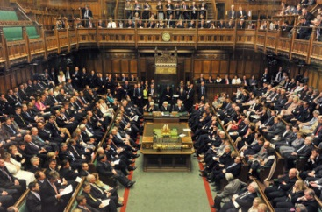
Who? Those who enable the flows
Pin-stripe mafia
(lawyers and accountants)
Governments

Slide 7
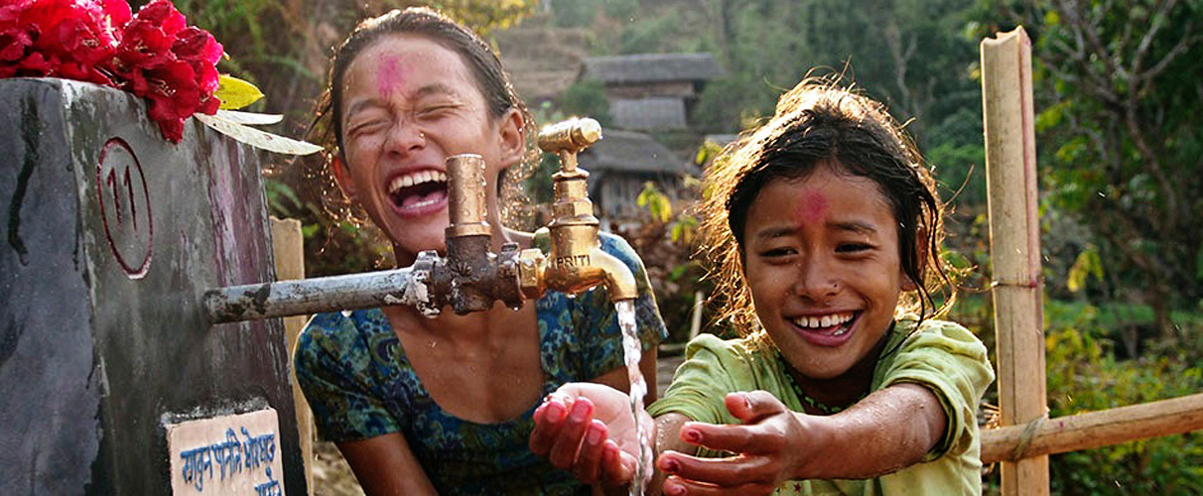
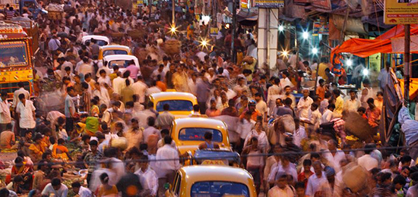
Who? Those who suffer as a result
The poorest suffer most
(women especially)
Society as a whole

Slide 8
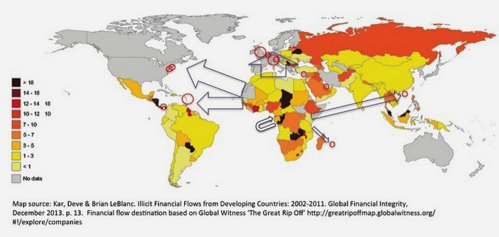
Where?
Everywhere
Flows out from developing countries
Flows into tax havens (not just hot islands)

Slide 9

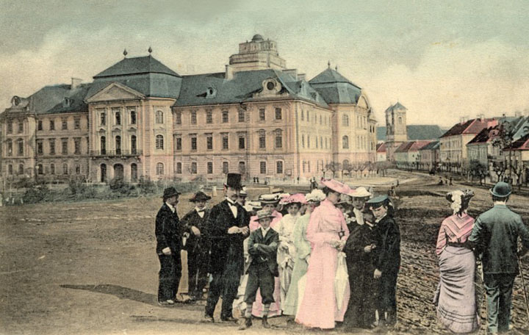
When?
NOW!
Our Challenge is to make it the past

