Slide 1

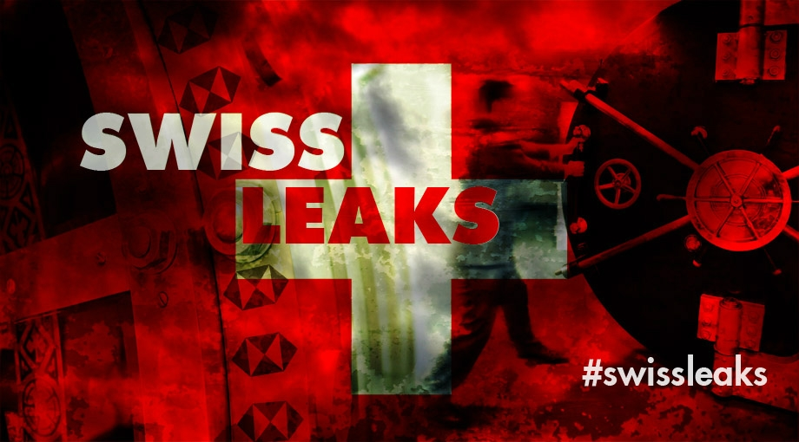
Global investigative journalism
Kristof Clerix (ICIJ), Jakarta, October 2015

Slide 2

ICIJ
°1997 by journalist Charles Lewis (US) from within the non-profit Center for Public Integrity
staff: 11 FTE
1997: 76 journalists from 41 countries
2015: 190 journalists from 65 countries

Slide 3
ICIJ
Each ICIJ project must meet three criteria
topic of global importance
reveal systemic problems
achieve concrete results

Slide 4
© Shutterstock / Tim Meko

Slide 5
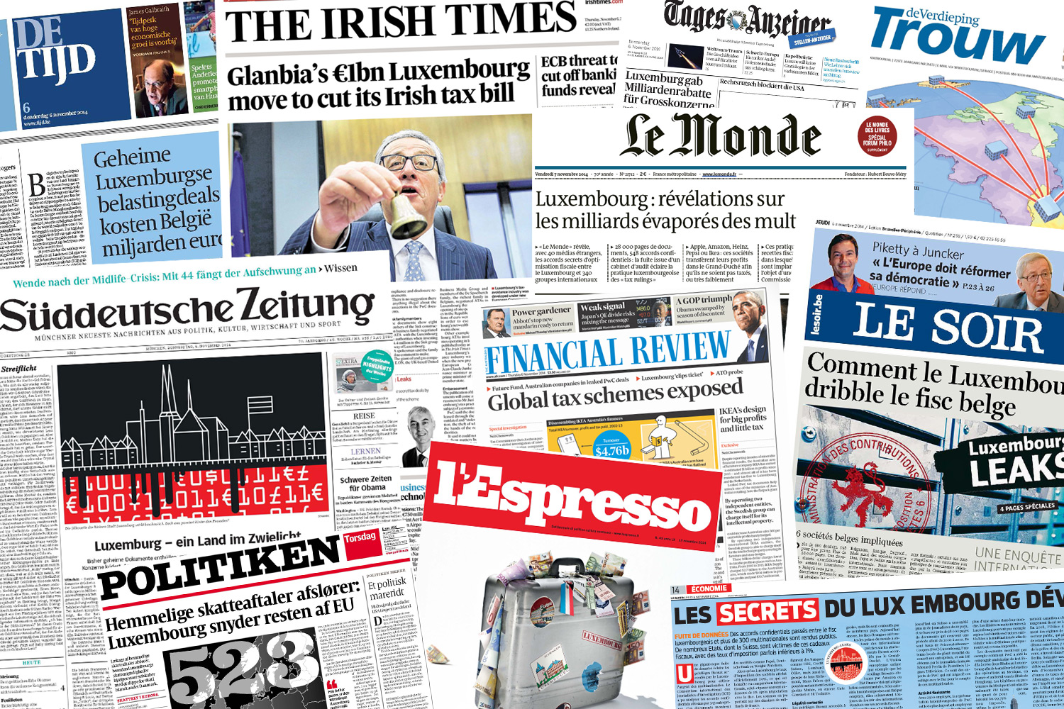
November 5, 2014

Slide 6

©Lectrr
Pepsi, IKEA, Deutsche Bank and nearly 340 other companies have secured secret deals from Luxembourg that allowed many of them to slash their global tax bills.

Slide 7
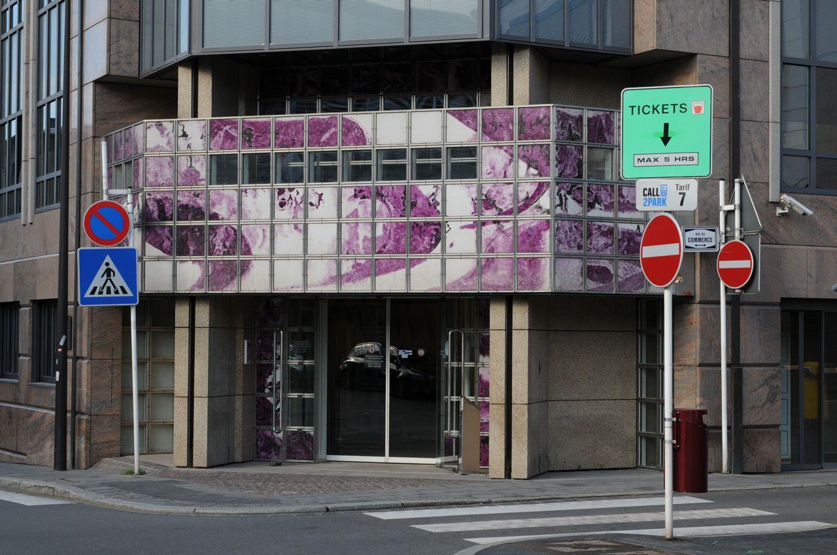
© Kristof Clerix
The “rulings” provided assurance that companies’ tax-saving plans would be viewed favorably by Lux. authorities.

Slide 8
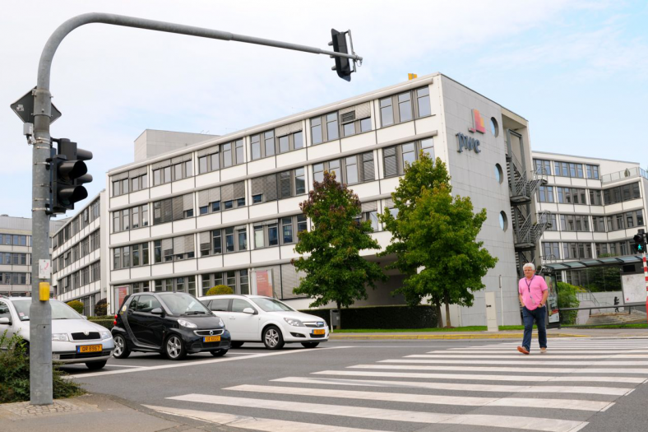
© Kristof Clerix
PricewaterhouseCoopers helped the multinationals to obtain the tax rulings.

Slide 9

Pictures of Money (CC BY 2.0)
Companies channeled hundreds of billions of dollars through Luxembourg.

Slide 10

©Lectrr
Many tax deals exploited international tax mismatches that allowed companies to avoid taxes both in Luxembourg and elsewhere through the use of so-called hybrid loans.

Slide 11
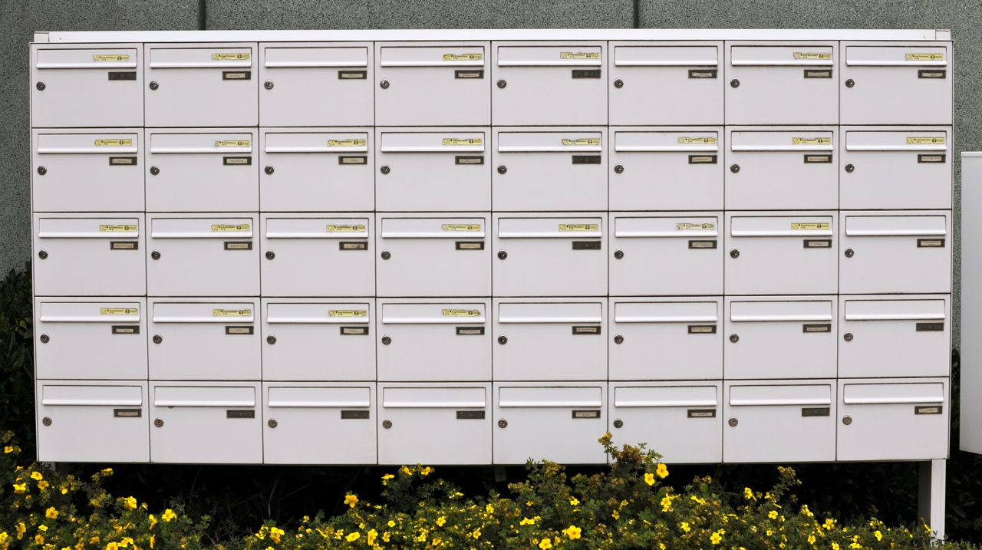
© Kristof Clerix
Luxembourg subsidiaries handling billions of dollars in business maintained little presence and conducted little economic activity in Luxembourg.

Slide 12
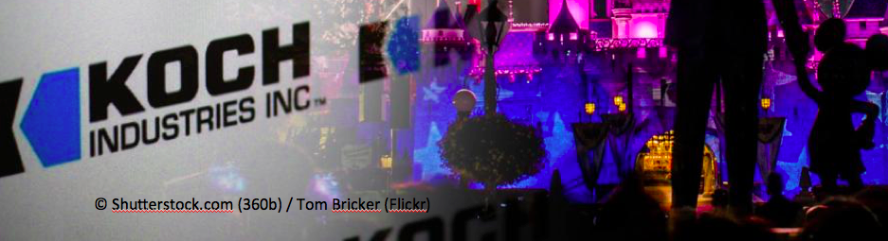
December 9, 2014
A second leak –including rulings with The Walt Disney Co, Koch industries and 33 other firms– revealed the role of the Big Four & expanded the timeframe.

Slide 13
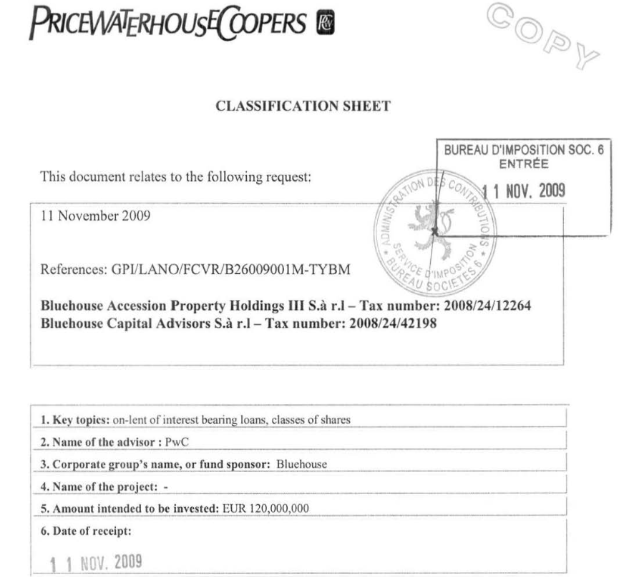
28.000 pages = 548 rulings

Slide 14
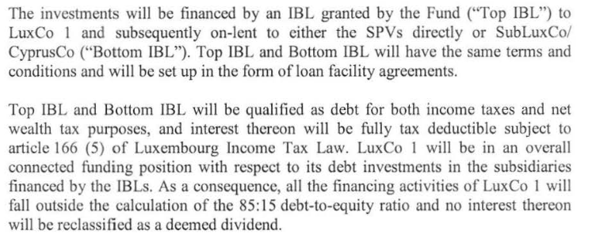
The challenge

Slide 15
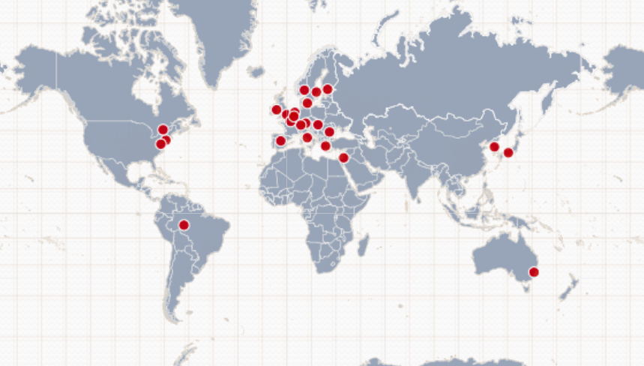
Over 80 journalists in 26 countries
© ICIJ

Slide 16
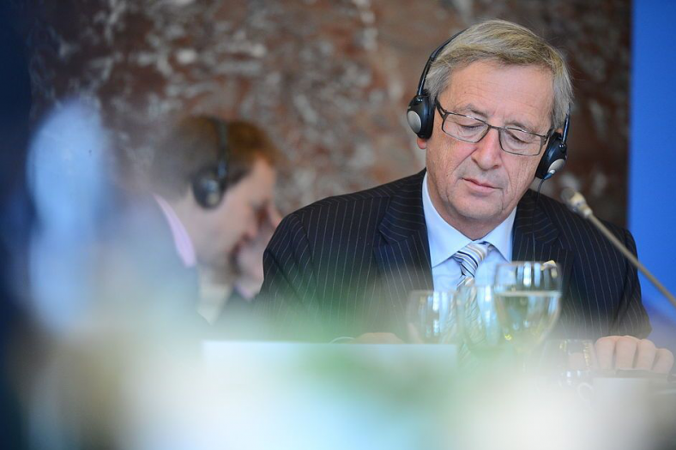
Impact
EVP (CC BY 2.0)

Slide 17
Impact
European Commission:
state aid inquiry into Ireland (Apple), the Netherlands (Starbucks), Luxembourg (Fiat & Amazon), Belgium (excess profit rulings)
exchange rulings between member states
proposal on country by country reporting

Slide 18
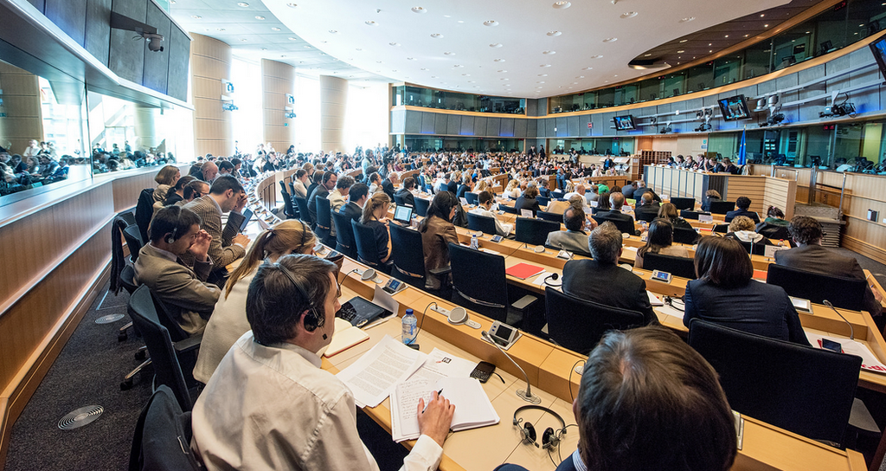
Impact
European Parliament: TAXE committee
© European Parliament

Slide 19
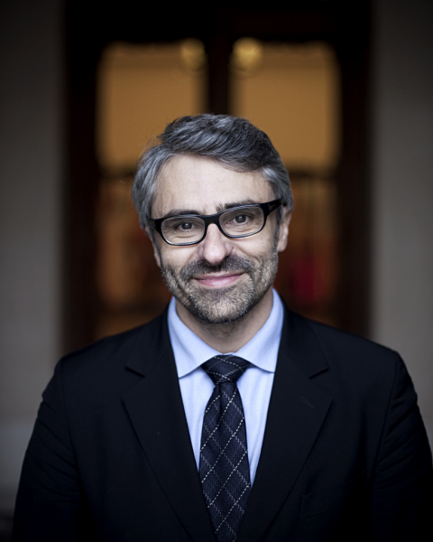
Impact
Window of opportunity for the BEPS project (Base Erosion Profit Shifting) of the OECD
OECD tax chief
Pascal Saint-Amans:
Corporate tax avoidance
while taxpayers suffer is simply not acceptable.
“
”
© OECD

Slide 20
Legal
ICIJ has not faced any lawsuits following LuxLeaks.
Some companies have publicly criticized our work, claiming inaccuracies in our work, but they never pointed at the concrete examples.
We are not aware of any legal claims against ICIJ partner media (there have only been threats of lawsuits).

Slide 21
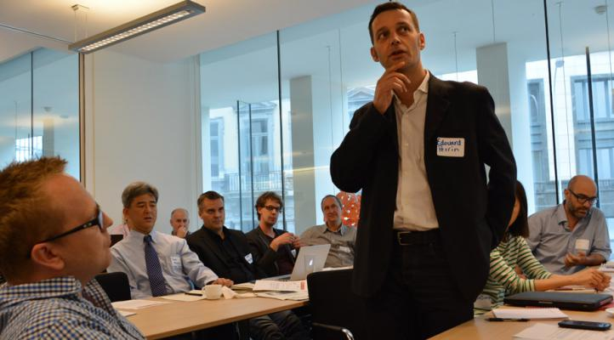
Legal
April 2015
Edouard Perrin (ICIJ) indicted in Luxembourg
© Mar Cabra

Slide 22
© Shutterstock / Tim Meko

Slide 23
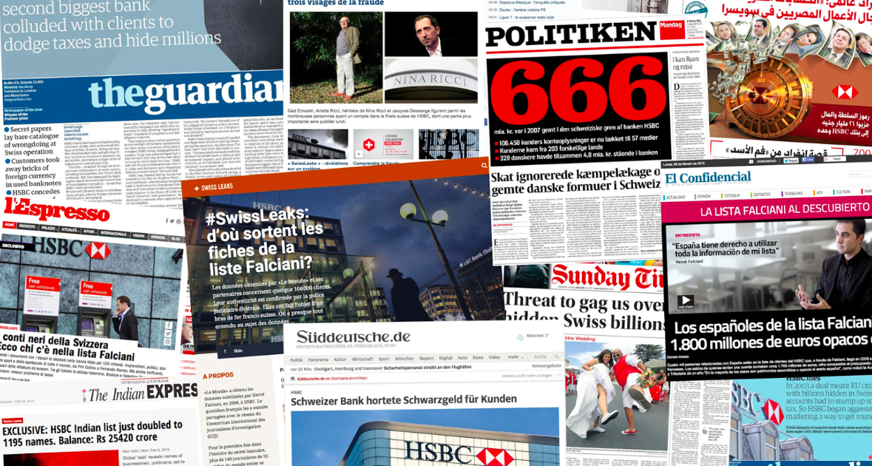
February 8, 2015: SwissLeaks
© Shutterstock / Tim Meko

Slide 24
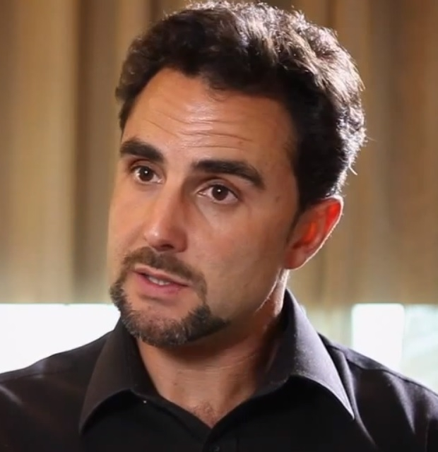
HSBC whistleblower
© Eldiarioes CC BY - SA 3.0
In 2006 the
French Italian system engineer Hervé Falciani started working
as an IT expert for HSBC Private Bank in Geneva, Switzerland.

Slide 25
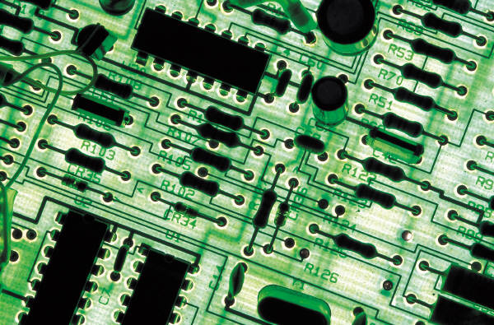
Hervé Falciani
Falciani copied client data from the bank files.
During a search of Falciani’s house in 2009 French investigators seized the data: bank information relating to 106.458 people and companies from 203 countries.

Slide 26
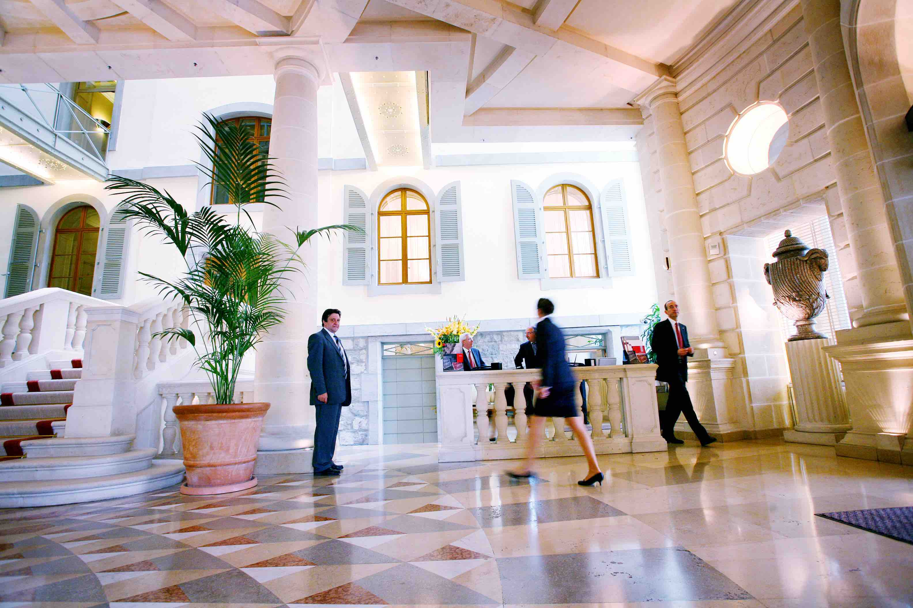
HSBC Private Bank (Geneva)
© Laurent Guiraud / Tamedia

Slide 27

SwissLeaks – the making of
French newspaper Le Monde managed to get a copy of the data and shared them with ICIJ. Over 140 journalists from 45 countries collaborated.
© ICIJ

Slide 28

SwissLeaks – the revelations
ICIJ’s data anylsis revealed that the maximum amount on all 81.458 bank accounts was
102 billion dollar (in the period 2006-2007).
© E401K 2012 CC BY – SA 2.0

Slide 29
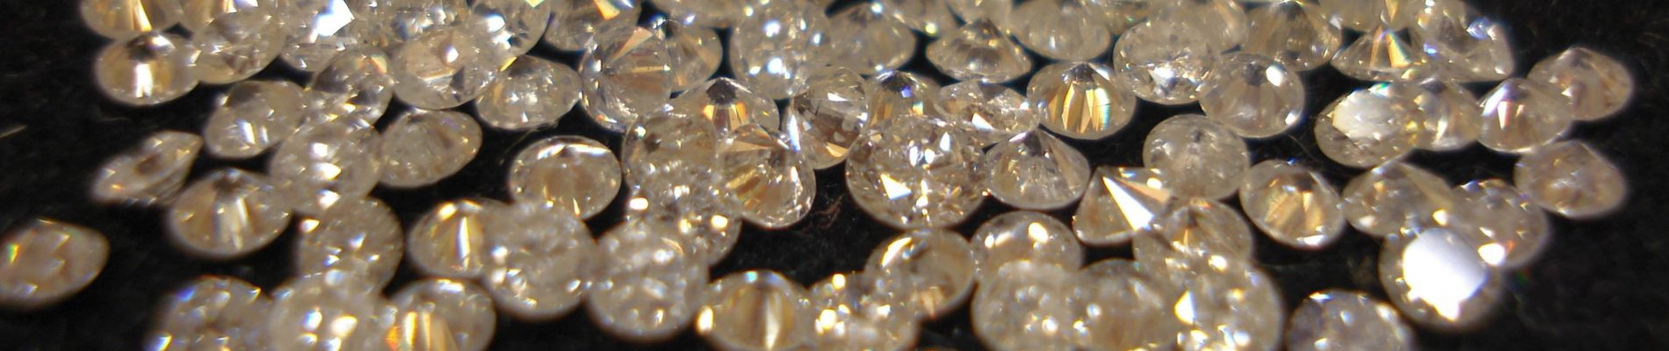
SwissLeaks – the revelations
HSBC Private Bank (Suisse) continued to offer services to clients who had been unfavorably named by the United Nations, in court documents and in the media as connected to arms trafficking, blood diamonds and bribery.

Slide 30
SwissLeaks – the revelations
HSBC served those close to discredited regimes such as that of former Egyptian president Hosni Mubarak, former Tunisian president Ben Ali and current Syrian ruler Bashar al-Assad.
HSBC clients also included former and current politicians from 19 countries.

Slide 31
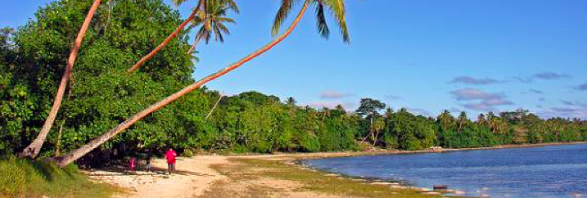
SwissLeaks – the revelations
Bank employees discussed with clients how
to avoid paying taxes in their home countries.
This included holding accounts in the name
of offshore companies to avoid the European Savings Directive.
Phillip Capper (CC BY 2.0)

Slide 32
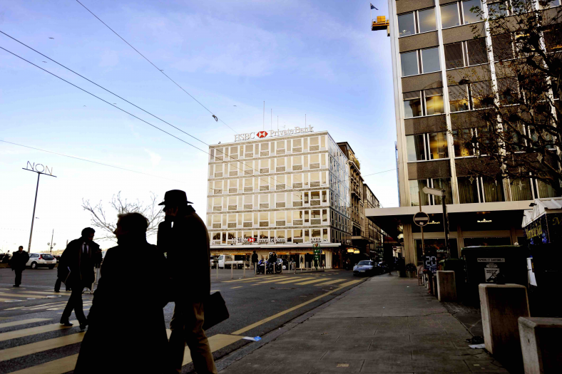
Reaction HSBC
‘We acknowledge that the compliance culture and standards of due diligence in HSBC’s Swiss private bank, as well as the industry in general, were significantly lower than they are today.’

Slide 33
Reaction HSBC
The bank has ‘taken significant steps over the past several years to implement reforms and exit clients who did not meet strict new HSBC standards, including those where we had concerns in relation to tax compliance.’

Slide 34

Legal
ICIJ has received some legal letters following the publication of the SwissLeaks revelations but is not facing any law suits.

Slide 35
Conclusion
When whistleblowers reveal systemic wrongdoings to international journalist networks such as ICIJ, we can conduct professional research and translate the
leak into a story with global impact.

Slide 36

Thank you for listening
Kristof.clerix@mo.be
kristofclerix
www.icij.org

