Slide 1

Raising Revenue in an Age of Tax Incentives
Francisco J. Beiner
Director, Institutional Management and Operations
Inter-American Center of Tax Administrations – CIAT
Jakarta, Indonesia, October 21, 2015
Based on: Tax Expenditures and Incentives in Latin America
CIAT Studies and Research Directorate

Slide 2

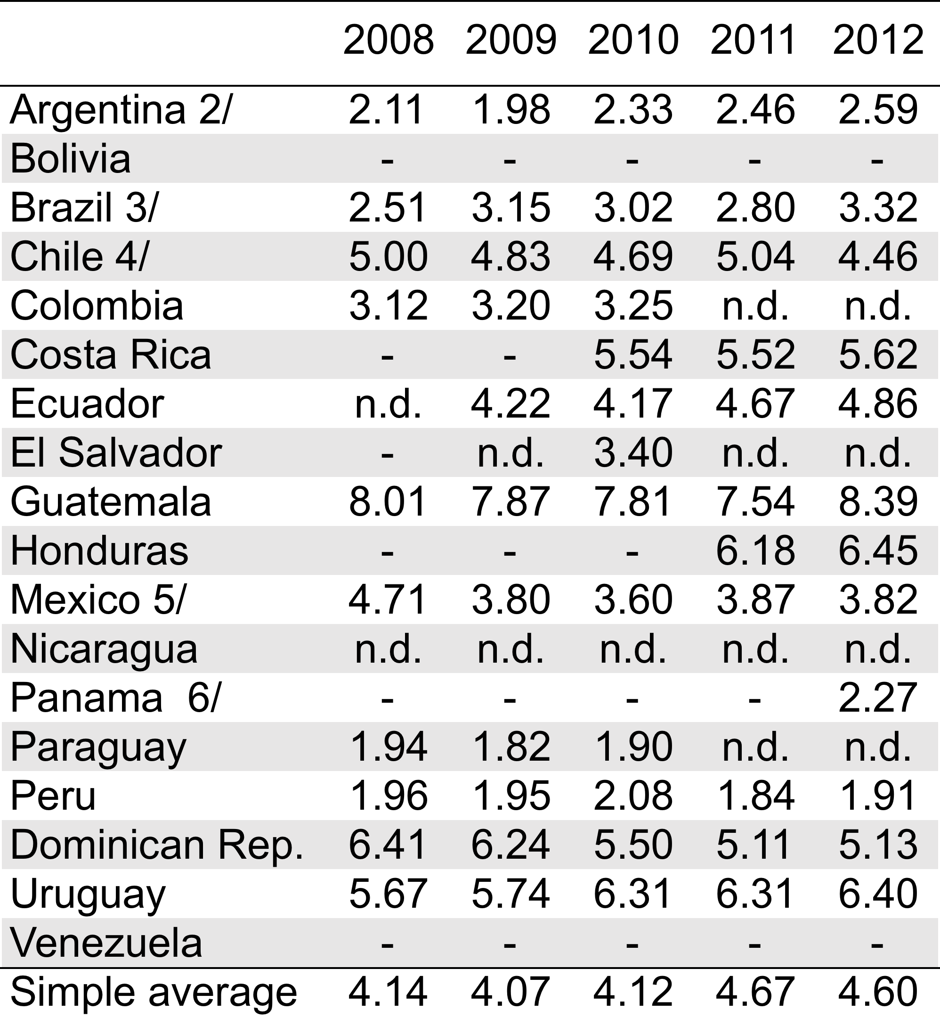
Tax expenditures and incentives
In GDP percentages
Notes:
2

Slide 3
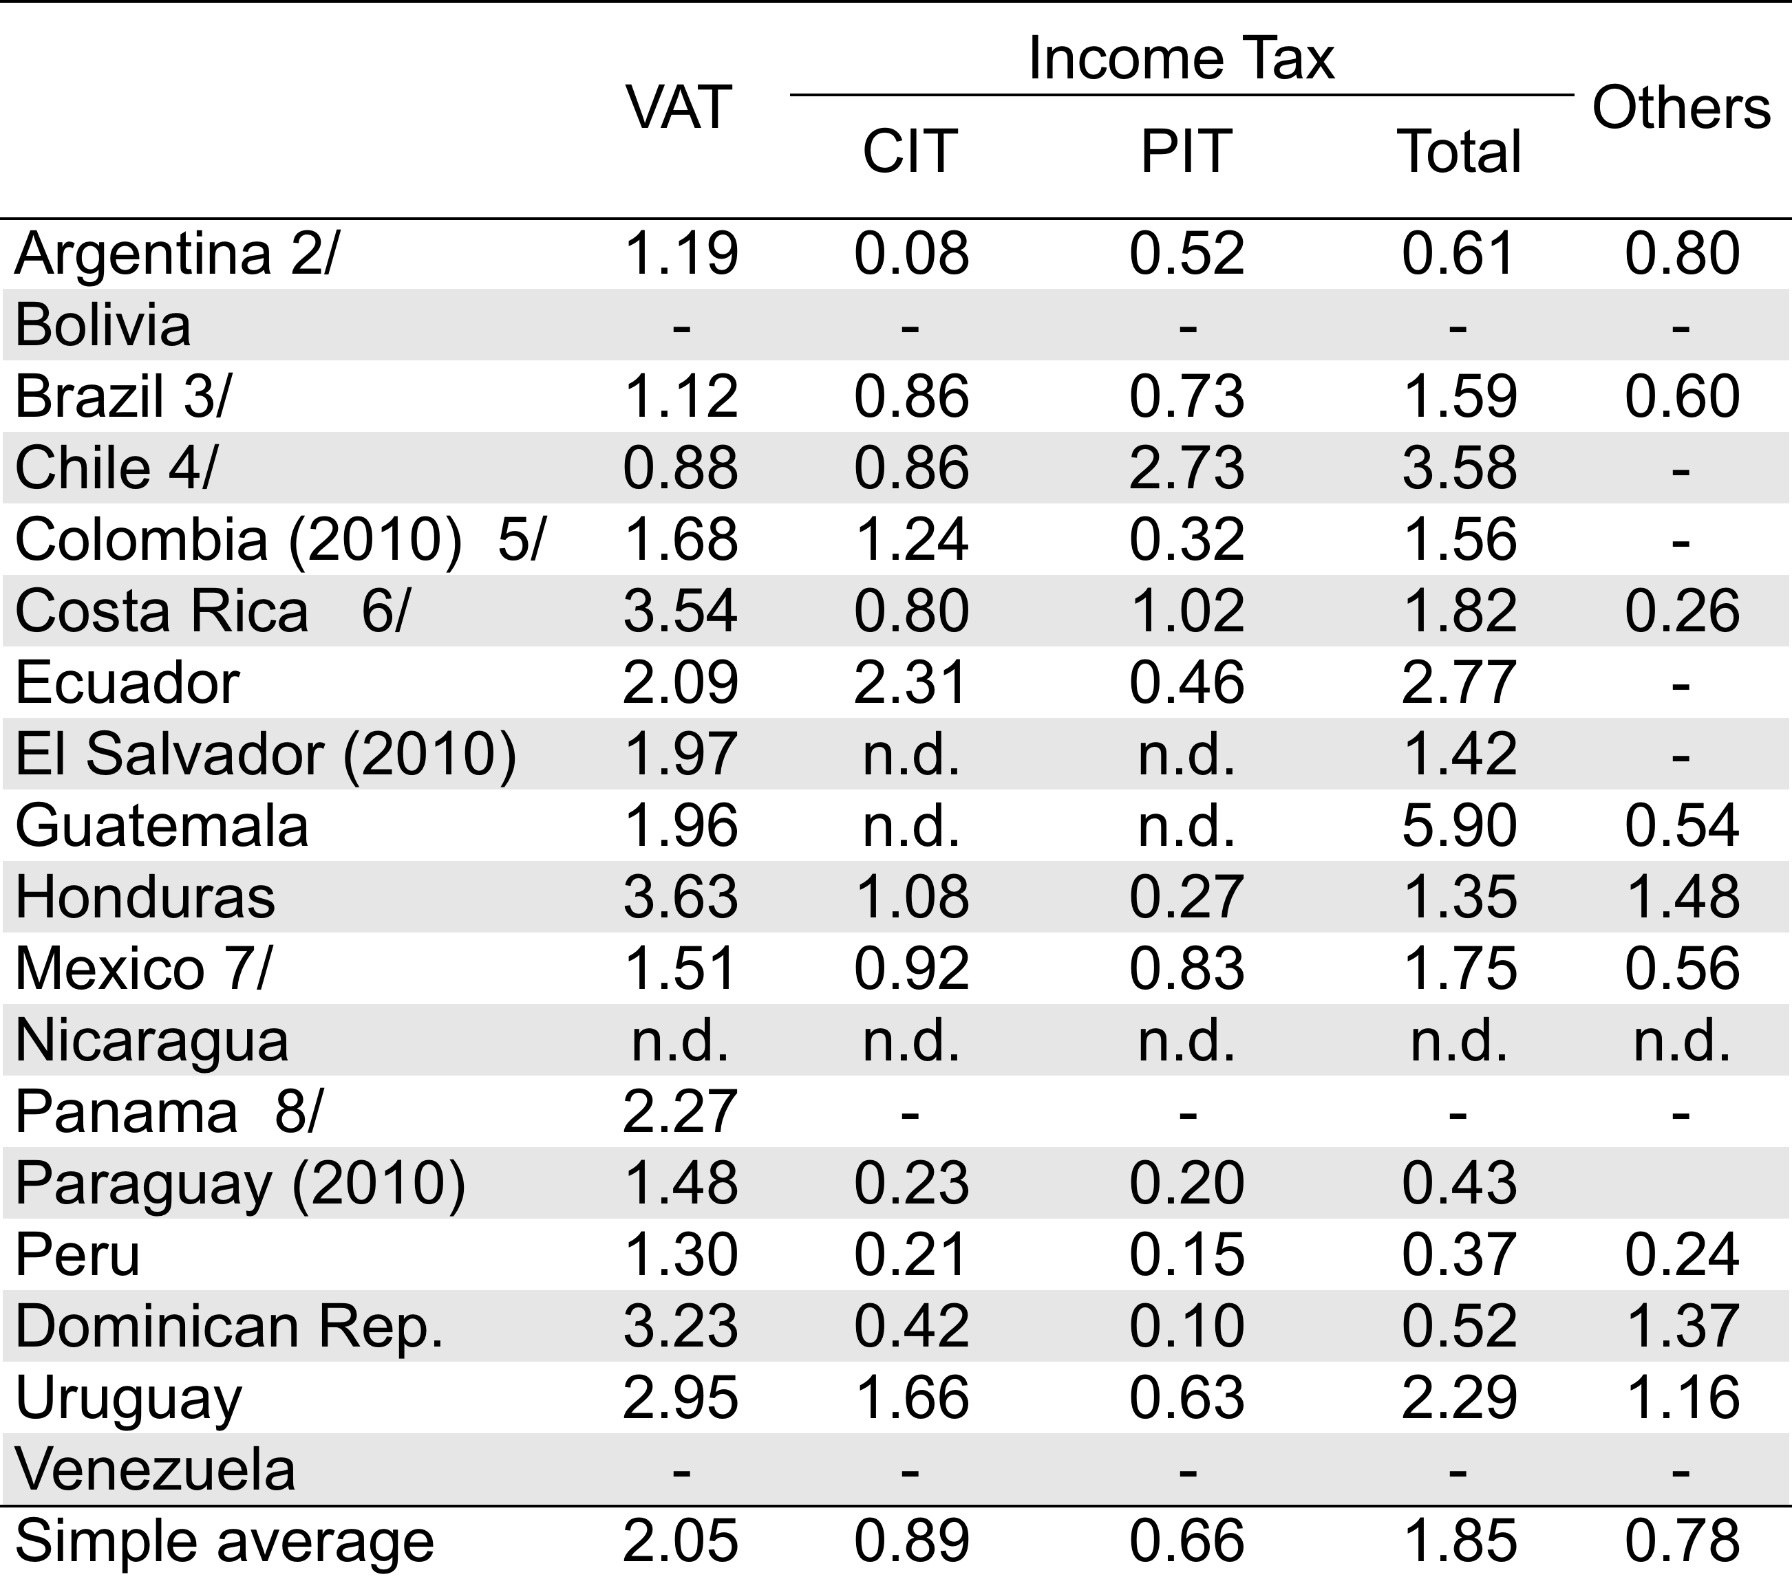
Tax expenditures and incentives by tax, 2012
In GDP percentages
Notes:
3

Slide 4
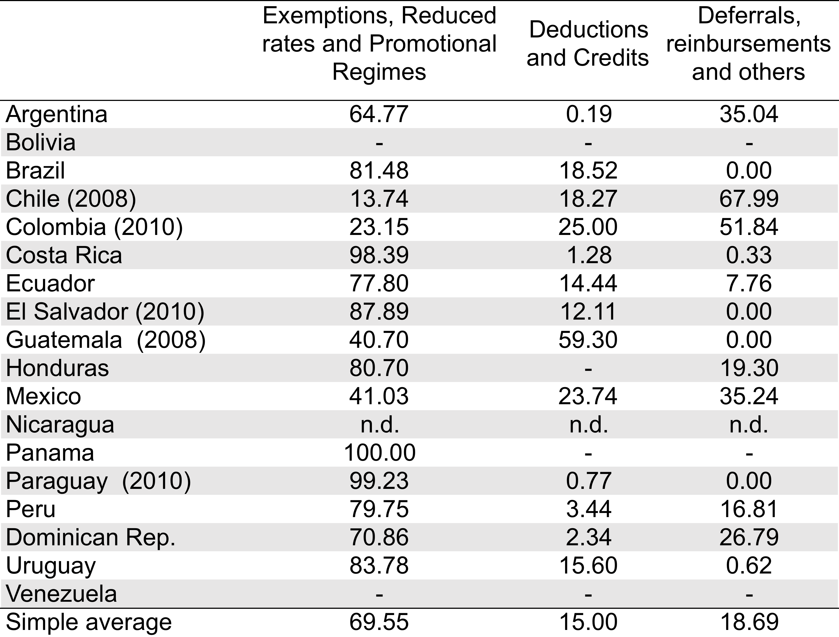
Tax expenditures and incentives by type, 2012
In percentages of total revenue loss
Notes:
4

Slide 5
Tax incentives
  Incentives supporting investment (CIT, VAT, excise taxes and import tariffs).
  Incentives supporting employment (PIT, SSC, Payroll taxes)
  Incentives supporting savings (PIT).
  Incentives supporting housing (PIT, Property taxes).
  Environmental tax incentives.

Slide 6
Types of tax incentives
  Exemptions and exclusions
  Tax holidays, partial or full exemption from import tariffs, excises and VAT
  Deductions / Credits
  Investment tax credits (or allowances), CIT extra deductions
  Preferential (reduced) tax rates
  Including a low statutory tax rate, reduced withholding tax rates (treaty provisions), reduced import tariffs
  Deferrals
  Capital recovery (accelerated depreciation and initial capital allowance)
  Simplified, promotional or special tax regimes
  Free-trade Zones (FTZ) and Export Processing Zones (EPZ), SMEs regimes

Slide 7
Revenue Authorities challenges
  Manipulation of transactions between related companies; manipulation of “internal” transfer pricing (tax holidays, reduced CIT rates).
  False purchasing and re-purchasing of assests; channeling asset purchases through qualifying companies on behalf of non-qualifying partners (Capital recovery - accelerated depreciation and initial capital allowance).
  Taxation in the country of the investor: imputation or exemptiom system (tax holidays).
  Treaty shopping (reduced withholding tax rates).
  Fiscal dwarfism (SMEs regimes)

Slide 8
Revenue Authorities challenges (cont’d)
  Qualified purchases can easily be diverted to buyers not intended to receive the incentives (FTZ/EPZ)
  Leakages of goods into the domestic market (FTZ/EPZ).
  Under-invoicing allowing some of the income to stay there, where it is exempt. (FTZ/EPZ).
  Inappropriate refunds (FTZ/EPZ).
  Leakage risks (Tariffs Suspensive Regimes or VAT Suspensive Regime).
  Misclassification of shipments (reduced import duties on capital goods, raw materials and intermediate goods).

Slide 9
Evaluating tax incentives for investment
  Agostini and Jalile (2009) – LATAM (11): semi-elasticity of FDI to CIT rate between -0.75 y -0.96
  Case-by-case analysis
  Jorratt (2009) – Ecuador: deduction for net increase in jobs, reduced rate for reinvestment of profits and the deferral for accelerated depreciation.
  World Bank (2012) – Colombia: Special Taxation Regime and EPZ/FTZ.
  Giuliodori and Giuliodori (2012) – Argentina: R&D tax credit.
  CEF, IECON, CINVE (2014) – Uruguay: Investment Promotional Regime.
  Agostini and Jorrat (2014) – Chile: Import tariffs exemption on capital goods and investment tax credits.
  Artana (2015) – FTZ/EPZ in Costa Rica, El Salvador and Dominican Republic.

Slide 10


