Slide 1
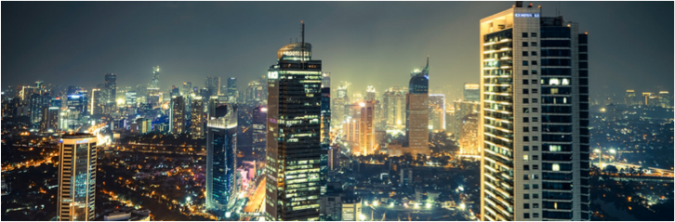
Zooming-in
the anti-money laundering
Svitlana Zalishchuk, Ukraine
Many Voices, One purpose: The 6th Financial Transparency Conference

Slide 2
Meeting of the Russian Church Patriarch
and Minister for Justice

Slide 3
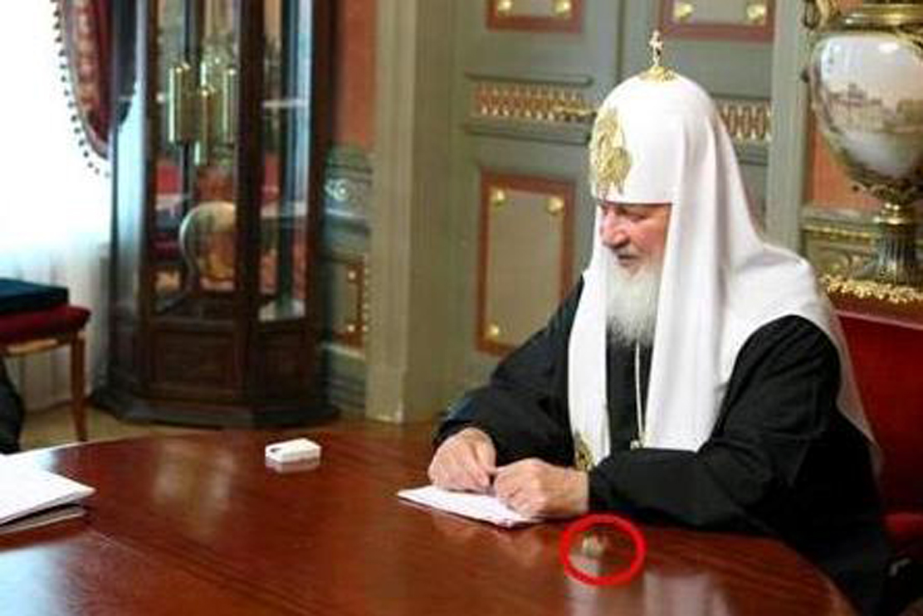
Zooming-in…

Slide 4
Photoshop for the Reputation-Laundering

Slide 5

Visa-free regime for corruption

Slide 6
Do we always need revolutions to investigate illicit money?
Ukraine, winter 2014

Slide 7
Protesters pictured on top of the
£10 m Gaddafi property in London

Slide 8
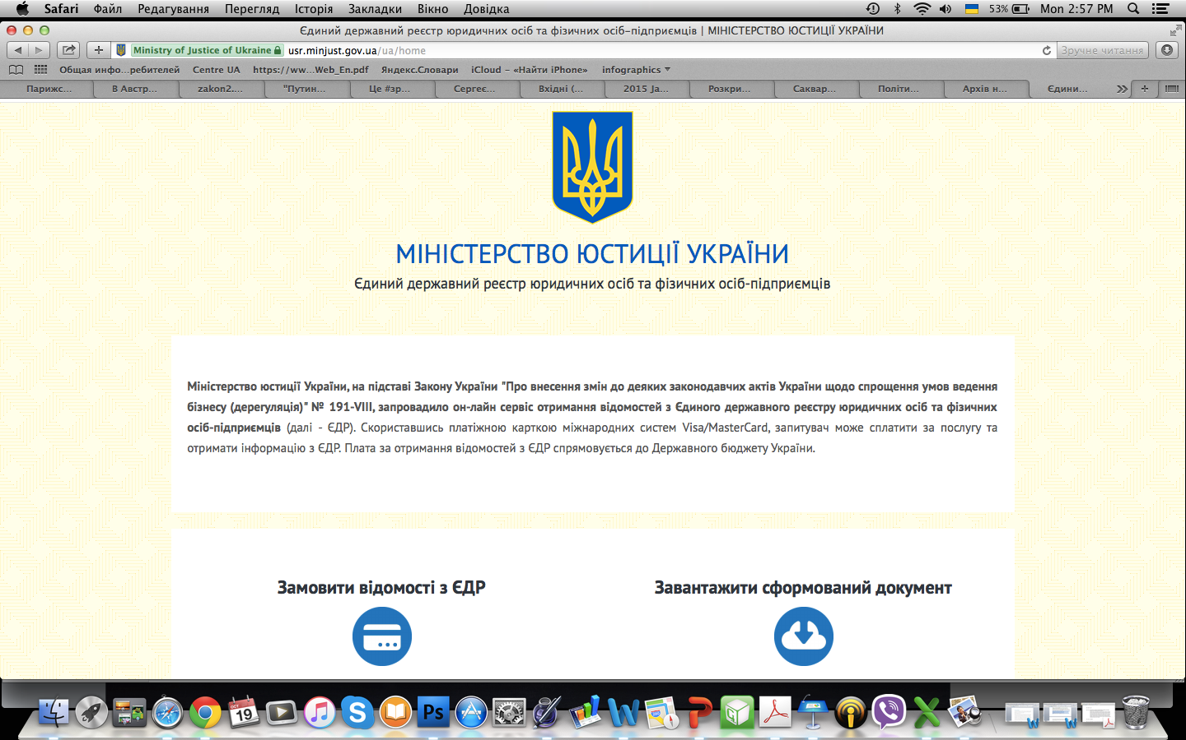
Ukraine made its registry on the beneficial ownership public

Slide 9
«Good things
happen in politics too»

Slide 10
Our chance to create anti-money laundering zoom-in

