Slide 1
Whistleblowers and Investigative Journalism in Indonesia
Wahyu Dhyatmika (Tempo Magazine)

Slide 2
overview
phenomenal whistleblowers
protection for future whistleblowers
challenges ahead

Slide 3
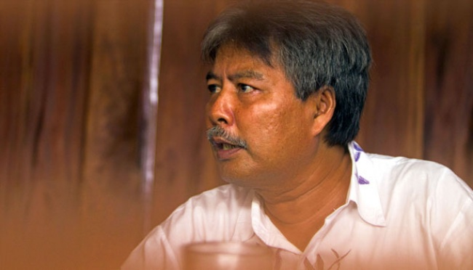
Agus Condro

Slide 4

Yulianis

Slide 5
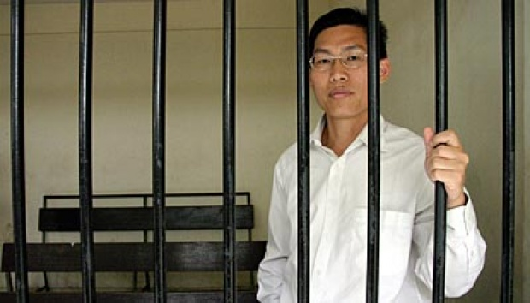
Vincentius Amin Sutanto

Slide 6

Transfer Pricing

Slide 7
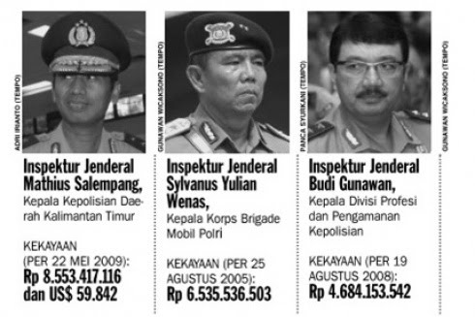
Police Fat Bank Account

Slide 8


Overseas Tax Havens

Slide 9
How do we protect them?
anonymity in media
legal aid, lobby and campaign to relevant authority
constant coverage on the news
pushing for more open data and public transparency
strengthening FOIA and RTK

Slide 10

We need whistleblowers
In December 2013, Tempo Magazine published a special edition on whistleblowers and justice collaborators: people who sacrifice everything to expose wrongdoings around them.
We celebrate them as heroes, and encourage others to come forward.

