Slide 1
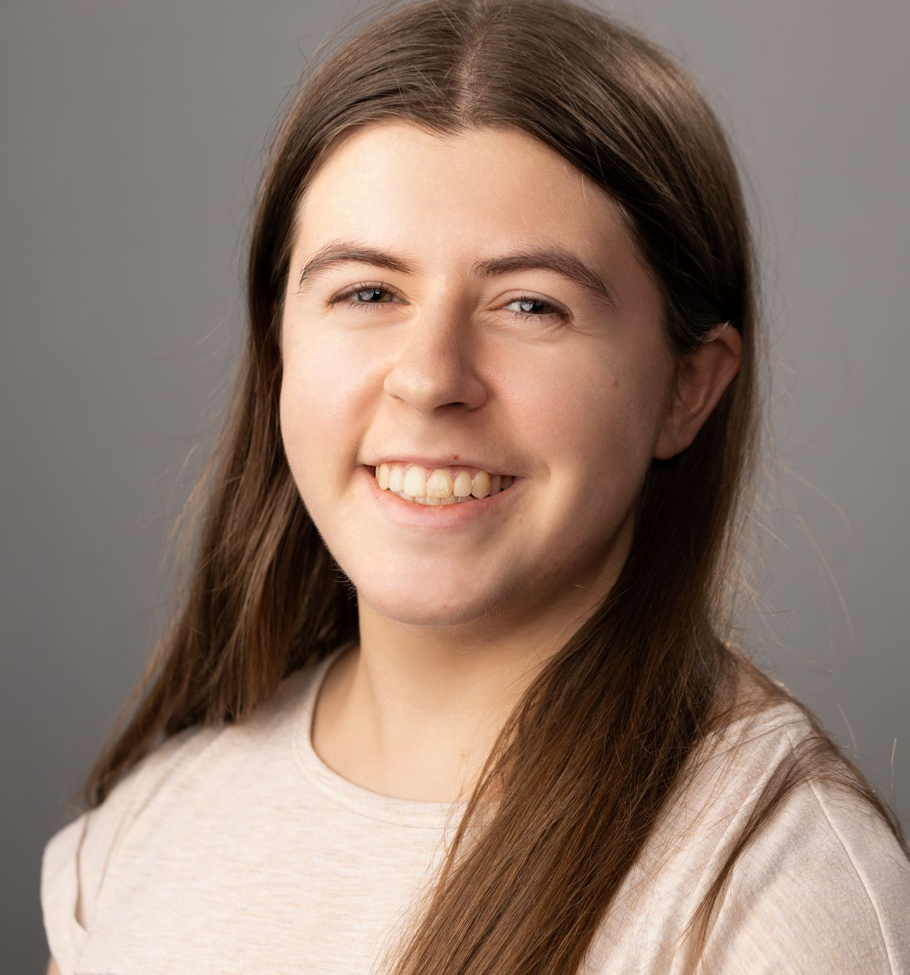
Chloe Tenembaum
Business Process Analyst
Data Visualization and Analytics
AFS PROJECT EXPERIENCE
Data and BI Analyst U.S. Department of Energy - April 2024-Present
Developed a Power BI Spending Plan Dashboard, providing DOE senior leadership with immediate access to budget insights.
Completed O&M tickets for Cognos and Power BI reports.
Conducted smoke tests of SQL servers to ensure availability for federal contractors and senior leadership.
Aided in Power BI migration from report server to cloud
Became the POC for Power BI migration deployments and Power BI permission changes
Performed ETL on data pulls to share with BO’s and PO’s
Created knowledge transfer documents to educate other team members of the methodology of the work completed
Business Analyst U.S. Department of Defense - July 2023-January 2024
Helped with Business Development of AI service that sold $1M in AI work.
Created a presentation and one-pager of AI tool that were presented to ~50 clients and contractors at the CECOM LMP Innovation Day Conference.
Supported new and existing deployments of Task Management Tool (TMT).
EXTERNAL PROJECT EXPERIENCE
Biomedical Engineering TA/Consultant Virginia Tech Department of Biomedical Engineering - January 2023-September 2023
Co-led a clinical immersion course with Industrial Design and Biomedical Engineering students, addressing 15 user needs of rural VA hospital patients that were identified through interviews.
Develop medical UI solutions, resulting in two successful capstone projects aimed at alleviating identified patient pain points.
Co-authored a paper submitted to the Journal of Biomedical Engineering Education.
chloe.tenembaum@afs.com
linkedin.com/in/chloe-tenembaum
Office Location: Arlington, VA
BACKGROUND
Chloe is a recent college graduate from Virginia Tech with a background in data analytics and research. She is skilled in end-to-end data handling processes, including extracting data from servers, cleaning and transforming datasets, and developing interactive dashboards in Power BI. She is eager to leverage her background in medical research to contribute to impactful federal health initiatives.
Education: Virginia Tech | B.S. in Biomedical Engineering – August 2019-May 2023
Interests: Data visualization, data cleaning, dashboard creation, predictive modeling, storytelling, and business analytics.
Certifications: Salesforce Certified: Tableau CRM and Einstein Discovery Consultant (2024), Microsoft Certified: Power BI Data Analyst Associate (2023).
RELEVANT SKILLS – Technical/Functional
• Power BI • Dashboard Creation • SQL
• Tableau • Agile Team Practices • Technical Writing
• Salesforce CRM Analytics • Python & R • Databricks
• Salesforce Einstein Discovery • Power Query • MATLAB
Industries: Defense, Energy, Health

