Slide 1


FUJITSU
×
New Self-Checkout Function Specification
ฟังก์ชันการทำงานราย screen, scope, การเชื่อมต่อ และการรองรับภาษีไทย — what the system does, screen by screen.
Function tables
Scope & integration
Thai localization
Notes:
Fujitsu New Self-Checkout for Foodland — a function specification. This deck is organized as function tables per screen, plus the integration, promotion and localization scope. We assume the SCO business case is already understood; the focus here is exactly what the system does.

Slide 2
CONTENTS
How this spec is organized
01
Function map
02
Function tables per screen
Every screen & its functions
Startup → scan → member → pay → receipt → admin
03
Scope of work
04
Promotions & integration
Modules, payments & fiscal printing
Supported promo types, in/outbound
05
Thailand localization
06
Function status matrix
ABB tax invoice, EDC, VAT, architecture
SCO · API · operation-controlled
Notes:
How the deck is organized: a function map, then a function table for every screen — startup, scan, member & coupon, payment, processing & receipt, store-management admin, and edge cases — followed by the scope, promotions, integration, localization and architecture.

Slide 3
FUNCTION MAP
Every screen, every function
#
Screen · หน้าจอ
Key functions
Primary actor
1
Startup · เริ่มต้น
Touch/scan to start · Need Help (LED) · Language ×5 + voice · Volume
Shopper
2
Scan product · สแกนสินค้า
Scan barcode/QR · line item & price · qty +/− · delete · group · count · cancel
Shopper
3
Member & coupon · สมาชิก
Phone / app QR / card QR · scan coupons · PDPA mask · skip
Shopper
4
Payment · ชำระเงิน
Order summary & discounts · card · QR PromptPay/QRCS · Alipay · WeChat (EDC)
Shopper
5
Processing & receipt · ใบเสร็จ
EDC guidance · retry · receipt none/print ABB/e-receipt
System
6
Store management · เมนูพนักงาน
PIN login · reprint · close shift · close program · out of service · report
Staff
7
Edge cases · กรณีพิเศษ
Weighed item · age approval · unknown barcode · call staff
Staff
Shopper
self-service ·
Staff
attended ·
System
automatic
Notes:
Function map — the whole system at a glance: seven screens and the count of functions each provides, and who acts on them — shopper, staff or system. The following slides detail each.

Slide 4

PROCESS FLOW
SCO checkout — end-to-end process
กระบวนการชำระเงินด้วยตนเอง — ตั้งแต่เริ่ม สแกนสินค้า ระบุสมาชิก ชำระเงิน จนถึงรับใบเสร็จและสินค้า
1
2
3
4
5
6
เริ่มต้น
›
สแกนสินค้า
›
สมาชิก & คูปอง
›
ชำระเงิน
›
ประมวลผล
›
ใบเสร็จ & รับสินค้า
ลูกค้าแตะหน้าจอ หรือสแกนสินค้าชิ้นแรกเพื่อเริ่ม
ระบบแสดงชื่อ ราคา จำนวน และยอดรวมแต่ละรายการ
สแกนบัตร/เบอร์โทร และคูปอง (ข้ามได้)
เลือกวิธีชำระ — บัตร / QR / Wallet ผ่าน EDC
ระบบยืนยันการชำระกับธนาคารผ่าน EDC
พิมพ์ ABB / e-receipt แล้วรับสินค้า
Shopper
Shopper · System
Shopper
Shopper · EDC
System
System
Exception handling · กรณีพิเศษระหว่างทาง
2A
ชั่งน้ำหนัก — สินค้าชั่งกิโล คิดราคาจากตาชั่ง
2B
ตรวจอายุ — สินค้าควบคุม รอพนักงานอนุมัติ
5B
ชำระไม่สำเร็จ — ลองใหม่ / เปลี่ยนวิธี (ไม่ตัดเงิน)
Key controls: เรียกพนักงานได้ทุกขั้นตอน · ปกปิดข้อมูลสมาชิกแบบ PDPA · ไม่ตัดเงินเมื่อชำระไม่สำเร็จ · ออก ABB ทุกบิล
Notes:
Process flow — the end-to-end checkout as a process: start, scan, member and coupon, payment, processing, then receipt and pickup. Each step is labelled with who acts on it. Below, the exception sub-flows — weighed items, age approval, and payment retry — and the key controls that apply throughout.

Slide 5
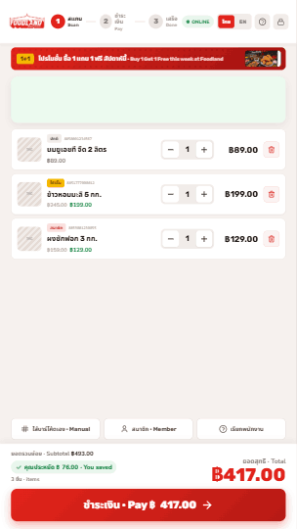
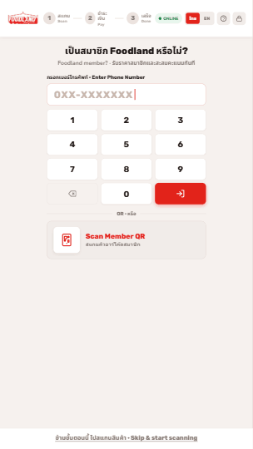
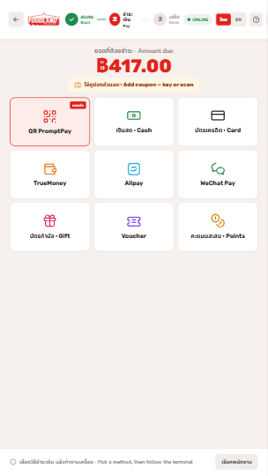
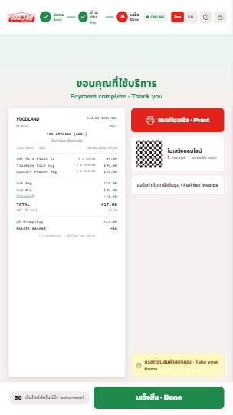

SCREEN FLOW
The screens, in order
ลำดับหน้าจอจริงบนเครื่อง SCO ตั้งแต่เริ่มจนจบการชำระเงิน
1
2
3
4
5
→
→
→
→
Startup
Scan
Member
Pay
Receipt
แตะเพื่อเริ่ม
สแกนสินค้า
ระบุสมาชิก
ชำระเงิน
ใบเสร็จ
เมนูพนักงาน (Store management) เรียกใช้ได้ทุกขั้นตอน
Notes:
Screen flow — the same sequence shown as the actual screens on the kiosk: Startup, Scan, Member, Pay, Receipt, in order, with the store-management menu reachable at any step.

Slide 6
SCREEN 1 · STARTUP
Function table
#
Function
Detail
Actor
1
Touch / scan to start เริ่มได้ทันที
Tap the screen or scan the first item to begin.
Shopper
2
Need Help เรียกพนักงาน
One touch calls staff and lights the red lane LED.
Staff
3
Language + voice เปลี่ยนภาษา
Thai, English, Chinese, Japanese, Arabic — with voice guidance.
Shopper
4
Speaker volume ปรับเสียง
Adjust audio level for guidance.
Shopper
Notes:
STARTUP functions: touch or scan to start; one-touch Need Help that lights the red lane LED; a five-language selector with voice guidance; and speaker volume control.

Slide 7
SCREEN 2 · SCAN PRODUCT
Function table
#
Function
Detail
Actor
1
Store management
Entry to the staff admin menu.
Staff
2
Camera feed
Shopper sees themselves while scanning.
System
3
Item line
Name, unit price, qty, line total (regular price).
System
4
Item count
Running number of items scanned.
System
5
Quantity +/− & delete
Adjust quantity or remove a line.
Shopper
6
Group repeats
Repeated SKUs accumulate into one line.
System
7
Cancel item / order
Void one item or the whole order (configurable).
Shopper
Notes:
SCAN PRODUCT functions: store-management entry, on-screen camera feed, item line with name/unit price/qty/line total, running item count, quantity plus-minus, delete, auto-grouping of repeats, help/language/volume, and item or whole-order cancel.

Slide 8
SCREEN 2 · SAFEGUARDS
Timeout & cancel-order flow
#
Function
Behaviour
Actor
1
Inactivity timeout · หมดเวลา
After a set idle time the kiosk asks “Are you still here? · ยังอยู่ไหม”.
System
2
Continue order
Returns to the same cart, untouched.
Shopper
3
Cancel order · ยกเลิก
Opens a confirmation — never an instant wipe.
Shopper / Staff
4
Yes, cancel the list
Clears everything and restarts a fresh scan.
Shopper
5
No, keep ordering
Returns to the current cart.
Shopper
Cancel can be configured as shopper-initiated or staff-only per Foodland's policy.
Notes:
SCAN SAFEGUARDS: an inactivity timeout that asks 'Are you still here?' with continue, and a confirmed cancel-order flow — yes restarts, no keeps the cart — configurable to shopper or staff.

Slide 9
SCREEN 3 · MEMBER & COUPON
Function table
#
Function
Detail
Actor
1
Member prompt on Pay
“Scan member card” appears when Pay is pressed.
System
2
Phone / member no.
Key a phone or member number.
Shopper
3
App QR / card QR
Scan from the loyalty app or behind a co-brand card.
Shopper
4
Scan coupons
Apply member coupons, then continue.
Shopper
5
PDPA mask
Member info masked on screen (e.g. 092629xxxx).
System
6
Skip
Continue as a guest, no identification.
Shopper
Notes:
MEMBER & COUPON functions: member prompt on Pay; identify by phone/number, app QR or co-brand-card QR; scan member coupons; PDPA-masked display; and a skip path for guests.

Slide 10
SCREEN 4 · PAYMENT
Function table
#
Function
Detail
Actor
1
Order summary
Sale price per line, subtotal and total.
System
2
Discounts shown
Member coupon, member card, auto-trandis, deal & free.
System
3
Card
Credit / debit via EDC.
Shopper
4
QR
PromptPay / QRCS via EDC.
Shopper
5
Wallets
Alipay, WeChat Pay via EDC.
Shopper
6
EDC slip
Sale slip printed with POS Tax ID.
System
Notes:
PAYMENT functions: order summary with sale prices and every discount, then tender selection — credit/debit card, QR PromptPay/QRCS, Alipay, WeChat — all via the EDC, which prints the slip.

Slide 11
SCREEN 5 · PROCESSING & RECEIPT
Function table
#
Function
Detail
Actor
1
Payment guidance
On-screen steps mirror the EDC (tap / insert / QR).
System
2
Processing state
Clear “please wait” during bank authorization.
System
3
Retry on failure
Graceful retry — no money taken.
Shopper
4
Receipt: none
Paperless — nothing printed.
Shopper
5
Receipt: print ABB
Abbreviated tax invoice on the printer (current default).
System
6
E-receipt
Routes to Foodland landing page; no personal info entered.
Shopper
Notes:
PROCESSING & RECEIPT functions: on-screen guidance mirroring the EDC, a clear processing state, fail-safe retry with no money taken, and three receipt options — none, printed ABB, or e-receipt to the landing page.

Slide 12
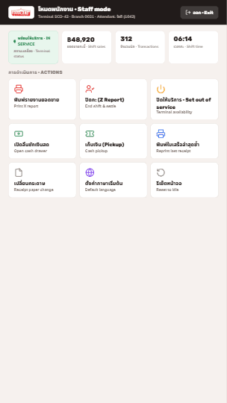
SCREEN 6 · STORE MANAGEMENT
Function table
#
Function
Detail
Actor
1
PIN login
Staff authorize to open the menu.
Staff
2
Reprint ABB
Duplicate tax invoice (shows “duplicate”).
Staff
3
Close shift
Settle and close the shift.
Staff
4
Close program
Shut the lane software down.
Staff
5
Out of service
Take the lane offline.
Staff
6
Closing report
Sales, payment types & receipts summary.
Staff
7
About SCO
Device / version information.
Staff
Notes:
STORE-MANAGEMENT (ADMIN) functions: PIN login, reprint ABB, close shift, close program, out-of-service, closing report and about-SCO.

Slide 13
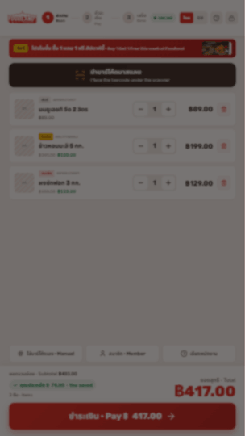
EDGE-CASE FUNCTIONS
Special item handling
#
Function
Behaviour
Actor
1
Weighed produce ชั่งน้ำหนัก
Place on scale → live price by weight → confirm.
Shopper
2
Age-restricted ตรวจอายุ
Pauses for quick staff approval (alcohol & more).
Staff
3
Unknown barcode ไม่พบสินค้า
Clear retry, manual entry, or call staff.
Shopper
4
Call staff เรียกพนักงาน
One-touch help with red lane LED.
Staff
Notes:
EDGE-CASE functions: weighed produce priced on the scale, age-restricted items requiring staff approval, unknown-barcode recovery, and one-touch call-staff.

Slide 14
SCOPE OF WORK
Six modules · mapped to Fujitsu API
Module
Functions
Fujitsu API
1 · Cart login
Cashier login / authorize to open the lane.
Display authorize (#0)
2 · Sale process
Member lookup, scan barcode/QR, promotion & quota, coupon validate, qty +/−, delete, group, Thai/Eng.
Customer, item, promotion, coupon (#1·#2·#7)
3 · Complete sale
Checkout, send finalized transaction, issue tax invoice (ABB), reprint.
Send transaction, ABB (#10·#11)
4 · Cart logout
Cashier logout / authorize for reporting.
Display authorize (#13)
5 · Print closing
Closing report — sales, payment types, receipts.
Issue closing report (#14)
6 · Payment at cart
EDC payment (BBL) — card, QR, wallets; print sale slip.
Interface with EDC device
Notes:
Scope of work across six modules — cart login, sale process, complete-sale, cart logout, print closing and payment — each mapped to a Fujitsu API call.

Slide 15
PAYMENTS & FISCAL PRINTING
Tenders & documents
Payment via EDC · BBL
Slip
Fiscal document · Thailand
Issued by
Credit card
EDC slip
Abbreviated tax invoice (ABB)
New SCO
Debit card
EDC slip
EDC sale slip + POS Tax ID
New SCO
QRCS
EDC slip
Full tax invoice
Fujitsu API
PromptPay QR
EDC slip
Sale VAT report
Fujitsu API
Alipay
EDC slip
Closing report
New SCO
WeChat Pay
EDC slip
ABB carries all Revenue-Department particulars — branch & tax ID, transaction no., date/time, items & VAT type, tender, member ID, points, reference barcode, footer message.
Notes:
Payments and fiscal printing: EDC integration via BBL for card, QRCS/PromptPay, Alipay and WeChat, with the EDC slip and the Thai abbreviated tax invoice printed from the SCO.

Slide 16
INTEGRATION
New SCO ↔ Fujitsu API ↔ Foodland systems
Outbound → SCO
Source
Inbound → POS
Target
Master data · catalog & image
POS / SAP
Finalized transaction
POS
Promotions (BBY)
POS
EDC link (BBL)
EDC
Loyalty profile & points
Member
Member earn-point
Member
Coupon validation
App
Printing — ABB & closing
Printer
Standards-based — Fujitsu provides the lane & API center; Foodland keeps its POS, loyalty and member systems of record.
Notes:
Integration: outbound master data, promotions, loyalty and coupon validation; inbound finalized transactions, EDC linkage, earn-point and fiscal printing.

Slide 17
LOCALIZED FOR THAILAND
Revenue-Department requirements
Requirement
Detail
Owner
POS register / Tax ID
Registered POS Tax ID printed on every receipt.
Foodland / SCO
Abbreviated tax invoice (ABB)
Issued by the SCO, matching the approved layout.
New SCO
Closing report
Shift / day summaries on the receipt printer.
New SCO
Payment via EDC (BBL)
Card, QRCS, PromptPay, Alipay, WeChat + slip.
New SCO / BBL
Full tax invoice
For shoppers claiming input tax credit.
Fujitsu
Sale VAT report
Submission-ready, including SCO sales.
Fujitsu
Notes:
Localized for Thailand and the Revenue Department: POS register/Tax ID, abbreviated tax invoice, closing report, EDC payment, full tax invoice and Sale VAT report.

Slide 18









HIGH-LEVEL ARCHITECTURE
Master data flow — ERP to SCO
SCO is treated as one POS terminal on the store network.
Customer ERP
sync schedule
POS Server HQ
sync realtime
POS Store Server
sync realtime
POS API
sync realtime
SCO
Master source สินค้า · ราคา · โปรโมชัน
Head-office central POS
Fujitsu API interface layer
เครื่องชำระเงิน self-checkout
In-store controller
SCO = one POS terminal มองเป็น POS terminal หนึ่งเครื่อง
Scheduled batch sync
Real-time sync
Notes:
High-level architecture — master data flows from the customer ERP on a scheduled sync to the HQ POS server, then real-time to the in-store POS server, through the POS API, down to the SCO. The SCO is treated as just one POS terminal on the store network.

Slide 19
ARCHITECTURE
Cloud API center
AWS API Gateway
Foodland systems
Fujitsu API Engine
Loyalty / app server
SCO Client
→
Cache · Database · CICD
→
Scanner · scale · EDC · printer
Fujitsu scope of work
POS server
Member server
Customer provides the AWS management service & CICD pipeline; Fujitsu builds and operates the API center & SCO software.
Notes:
Architecture: SCO client to AWS API Gateway and the Fujitsu API engine, integrating with the loyalty app, POS and member servers — with a clear split of Fujitsu and customer responsibilities.

Slide 20
FUNCTION STATUS MATRIX
Who delivers each function
Function
New SCO
Fujitsu API
Operation-controlled
Member lookup & display
●
●
Scan barcode / QR & price
●
●
Promotion & quota check
●
●
E-coupon validate & apply
●
●
Qty +/− · delete · group
●
Submit / finalize transaction
●
●
Tax invoice (ABB) & reprint
●
●
EDC payment (BBL)
●
BBL
Closing report
●
●
On-top / manual / markdown / redeem
○ ready
●
● delivered · ○ ready available via API when operations enable it
Notes:
Function status matrix — for each capability, whether it is delivered by the SCO, the Fujitsu API, or controlled by operations and API-ready.

Slide 21
SCOPE SUMMARY & NEXT STEPS
Confirm the function scope, then pilot
1 · Confirm functions
2 · Integration points
3 · Build & validate
Lock the per-screen function list & actors in scope.
POS, loyalty, coupon, EDC (BBL), fiscal printing.
Acceptance against this function spec, then pilot.
FUJITSU
×
ขอบคุณครับ · Thank you
Notes:
Scope summary and next steps to a scoped pilot — agree functions in scope, integration points and acceptance, then build and validate. Thank you.

