Slide 1

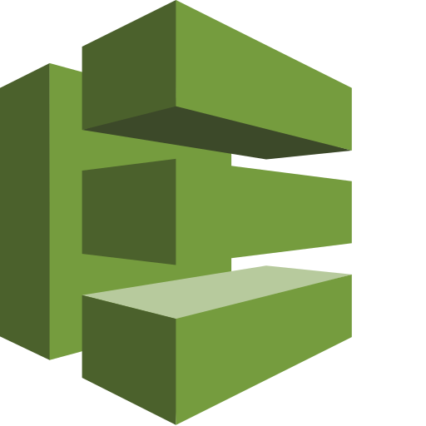

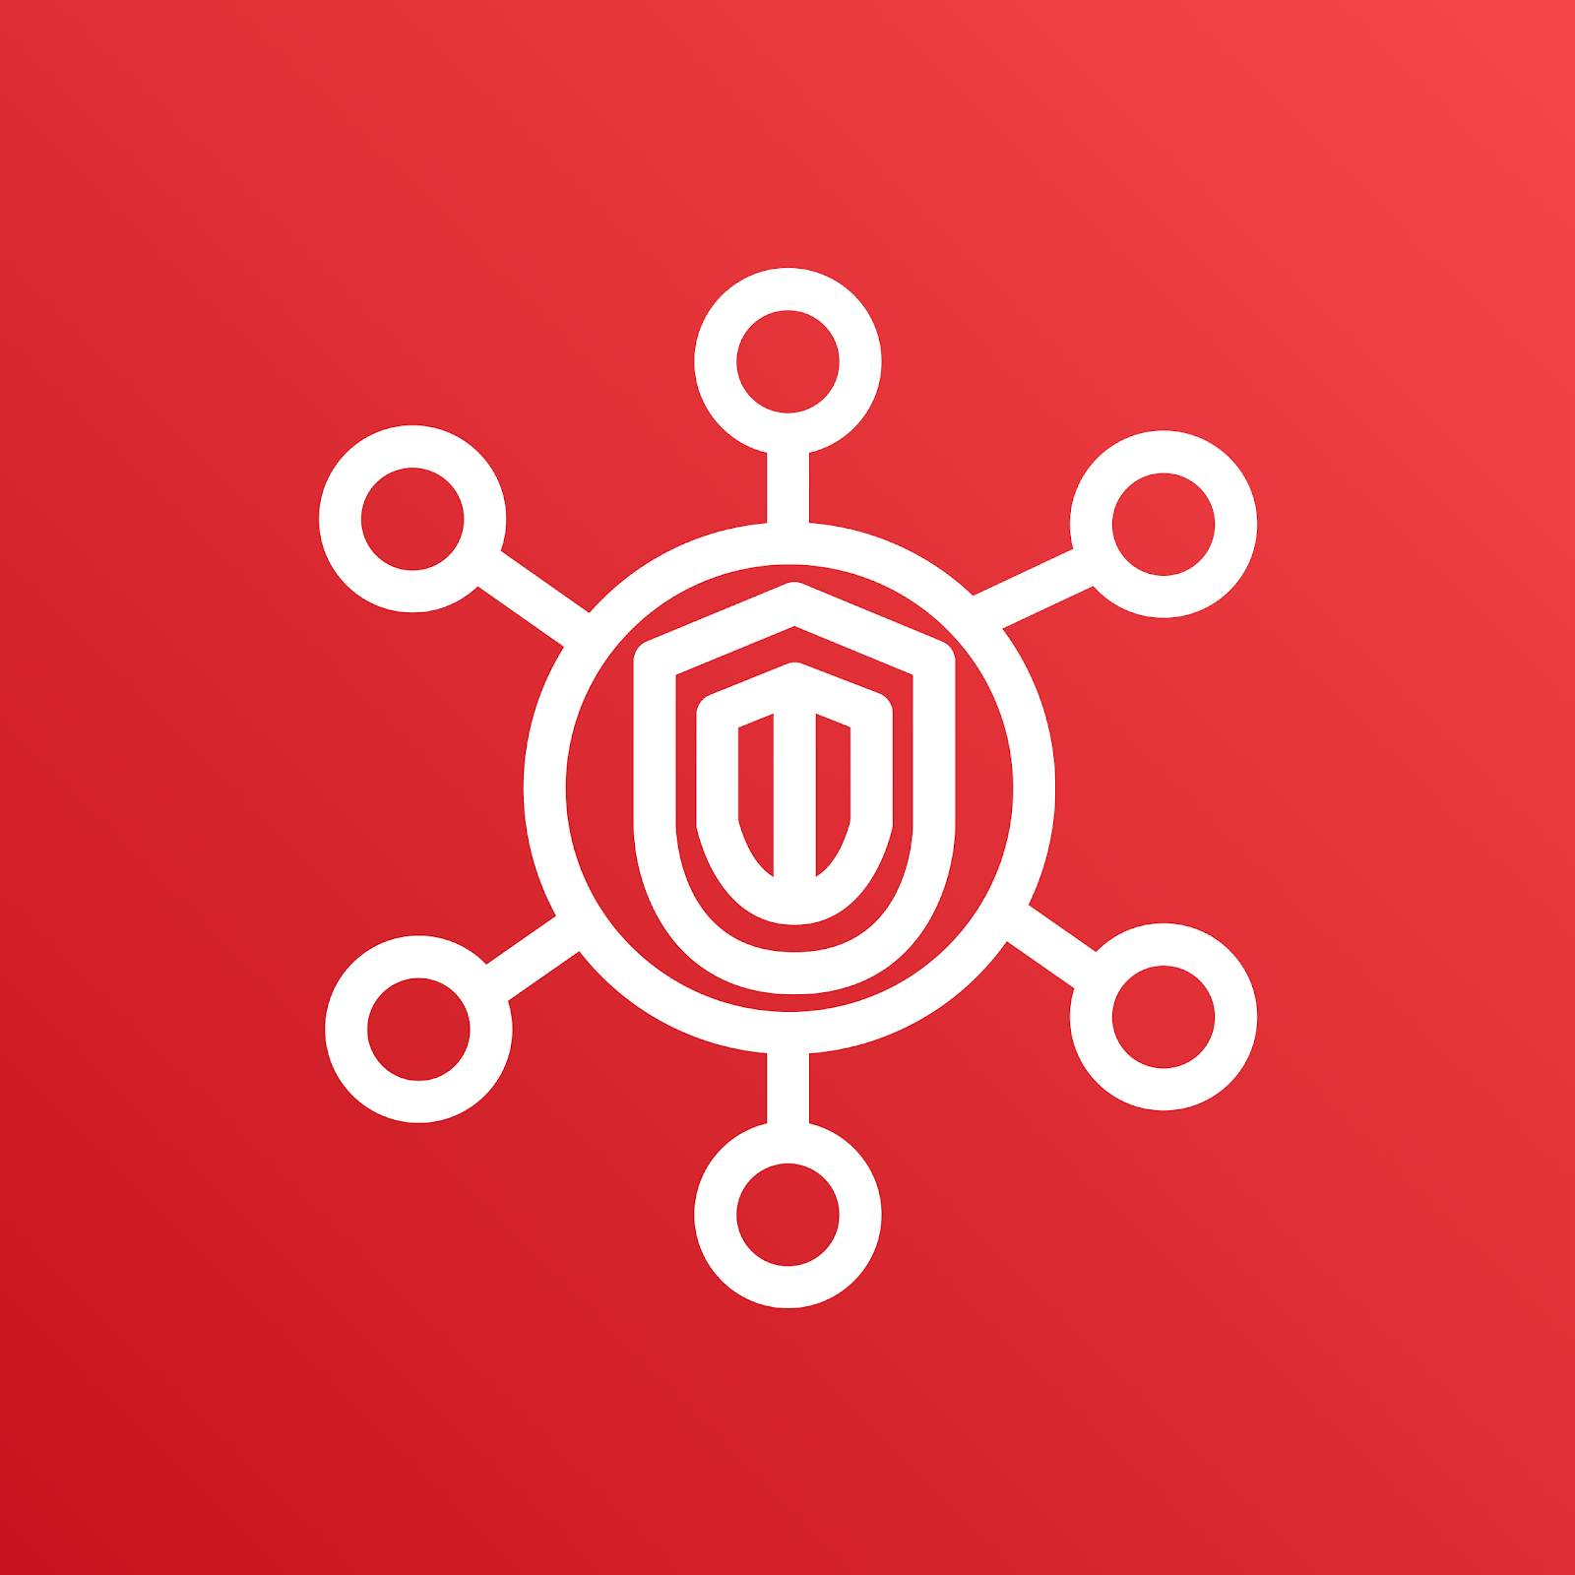


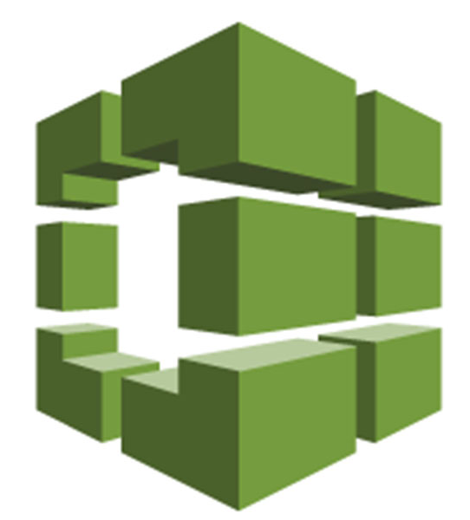
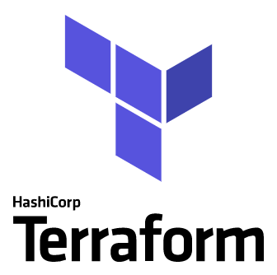
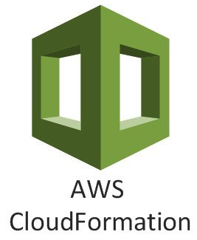

Update cloud and infrastructure configuration
Deploy cloud configuration or application to environment
Runs Compliance and Monitoring tools (post-deployment)
Archore
AMI or container image scanning
AWS Inspector AWS Config AWS GuardDuty AWS Security Hub
Application code or OS change
Build application container or OS image
Prisma Cloud
Infrastructure code change
Infrastructure as code compliance scanning

