Slide 1
Facial Expression Recognition in Images using pre-trained Convolutional Neural Network features
Fathima Syeda
2790024

Slide 2
This project implements the paper by Aravind Ravi, Department of Systems Design Engineering, University of Waterloo, Ontario CA
Traditional method of hand-crafted feature extraction are using HOG , SIFT, local binary patterns etc.
Deep CNN features have been shown to be useful as a preliminary candidate for image classification
A CNN can be viewed as a framework combining a feature extractor and a classifier.
Convolutional layers behave as feature extractors that learn the representations automatically from the input data.
Earlier layers of the CNN : learn Features such as (shapes, edges, and color blobs )are learned in the
Later layers :learn features more specific to the original dataset.
The learned features are fed into the last fully connected layers to classify the data into one of the classes.

Slide 3
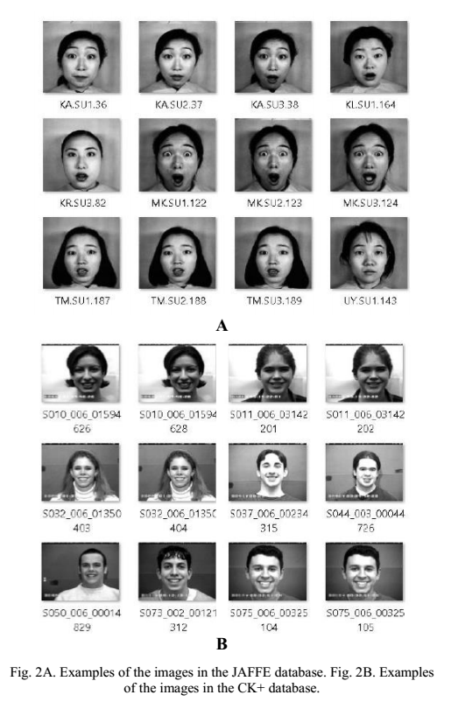
Datasets Used
JAFFE dataset :
consists of 213 images from 10 Japanese female subjects.
For each subject 4 images for each of the 7 expressions
All images are grayscale images of size 256 by 256 pixels..
CK+ dataset:
A subset of this (210 images) with 10 subjects, 5 Male and 5 Female for each of the 7 expressions
a diverse group of individuals comprising of both M and F of various ethnicities.
All images are grayscale of size 640 by 480 pixels.

Slide 4
Transfer Learning
Transfer learning is defined as the ability of a system to recognize and apply knowledge and skills learned in previous tasks to novel tasks .
Extracting knowledge from one source task and applying the knowledge to a target task.
Two kinds :
the last fully connected layers are removed, and the rest of the network is used as a fixed feature extractor for the target domain
Fine-tuning the weights of the CNN by continuing the backpropagation on the target domain.
It can be performed on all layers or it is possible to freeze some of the weights of earlier layers and fine-tune deeper layers of the CNN.

Slide 5
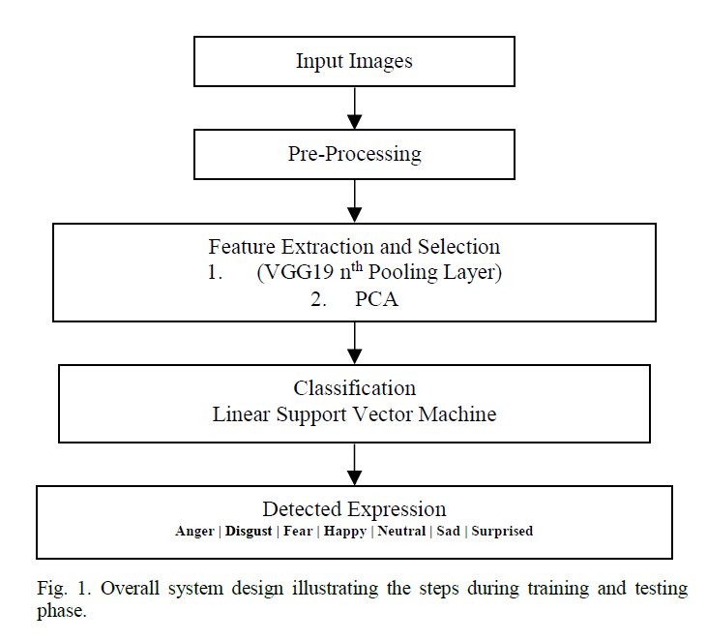
Transfer learning approaches:
Use a CNN, pre-trained on ImageNet , as a fixed feature extractor
Target dataset is:
small and similar :
Feature extraction with Linear Classifier.
large and similar :
fine-tune the weights of CNN and continue back propagation on target set.
small but very different :
Feature extraction with Linear Classifier.
large and very different :
Since the target dataset is very large, the CNN can be trained from scratch.

Slide 6
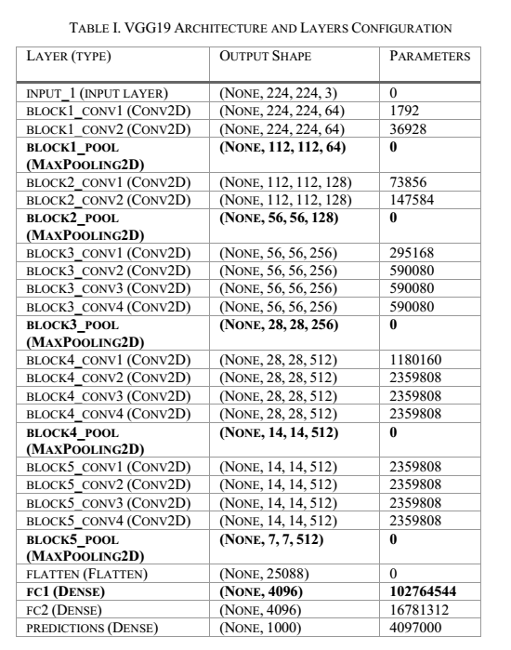
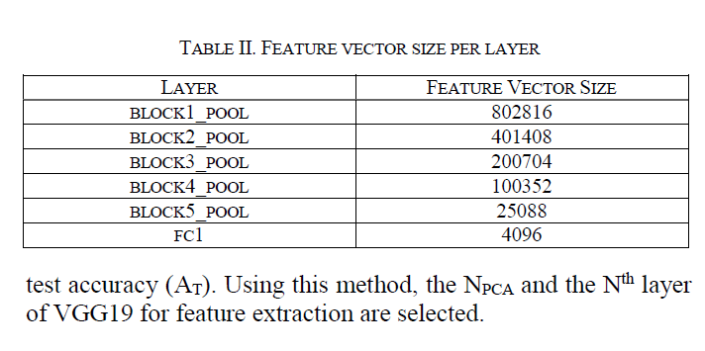
Feature Extraction
The layers of the VGG-19 network are shown in the fig.
Extract the output of each of the 5 block pooling layers as Feature vectors
The feature vectors are too large to train on a classifier hence PCA is applies.
PCA transformation is tried with N_{PCA} ={200,150,100,50}

Slide 7
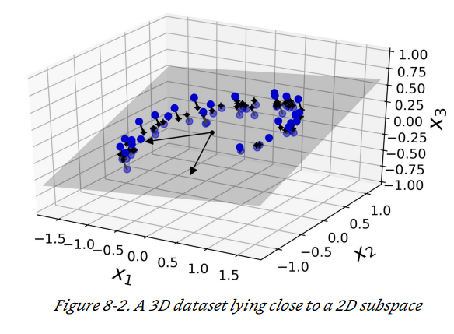
PCA
Principal Component Analysis (PCA) is the most popular dimensionality reduction algorithm.
identifies the hyperplane that lies closest to the data, and then it projects the data onto it,
you first need to choose the right hyperplane before transforming to a hyperplane.
PCA identifies the axis that accounts for the largest amount of variance in the training set
choose the N_{PCA} number of dimensions that add up to a sufficiently large portion of the variance (e.g., 95%).

Slide 8
Feature Selection
Feature selection for the final classifier is based on two parameters:
1.
2. NPCA value
parameters that provide the two highest accuracies on the training set based on a Leave One Out Validation
the least difference between the A _{LOO} and corresponding test accuracy (A_{T} ).
Using this method, the NPCA and the Nth layer of VGG19 for feature extraction are selected.

Slide 9
Classification and Validation
Classification :
Since the target dataset is different from the source dataset and also smaller in size, a linear classifier is trained on the features extracted from the pretrained CNN.
A Support Vector Machine with a linear kernel is used as the classifier
Validation:
The training data for both datasets were split into 80% for training the classifier and 20% was used for testing.
results are validated based on a 10-fold cross-validation, and due to the small size of the datasets, leave-one-out validation is also performed.

Slide 10
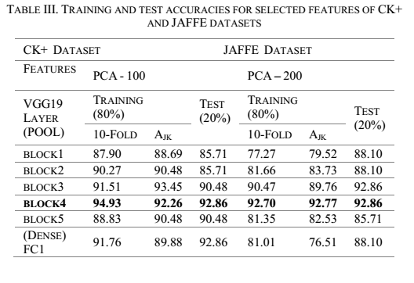
RESULTS
JAFFE Dataset PCA=200 | 10-Fold Cross Validation Scores | Leave-One-Out cross Validation Scores | Test Accuracy
block pool 1 | 81.76 | 83.52 | 72.093
block pool 2 | 86.47 | 87.64 | 74.41
block pool 3 | 88.82 | 90.58 | 79.06
block pool 4 | 90. | 91.764 | 86.04
block pool 5 | 90. | 90.58 | 86.04
CK+ Dataset PCA=100 | 10-Fold Cross Validation Scores | Leave-One-Out cross Validation Scores | Test Accuracy
block pool 1 | 95.29 | 97.02 | 90.47
block pool 2 | 95.88 | 97.61 | 90.47
block pool 3 | 96.47 | 97.61 | 92.85
block pool 4 | 96.47 | 98.21 | 92.85
block pool 5 | 96.47 | 98.88 | 100

Slide 11
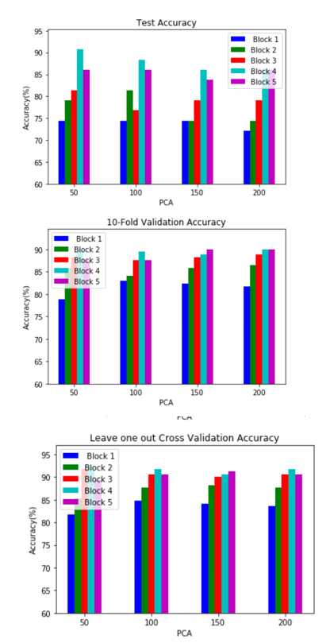
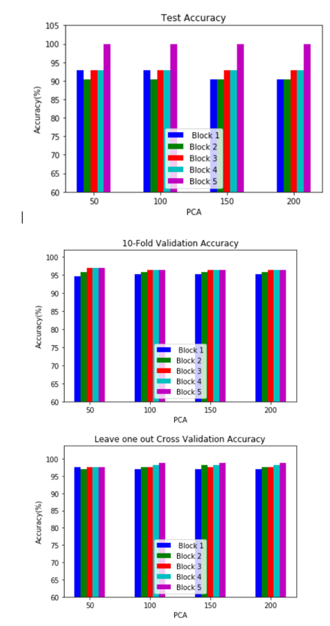
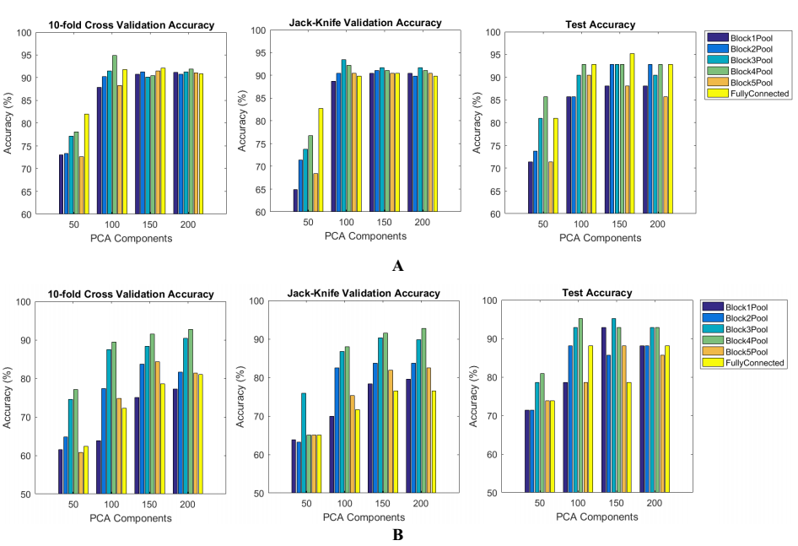
JAFFE Dataset
CK+ Dataset

Slide 12
Conclusion
Features learned from pre-trained networks trained for a particular task such as object detection can be transferred, and used for a different task such as facial expression recognition.
a small dataset, using features from earlier layers of the network provide better accuracy.

