Slide 1

Dockerfile
Nuage de mots:
FROM, MAINTAINER, RUN, WORKDIR,USER, CMD, EXPOSE, VOLUME, ENV, COPY, ADD

Slide 2

Dockerfile

Slide 3

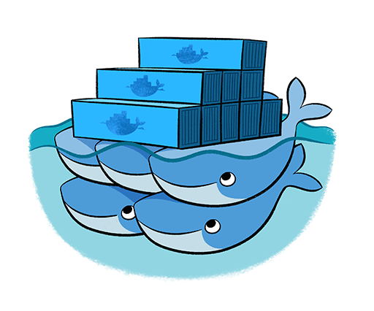

Docker Hub

