Slide 1


Building a Random Forest Model for Employee Attrition
General Assembly
Data Science Course Final Presentation
Francesco Yuri Tinelli (Washington, D.C.)
April 2020

Slide 2


Executive Summary
Problem Statement
Employee attrition is known to be a significant factor of both tangible and intangible cost for companies. Thus, it's important for every company to analyze and manage employee attrition and retention. As well as, develop and implement strategies to handle attrition and retention. Can a random forest classification model be built to help predict whether an employee will stay or leave the company?
Data Summary
Human resource employee data consists of general workforce details about employees and survey results pertaining to employees’ responses on environment, job, and work life balance satisfaction level.
Total of 4,410 employees and survey responses
General workforce details include 24 distinct features
Total time at company, salary, gender, age, job role, distance, education, number of previous companies, etc.
Survey responses include 3 distinct features
Approach and Process
Exploratory data analysis and cleaning was conducted on the available human resource employee data to prepare for model development/implementation.
Following feature selection, parameter tuning, and model implementation, model performance was evaluated using a confusion matrix to find the precision and accuracy of the model.
Through this approach and process the random forest classification model classifies an employee as either 'staying' or 'leaving' in order to inform/support a company's attrition and retention strategies for their workforce/employees.

Slide 3
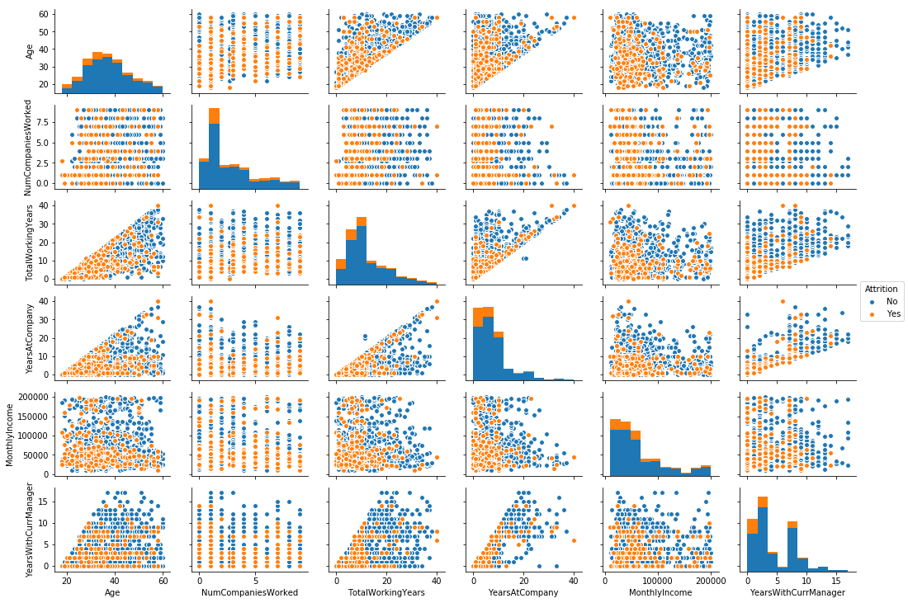
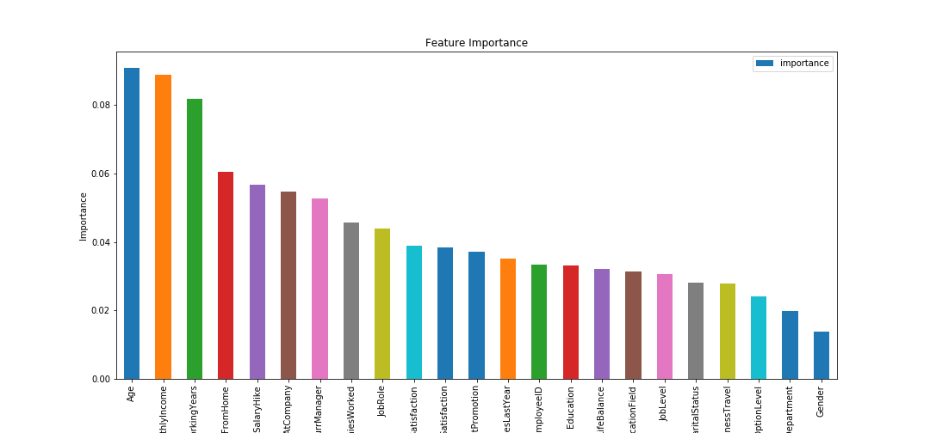
Random Forest Classification Model
What is a random forest classification model?
A random forest is made up many decision classification trees. Each tree gives a classification/decision, ‘voting’ for that class/decision. The forest then takes the classification/decision that has the most votes. Decision trees use variables/features to build nodes, branches, and splits to answer yes/no question and eventually help you decide/assign it a class.
Model Solution
With some exploratory data analysis and cleaning, plotting feature correlation by attrition revealed moderately clear segments. Seen in age & monthly income, years at company & years with current manager, monthly income & years at company, etc..
This led to feature selection, parameter tuning, and model implementation. Threshold hold for important features were those greater than or equal to the mean; age, monthly income, total working years, distance from home, percent salary hike, years at company, years with current manager, number of companies worked, and job role. This provides insight into the features which are most selective/influential for employee attrition.

Slide 4
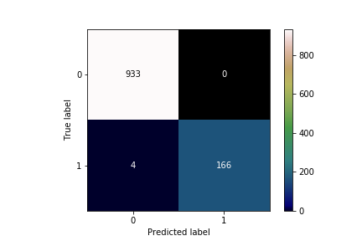
Performance Evaluation
Baseline
From the HR employee data, 16% of the employees have left the company while 84% have stayed.
Out-Of-Bag R-squared score: .98276
Accuracy: .89754
Feature Selection & Parameter Tuning
Via Gridsearch the parameters for model were tuned, model accuracy very slightly decreased from baseline and slight increase to out-of-bag score.
Out-Of-Bag R-squared score: .98881
Accuracy: .89389
Confusion Matrix
Confusion Matrix Report
 | Precision | Sensitivity
Stayed | 1.00 | 1.00
Left | 1.00 | .98
Impact
The final random forest classification model made a total of 1,103 predictions;
Classified 1,103 employees as either staying or leaving.
Out of the 1,103 predictions the model classified 937 employees as staying and 166 employees leaving.
In terms of attrition, 15% of the employees would have left the company while 85% have stayed.
Where in the test data, the actual employees that stayed is 933 and 170 that left.
Remembering that data showed 16% of the employees have left the company while 84% have stayed.
The model had 0 false positives, meaning there were no instances when the model predicted the employee will leave and the employee actually stayed. Speaks to the high OOB score and insightful for attrition strategies.
Recommendation
The business objective is to focus on those who would leave the company to the update/tailor attrition strategies to retain these employees. Thus, we can evaluate how the model performed based on when the actual employee left and how often the prediction is correct. Those two metrics would be sensitivity and precision.
Sensitivity - when the employee left, how often is the prediction correct? 98%
Precision - when the model predicted the employee would leave, how often is the prediction correct? 100%
To test results of model, next steps are replicate case study with other algorithms (SVM, kNN, logistic regression) and see if the results are consistent.

